Slide 1
Assignment 5_Seg2105
Student Name : Qunshu Fei
Student number: 300016374

Slide 2
Objective
Improve coding skills
Fix some problems from assignment3
Seeking a better design of this project

Slide 3
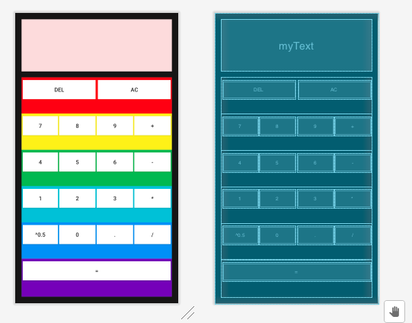
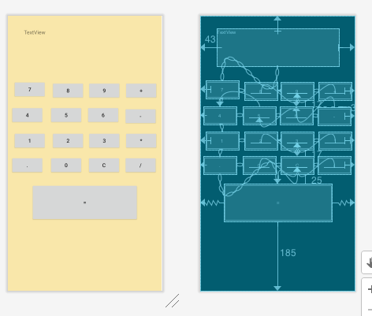
The Design

Slide 4
Thank you !

