Slide 1
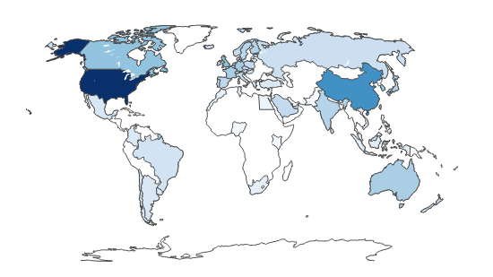
Spain in the Global AI Ecosystem: Comparative and Strategic Analysis.
Francisco Gil Valverde & Gastón Fernández Rodríguez

Slide 2

Introduction and Motivation
The Problem: Artificial Intelligence is a strategic economic and geopolitical asset, but Spain faces challenges to get the best strategy investment and its distribution.
Project Objectives:
Analyse Spain's position by identifying strengths and weaknesses
Compare with "mirror countries" (similar in economics and demographics)
Propose an optimal investment strategy for public decision-makers

Slide 3


Data
Data Source: Global AI Index (62 countries, 7 pillars) enriched with World Bank data (GDP, Population)
Country, Talent, Infrastructure, Operating Environment, Research, Development, Government Strategy, Commercial, Total score, Region, Cluster, Income group, Political regime
GDP_2023, POP_2023, iso3 / iso, flag_url,
New Metrics Created
Strategy Gap: It measures the distance between what the government "promises" (Strategy) and the real capacity of R+D
Global_AI: A weighted metric (70% Total Score + 30% Intensity) to identify efficient comparable countries

Slide 4
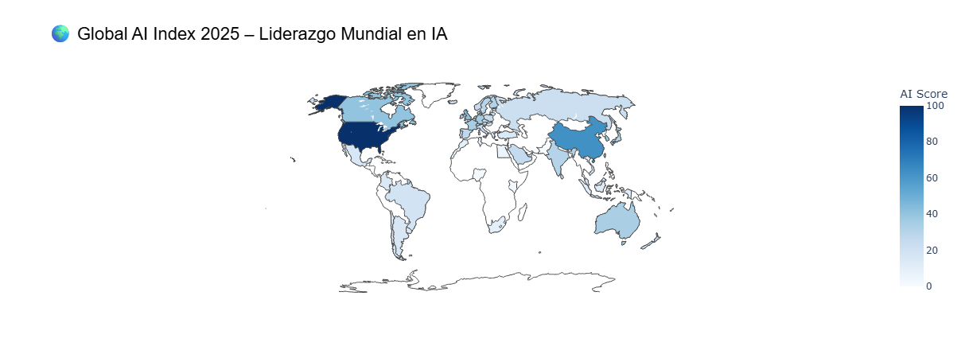
Global Overview
Which countries have the highest and lowest Total Score, and how are they distributed by region and income group (Region, Income group)?
Leadership: The United States and China are the undisputed leaders.
Europe: It shows homogeneous average scores, without a dominant leadership.
Conclusion: AI leadership is highly concentrated in two superpowers

Slide 5
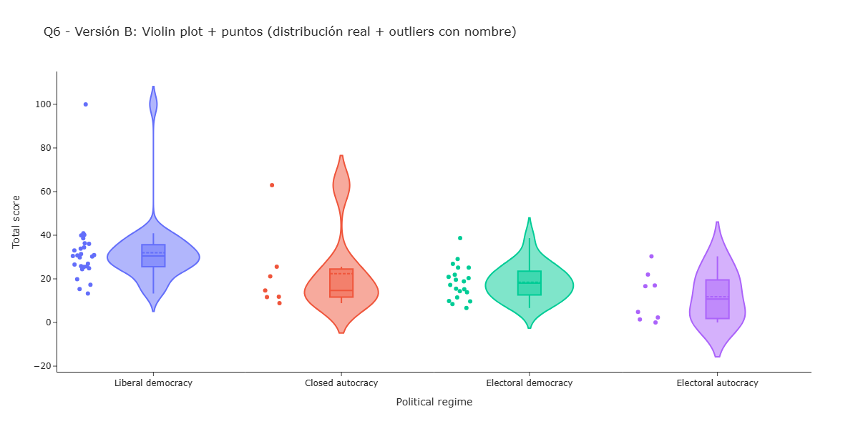
Influence of the Political Regime
Does the political regime influence AI?
Key Points: Leadership: The United States and China are the undisputed leaders.
Europe: It shows homogeneous average scores, without a dominant leadership.
Conclusion: AI leadership is highly concentrated in two superpowers

Slide 6
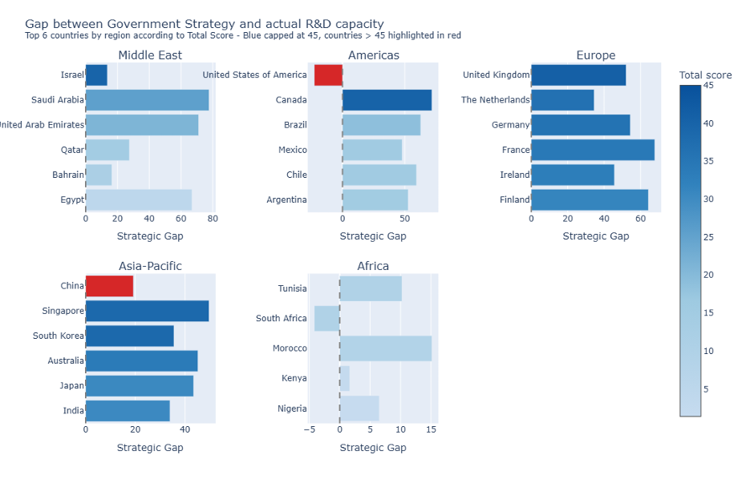
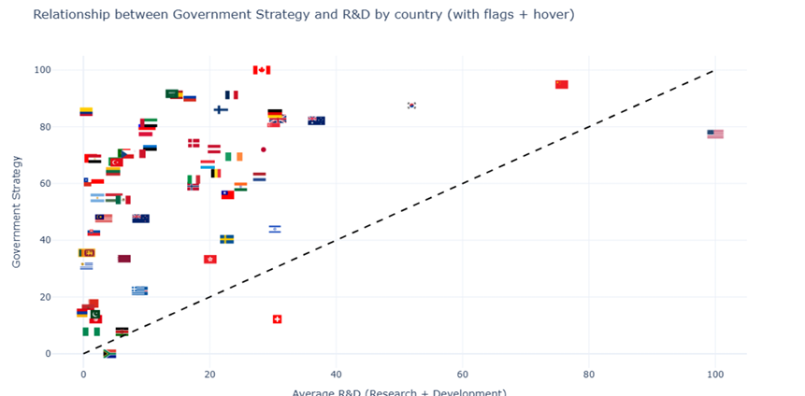
Strategic Gap Analysis
Which countries show a gap between Government Strategy and actual Research and Development capacity?
Key Points: Many countries have a government strategy that is much more ambitious than their actual research and development capacity.
The finding: Mature countries like the U.S. or South Korea. Its policies are aligned with its scientific reality

Slide 7
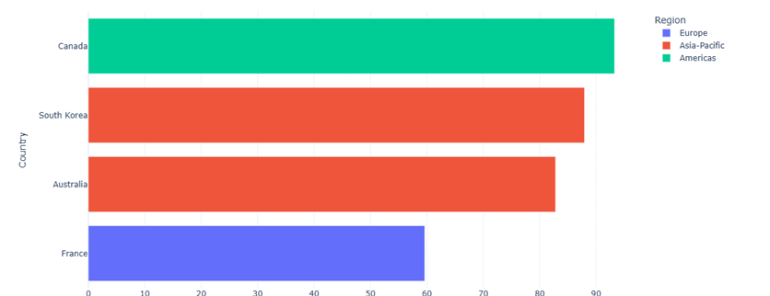
Selection of "Mirror Countries"
Which countries have a better AI investment strategy (Intensity)? Which countries with a situation similar to Spain (GDP/population) have a better strategy (Total Score)?
Criteria: We selected countries with GDP and Population between 0.5x and 2x those of Spain.
The Chosen Ones: Canada, South Korea, Australia and France are our benchmarks because they have better performance in AI being similar to us

Slide 8
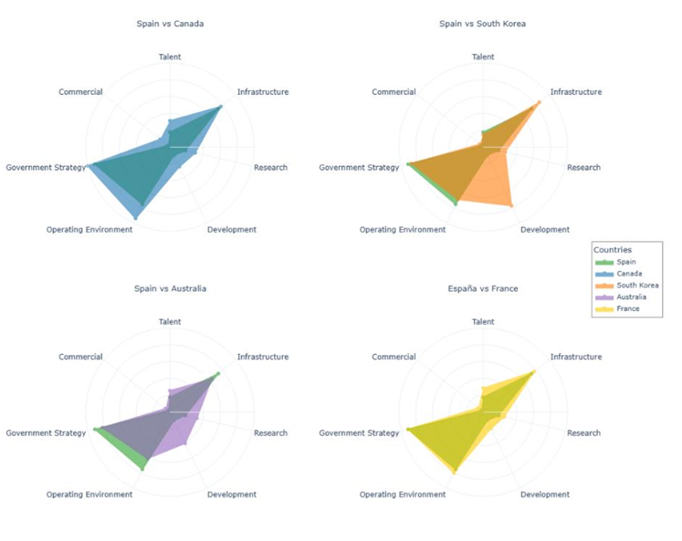
Profile Comparison
What common investment patterns stand out in the four countries with the highest AI performance, and how do they compare with Spain’s current strategy?
Analysis: France and Canada: They have the same "shape" as Spain (green polygon), they only invest more money. They follow the same model.
South Korea and Australia: They have a different shape. This indicates that they have a distinct strategy that works better. We must look at them.

Slide 9
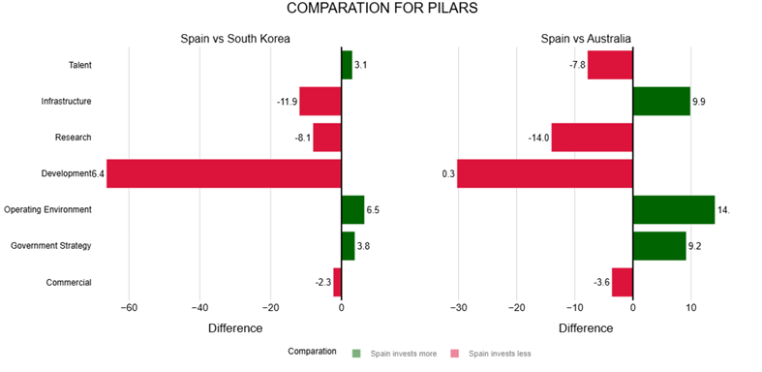
Spain vs South Korea and Australia
In which AI investment pillars does Spain differ from South Korea and Australia? What is the magnitude of this gap?
Green Bars: Spain invests more than Korea and Australia in "Operating Environment" and "Government Strategy".
Red Bars: Spain loses by a lot in Research, Development and Infrastructure.
Conclusion: We have a lot of bureaucracy/strategy (green) but we lack "technical execution" (red).

Slide 10
Conclusions and Strategic Recommendation
Diagnosis: Spain has good political intentions but lacks real technical execution capacity.
Roadmap (Actionable Insight): Slightly reduce the focus on "Government Strategy" and "Operating Environment". Redirect resources massively towards Research and Development.
Goal: Close the quantitative gap with similar-sized leaders such as South Korea.

