Slide 1
Meta Feed
Composer
A four-step tutorial
Copy. Paste. Check. Download.
meta-feed-composer-fran.dept-7420.chatgpt.site
Meta Feed Composer
Made with <3 by Francisco Iafar
01
Notes:
[Sources]
- No external sources. Product URL and workflow are part of the Meta Feed Composer project.
[/Sources]

Slide 2
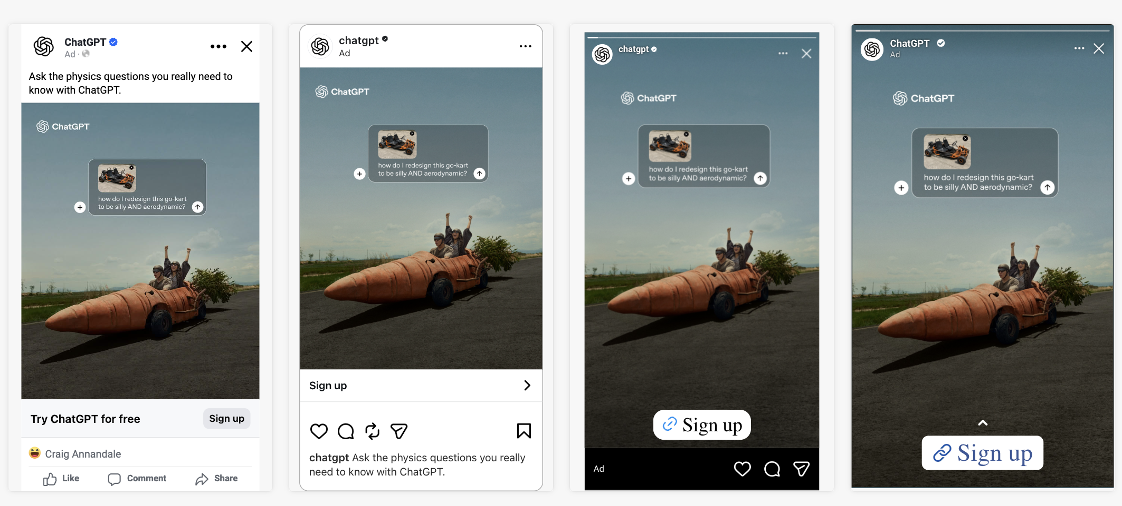
1. Copy the Meta preview. 2. Paste it.
Use Cmd + V on Mac or Ctrl + V on Windows. Paste the screenshot as-is.
No cropping. No panel selection. No file upload.
Meta Feed Composer
Made with <3 by Francisco Iafar
02
Notes:
[Sources]
- User-provided Meta preview screenshot: /var/folders/5c/y8r37s2x22j7bx7bc1cyff5r0000gn/T/codex-clipboard-8d72c1df-8023-4057-b056-0aca8b3eba28.png
[/Sources]

Slide 3

3. Check the Feed cards. 4. Download.
The tool ignores Stories, removes duplicates, and keeps every card the same size.
Optional: add a title or reorder cards before downloading the PNG.
Meta Feed Composer
Made with <3 by Francisco Iafar
03
Notes:
[Sources]
- Tool-generated Meta Feed Composer output: /Users/francisco.iafar/Documents/Codex/2026-08-25/te-estoy-pasando-varios-screenshots-y/work/deck-assets/tutorial-output-en.png
[/Sources]

Slide 4
Meta Feed
Composer
Un tutorial en cuatro pasos
Copiá. Pegá. Revisá. Descargá.
meta-feed-composer-fran.dept-7420.chatgpt.site
Meta Feed Composer
Hecho con <3 por Francisco Iafar
04
Notes:
[Sources]
- No external sources. Product URL and workflow are part of the Meta Feed Composer project.
[/Sources]

Slide 5
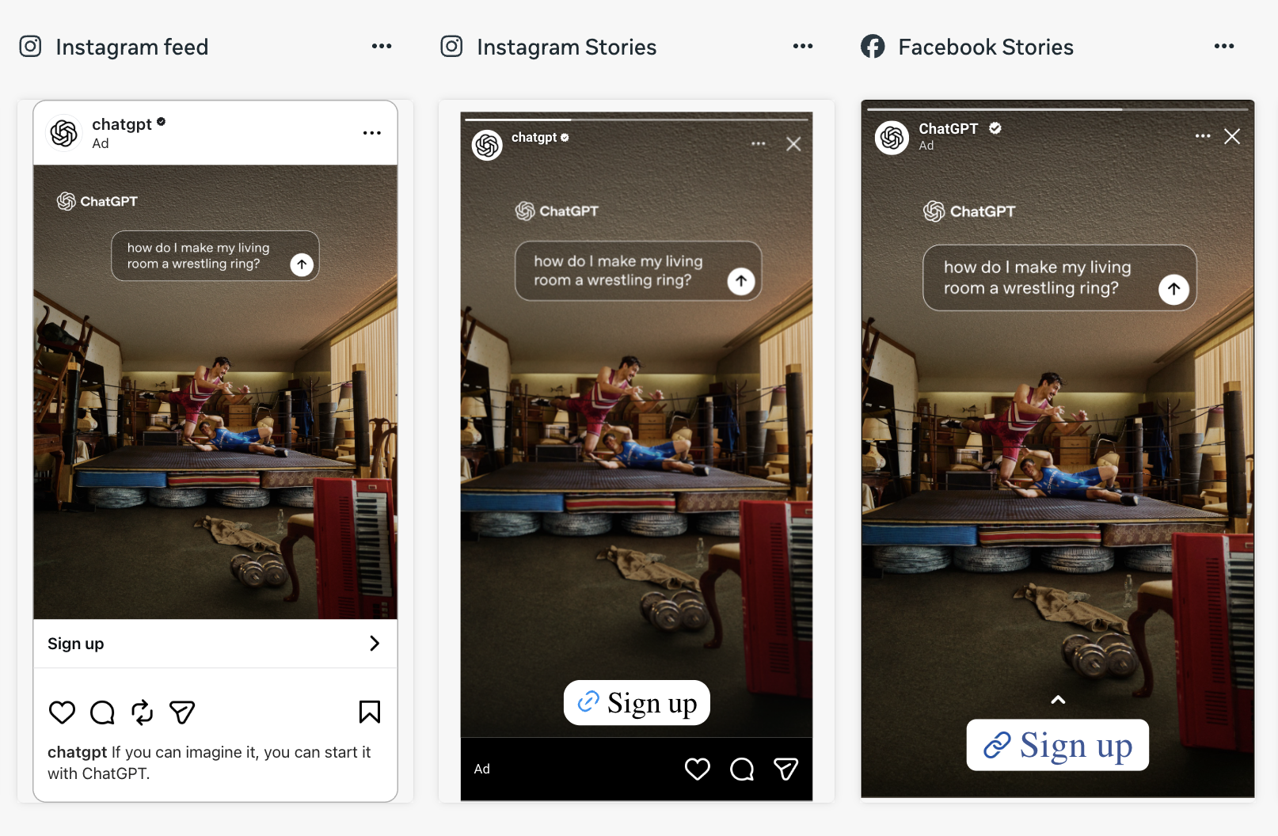
1. Copiá el preview de Meta. 2. Pegalo.
Usá Cmd + V en Mac o Ctrl + V en Windows. Pegá el screenshot tal como está.
Sin recortar. Sin elegir paneles. Sin subir archivos.
Meta Feed Composer
Hecho con <3 por Francisco Iafar
05
Notes:
[Sources]
- User-provided Meta preview screenshot: /var/folders/5c/y8r37s2x22j7bx7bc1cyff5r0000gn/T/codex-clipboard-68aee791-b91e-424f-a51d-e7b68184689e.png
[/Sources]

Slide 6

3. Revisá los Feed. 4. Descargá.
La herramienta ignora Stories, elimina duplicados y deja todas las tarjetas del mismo tamaño.
Opcional: agregá un título o reordená las tarjetas antes de descargar el PNG.
Meta Feed Composer
Hecho con <3 por Francisco Iafar
06
Notes:
[Sources]
- Tool-generated Meta Feed Composer output: /Users/francisco.iafar/Documents/Codex/2026-08-25/te-estoy-pasando-varios-screenshots-y/work/deck-assets/tutorial-output-es.png
[/Sources]

