Slide 1
Airbus Ship Detection Challenge

Slide 2
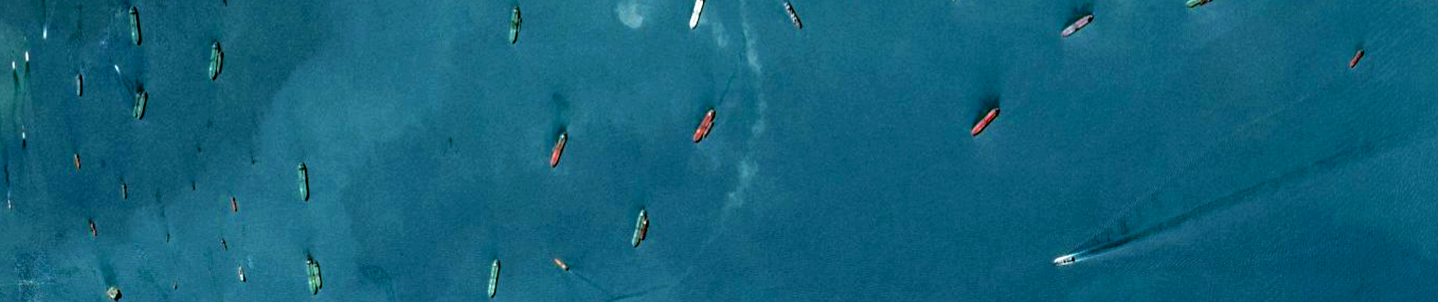
Project Objective
Automatically detect and bound instances of ships in satellite imagery

Slide 3
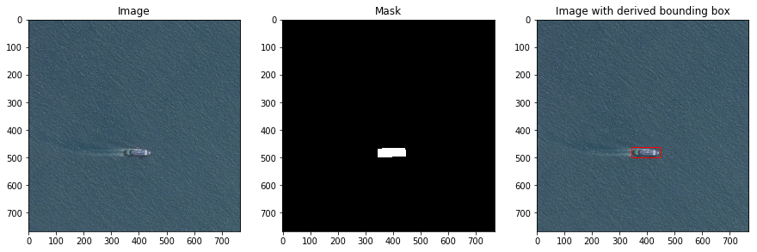
ETL

Slide 4
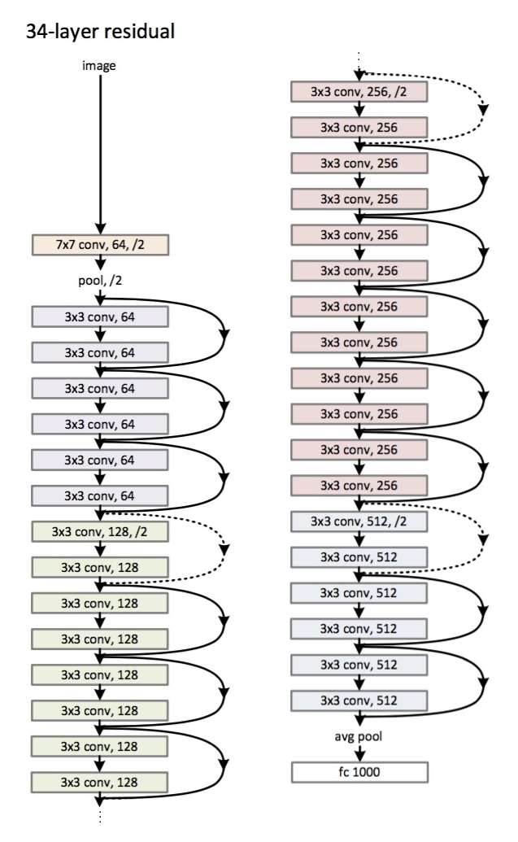
Modeling Strategy
ResNet-50

Slide 5
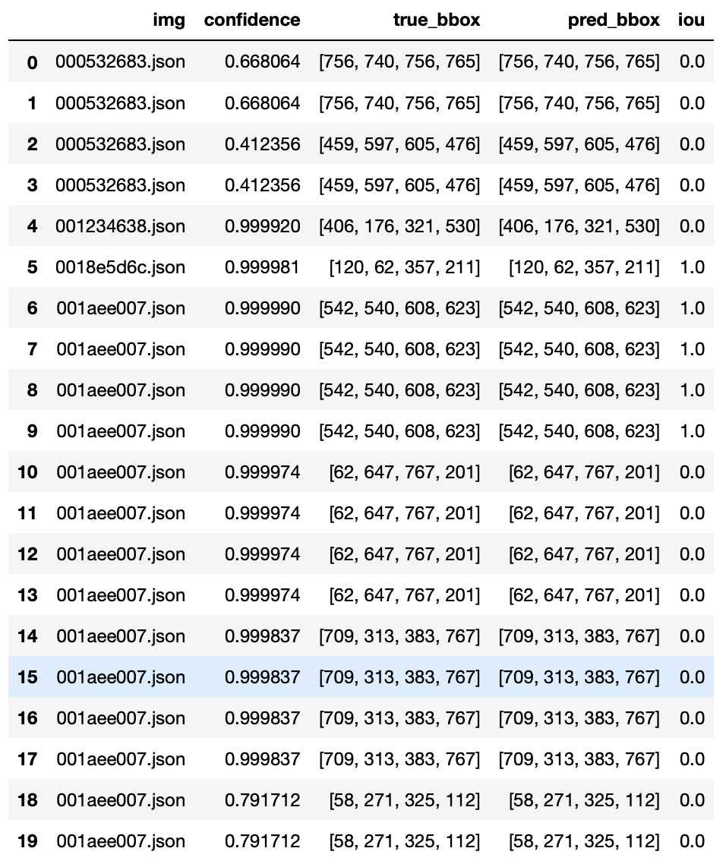
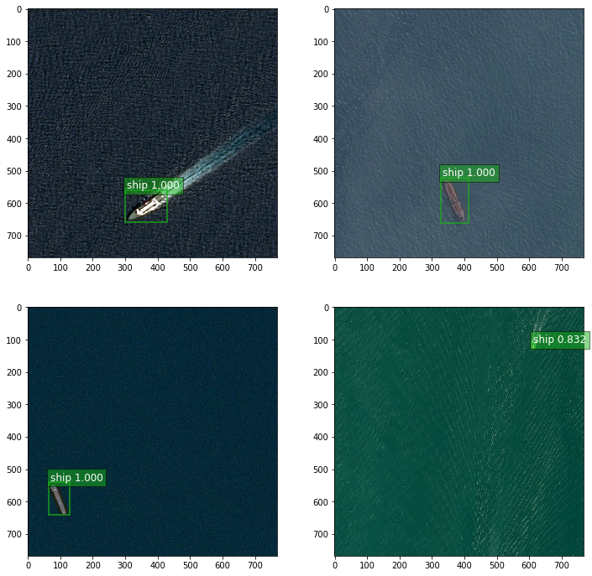
Results

Slide 6
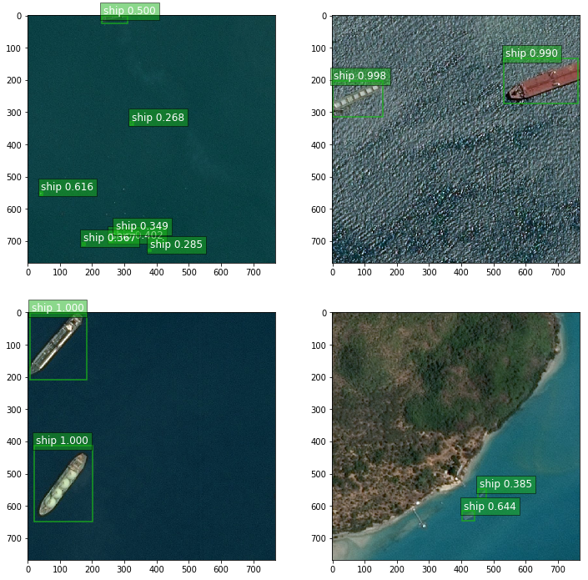
Results

Slide 7
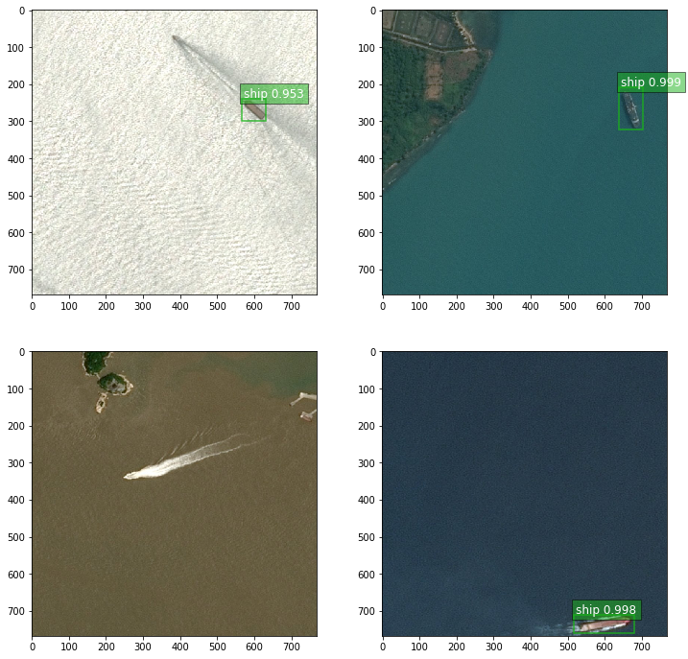
Results

Slide 8
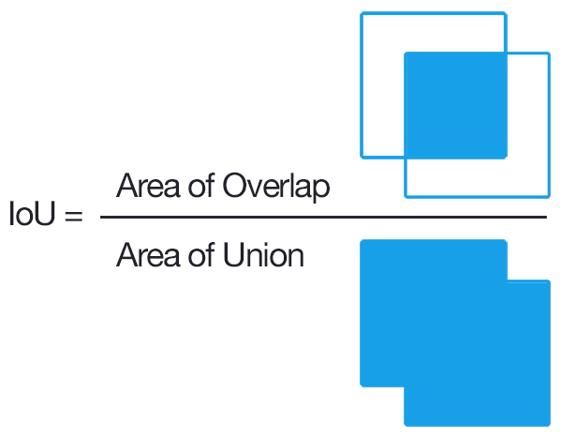
Validation Metrics

