Slide 1


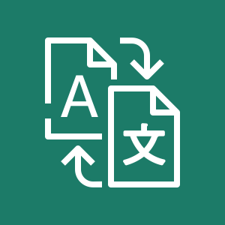

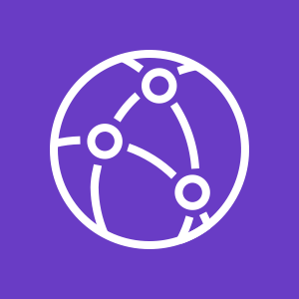
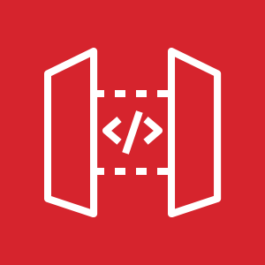





Multilanguage Bot Stack
(Parent Stack)
1
Edge Stack
(DNS, CDN, Website)
Identity Stack
(Cognito)
Side-Processor
(Amazon Translate)
2
Multilanguage API Stack
(API Gateway,
Lambda)
API
Origin
Users
Bot
(Amazon Lex)
S3 Origin
Deploy
Deploy
Test
Metrics,
Logs
Pipeline
Stack
Build
CloudWatch
Code Repo
(Github)
Fixes
and awesome features
Alerting and monitoring
Engineering

Slide 2
1
2
Edge Stack
(CDN, Website)
Identity Stack
(Cognito)
Side-Processor
(Amazon Translate)
Multilanguage API Stack
(API Gateway,
Lambda)
API Origin
Worldwide
Users
S3 Origin
Bot
(Amazon Lex)
Deploy
Test
Metrics,
Logs
Deploy
Pipeline
Stack
Build
CloudWatch
Code Repo
(Github)
Fixes and Features
Monitoring & Alerting
Engineering

Slide 3
1
2
Edge Stack
(CDN, Website)
Identity Stack
(Cognito)
Side-Processor
(Amazon Translate)
Multilanguage API Stack
(API Gateway,
Lambda)
API Origin
Worldwide
Users
S3 Origin
Bot
(Amazon Lex)
Deploy
Test
Metrics,
Logs
Deploy
Pipeline
Stack
Build
Code Repo
(Github)
CloudWatch
Ship awesome features
Monitoring & Alerting
Engineering

Slide 4

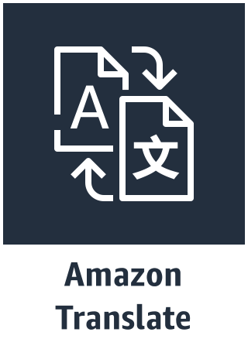
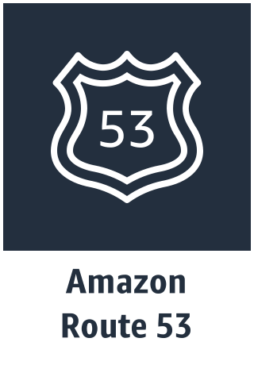

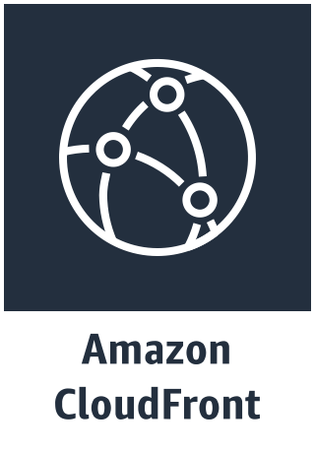
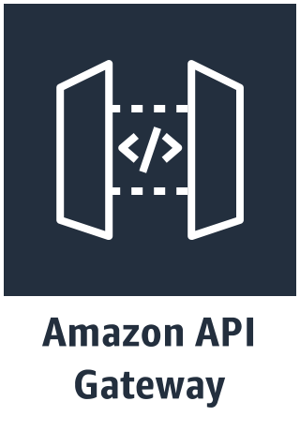
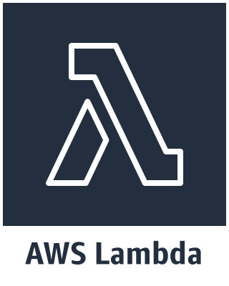
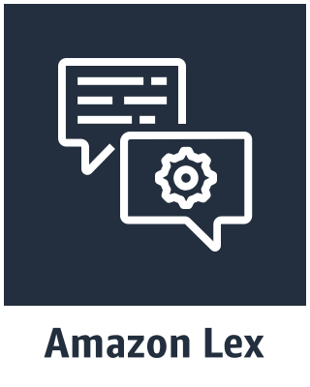
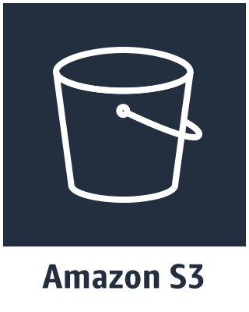
3
1
Edge Stack
Identity Stack
Translation side-processor
2
Multilanguage Bot Stack
Order Flowers
Multilanguage
US English
Pipeline Stack
Distribution

