Slide 1





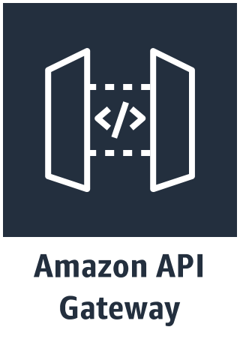



3
1
Edge Stack
Identity Stack
Translation side-processor
2
Multilanguage Bot Stack
Order Flowers
Multilanguage
US English
Pipeline Stack
Distribution

Slide 2











3
1
Edge Stack
Identity Stack
Side-Processor:
Amazon Translate
2
Multilanguage Bot Stack
Order Flowers Bot:
Amazon Lex
Multilanguage
Users
Deploy website
Deploy API
4
Pipeline
Stack
Source repo:
Github
CodePipeline
code
metrics
Engineering

