Slide 1
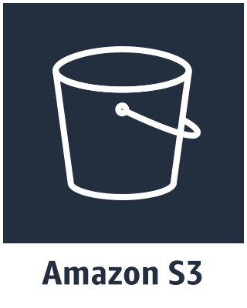




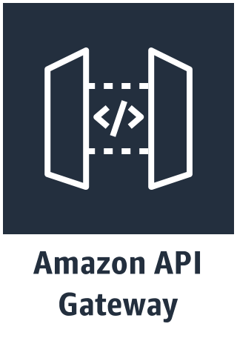



Edge Stack
Identity Stack
Translation side-processor
Multilanguage Bot Stack
Order Flowers
Multilanguage
US English

