Slide 1
Finding the Fulcrum: Merton life-cycle model with mismatch risk for LDI overlay optimization under the Wtp
20 October 2026
MSc Quantitative Finance
Frank Heijnen

Slide 2
Agenda
Problem description
Modeling approach
Results & next steps

Slide 3
Problem description
01

Slide 4
Problem: mismatch return under the Wtp
SPR, indirect method: the protection return calculated based on DNB RTS, but has to be earned with real instruments
Return of the interest rate overlay
What the LDI portfolio actually earns: cash, receiver swaps and bonds
Two drivers the LDI manager controls
1
Cash drag
≈ −25 bp per year, near-certain
Swaps require paying 6-month floating Euribor, while cash in MMF has historically earned less.
−
Theoretical protection return
% change of the annuity factor (DNB RTS) × protection level, credited independent of the investment result
=
2
Spread risk
Spread s = bond yield − swap rate
Bonds compensate the cash drag, but the spread moves with liquidity and credit risk (negative spread in 2015–2022).
Mismatch return
Enters the excess return and lands mostly with younger cohorts. A structurally negative mismatch is a predictable transfer from young to old.

Slide 5
Modelling approach
02

Slide 6
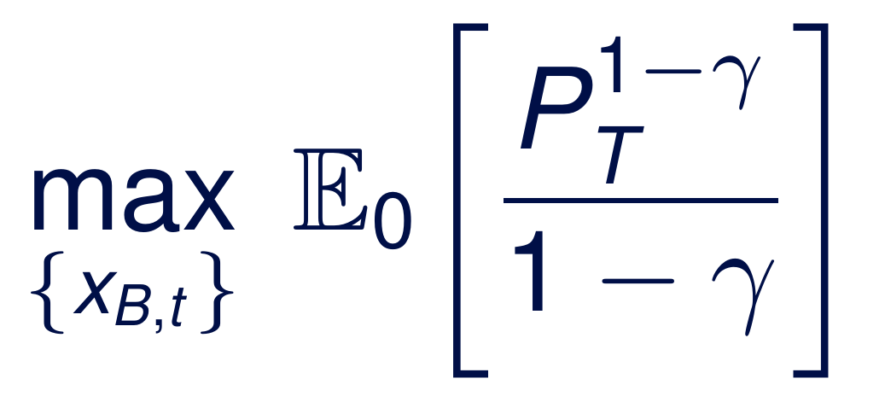
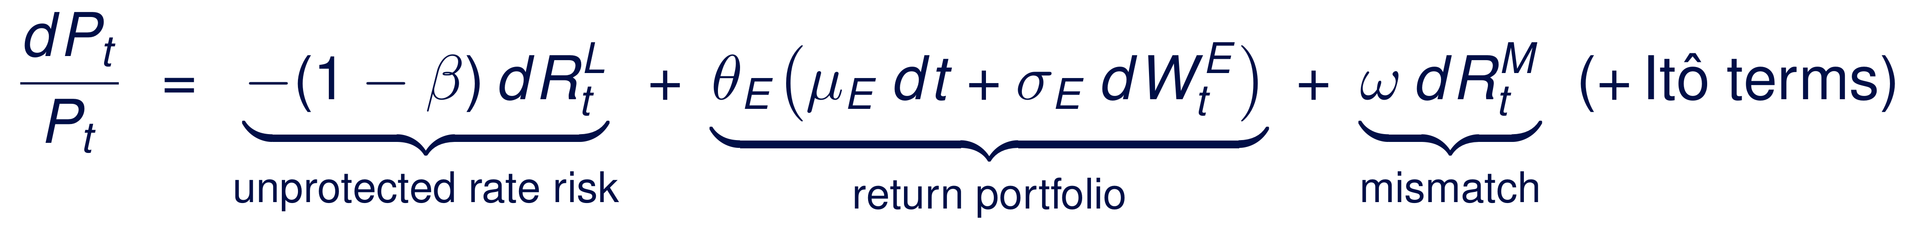
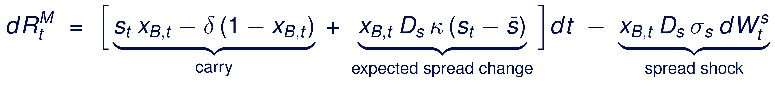

Merton life-cycle model with mismatch risk
Choose the bond allocation x_{B} of the overlay over time to maximize expected utility of the pension entitlement
Objective. Pension entitlement P_{t} = F_{t} / a_{t}: the yearly benefit the capital buys (F_{t}: capital, a_{t}: annuity factor, γ: risk aversion).
Modeling choices
Wealth in pension entitlement (Numeraire); the protection return acts as the risk-free asset
Overlay duration matches annuity duration: rate risk drops out of mismatch
10-year constant-maturity bond: spread duration D_{s} ≈ 8.6.
Euler approximation for coding the SDEs.
Constraints: 0 ≤ x_{B} ≤ 1 and spread-risk limit x_{B} D_{s} ≤ SL
Test 2 policies:
No spread risk: x_{B,t} =0
Spread risk to compensate cash-drag (carry = 0):
x_{B,t} = δ / (s_{t} + δ) if s_{t} >0 else 0
swap spread follows Ornstein–Uhlenbeck process
R_{t}^{L} : protection return · R_{t}^{M}: mismatch return · β: protection level · θ_{E}: return-portfolio allocation · ω: share of mismatch borne · x_{B}: bond share of protected capital · s_{t}: swap spread · δ: cash drag · D_{s}: spread duration
The trade-off
Cash and swaps (x_{B} = 0)
Small but certain underperformance: the cash drag
vs
Bonds (x_{B} > 0)
Uncertain spread result with a positive expected value
−δ
+s

Slide 7
Results & next steps
03

Slide 8

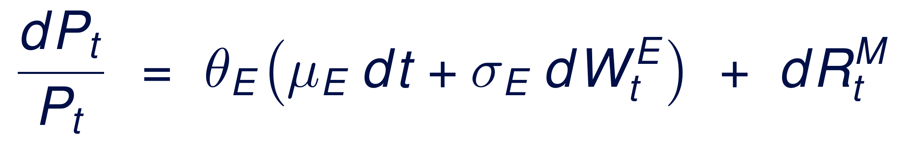
Base-base case: benchmark policies
Policies of Ernsting et al. (2025) for a fully protected cohort (β = ω = 1, θ_{E} = 0): only mismatch risk, age 25 to 68
Pension entitlement P_{t} by age (P₀ = 1)
 | Policy 1 no spread risk x_{B,t} =0 | Policy 2 zero carry x_{B,t} = δ / (s_{t} + δ)
Certainty equivalent P_{T} | 0.898 | 0.982
Mean P_{T} | 0.898 | 0.985
5%–95% range P_{T} | - | 0.927 - 1.053
CE-equivalent mismatch | -25 bp/yr | -4.3 bp/yr
Average bond allocation x_{B} | 0% | 36%
Key takeaways
Cash and swaps (policy 1) cost a certain 25 bp per year, which indicates a ~10% lower pension at T=68 in comparison with policy 2.
Policy 2 saves about 83% of the cash drag in yearly certainty-equivalent terms and ends below policy 1 in only 0.4% of paths. Hence, an easy spread-risk policy outperforms taking no spread-risk at all, for this base case.
Policies from Ernsting et al. (2025); see Python Notebook. Uncalibrated parameters: δ = 25 bp, s̄ = 30 bp, κ = 0.3, σ_{s} = 25 bp, D_{s} = 8.6 (10-year constant-maturity bond), γ = 5; annual Euler steps, 10.000 paths.

Slide 9
Roadmap: three model cases
From evaluating benchmark policies to the optimal overlay policy over the life cycle
1
Base-base case
Done
2
Base case
Next step
3
General case
Later stage
SETTING
Fully protected cohort (β = ω = 1), no return portfolio (θ_{E} = 0): only mismatch risk.
QUESTION
How do the benchmark policies of Ernsting et al. (2025) perform?
METHOD
Monte Carlo simulation of fixed policy
(i.e. x_{B}) rules
SETTING
As in the base-base case.
QUESTION
What is the optimal bond allocation, given the spread and the remaining horizon?
METHOD
HJB equation; analytical derivation.
SETTING
Full model summary: β_{t}, ω_{t}, θ_{E,t} follow the fund's life-cycle rules; Itô terms, rate model and spread limit incorporated in model.
QUESTION
What is the optimal overlay over the whole life cycle, taking into account equity as well as mismatch risk?
METHOD
Numerical methods, e.g. dynamic programming.
Solution: policy
Solution: analytical
Solution: numerical

Slide 10
Notes:
Slide 4
A pension fund hedges a large part of its interest rate risk with an interest rate overlay: receiver swaps, cash and bonds. Under the Wtp this task stays the same, but the way results are allocated changes.
Most funds choose the solidarity premium scheme (SPR) with the indirect, i.e. theoretical, method. The protection return is then not measured but calculated: the percentage change of the annuity factor on the DNB term structure, times the protection level of a cohort. It is credited regardless of what the investments earn.
The fund still has to earn that return with real instruments. The difference between the overlay return and the theoretical protection return is the mismatch return. Under the indirect method it enters the excess return and therefore lands mostly with younger participants. A structurally negative mismatch is a predictable transfer from young to old (Ernsting et al., 2025), and funds have to monitor and limit it.
Two sources the LDI manager controls directly: the cash drag (swaps pay 6m Euribor, money market funds earn about 25 bp per year less) and spread risk (bonds that yield more than swaps compensate the drag, but the spread moves and was even negative between 2015 and 2022).
Slide 6
To make the trade-off quantitative, I use Merton's life-cycle model, as also used for Dutch pension design (Bovenberg & Mehlkopf, 2014). Wealth is measured in pension entitlement P = F/a: the yearly benefit the capital buys. In those units the theoretical protection return plays the role of the risk-free asset, and cash is risky.
Ito's lemma on P = F/a gives three parts: unprotected rate risk (zero for a fully protected cohort, beta = 1), the return portfolio, and the mismatch, plus covariance (Ito) terms that vanish if spread and rate shocks are uncorrelated. Mismatch is added as a second rewarded source of risk next to equity.
The mismatch follows from the instrument returns. Cash earns the short rate minus the cash drag; a receiver swap earns D_sw/D_a times the protection return; a bond earns the swap-curve return plus the spread s and a spread result -D_s ds. Choosing the swap notional so that the overlay duration equals the annuity duration makes the protection return drop out exactly. What remains is carry, s x_B - delta (1 - x_B), and the spread result.
The spread follows an Ornstein-Uhlenbeck process. The expected reward per unit of bonds, s + delta + D_s kappa (s - s_bar), rises with the spread level, so s is a state variable and the optimal allocation depends on the spread level and on the remaining horizon. The bond is a 10-year constant-maturity bond; its spread duration is held constant at the long-run spread, which is accurate to about 1 bp per year for a 10-year bond.
Slide 8
Base-base case: one fully protected cohort (beta = omega = 1) without return portfolio (theta_E = 0), so the entitlement only moves through the mismatch: dP/P = dR^M. Capital P_0 = 1 at age 25, no premiums, horizon to age 68 (T = 43). I simulate the two benchmark policies of Ernsting et al. (2025) on the same 10,000 spread paths.
Policy 1, no spread risk (x_B = 0): only cash and swaps. The mismatch is a certain -25 bp per year, so P_T = (1 - 0.0025)^43 = 0.898: a 10% lower pension at retirement, in every scenario.
Policy 2, zero carry (x_B = delta/(s + delta) for s >= 0, otherwise 0): enough bonds that the spread exactly offsets the cash drag. Certainty equivalent 0.982 versus 0.898, i.e. +9.3%; in certainty-equivalent terms the yearly cost drops from 25 bp to about 4.3 bp. The ranking is robust to risk aversion (CE 0.984 at gamma = 2, 0.978 at gamma = 10).
Two weaknesses. First, the yearly mismatch is volatile: standard deviation about 1%, worst 5% of years -1.7%. That matters because under the Wtp mismatch is realised and allocated every year. Second, the rule is 'buy high, sell low': it holds the most bonds when spreads are tight and sells after widenings. With these illustrative parameters the spread is negative in 19% of years; the rule then holds only cash and pays the full cash drag. This motivates the optimal, adaptive policy of the next step.
Caveats: parameters are illustrative and not yet calibrated (AR(1) on spread history is planned); annual Euler steps slightly overstate the spread variance, monthly steps are planned.
Slide 9
The thesis builds up in three cases, each nesting the previous one.
1. Base-base case (done): fixed policy rules are evaluated, so there is nothing to optimise. I simulate them by Monte Carlo with an Euler discretisation; policy 1 is also available in closed form.
2. Base case (next): same setting, but now the optimal bond allocation. The state is (P, s) with one Brownian motion. Because CRRA utility is homothetic in P and the expected reward is affine in s, the HJB equation admits an exponential-quadratic value function, as in Kim & Omberg (1996). This reduces the PDE to three Riccati ODEs in the remaining horizon. The optimal policy is the myopic Merton demand, lambda(s)/(gamma sigma_B), minus an intertemporal hedging demand that depends on the horizon. This is analytical (semi-closed form). The constraint 0 <= x_B <= 1 is handled with a grid check by dynamic programming, which must reproduce the closed form when the constraint does not bind.
3. General case (later): the full model summary, where beta, omega and theta_E follow the fund's life-cycle allocation rules and change with age. Then the protection return no longer drops out: it needs a rate model (a level factor, consistent with the parallel-shift assumption) and the Ito covariance terms matter. No closed form exists, so the HJB equation is solved numerically by backward induction on a grid, and the policy is evaluated by Monte Carlo. The extension adds several cohorts with weights and a downside-risk penalty on negative mismatch.

