Slide 1
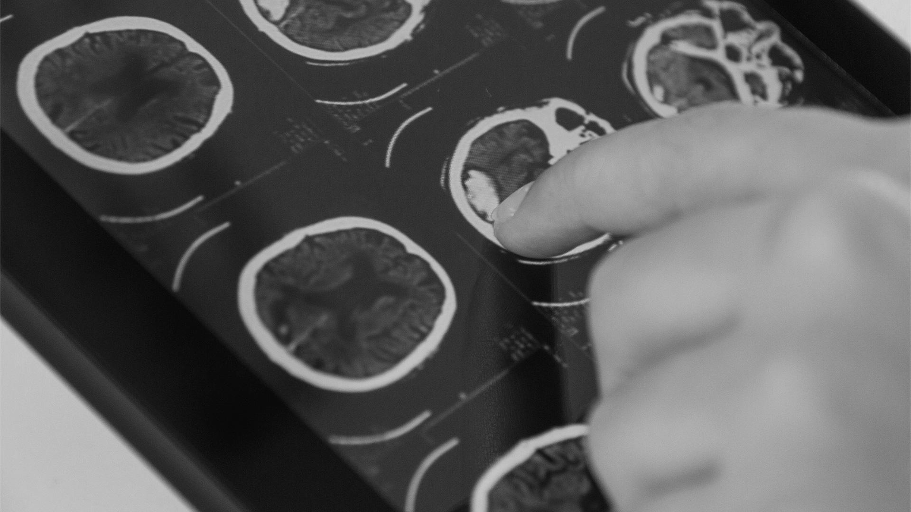
Breast Cancer Classification

Slide 2
INTRODUCTION
It is an AI machine learning project in which the model will predict the cancer type into positive test cancer or negative test cancer

Slide 3
Breast Cancer
What is Breast Cancer?
It is a disease in which cells in the breast grow out of control.
There are different kinds of breast cancer, the kind of breast cancer depends on which cells in the breast turn into cancer.
Breast cancer can spread outside the breast through blood vessels.
When breast cancer spreads to other parts of the body, it is said to have Metastasized.

Slide 4
Major Categories
Histopathological Type
The Grade of Tumor
The Stage of Tumor
The Expression of Proteins and Gens

Slide 5
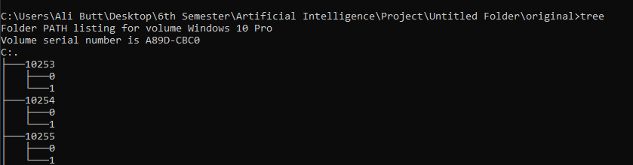
Data Sets
The Data Sets that is used are Histopathological Type.
Histopathological Type refers to the microscopic examination of tissues and to study the details about the Disease.
The Data Set holds round about 277,524 pictures of breast cancer specimens scanned at 40x.
1,98,738 images are test negative and 78,786 images are test positive.
Structure of the Data Sets:

Slide 6
Libraries used
Neural Networks Used
Kers
Tensorflow
Numpy
Panda
PIL
OS
Json
Math
Sklearn
CV2
Resnet :
Residual Neural Network
Densenet 201

Slide 7
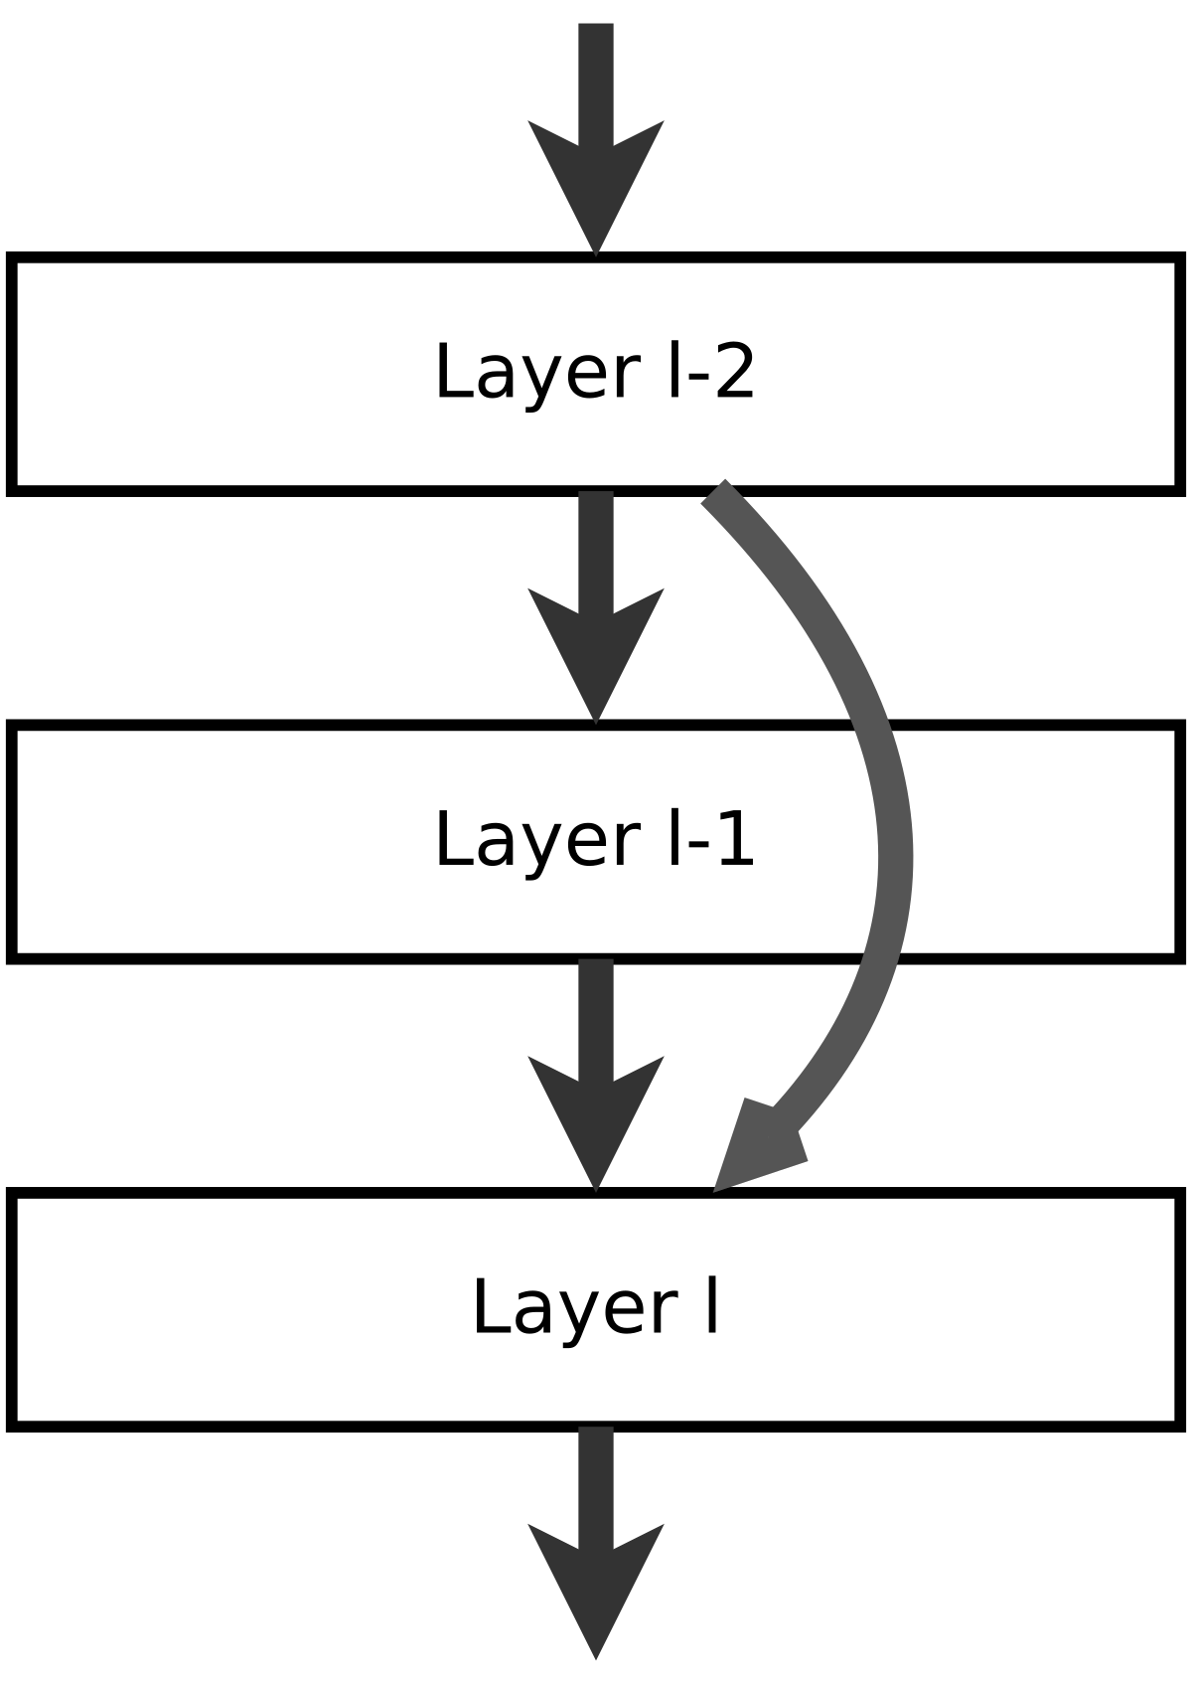
Residual Neural Network
It is an Artificial Neural Network, which applies identity mapping.
list all unassigned variables (in any order) that might be selected now by the Degree Heuristic (DH).
Deeper neural networks are more difficult to train. We present a residual learning framework to ease the training of networks that are substantially deeper than those used previously.

Slide 8
Dense Net 201
Dense Net(Densely Connected Convolutional Networks) is one of the latest neural networks for visual object recognition. It's quite similar to ResNet but has some fundamental differences.
Dense Net 201 a convolutional neural network that is 201 layers deep. We can load a pretrained version of the network trained on more than a million images from the Image Net database.

Slide 9
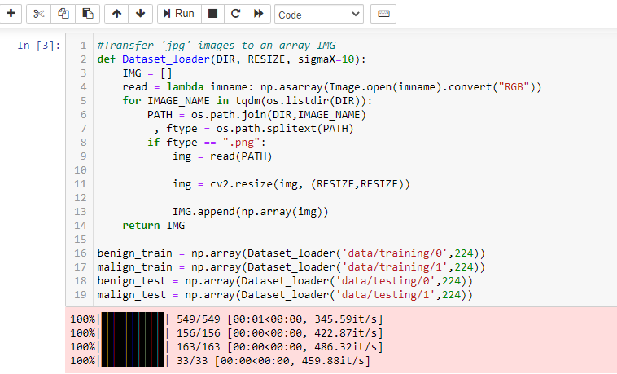
Data Loading

Slide 10
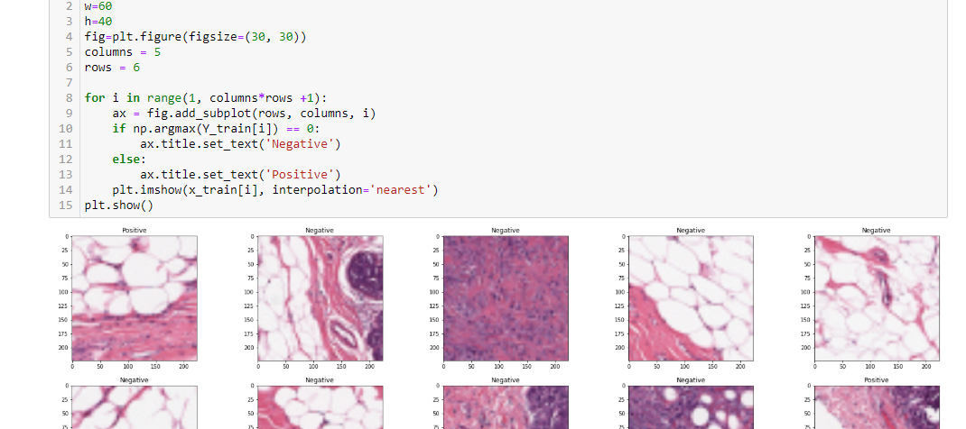
Displaying Loaded Data

Slide 11
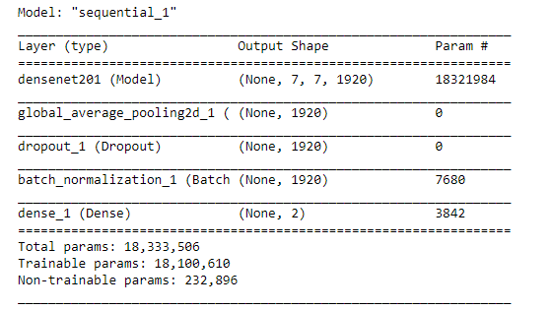
Model Summary Using DenseNet 201

Slide 12
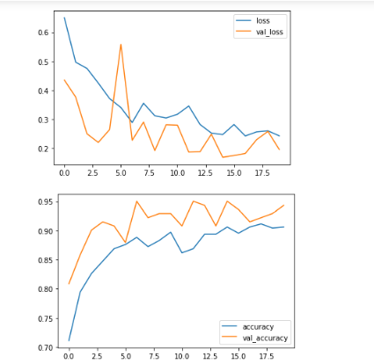
Accuracy, Loss

Slide 13
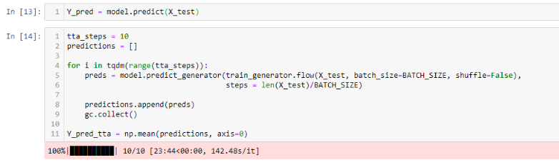
Test Time Augmentation (TTA)
Test-time augmentation is an application of data augmentation to the test dataset.
It involves creating multiple augmented copies of each image in the test set, having the model make a prediction for each
then returning an ensemble of those predictions.

