Slide 1
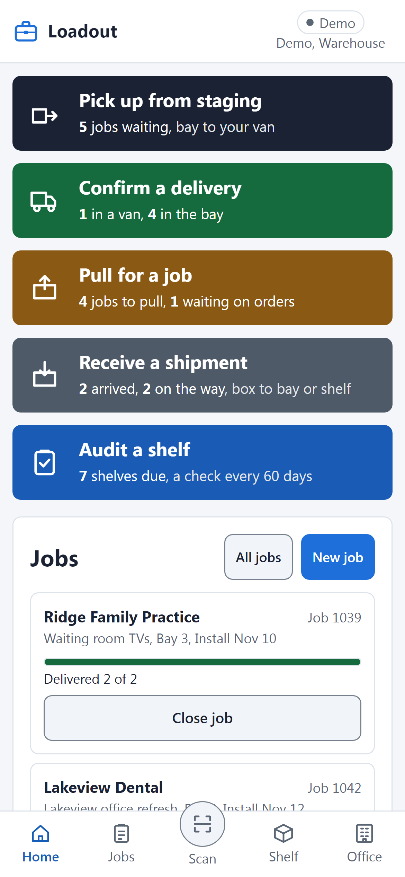
UMBRELLA
AUTOMATION
Loadout
How product moves from the shelf to the client
Screens show the demo's sample data, not real clients.
Notes:
This deck walks one job through Loadout, from the client saying yes to the product sitting on site. Every screen is the real app in demo mode, so the clients, products and people you see are invented sample data. Each step slide says what you do, what Loadout does, and the one thing to watch for. The slide colors match the doors on the phone, so the green slide is the green door. The most common mistake is treating Loadout as paperwork for later: it only stays true if you tap as you go.

Slide 2
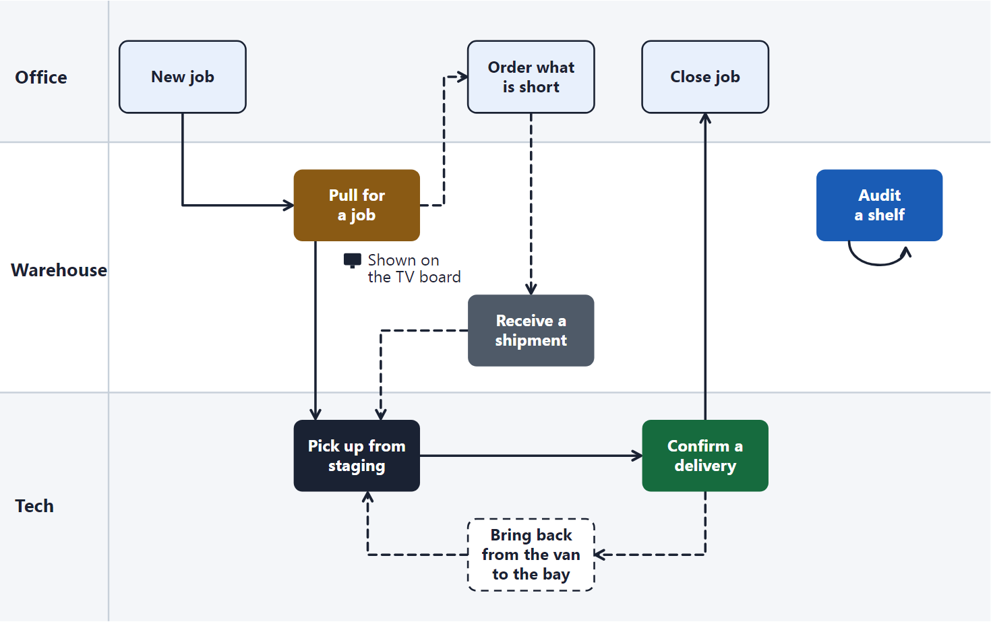
The whole thing in one line
Shelf
Pull
Bay
Pick up
Van
Deliver
Client
Notes:
Every piece of product is always in one of four places: on a shelf, in a job's bay, in a tech's van, or at the client. Pull moves it from the shelf to the bay, Pick up from the bay to the van, and Deliver from the van to the client. The chart shows who does each step: the office on top, the warehouse in the middle, the tech at the bottom. The dashed paths are the side trips, ordering what is short and bringing product back. The usual mistake is skipping a place, such as loading straight from the shelf into the van, and then no count matches.

Slide 3
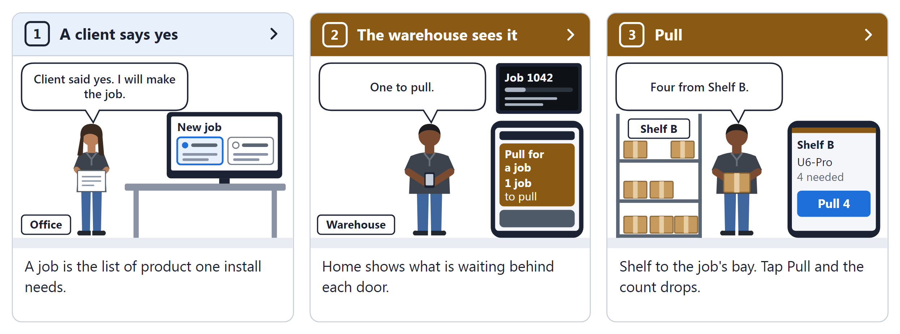
The comic: a job starts
The full page: Office, About, How Loadout works.
Notes:
The comic tells one job from start to finish in nine panels, three per slide. Panel 1: a client says yes, and the office makes the job, because a job is the list of product one install needs. Panel 2: the warehouse sees it on Home, which shows what is waiting behind each door, and the TV on the wall shows the same job. Panel 3: the warehouse pulls it, shelf to the job's bay, and each tap on Pull drops the shelf count. The thing people miss here is that nothing moves until someone taps; the comic shows the tap every time.

Slide 4
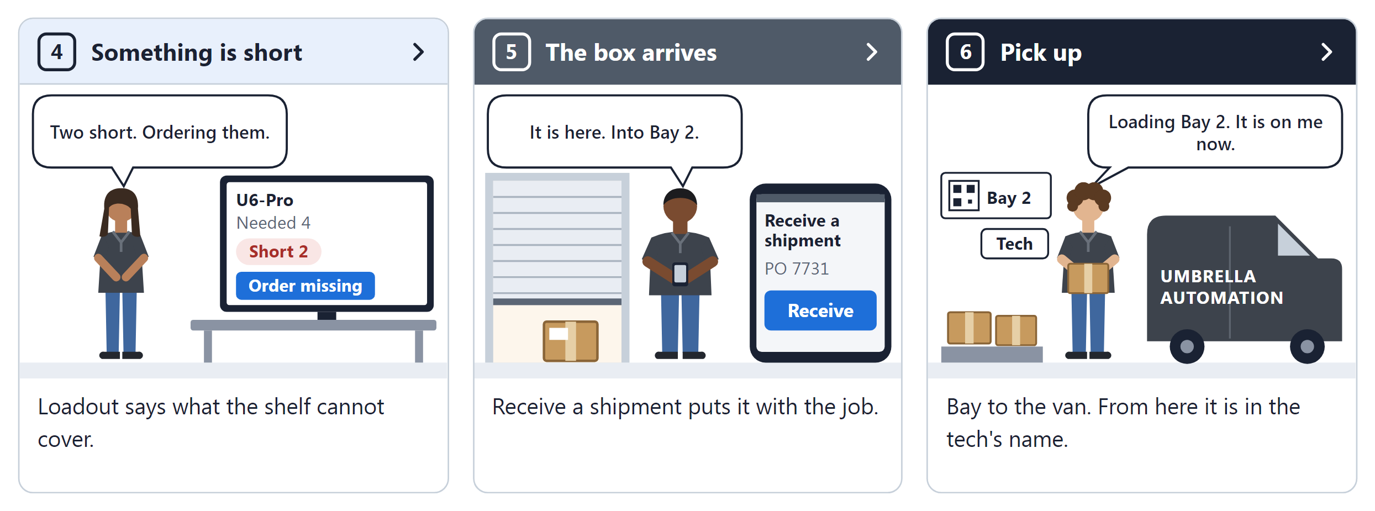
The comic: product comes together
The full page: Office, About, How Loadout works.
Notes:
Panels 4 to 6 are how the product for a job comes together. Panel 4: something is short, and Loadout says what the shelf cannot cover, so the office orders it. Panel 5: the box arrives, and Receive a shipment puts it with the job, straight into its bay. Panel 6: the tech picks it up, bay to the van, and from here it is in the tech's name. The common slip is loading the van without tapping Pick up, which leaves the product looking like it is still in the bay.

Slide 5
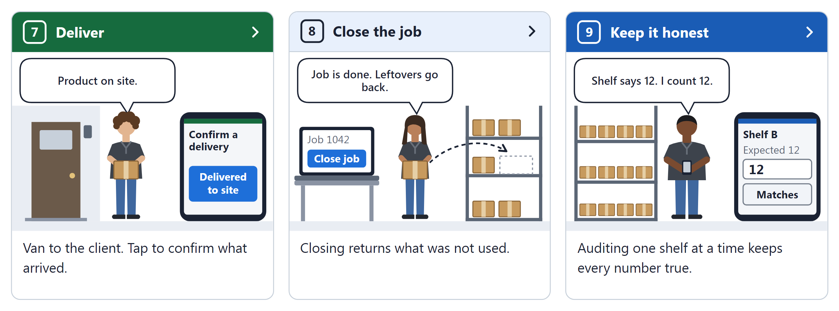
The comic: out the door and back
The full page: Office, About, How Loadout works.
Notes:
Panels 7 to 9 finish the job and keep the shop honest. Panel 7: deliver, van to the client, and a tap confirms what arrived. Panel 8: the office closes the job, and closing returns what was not used to the shelf. Panel 9: keep it honest, because auditing one shelf at a time keeps every number true. People tend to skip panel 9; it is the step that makes every other number on these slides worth trusting.

Slide 6
Who does what
Office
Warehouse
New job, order what is short, close the job.
Pull, receive shipments, audit shelves, watch the TV board.
Tech
Accounting
Pick up from staging, confirm deliveries, bring back.
Reports, including the Job report.
Notes:
Loadout has four roles, and each one sees only the doors it uses. The office starts jobs, orders what the shelves cannot cover, and closes jobs when they are done. The warehouse pulls product, receives boxes, audits shelves, and keeps an eye on the TV board. Techs pick up from the bay, confirm deliveries at the client, and bring back anything not used. If a door is missing on your phone, it is not broken: your role does not use it, and the last tab reads More for techs instead of Office.

Slide 7
Home and its doors
You
Open the door for the work in front of you.
Loadout
Shows on each door how much is waiting.
Watch for
A grey count means nothing is waiting there.
Notes:
Home is where every shift starts. Each colored door is one kind of work, and the line under it says how much is waiting, such as 4 jobs to pull. The colors carry through: the Pull screens wear the same amber as the Pull door. Tapping the Loadout name at the top always brings you back here. People often hunt through the Jobs tab instead; the doors already show only what needs doing.

Slide 8
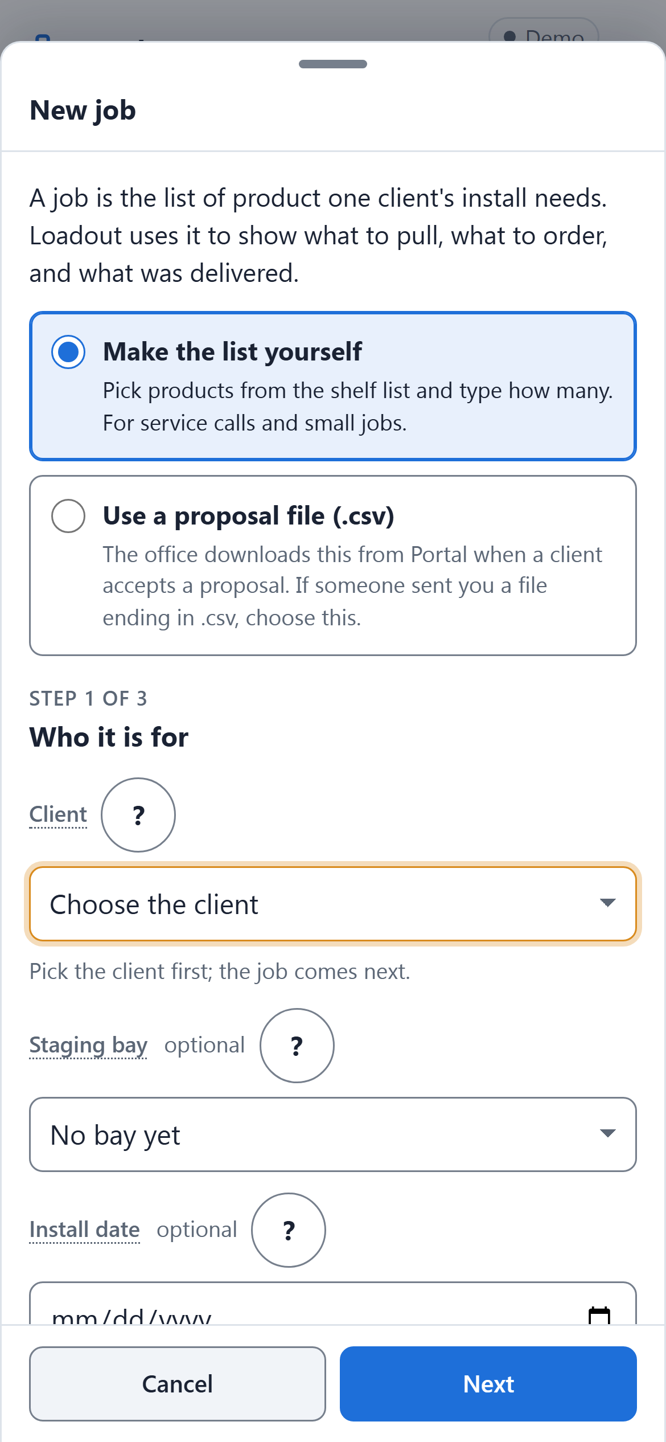
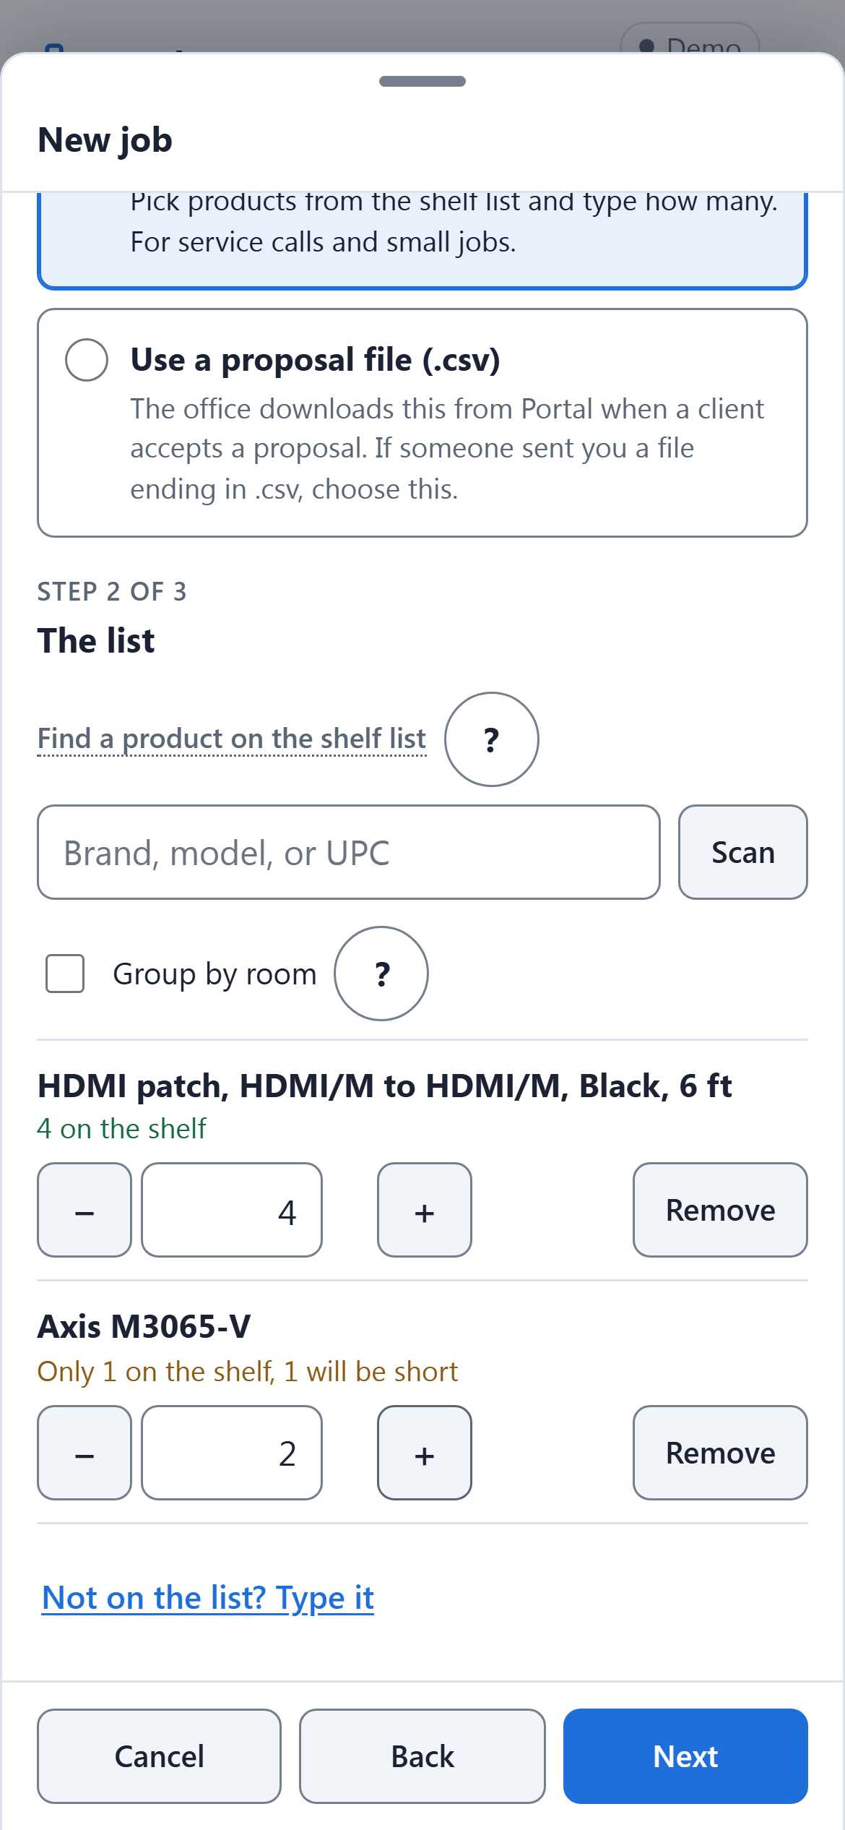
A job starts: New job
You
Pick the client, then add products and how many.
Loadout
Says what the shelf covers and what will be short.
Watch for
Use the proposal file when the office has one.
Notes:
A job is the list of product one client's install needs. When a client accepts a proposal, the office makes the job from the proposal file; for a service call, anyone who can pull can make the list by hand. As you add each product, Loadout tells you how many are on the shelf and how many will be short. The last step creates the job and opens its Pull screen. The mistake to avoid is typing a product as a free note when it is already on the shelf list, because a note line cannot be pulled or counted.

Slide 9
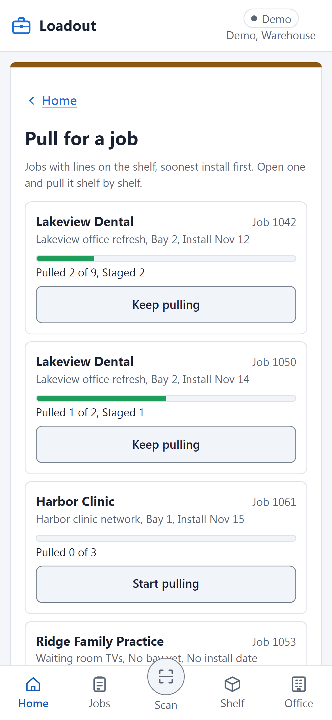
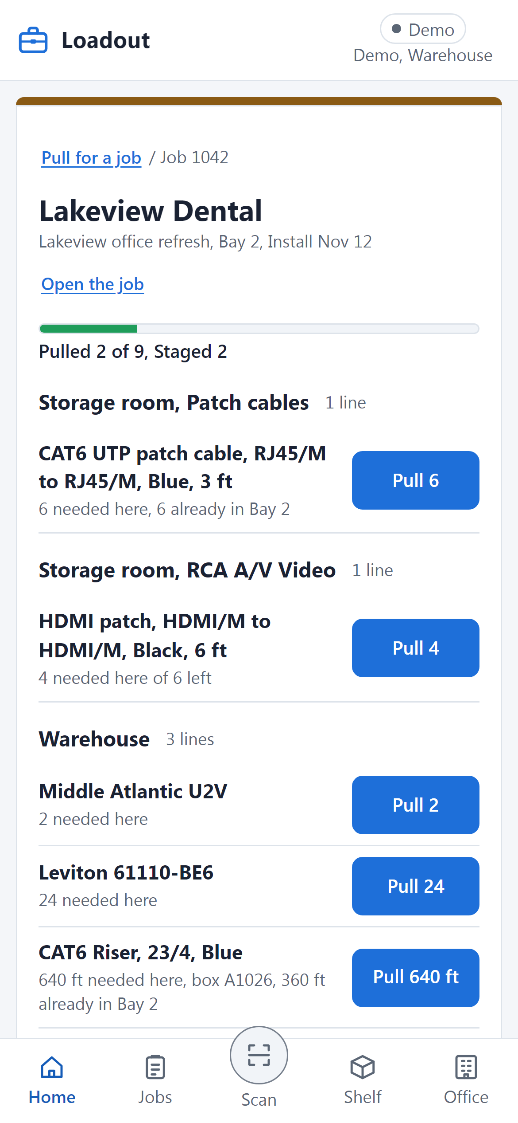
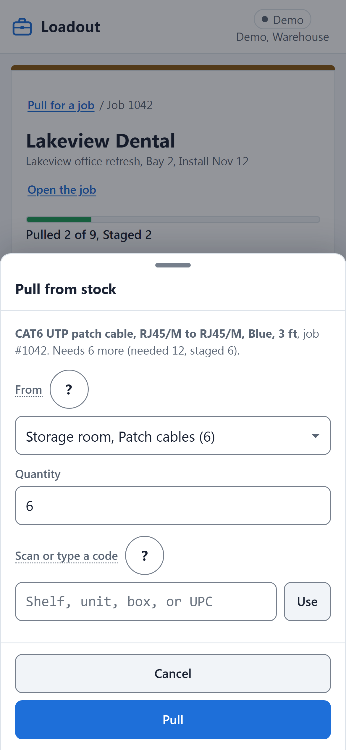
Pull for a job
You
Work shelf by shelf; tap Pull on each line.
Loadout
Lists lines by shelf in pick order.
Watch for
Tap Pull as it leaves the shelf, not later.
Notes:
Pulling moves product from the shelves to the job's bay. Open the job from the Pull door and you get its lines grouped by shelf, in the order you walk the room. Tap Pull on a line, check the shelf and the quantity, and confirm; the shelf count drops and the line moves to In the bay. The TV board shows the same list for the whole warehouse. The common mistake is pulling everything first and tapping later from memory, which is how counts drift.

Slide 10
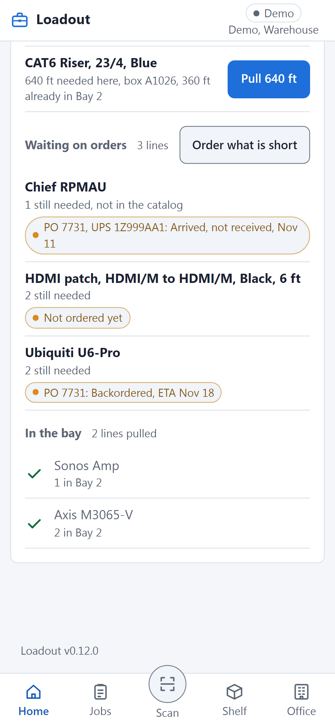
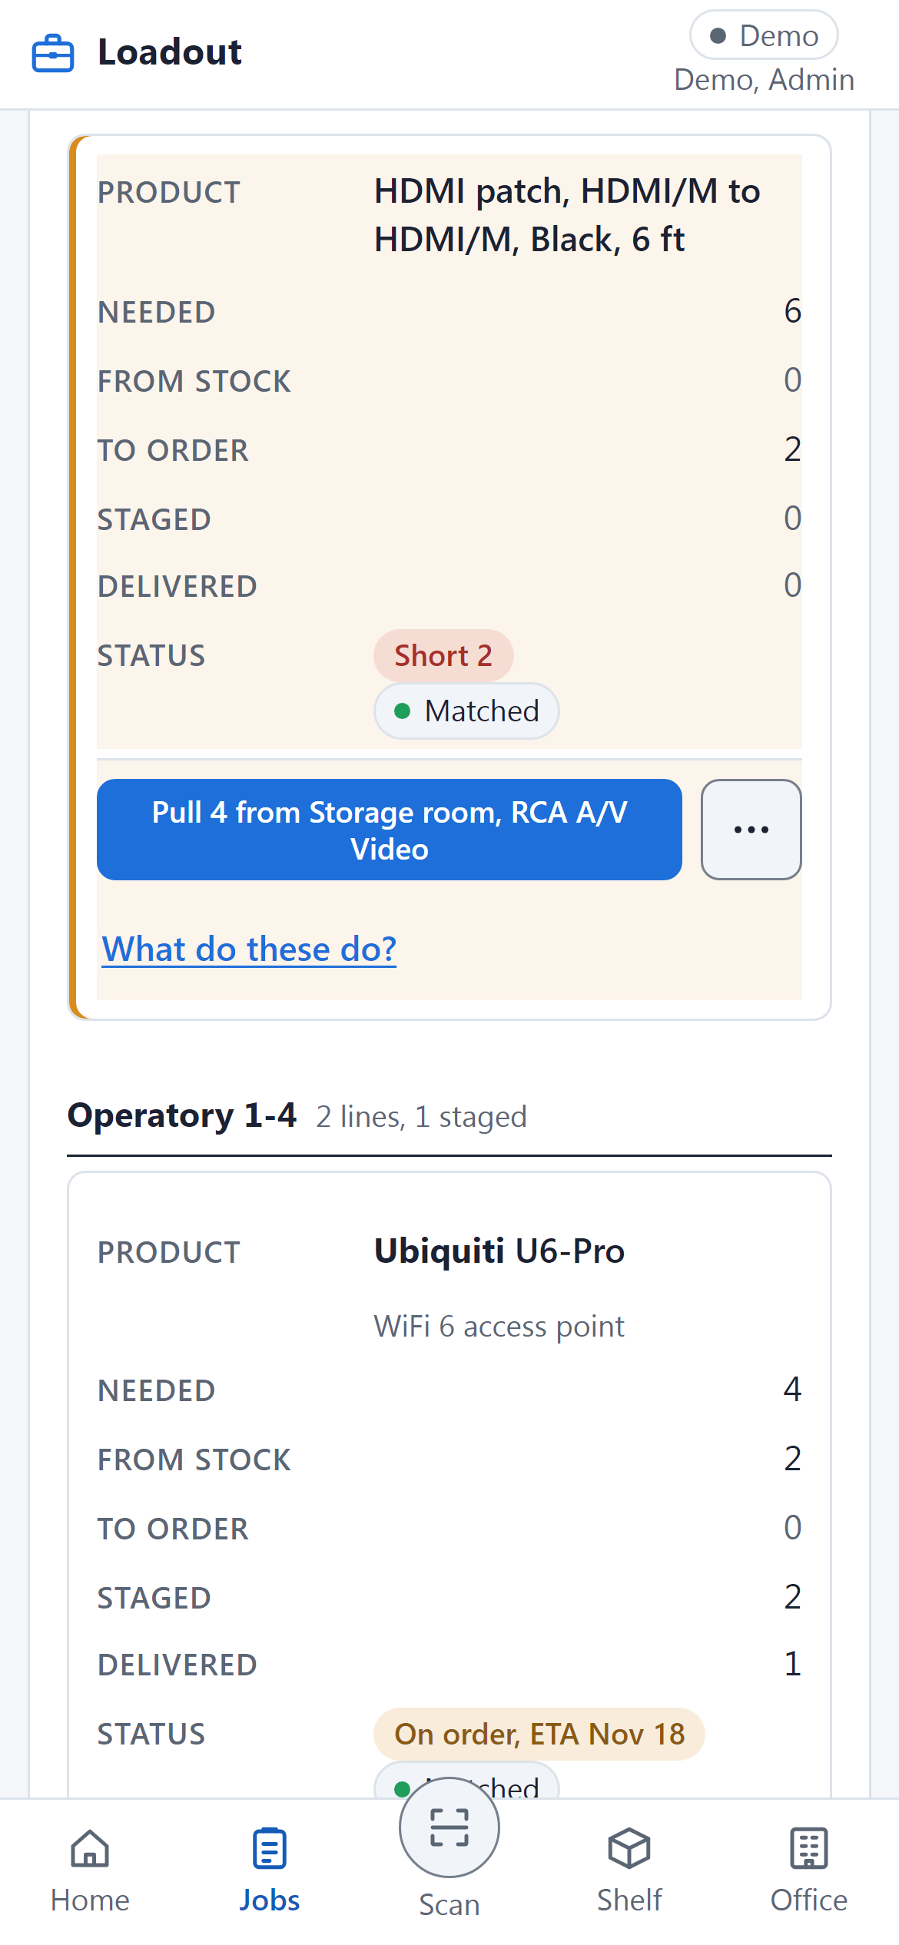
When something is short
You
Leave the line; the office orders it.
Loadout
Marks it Short and lists it under Waiting on orders.
Watch for
Never borrow from another job's bay.
Notes:
Sometimes the shelves cannot cover a line. Loadout keeps that line under Waiting on orders on the Pull screen, with the status of any purchase order that carries it. On the job page the office sees a red Short chip and can put everything short on one draft order. When the box arrives and is received, the line comes back up to pull. Do not cover a short line by taking product from another job's bay: that job then comes up short and nobody knows why.

Slide 11
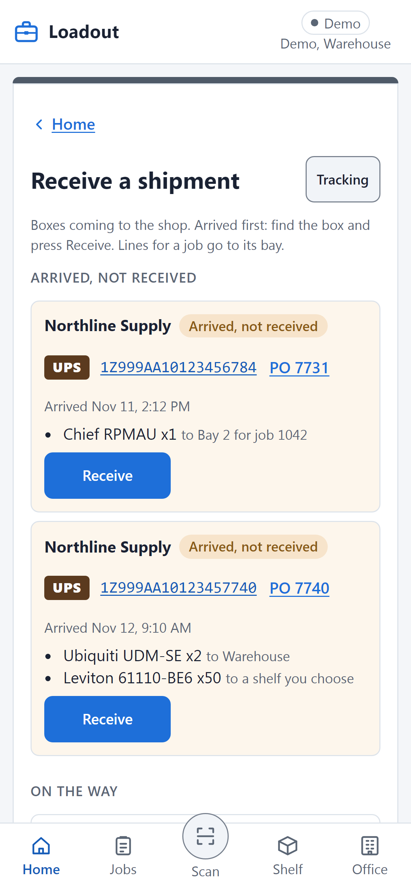
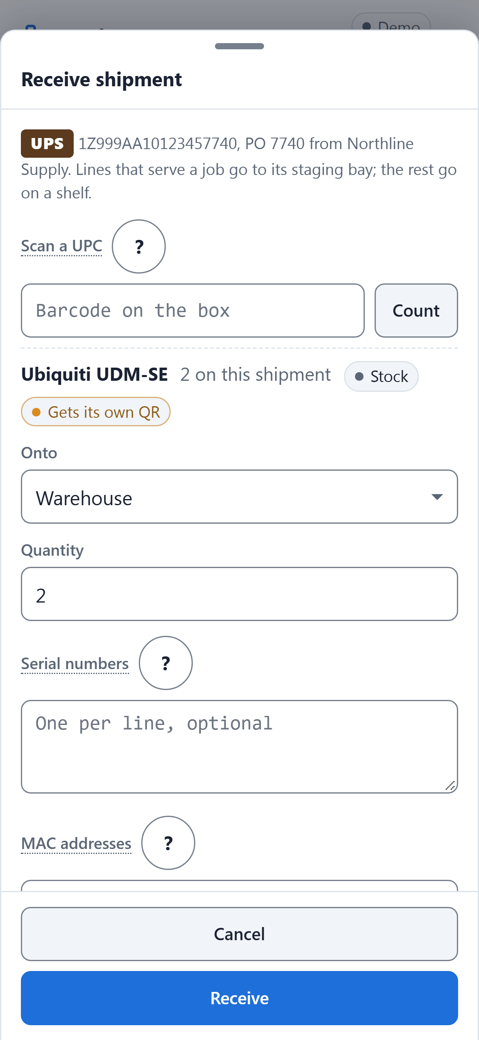
Receive a shipment
You
Find the box, press Receive, confirm where it goes.
Loadout
Sends job lines to that job's bay, the rest to a shelf.
Watch for
Enter the serial or MAC for each unit.
Notes:
Receiving is the only way new stock gets into Loadout. The Receive door lists boxes that have arrived at the shop first, then the ones still on the way. Press Receive on the box in front of you, check the quantity, and confirm where it goes: a line for a job goes straight to that job's bay, and everything else goes to a shelf. For serialized products such as access points, type or scan each serial or MAC so every unit gets its own label. The mistake here is leaving a box on the floor unreceived, because the job it belongs to keeps showing as short.

Slide 12
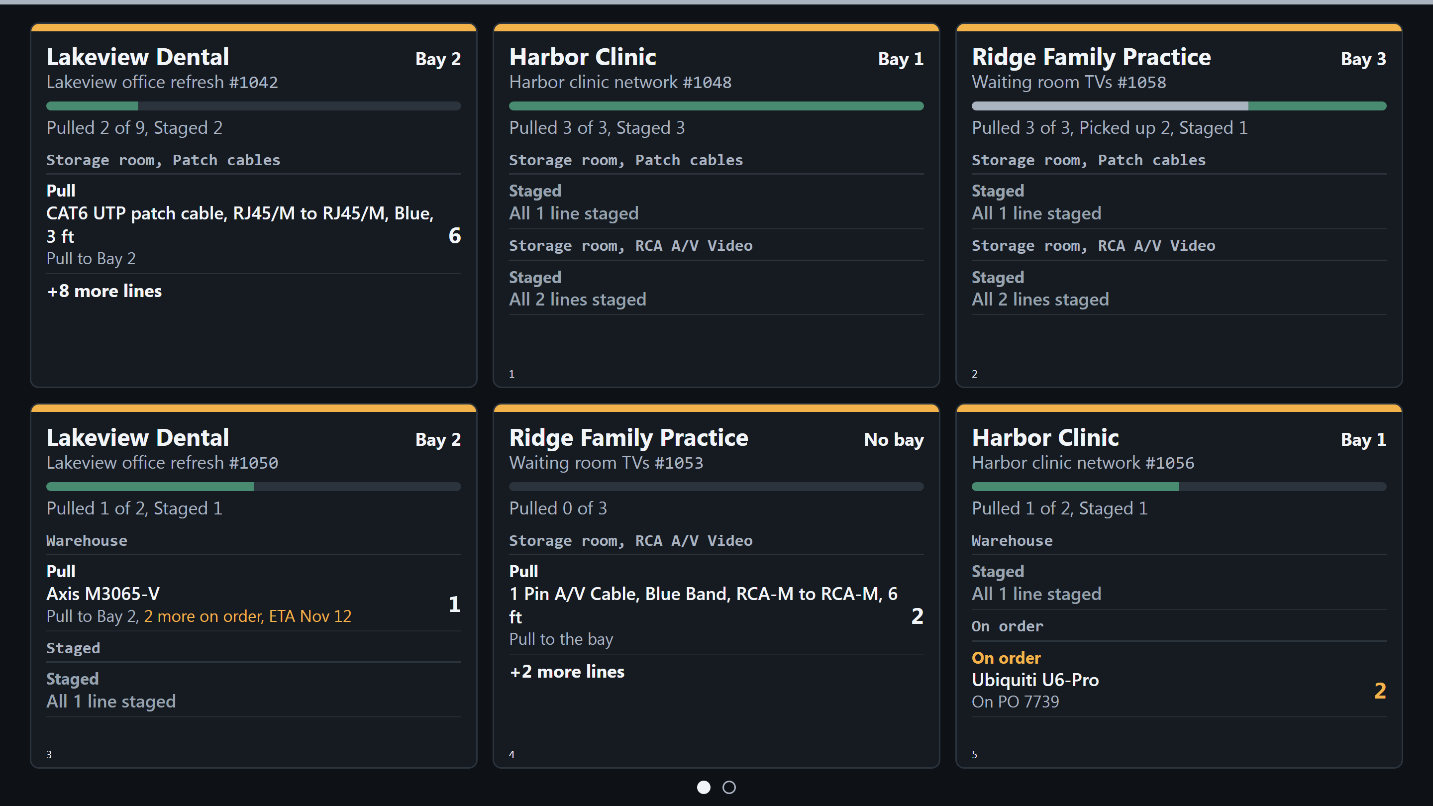
The TV board
You
Look up to see what is left to pull.
Loadout
Shows six jobs at a time, lines by shelf.
Watch for
The board only shows; pull on your phone.
Notes:
The TV on the warehouse wall shows every open job as a card. Each card has the client, the bay, a progress bar, and the lines still to pull grouped by shelf. When there are more than six jobs, it turns the page on its own. It updates as soon as someone taps Pull on a phone. Nobody can pull from the TV itself, so if a card looks wrong, fix it on the phone and the board follows.

Slide 13
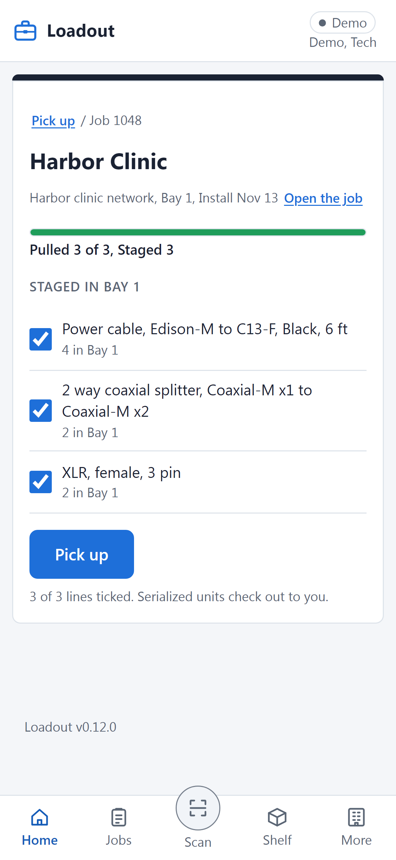
Pick up from staging
You
Tick what you are loading, then tap Pick up.
Loadout
Puts each line, and its units, in your name.
Watch for
Untick anything you leave in the bay.
Notes:
Pick up is the step between the bay and the van. Open the job from the Pick up door, and every staged line starts ticked. Untick anything you are not taking today, then tap Pick up. From that moment the product is in your name, so the shop always knows where it is. The mistake is loading the van without tapping Pick up: the product looks like it is still in the bay, and the next person goes looking for it.

Slide 14
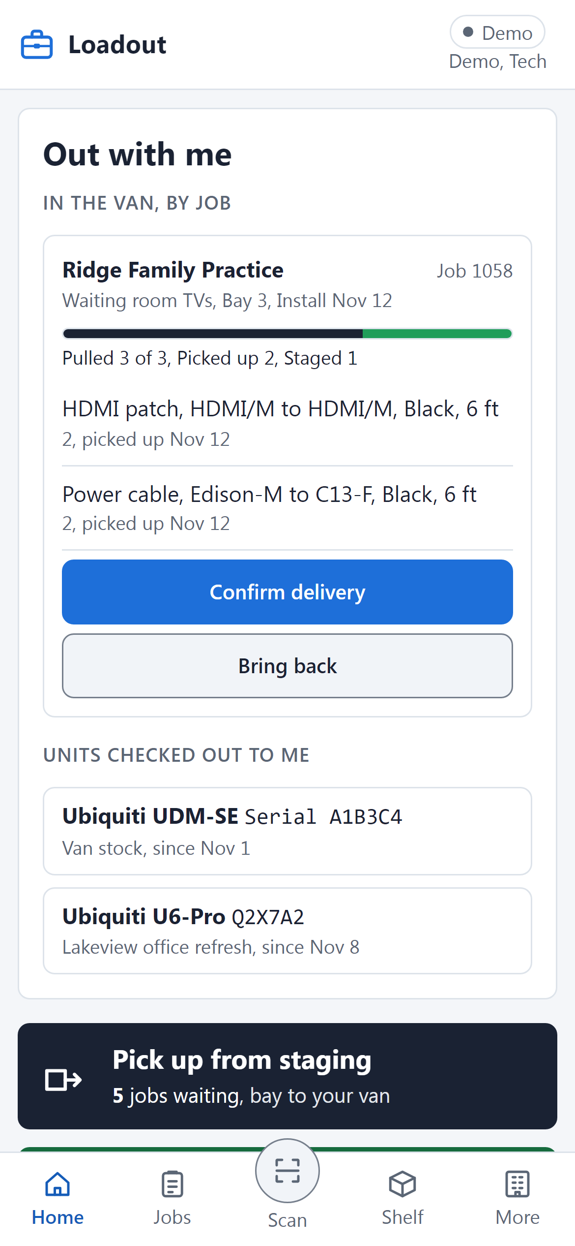
Out with me
You
Check what is in your van before you leave.
Loadout
Lists picked-up lines by job, and your units.
Watch for
It stays in your name until delivered or back.
Notes:
A tech's Home opens on Out with me: everything in your name right now. Product is grouped by job, with the units checked out to you listed under it. Confirm delivery and Bring back sit right on each job, so you rarely need another screen. Glance at it before you drive off and again at the end of the day. If something on this list is not in your van, say so now, because it stays your responsibility until it is delivered or brought back.

Slide 15
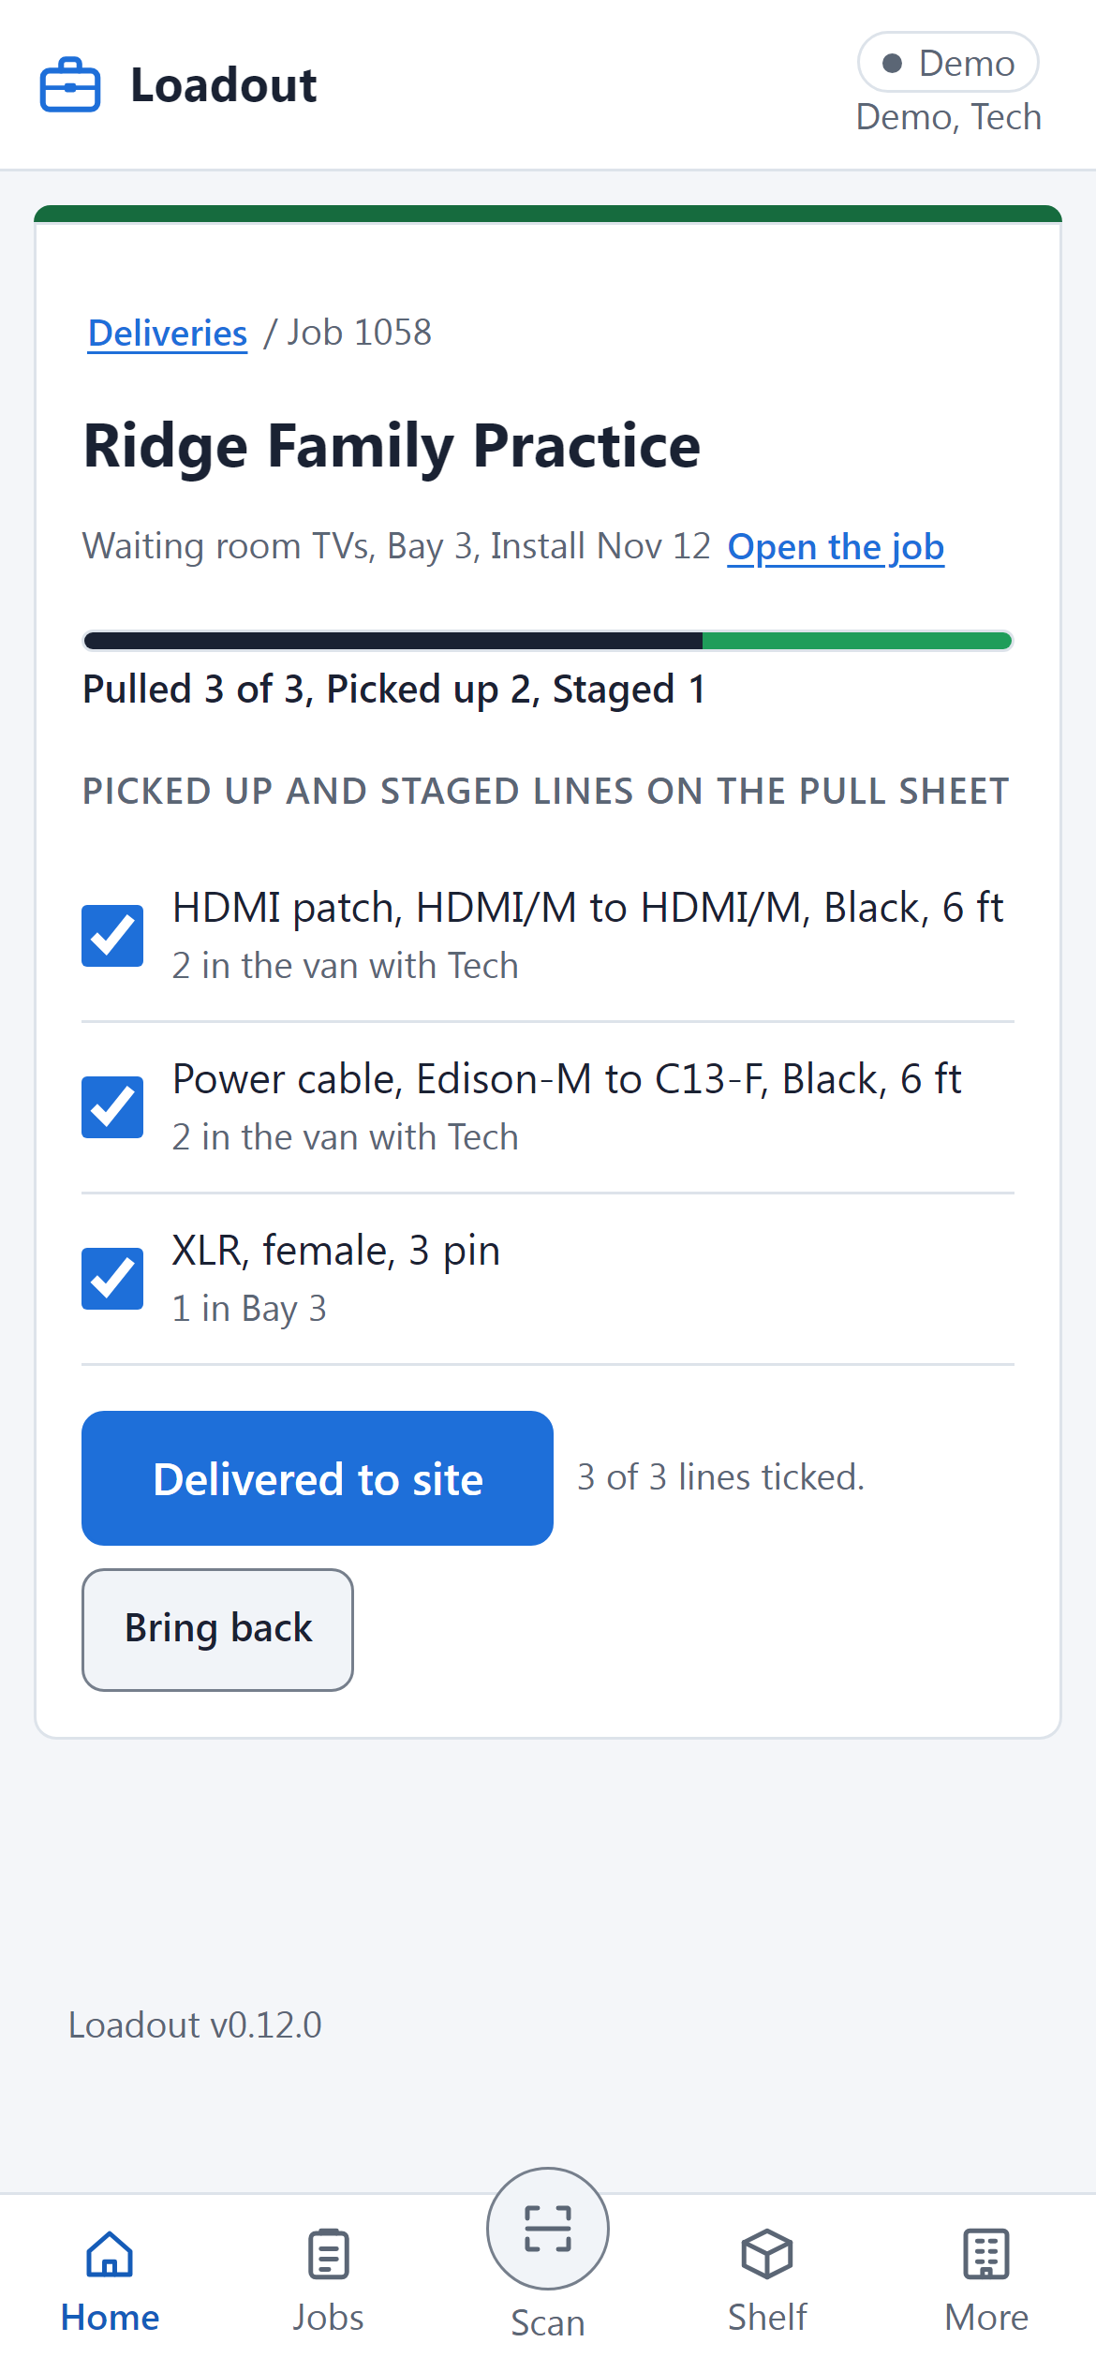
Confirm a delivery
You
At the client, tick what arrived and confirm.
Loadout
Marks those lines delivered and off your name.
Watch for
Confirm on site, not at the end of the week.
Notes:
Deliver means the product is at the client's site, and only that. Open the job from the green door or from Out with me, tick what actually arrived, and tap Delivered to site. Those lines leave your name and the job's progress bar fills in. If something did not make it, untick it and add a note so the office knows. The common mistake is confirming a whole week of deliveries on Friday from memory, which is how product goes missing on paper.

Slide 16
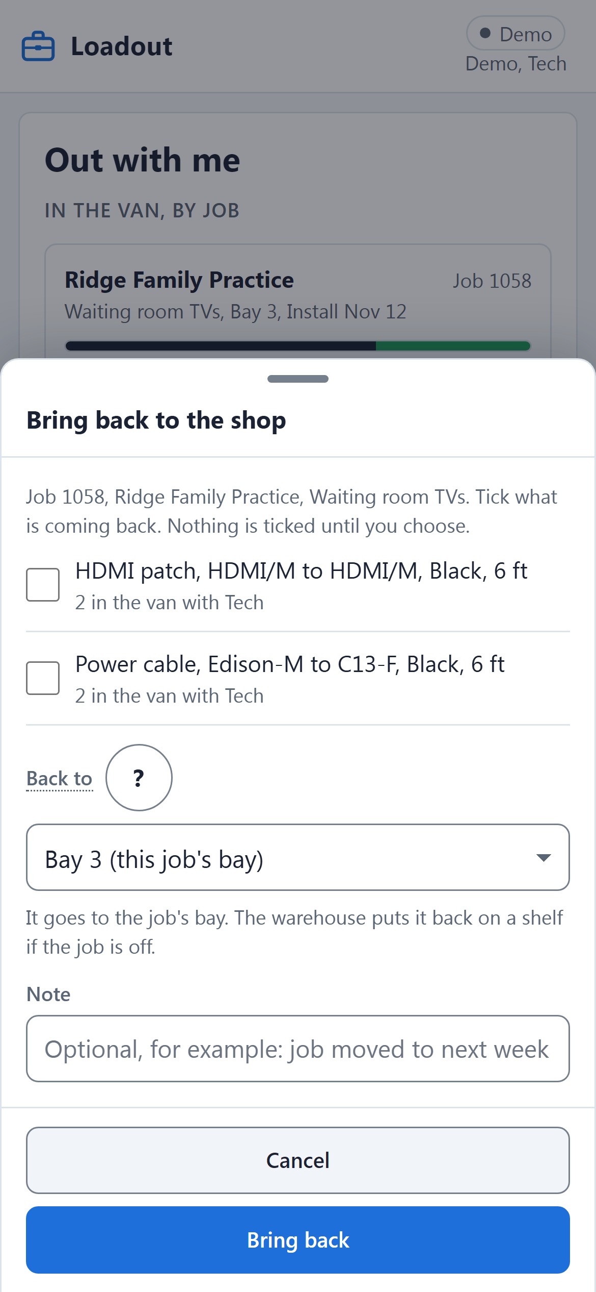
Bring back
You
Tick what is coming back and where it goes.
Loadout
Moves it from your van back to the job's bay.
Watch for
Postponed job? Bring it back, do not keep it.
Notes:
Not every picked-up line gets installed. Jobs get postponed and plans change on site. Bring back takes product off your name and puts it in the job's bay, ready for the next pick-up; the warehouse can return it to a shelf if the job is off. Nothing is ticked until you choose, so you only bring back what you mean to. The mistake is leaving unused product riding around in the van, still in your name, for weeks.

Slide 17
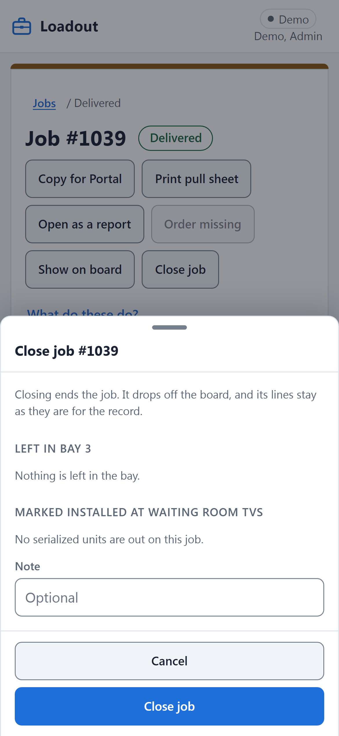
Close the job
You
Close it once everything is delivered.
Loadout
Returns leftovers and marks units installed.
Watch for
It will not close with product in a van.
Notes:
Closing ends the job and takes it off the TV board. Before it closes, Loadout asks what to do with anything still in the bay, and marks the job's serialized units as installed at the client. If any line is still in a van, the job will not close until it is delivered or brought back. The lines stay on record, so the Job report still works afterwards. The mistake is closing early to tidy the list, which hides product that is still out.

Slide 18
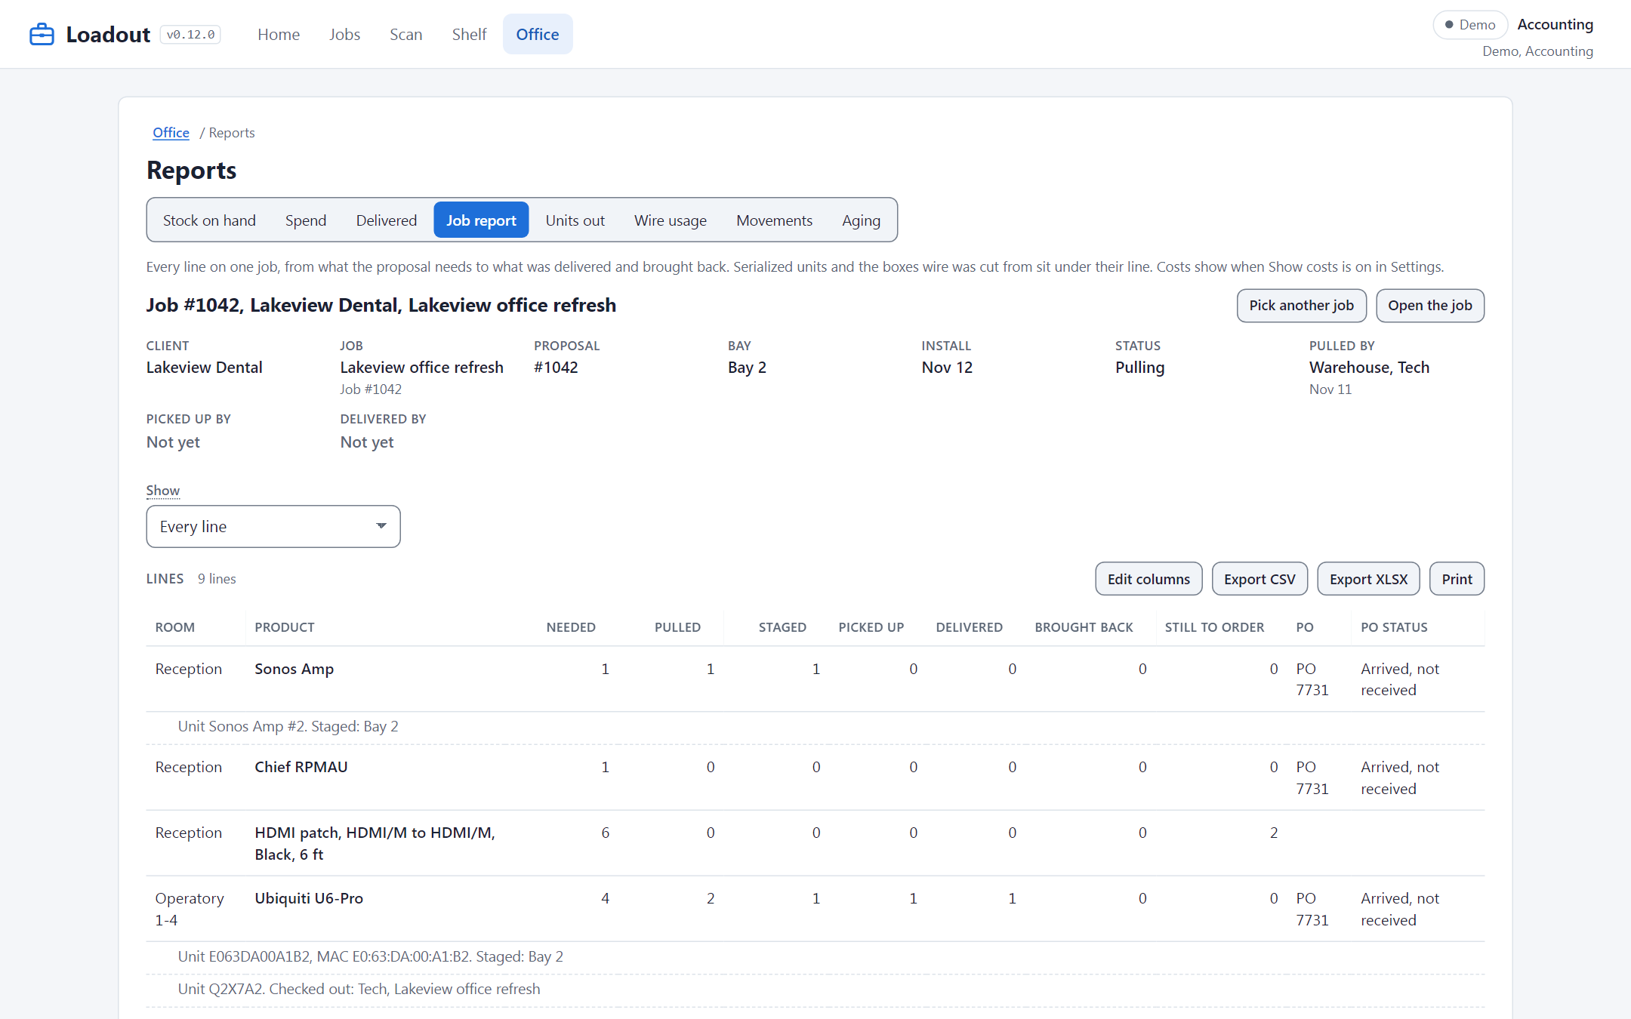
The Job report
You
Pick a job to see every line in one table.
Loadout
Shows needed, pulled, delivered, brought back.
Watch for
Export CSV or XLSX for billing.
Notes:
Accounting and the office can see a whole job on one page under Reports, Job report. Every line shows how many were needed, pulled, picked up, delivered and brought back, and what is still to order. Serialized units sit under their line with the serial or MAC and where each one is now. It exports to CSV or XLSX and prints, so it can go straight into billing. People sometimes bill from the proposal instead; this report shows what really went to the client.

Slide 19
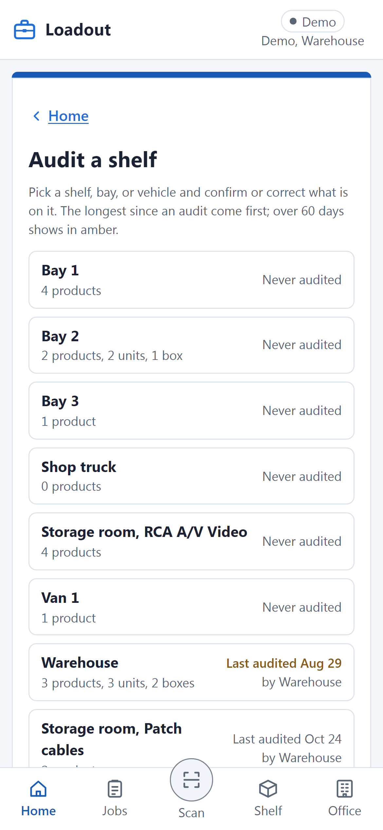
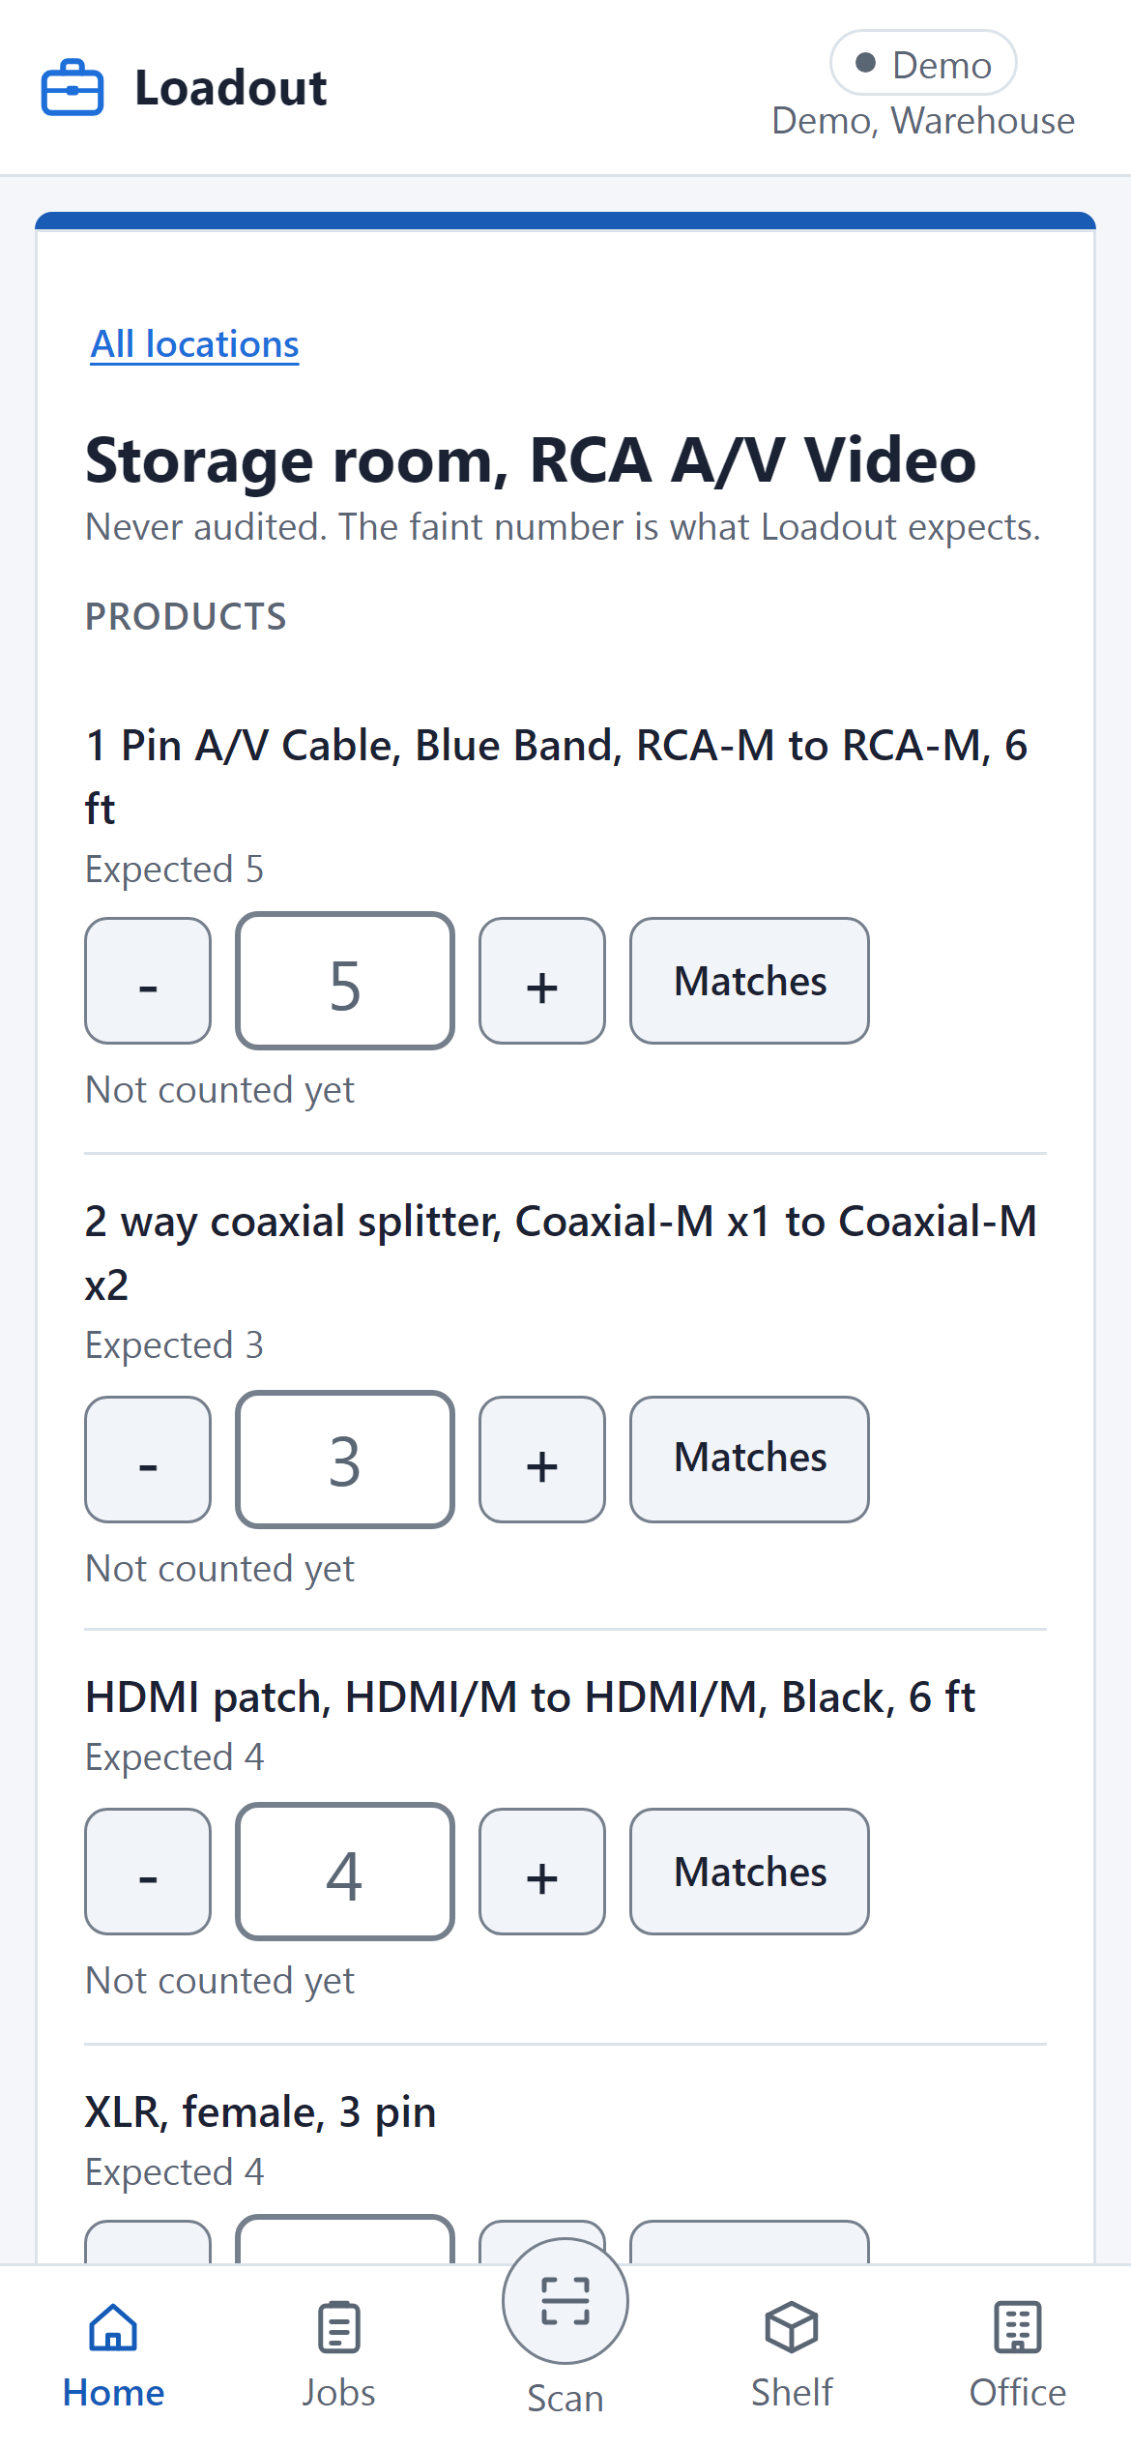
Audit a shelf
You
Pick a shelf and count what is really there.
Loadout
Shows the expected number faint by each product.
Watch for
Count first, then look at the faint number.
Notes:
Auditing keeps every other number honest. The Audit door lists every shelf, bay and vehicle, with the ones not checked longest at the top; anything over 60 days shows in amber. Pick one, count each product, and press Matches or type the real number. Saving writes the corrections and the date, so the next person knows it is fresh. The trap is copying the faint expected number without counting, which makes the audit worthless.

Slide 20
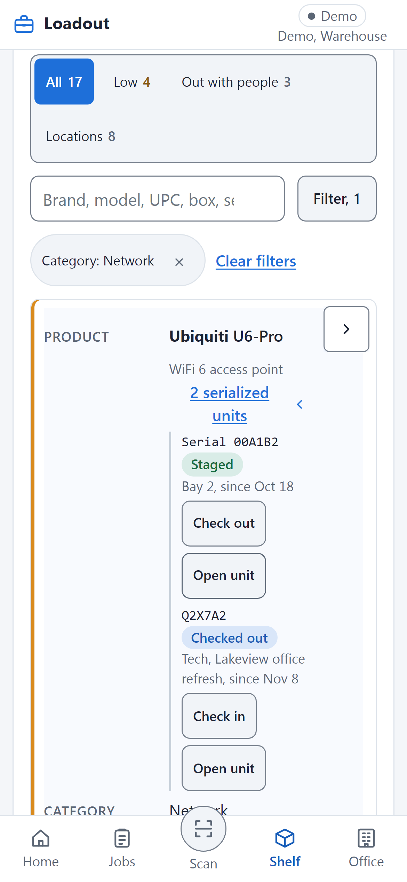
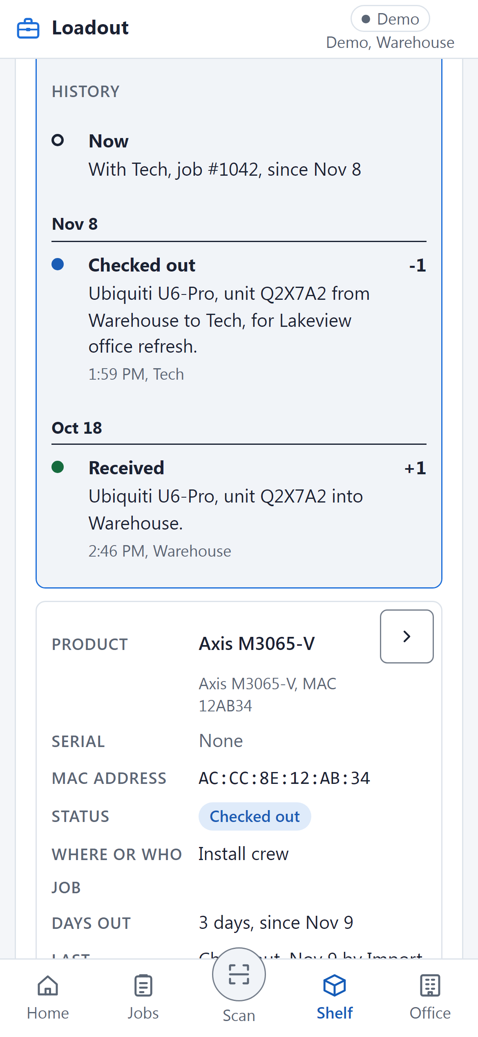
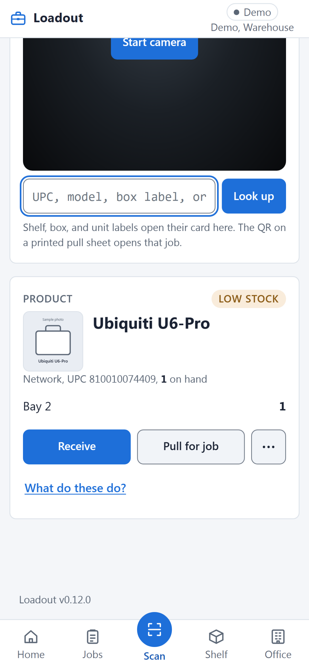
Shelf and Scan: find anything
You
Search or filter Shelf, or scan a label.
Loadout
Shows where each unit is and its history.
Watch for
No camera? Type the code under the label.
Notes:
Shelf is the list of everything the shop owns. Filter by category, brand or location, and open a product to see each serialized unit and who has it. Every unit has a history, newest first, from the day it was received to where it is now. Scan reads UPCs and Loadout labels with the phone camera, and the QR on a printed pull sheet opens that job. When a label is torn or the camera will not focus, type the code printed under it instead of guessing.

Slide 21
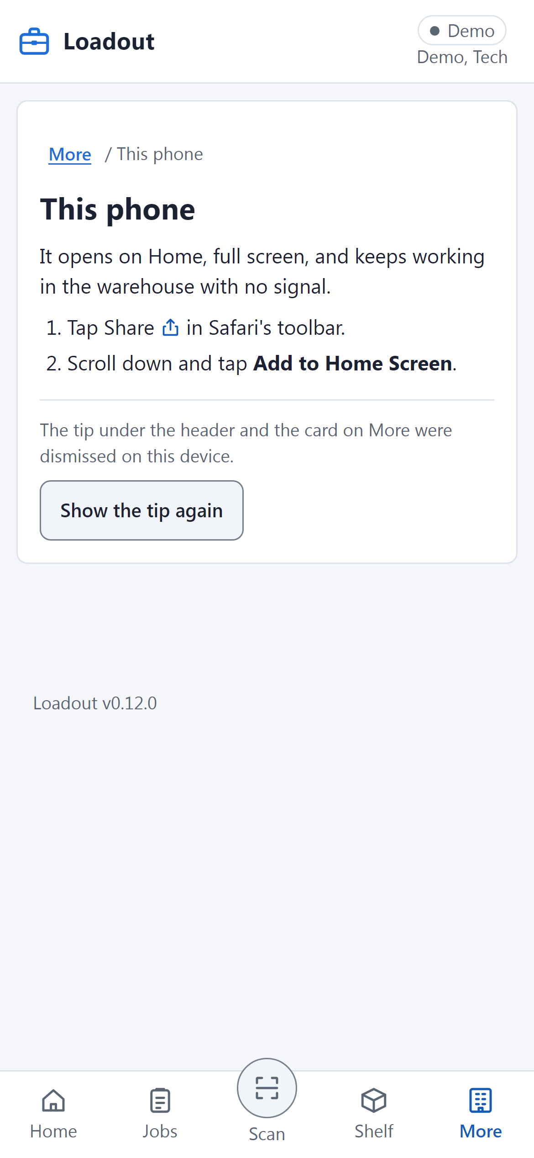
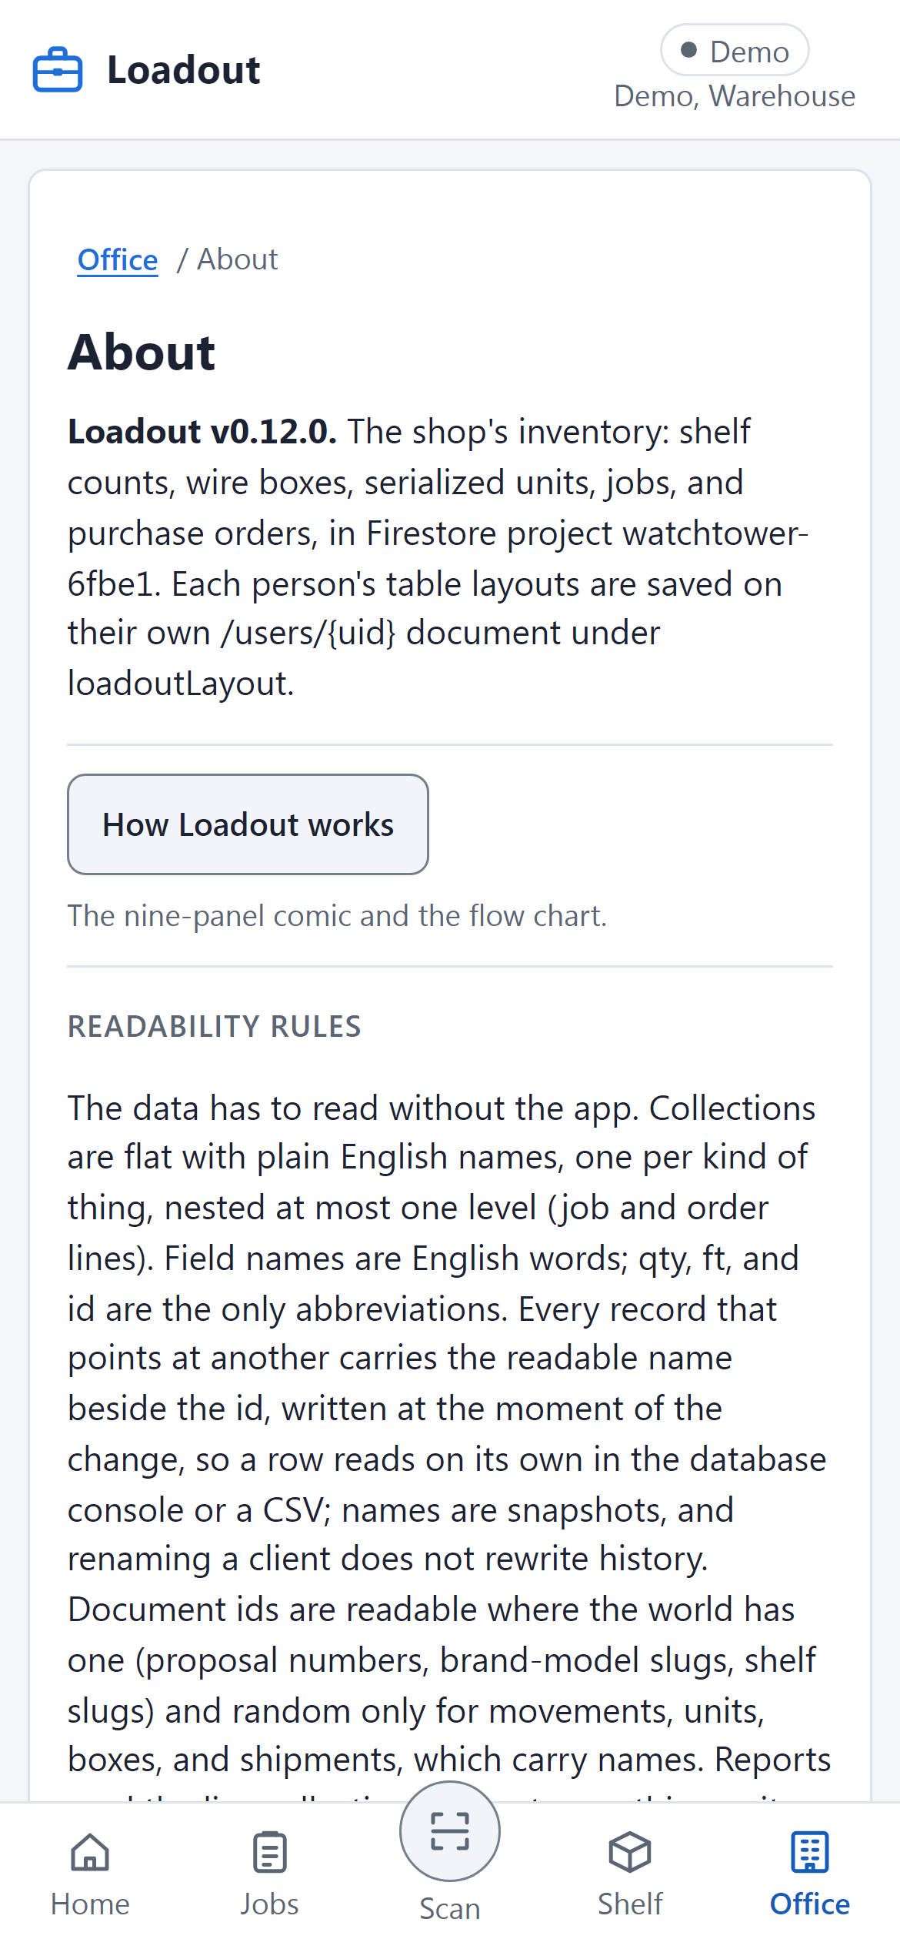
Get it on your phone
You
This phone, under More (or Office): add it.
Loadout
Opens full screen and works with no signal.
Watch for
Help: About, How Loadout works.
Notes:
Loadout works best as an icon on your home screen. Open the last tab, More for techs or Office for everyone else, then This phone, and follow the two steps it shows for your phone. Once it is on the home screen, it opens full screen and keeps working in the warehouse with no signal, catching up when you are back online. The comic and the flow chart are always one tap away under About, How Loadout works. If something looks wrong, ask the office before working around it.

Slide 22
Shelf, Bay, Van, Client
Shelf
Pull
Bay
Pick up
Van
Deliver
Client
Open Loadout
devriz.umbrellaautomation.com/loadout/
The comic again
Office (or More), About, How Loadout works
Notes:
That is the whole app: product moves from the shelf, to a bay, to a van, to the client, and each move is one tap by the person doing it. Open Loadout at the address on the slide and add it to your home screen today. The comic and the flow chart are under Office, or More for techs, then About, How Loadout works. Questions go to the office. The one habit that matters most is tapping at the moment the product moves.

