Slide 1
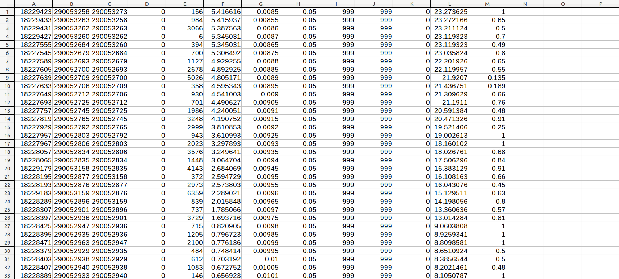
Layout of Connectivity File
FromNode
Divergence
MAF (M³/s)
Manning’s n
Lon
COMID
ToNode
Length (m)
Slope
Lat

Slide 2
Layout of Connectivity File – Trapezoidal Channel Shape
Shapeflag
Sidewall Slope
Bottom Width

Slide 3
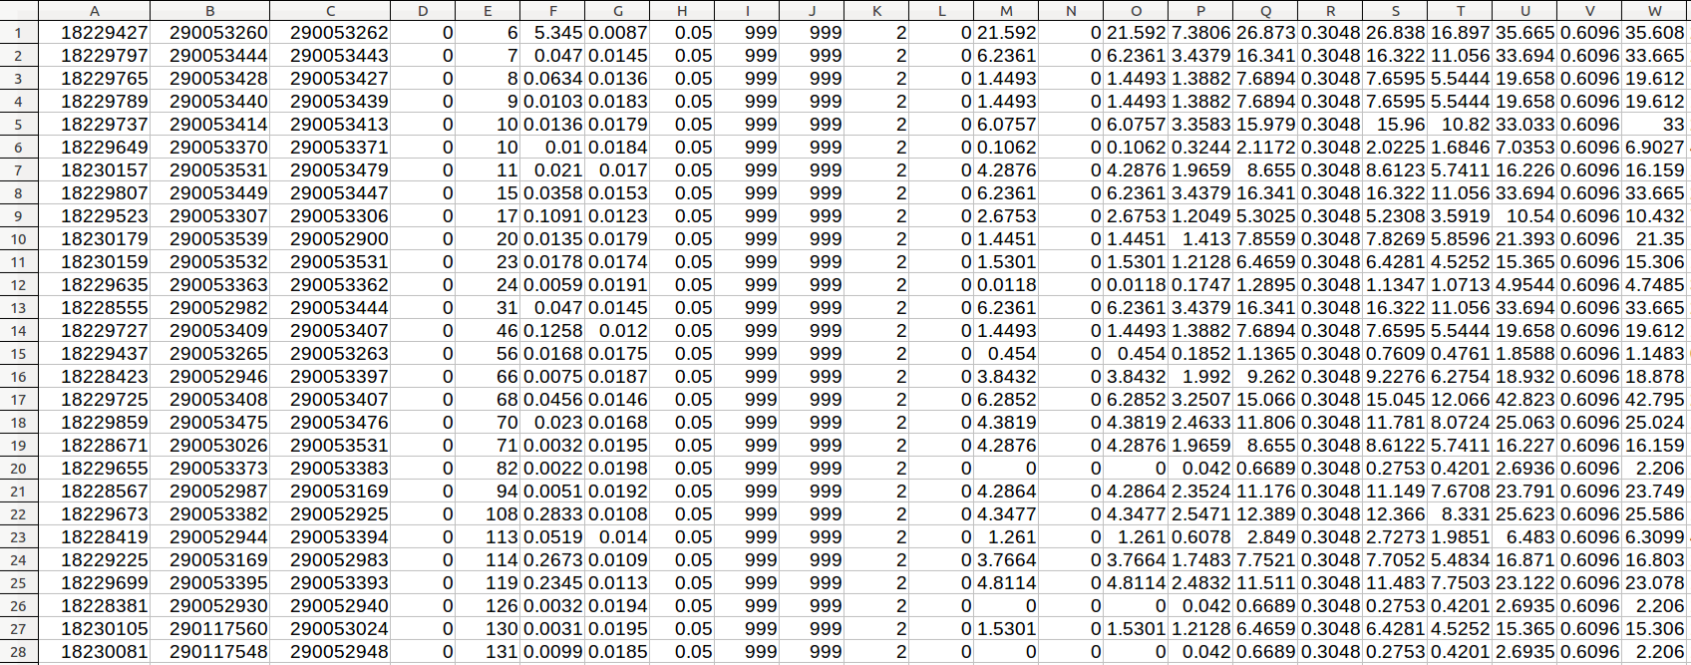
Layout of Connectivity File – Intrinsic Channel Shape
Shapeflag
P₁
W₁
P₂
W₂
A₁
A₂
Y₁
Y₂

Slide 4
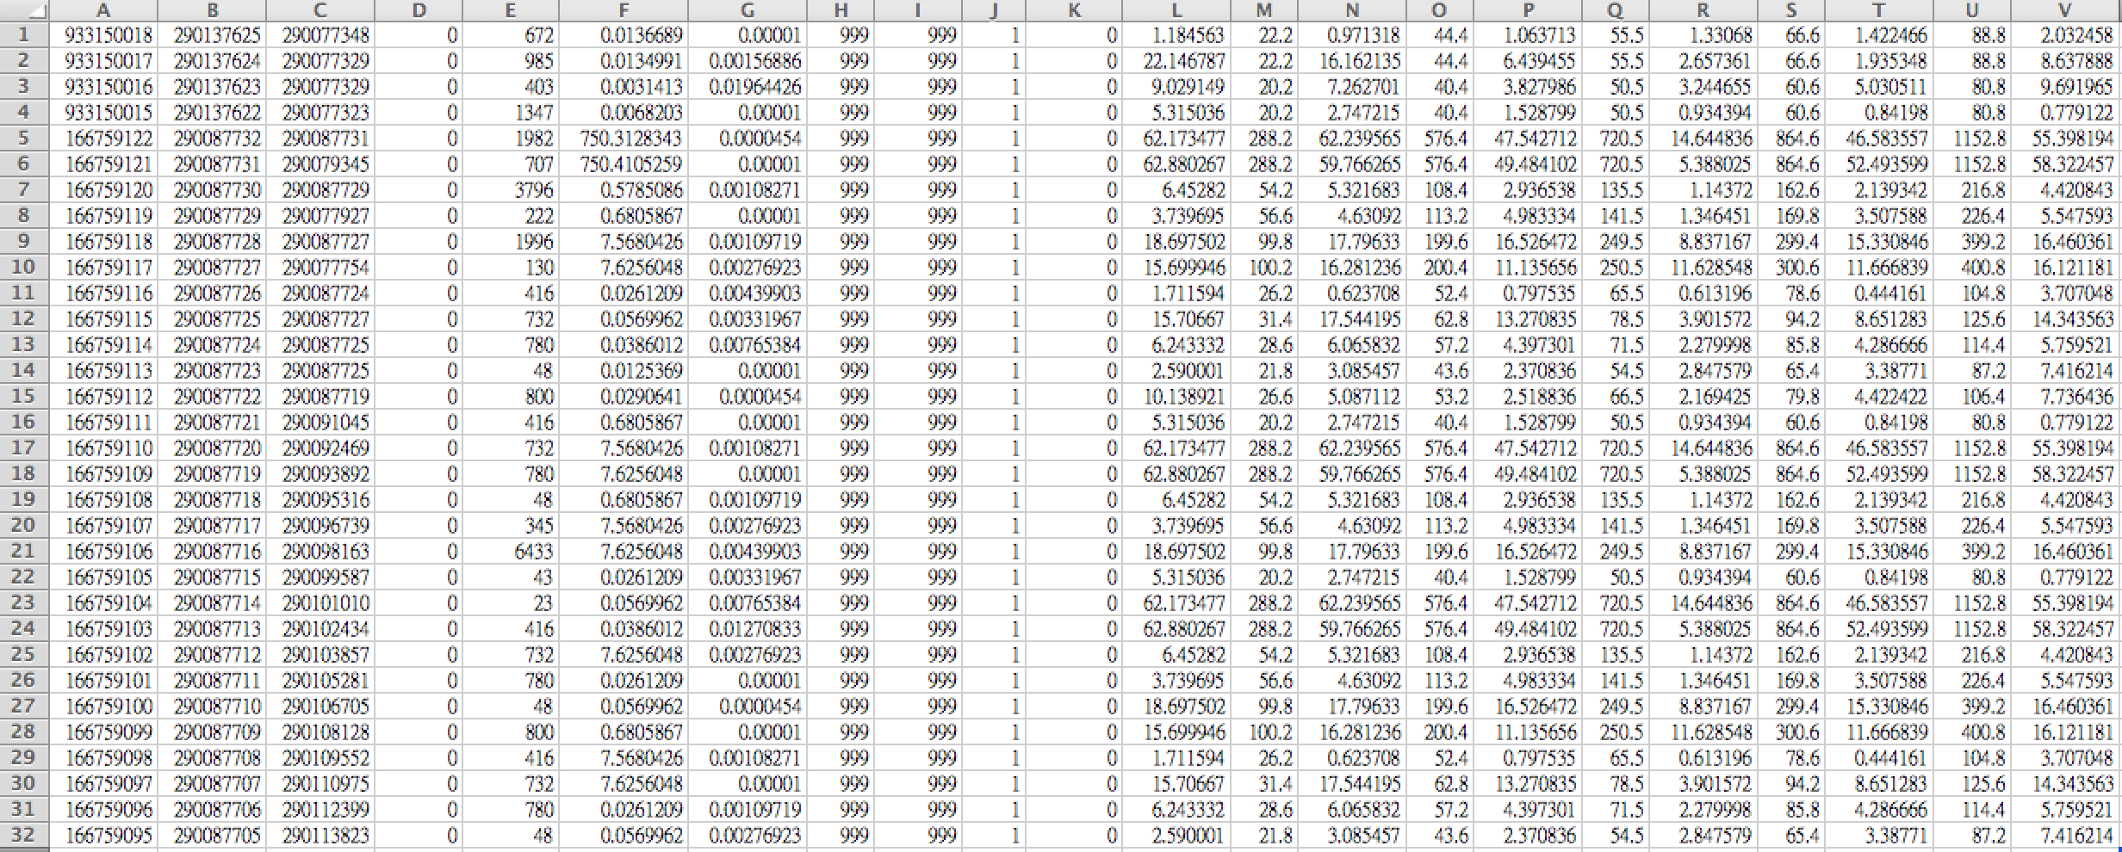
Layout of Connectivity File – XY Coordinate Channel Shape
X₁
X₂
X₃
X₄
ShapeFlag
Y₁
Y₂
Y₃
Y₄

