Slide 1
Architecting Context: An Introduction to Model Context Protocol
Frank Kovacs @statkovacs frank-Kovacs.net
Notes:
Intro context
Definition heavy
Excited to be here
Thank you Jared

Slide 2
Roadmap
Introduction / Definition
MCP Architecture Components
Code Samples
Questions

Slide 3
Goals
Define MCP
MCP Components
How it works
Notes:
Define MCP and its components, lot of misinformation
Components: 3 of them, two are close, one is used commonly
How it works --> agentic vs. not

Slide 4
Caveats
LLM Specific
Released in November 2024
https://frank-kovacs.net/projects/mcp_nycr/
Notes:
Brand new
LLM specific. Frameowkr can be adapted for workflow automations
Will move around as much as I can

Slide 5

About Me
ETL → Data Science → AI / Architecture
Former Senior data engineer at consulting firm
$60M+ in value-add projects
Previous: MS and BS at Carnegie Mellon University
Local: Hoboken, NJ

Slide 6
Framing
“The true power of AI lies not in replacing humans, but in working alongside us to achieve what neither can do alone. ” -Sebastian Thurn
“Surprisingly, we find that when developers use AI tools, they take 19% longer than without—AI makes them slower.” (Becker, Rush, Barnes and Rein, 2025)
Notes:
Two quotes behind me
First is aspirational and grounded --> AI as a tool. Value defined in how we use it
Second is pessimistic and very famous.
Study sponsored by RAND shows that seasoned open-source devs
are slowed down when using AI
Understand this lets examine a typical AI workflow
MCP tool to supercharge it and move towards remediating second point

Slide 7
Example LLM Workflow: Basic
Construct prompt
LLM “Black Box”
Notes:
Make a prompt, submit it via a GUI or API call to an LLM. This covers a lot of bases and can help us for static questions; “Find the line things go wrong”, “Write a poem”
This works. This is sufficient for some use cases.
Little to no control over what happens in step 2
Working with LLMs since their rise to prominence has taught us that we can make them better by engaging in some prompt engineering.

Slide 8
Example LLM Workflow: Basic Drawbacks
Tool Specification
Knowledge cutoff
Notes:
Two drawbacks
Tool specification: How we get answers
Temperature and stock price answer. Typically answer is pretty good
Auditability -- "How you do you know?"
If I give that answer its no better than asking a random person
Knowledge cutoff: Models are trained with only a certain amount of information
Drwabacks are fixable but annoying

Slide 9
Example LLM Workflow: Basic Drawbacks
Tool Specification
Knowledge cutoff
Time-consuming
Dubious security
Labor-intensive: N by M Integration Problem
Notes:
Two drawbacks
Tool specification: How we get answers
Temperature and stock price answer. Typically answer is pretty good
Auditability -- "How you do you know?"
If I give that answer its no better than asking a random person
Knowledge cutoff: Models are trained with only a certain amount of information
Drwabacks are fixable but annoying

Slide 10
Definitions
Model Context Protocol – An extension of the client / server architecture pattern that provides a standardized way for models to interact with functions and static resources.
Notes:
Read definition exactly
Language / Protocol being used to connect LLMs to the outside world
We note that this is a protocol with an accompanying SDK: Protocol – Implements a standard for communication
Aking to ReSTFUL APIs and HTTP, a way of doing things
Stateful
Inspired by Language Server Protocol
SHORTEN SLID

Slide 11
Use cases
Non-public APIs
Proprietary data sources
More reliable information
Faster development
Notes:
Reliable information: Use latitude / longiture geolocate example for small places. When I put my high school into claude it extracted the lat long from Wikipedia.
Faster development: Piecewise and can be version controlled. Easier to extend
Not TECHNICALLY NEEDED but can help

Slide 12
Benefits
Standardized communication
Client / Server benefits
Piecewise across servers
Bespoke: Additional context
Notes:
Benefits: Standardized, helps us out a lot

Slide 13
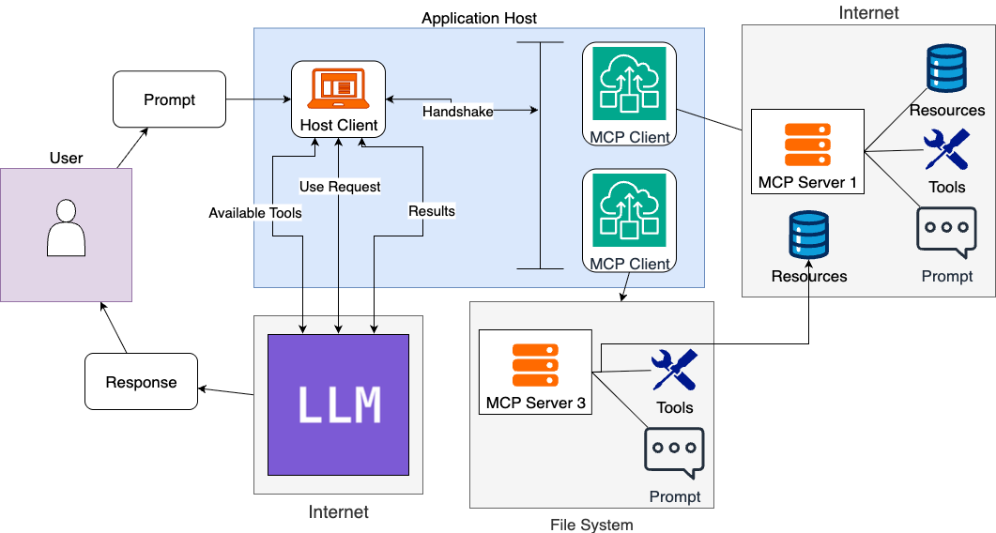
MCP Diagram
Notes:
Observations:
Organization of functionality within MCP server can be a bottleneck on that end. Organize by use case, etc.
Walk through diagram. User puts in a prompt to the host client.
1:1 with client / server
Servers can live anywhere
Application host is critical

Slide 14
MCP Defined
Components
Application Host
Client: Within Host
Server
Layers
Data Layer
Transport Layer
Notes:
Components, layers
components far more important, specifically server

Slide 15
Aside: Client / Server Architecture
Client / Server Architecture – A distributed compute model in which the client(s) request data from a server: ask / answer
Notes:
The client is a software component/module that interacts with the mcp sdk. The host is all the other application code, e.g. a desktop app or browser extension. A host could have one to many mcp clients

Slide 16
MCP Components: Application Host
Application Host – The application that the user interacts with.
Notes:
Example: claude desktop
Sometimes using the term “client” interchangeab;y
Can give us the client for free
Controls the agentic / workflow balance
This is critical as it allows us to determine what is what
Example: Input tool calls from application host side
Controls user input
Sometimes termed “client” interchangeably
Balance is not needed. This portion is typically handled for free
LLM usage must be handled here

Slide 17
MCP Diagram
Notes:
Zoom in on the application host. Two components,
Host client – whatever the MCP client is NOT

Slide 18
MCP Components: MCP Client
MCP Client – Piece of code within application host that negotiates communication with a server
1:1 relationship with server
Spawned within application host
Notes:
Stateful
1:1 relationsjip with server
Establishes connection, handles handshakes
Usually get this for free

Slide 19
MCP Diagram
Notes:
In this case we see the

Slide 20
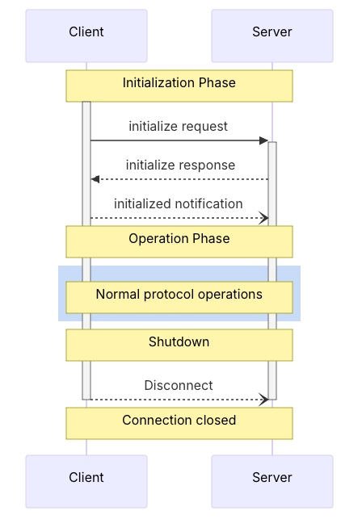
MCP Components: Client Lifecycle
Initialization
Negotiate capabilities
Initiated by client as standalone
Operation
Shutdown
Initiated by client
Notes:
Of note here is that we need to negotiate the capabilities before any use
Shutdown needs to happen to terminate the communication

Slide 21
MCP Components: Client Functionality
Sampling – Servers requesting completions from clients
Roots – Specify files
Elicitation – Request specific information from end user during execution
Notes:
Fairly new even within MCP
Not of super concern due to the fact that te client is typically spawned from the application host
Listing them here for reference

Slide 22
Client code sample
Notes:
Show Anthropic code and highlight MCP client construction + all else
Class MCP client is the client, everything else is the host

Slide 23
MCP Components: MCP Server
MCP Server – Expose the AI model to outside functionality
Authentication sometimes needed
Notes:
This is what people think of when they say MCP, this is where the magic happens
Locally or remote
Authentication handled by server
This is where the magic happens. We can connect to many things are have it used by the ai application
1+ per application host
1 per client

Slide 24
MCP Server Functionality
Tools – Functions that can be called by the LLM
Prompts – Templates called by the user stored on server
Resources – Read-only data sources for additional context. Controlled by application
Notes:
Things that can be included in an MCP server
Tools: Interact with specific software pacakges and APIs. If it can be construed in a python function it is fair game
Well-defined function
Limitations? No sir
Prompts: Automatic prompts exposed for ease of use. Can be parameterized. Extension of traditional prompt engineering techniques
Resource: Can interact with RAG. Static or dynamic. Read directly. Can extract information via API with a tool or read from a passive data via resource
Not all at once

Slide 25
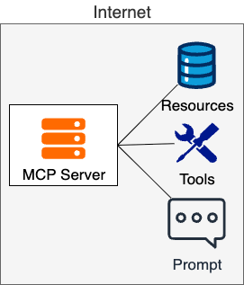
MCP Server Architecture
Separation of concerns
Single responsibility

Slide 26
Aside: RAG vs. MCP
Enhancement vs. Protocol
Neighbors in different industries

Slide 27
MCP Layers: Data Layer
Data Layer Protocol – Message structure and semantics between client and server
Notes:
Method definitions
Client features
Server features
For server

Slide 28
MCP Data Layer Reference
Tools
List
List
Prompts
Call
Resources
Read
Subscribe
List
Get
List / Template
Notes:
Included this here for after the fact. All have list methods, others are specific
Resources
List
Templates / list
Read
Subscribe
Prompts
List
Get

Slide 29
MCP Layers: Transport Layer
Transport Layer – Connection establishment and security, “the how”
Stdio transport: Local
Http: POST with standard authorization
Notes:
Transport layer is the how
Stdio is for local development. A number of these can run locally and do not need sophisticated authentication
Streamable http is standard for remote servers
Authorization handled within host application within client implementation -→ not handled by user or exposed

Slide 30
MCP Diagram
Notes:
In this case we see the

Slide 31
Code Demo

Slide 32
MCP Execution Steps
1. User request to application host
2. Client initiates server connection
3A. Model receives tool list
Model uses tool
Model does not use tools
4. Returns answer
4. Model returns structured call
3B. Model receives resource list
Model does not use resources
Model returns answer
Model does use resources
4. Request to client

Slide 33
Step 4 Zoom-In: Tools & Resources
Tools / Resources defined as follows:
Name: Primary key for execution
Title: Human-readable
Description: Primarily used to determine usefulness
(Tools only): Input and output specification

Slide 34
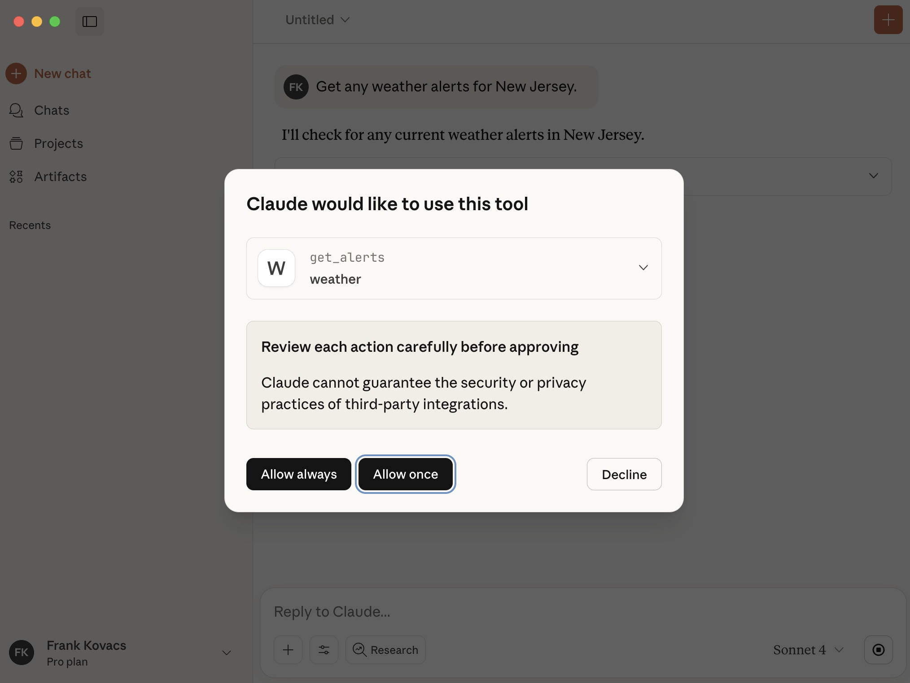
Step 4 Example

Slide 35
Aside: Agent vs. Workflow
Workflow - Deterministic, pre-defined
Agent – Non-deterministic, LLM as a black box
Notes:
In our example the ultimate decision to use tools falls on the LLM.

Slide 36
Demo
Notes:
GitHub Repo

Slide 37
Recap
MCP is a protocol that enables LLMs to access tools, resources and prompts
Agentic vs. workflow constructions
Standardization
Implementation: Server first
Client within application host

Slide 38
FAQ
RAG vs. MCP: Two different ballgames
Necessary? No. Helpful? Yes
First move advantage
Notes:
LangChain vs. MCP: Application-side vs. Server-side

Slide 39
Questions

Slide 40
Thank you!

Slide 41
Other Definitions
Anthropic: “USB-C for AI”
AWS: “Universal language for AI systems to communicate with external data sources”
Google: “Language for LLMs to communicate with external data…”

Slide 42
Zoom in
Notes:
Downside is that crafting the prompt to provide the CONTEXT takes a long time and requires a lot of work on the end user.
Takes a lot of time, lot of effort but gives us good results.
We can also give the LLM access to resources not included in the prompt. For example we can directly integrate it with access to sources such as google drive. That takes time and often has some lift on the LLM side. We need to manually register the LLM
Functions need to be registered with an LLM
What if we were to shift these to the other side of the diagram? What if we were able to standardize how we can give this context to the model automagically?
This is where model context protocol comes in

Slide 43
Aside: Client / Server
Client – Sends requests, “Ask”
Server – Sends answers, “Answer”
Benefits:
Centralization
Scalability
Protection: One thing
De-coupled
Notes:
As an aside, we will be using the terms client and server

Slide 44
Workflow automation
Notes:
Aka agentic AI
Workflow automation is calling specific tools with little code
Difference is in pattern
MCP is how they interact, Automation is agentic
MCP emphasizes LLM integration

