Slide 1
Architecting Context: An Introduction to Model Context Protocol
Frank Kovacs @statkovacs frank-Kovacs.net

Slide 2
Roadmap
Introduction / Definition
MCP Architecture Components
Code Samples
Questions

Slide 3
Caveats
LLM Specific
Released in November 2024

Slide 4

About Me
ETL → Data Science → AI / Architecture
Former Senior data engineer at consulting firm
$60M+ in value-add projects
Previous: MS and BS at Carnegie Mellon University
Local: Hoboken, NJ

Slide 5
Framing
“The true power of AI lies not in replacing humans, but in working alongside us to achieve what neither can do alone. ” -Sebastian Thurn
“Surprisingly, we find that when developers use AI tools, they take 19% longer than without—AI makes them slower.” (Becker, Rush, Barnes and Rein, 2025)
Notes:
AI is a companion and a tool
RAND METR paper

Slide 6
Example LLM Workflow: Basic
Construct prompt
LLM “Black Box”
Notes:
Make a prompt, submit it via a GUI or API call to an LLM. This covers a lot of bases and can help us for static questions; “Find the line things go wrong”, “Write a poem”
This works. This is sufficient for some use cases.
Little to no control over what happens in step 2
Working with LLMs since their rise to prominence has taught us that we can make them better by engaging in some prompt engineering.

Slide 7
Example LLM Workflow: Basic Drawbacks
Tool Specification
Knowledge cutoff
Time-consuming
Dubious security
Labor-intensive: N by M Integration Problem
Notes:
Make a prompt, submit it via a GUI or API call to an LLM. This covers a lot of bases and can help us for static questions; “Find the line things go wrong”, “Write a poem”
This works. This is sufficient for some use cases.
Little to no control over what happens in step 2
Two problems: Tool specification
Knowledge cutoff
These solutions are not ideal and partially defeat he

Slide 8
Definitions
Model Context Protocol – An extension of the client / server architecture pattern that provides a standardized way for models to interact with functions and static resources.
Protocol – Implements a standard for communication
Inspired by Language Server Protocol
Stateful

Slide 9
Use cases
Non-public APIs
Proprietary data sources
More reliable information
Faster development
Notes:
Reliable information: Use latitude / longiture geolocate example for small places. When I put my high school into claude it extracted the lat long from Wikipedia.

Slide 10
Benefits
Standardized communication
Client / Server benefits
Piecewise across servers
Bespoke: Additional context

Slide 11
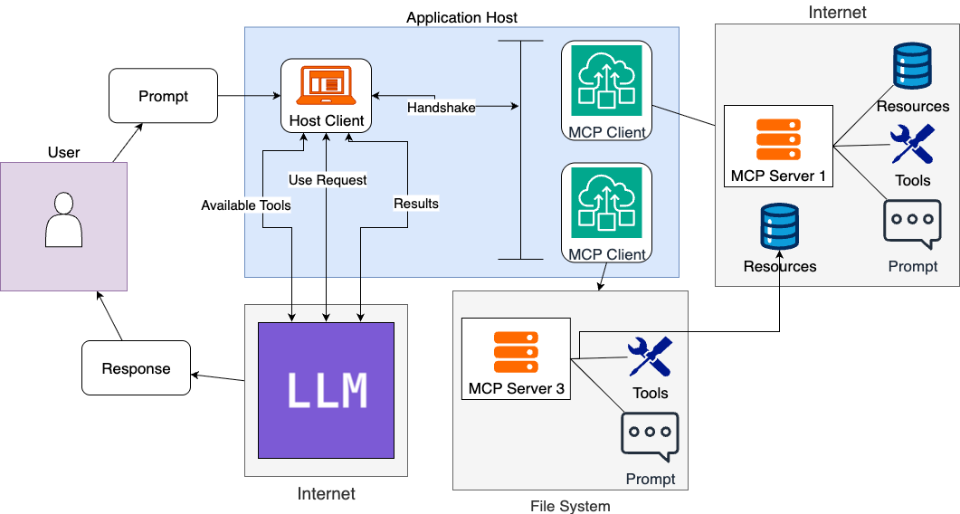
MCP Diagram
Notes:
Observations:
Organization of functionality within MCP server can be a bottleneck on that end. Organize by use case, etc.

Slide 12
MCP Defined
Components
Application Host
Client: Within Host
Server
Layers
Data Layer
Transport Layer

Slide 13
Aside: Client / Server Architecture
Client / Server Architecture – A distributed compute model in which the client(s) request data from a server: ask / answer
Notes:
The client is a software component/module that interacts with the mcp sdk. The host is all the other application code, e.g. a desktop app or browser extension. A host could have one to many mcp clients

Slide 14
MCP Components: Application Host
Application Host – The application that the user interacts with.
Controls user input
Examples: Claude desktop
Sometimes termed “client” interchangeably

Slide 15
MCP Components: MCP Client
MCP Client – Piece of code within application host that negotiates communication with a server
1:1 relationship with client
Spawned within application host
Stateful needed for context

Slide 16
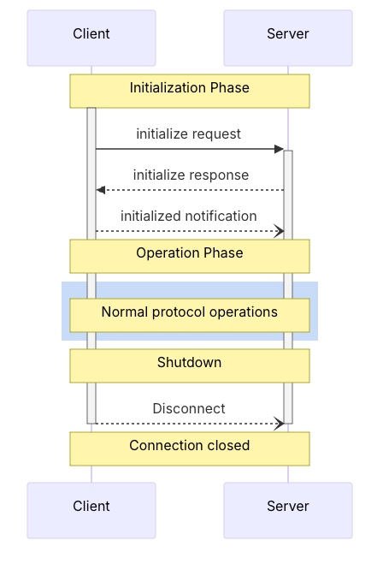
MCP Components: Client Lifecycle
Initialization
Negotiate capabilities
Initiated by client as standalone
Operation
Shutdown
Initiated by client

Slide 17
MCP Components: Client Functionality
Sampling – Servers requesting completions from clients
Roots – Specify files
Elicitation – Request specific information from end user during execution

Slide 18
Client code sample
Notes:
Show Anthropic code and highlight MCP client construction + all else
Class MCP client is the client, everything else is the host

Slide 19
MCP Components: MCP Server
MCP Server – Expose the AI model to outside functionality
Authentication sometimes needed
Notes:
This is what people think of when they say MCP, this is where the magic happens
Locally or remote
Authentication handled by server
This is where the magic happens. We can connect to many things are have it used by the ai application
1+ per application host
1 per client

Slide 20
MCP Server Functionality
Tools – Functions that can be called by the LLM
Prompts – Templates called by the user stored on server
Resources – Read-only data sources for additional context. Controlled by application
Notes:
Things that can be included in an MCP server
Tools: Interact with specific software pacakges and APIs. If it can be construed in a python function it is fair game
Well-defined function
Limitations? No sir
Prompts: Automatic prompts exposed for ease of use. Can be parameterized. Extension of traditional prompt engineering techniques
Resource: Can interact with RAG. Static or dynamic. Read directly. Can extract information via API with a tool or read from a passive data via resource

Slide 21
Aside: RAG vs. MCP
Enhancement vs. Protocol
Neighbors in different industries

Slide 22
MCP Layers: Data Layer
Data Layer Protocol – Message structure and semantics between client and server
Server: list / call
Client:
Notes:
Method definitions
Client features
Server features
For server

Slide 23
MCP Data Layer Reference
Tools
List
List
Prompts
Call
Resources
Read
Subscribe
List
Get
List / Template
Notes:
Included this here for after the fact. All have list methods, others are specific
Resources
List
Templates / list
Read
Subscribe
Prompts
List
Get

Slide 24
MCP Layers: Transport Layer
Transport Layer – Connection establishment and security, “the how”
Stdio transport: Local
Http: POST with standard authorization
Notes:
Transport layer is the how
Stdio is for local development. A number of these can run locally and do not need sophisticated authentication
Streamable http is standard for remote servers
Authorization handled within host application within client implementation -→ not handled by user or exposed

Slide 25
Code Demo

Slide 26
MCP Execution Steps
1. User request to application host
2. Client initiates server connection
3A. Model receives tool list
Model uses tool
Model does not use tools
4. Returns answer
4. Model returns structured call
3B. Model receives resource list
Model does not use resources
Model returns answer
Model does use resources
4. Request to client

Slide 27
Step 4 Zoom-In: Tools & Resources
Tools / Resources defined as follows:
Name: Primary key for execution
Title: Human-readable
Description: Primarily used to determine usefulness
(Tools only): Input and output specificaiton

Slide 28
Aside: Agent vs. Workflow
Workflow - Deterministic, pre-defined
Agent – Non-deterministic, LLM as a black box
Notes:
In our example the ultimate decision to use tools falls on the LLM.

Slide 29
Demo
Notes:
GitHub Repo

Slide 30
Recap
MCP is a protocol that enables LLMs to access tools, resources and prompts
Agentic vs. workflow constructions
Standardization
Implementation: Server first
Client within application host

Slide 31
FAQ
RAG vs. MCP: Location of “injection”
Necessary? No. Helpful? Yes
First move advantage
LangChain vs. MCP: Application-side vs. Server-side

Slide 32
Questions

Slide 33
Thank you!

Slide 34
Other Definitions
Anthropic: “USB-C for AI”
AWS: “Universal language for AI systems to communicate with external data sources”
Google: “Language for LLMs to communicate with external data…”

Slide 35
Zoom in
Notes:
Downside is that crafting the prompt to provide the CONTEXT takes a long time and requires a lot of work on the end user.
Takes a lot of time, lot of effort but gives us good results.
We can also give the LLM access to resources not included in the prompt. For example we can directly integrate it with access to sources such as google drive. That takes time and often has some lift on the LLM side. We need to manually register the LLM
Functions need to be registered with an LLM
What if we were to shift these to the other side of the diagram? What if we were able to standardize how we can give this context to the model automagically?
This is where model context protocol comes in

Slide 36
Aside: Client / Server
Client – Sends requests, “Ask”
Server – Sends answers, “Answer”
Benefits:
Centralization
Scalability
Protection: One thing
De-coupled
Notes:
As an aside, we will be using the terms client and server

Slide 37
Workflow automation
Notes:
Aka agentic AI
Workflow automation is calling specific tools with little code
Difference is in pattern
MCP is how they interact, Automation is agentic
MCP emphasizes LLM integration

