Slide 1
进程调度
进程三巨头
进程调度
进程优先级

Slide 2
idle进程
struct task_struct init_task = {
.state = 0,
.stack = init_stack,
.usage = REFCOUNT_INIT(2),
.flags = PF_KTHREAD,
.prio = MAX_PRIO - 20,
.static_prio = MAX_PRIO - 20,
.normal_prio = MAX_PRIO - 20,
.mm = NULL,
.active_mm = &init_mm,
.tasks = LIST_HEAD_INIT(init_task.tasks),
.real_parent = &init_task,
.parent = &init_task,
.children = LIST_HEAD_INIT(init_task.children),
.sibling = LIST_HEAD_INIT(init_task.sibling),
.group_leader = &init_task,
.fs = &init_fs,
.files = &init_files,
…
};
hard code
init_task idle进程

Slide 3
init进程
kernel_init
static int __ref kernel_init(void *unused)
{
int ret;
kernel_init_freeable();
if (!try_to_run_init_process("/sbin/init") ||
!try_to_run_init_process("/etc/init") ||
!try_to_run_init_process("/bin/init") ||
!try_to_run_init_process("/bin/sh"))
return 0;
panic("No working init found. Try passing init= option to kernel. "
"See Linux Documentation/admin-guide/init.rst for guidance.");
}

Slide 4
do_initcalls
kernel_init_freeable→do_basic_setup→do_initcalls
module_init ➔ device_initcall
#define pure_initcall(fn) __define_initcall(fn, 0)
#define core_initcall(fn) __define_initcall(fn, 1)
#define core_initcall_sync(fn) __define_initcall(fn, 1s)
#define postcore_initcall(fn) __define_initcall(fn, 2)
#define postcore_initcall_sync(fn) __define_initcall(fn, 2s)
#define arch_initcall(fn) __define_initcall(fn, 3)
#define arch_initcall_sync(fn) __define_initcall(fn, 3s)
#define subsys_initcall(fn) __define_initcall(fn, 4)
#define subsys_initcall_sync(fn) __define_initcall(fn, 4s)
#define fs_initcall(fn) __define_initcall(fn, 5)
#define fs_initcall_sync(fn) __define_initcall(fn, 5s)
#define rootfs_initcall(fn) __define_initcall(fn, rootfs)
#define device_initcall(fn) __define_initcall(fn, 6)
#define device_initcall_sync(fn) __define_initcall(fn, 6s)
#define late_initcall(fn) __define_initcall(fn, 7)
#define late_initcall_sync(fn) __define_initcall(fn, 7s)

Slide 5
kthreadd内核线程
for (;;) {
set_current_state(TASK_INTERRUPTIBLE);
if (list_empty(&kthread_create_list))
schedule();
__set_current_state(TASK_RUNNING);
spin_lock(&kthread_create_lock);
while (!list_empty(&kthread_create_list)) {
struct kthread_create_info *create;
create = list_entry(kthread_create_list.next,
struct kthread_create_info, list);
list_del_init(&create->list);
spin_unlock(&kthread_create_lock);
create_kthread(create);
}
}

Slide 6
进程调度
进程三巨头
进程调度
进程优先级

Slide 7
rq
runqueues[cpu]
字段 | 类型 | 描述
nr_running | unsigned int | TASK_RUNNING状态的进程数
cfs | cfs_rq | 完全公平调度rq
rt | rt_rq | 实时调度rq
curr | task_struct * | 当前执行的进程
idle | task_struct * | idle进程
stop | task_struct * | stop进程
clock | u64 | CPU累计运行的时间，单位为纳秒
clock_task | u64 | 进程累计占用CPU的时间
cpu | int | 对应的CPU

Slide 8
cfs_rq
Completely Fair Scheduler
task_struct.se
字段 | 类型 | 描述
nr_running | unsigned int | TASK_RUNNING状态的进程数
min_vruntime | u64
tasks_timeline. rb_root | rb_root | sched_entity对象组成的红黑树的根
tasks_timeline. rb_leftmost | rb_node * | 红黑树最左边的叶子
curr next | sched_entity * | 当前/下一个sched_entity

Slide 9
sched_entity
se
字段 | 类型 | 描述
load | load_weight
run_node | rb_node | 将它链接到cfs_rq的红黑树中
on_rq | unsigned int | 是否在rq上
exec_start | u64 | 上次更新时的时间，实际时间
sum_exec_runtime | u64 | 总共执行的时间，实际时间
vruntime | u64 | virtual runtime，虚拟时间
prev_sum_exec_runtime | u64 | 被调度执行时的总执行时间，实际时间

Slide 10
vruntime转换
weight
const int sched_prio_to_weight[40] = {
/* -20 */ 88761, 71755, 56483, 46273, 36291,
/* -15 */ 29154, 23254, 18705, 14949, 11916,
/* -10 */ 9548, 7620, 6100, 4904, 3906,
/* -5 */ 3121, 2501, 1991, 1586, 1277,
/* 0 */ 1024, 820, 655, 526, 423,
/* 5 */ 335, 272, 215, 172, 137,
/* 10 */ 110, 87, 70, 56, 45,
/* 15 */ 36, 29, 23, 18, 15,
};
delta *= NICE_0_LOAD/(se->load.weight)

Slide 11
task_tick_fair
check_preempt_tick(struct cfs_rq *cfs_rq, struct sched_entity *curr)
{
ideal_runtime = sched_slice(cfs_rq, curr);
delta_exec = curr->sum_exec_runtime - curr->prev_sum_exec_runtime;
if (delta_exec > ideal_runtime) {
resched_curr(rq_of(cfs_rq));
return;
}
se = __pick_first_entity(cfs_rq);
delta = curr->vruntime - se->vruntime;
if (delta < 0)
return;
if (delta > ideal_runtime)
resched_curr(rq_of(cfs_rq));
}
时钟中断

Slide 12
rt_rq
Real Time
t_s->rt
0-99
字段 | 类型 | 描述
active | rt_prio_array | priority array
highest_prio.curr | int | rt进程的最高优先级
highest_prio.next | int | rt进程的次高优先级
rt_throttled | int | rt进程被禁止
rt_time | u64 | 实时进程累计执行时间
rt_runtime | u64 | 实时进程最大执行时间
struct rt_prio_array {
DECLARE_BITMAP(bitmap, MAX_RT_PRIO+1);
struct list_head queue[MAX_RT_PRIO];
};

Slide 13
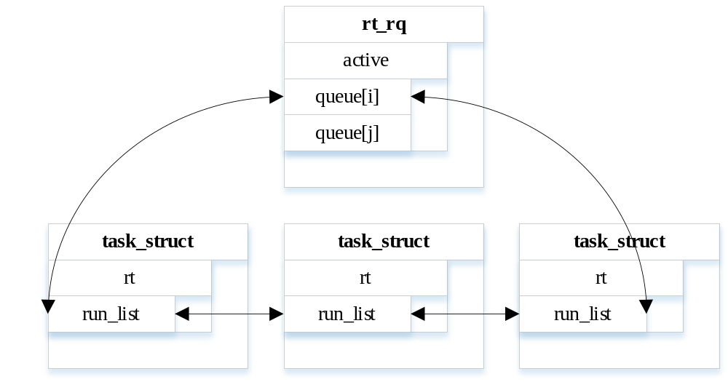
sched_rt_entity

Slide 14
task_tick_rt
时钟中断
SCHED_RR SCHED_FIFO
sched_rr_timeslice, 100 * HZ / 1000, 100ms
task_tick_rt(struct rq *rq, struct task_struct *p, int queued)
{
update_curr_rt(rq);
if (p->policy != SCHED_RR)
return;
if (--p->rt.time_slice)
return;
p->rt.time_slice = sched_rr_timeslice;
for_each_sched_rt_entity(rt_se) {
if (rt_se->run_list.prev != rt_se->run_list.next) {
requeue_task_rt(rq, p, 0);
resched_curr(rq);
return;
}
}
}

Slide 15
进程调度
进程三巨头
进程调度
进程优先级

Slide 16
进程优先级
实时进程
普通进程
最后期限
p->rt_priority的可选范围为[0, 99]
p->normal_prio = 99 - p->rt_priority;
p->prio = rt_mutex_getprio(p); // rt_prio_array的queue数组的下标
不关心static_prio的值
p->rt_priority等于0
p->static_prio = MAX_RT_PRIO + 20 + nice;
p->normal_prio = p->static_prio;
p->prio = rt_mutex_getprio(p);
p->prio小于0

Slide 17
Thanks

