Slide 1
PRODUCT ENGINEERING + BUYER-FACING SYSTEMS
Complex work, made easy to trust
A compact portfolio showing how technical evidence becomes clear decisions, reliable releases and professional client materials.
YEH I.
Full-Stack Product Engineer
YEH I. | B2B PORTFOLIO SAMPLE
01

Slide 2
POSITIONING
Buyers do not purchase a skill list. They purchase a controlled result.
01
02
03
Clarify
Verify
Deliver
Turn a broad brief into one bounded outcome, two required inputs and an acceptance condition.
Use inspectable evidence: screenshots, executable workflows, editable files and explicit pass/fail criteria.
Keep the handoff usable: concise findings, ranked actions and source files the buyer can maintain.
YEH I. | B2B PORTFOLIO SAMPLE
02

Slide 3
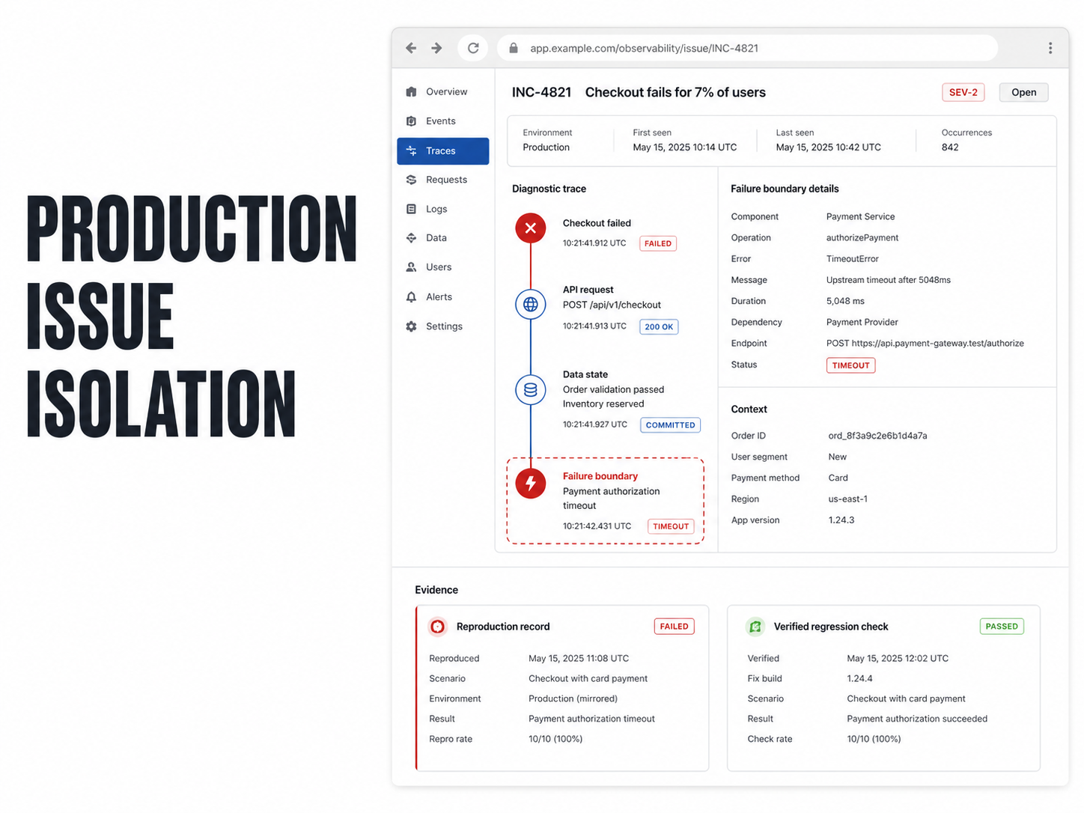
SELECTED WORK 01
A production symptom becomes a reproducible decision path
Issue isolation proof: observed failure, smallest reproduction, verified cause and bounded repair recommendation.
THE BUYER PROBLEM
A visible failure is expensive when nobody can state the exact trigger, evidence or repair boundary.
DELIVERABLE
Reproduction steps
Evidence register
Cause classification
Smallest safe repair scope
YEH I. | B2B PORTFOLIO SAMPLE
03

Slide 4
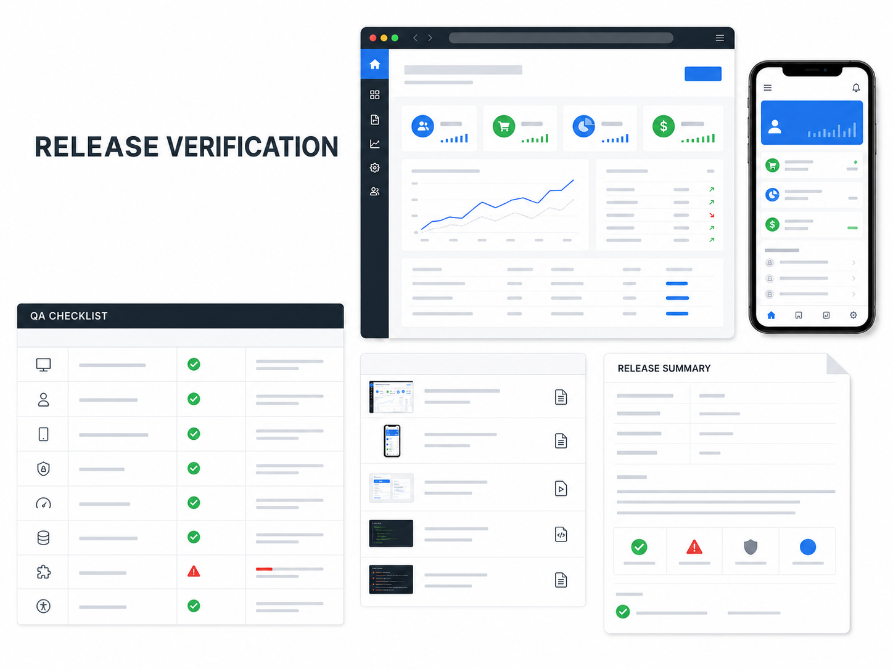
SELECTED WORK 02
Release confidence is a written, repeatable workflow
A paid iOS QA engagement completed with a 5.0 outcome and evidence-based release reporting.
One workflow covers the critical path from install to decision.
The buyer receives a concise pass/fail matrix, reproducible defects, evidence for each finding and a release recommendation. Communication and delivery stay fully asynchronous.
5.0
1
verified paid outcome
bounded critical workflow
YEH I. | B2B PORTFOLIO SAMPLE
04

Slide 5
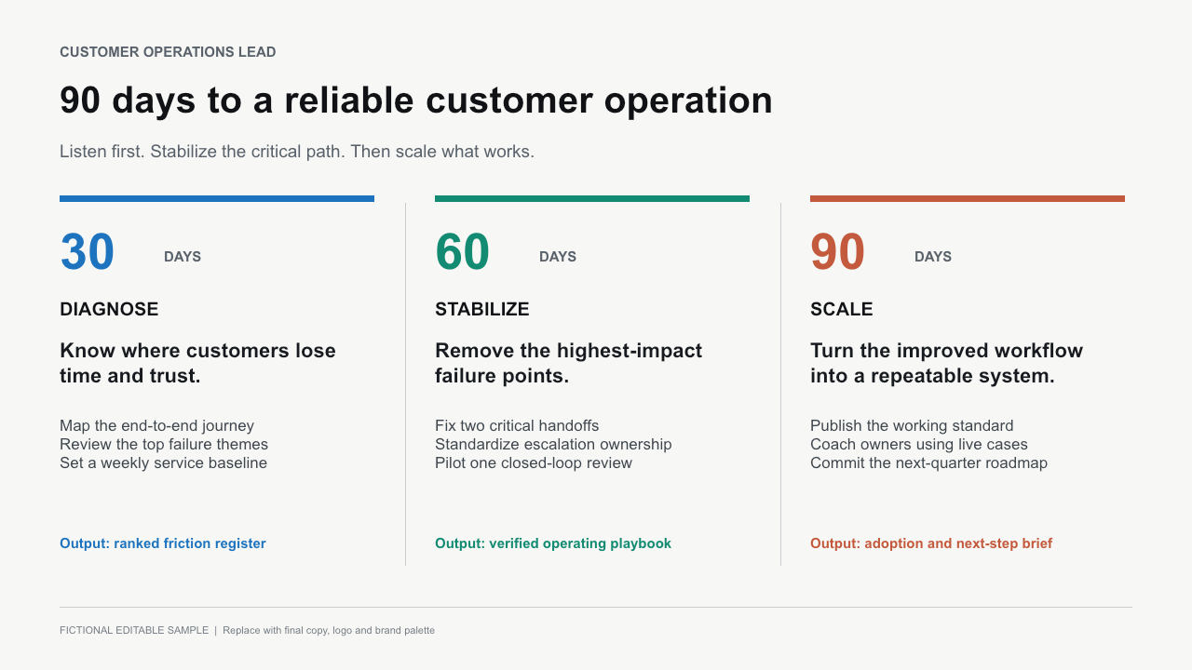
SELECTED WORK 03
An executive plan should show decisions, not decorate a calendar
A one-page editable 30/60/90 plan structured around outcomes, actions and evidence.
DESIGN PRINCIPLE
Each period earns its place by answering three questions:
What changes?
What gets delivered?
How will it be verified?
YEH I. | B2B PORTFOLIO SAMPLE
05

Slide 6
STAGED ENGAGEMENT
Start with the portfolio. Earn the right to build the website.
A small first phase keeps scope, feedback and commercial risk visible before expanding.
PHASE 1
Narrative structure, visual system, 3–4 case studies, editable source and export set.
Professional portfolio
PHASE 2
Positioning translated into a responsive B2B site with a maintainable content structure.
Studio website
PHASE 3
An 8–12 page sales asset adapted from the validated website narrative and identity.
Capability deck
The first decision is simple: approve one visual direction and one case-study structure.
YEH I. | B2B PORTFOLIO SAMPLE
06

