Slide 1
DSD HW2
Speaker: 施敬彥
Date: 2018/03/29

Slide 2
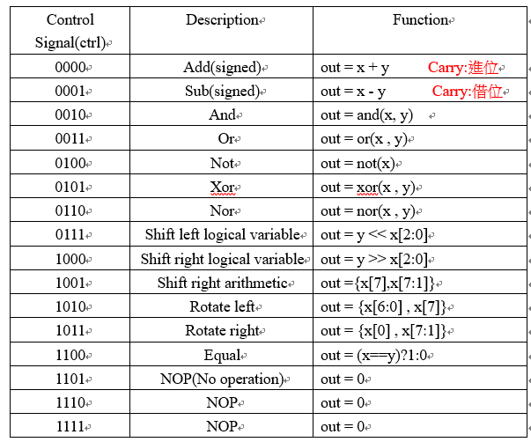
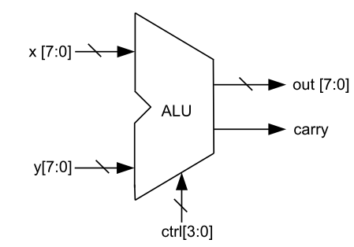
Problem 1: 8-bit Arithmetic Logic Unit
Implement 8-bit ALU with following functions

Slide 3
Problem 1: 8-bit Arithmetic Logic Unit
(1) Implement RTL (use continuous assignment, assign) model of the ALU
(2) Implement RTL (use event-driven procedure, always block) model of the ALU
(3) Modify the given test bench to verify all functions in your design are correct

Slide 4
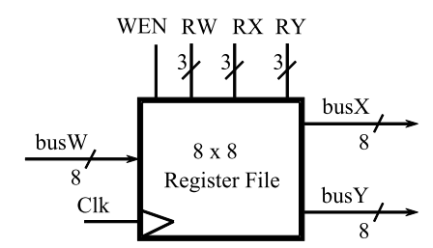
Problem 2. 8x8 Register File
Implement a 8 x 8 register file which can support read and write operation

Slide 5
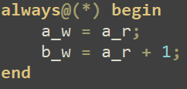
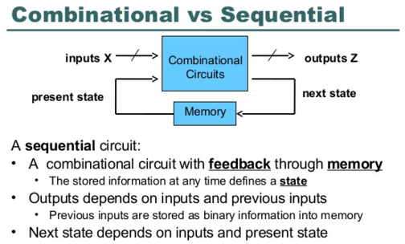
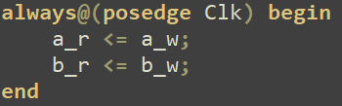
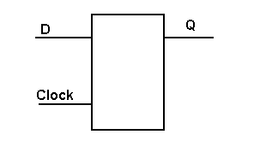
Flip-flop
a_w -> a_nxt
Combinational circuit
Sequential circuit
a_r -> a
a_w,
b_w
a_r,
b_r
a_w,
b_w

Slide 6
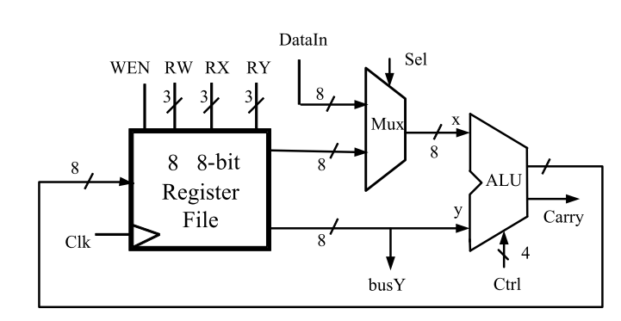
Problem 3. Simple Calculator

Slide 7
Note
Continuous assignment
Can be only for nets, not for register
always statement
only reg data type(left hand side)
Don’t use non-synthesizable syntax
Port
input
within the module, input must be declared as type wire(net), externally, they can connect to a type reg or wire
ouput
within the module, output can be declared as type reg or wire(default wire), externally they must always connect to net(wire)
if inout or output port used in an initial or always statement, the port must be redeclared as type reg

Slide 8
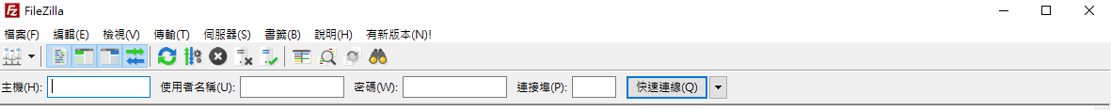

FileZilla
Download
https://sourceforge.net/projects/filezilla/files/

