Slide 1
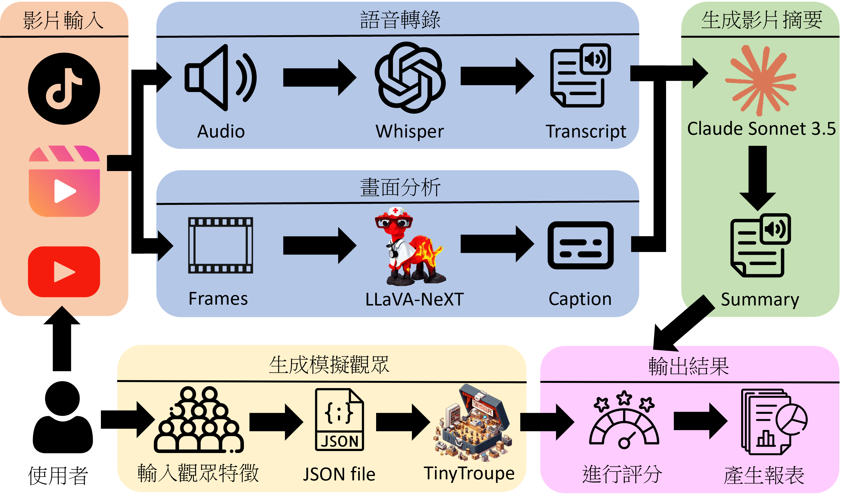
你好

Slide 2
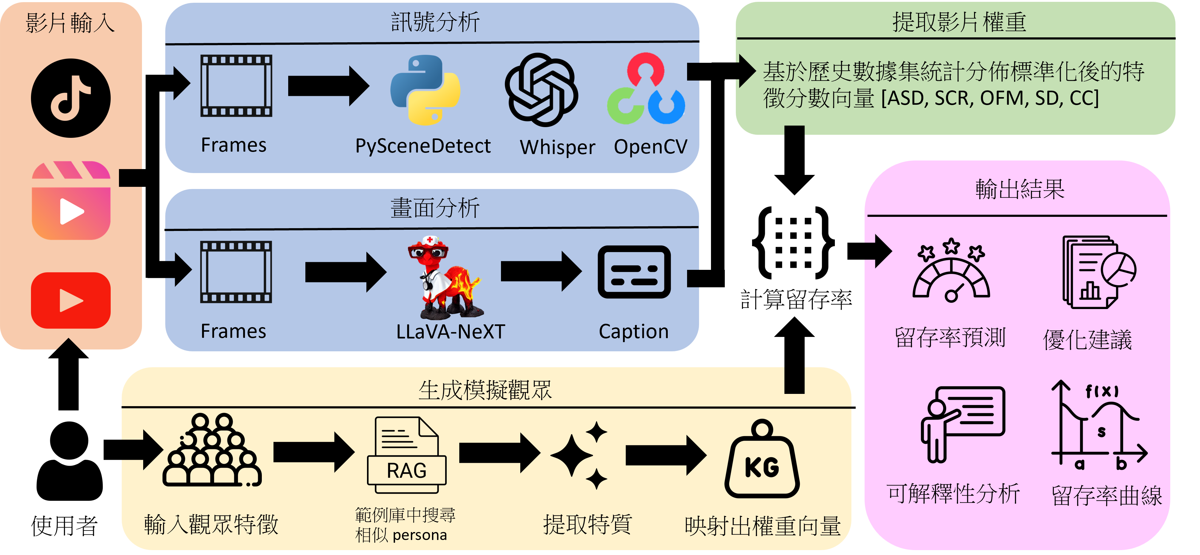
你好

Slide 3
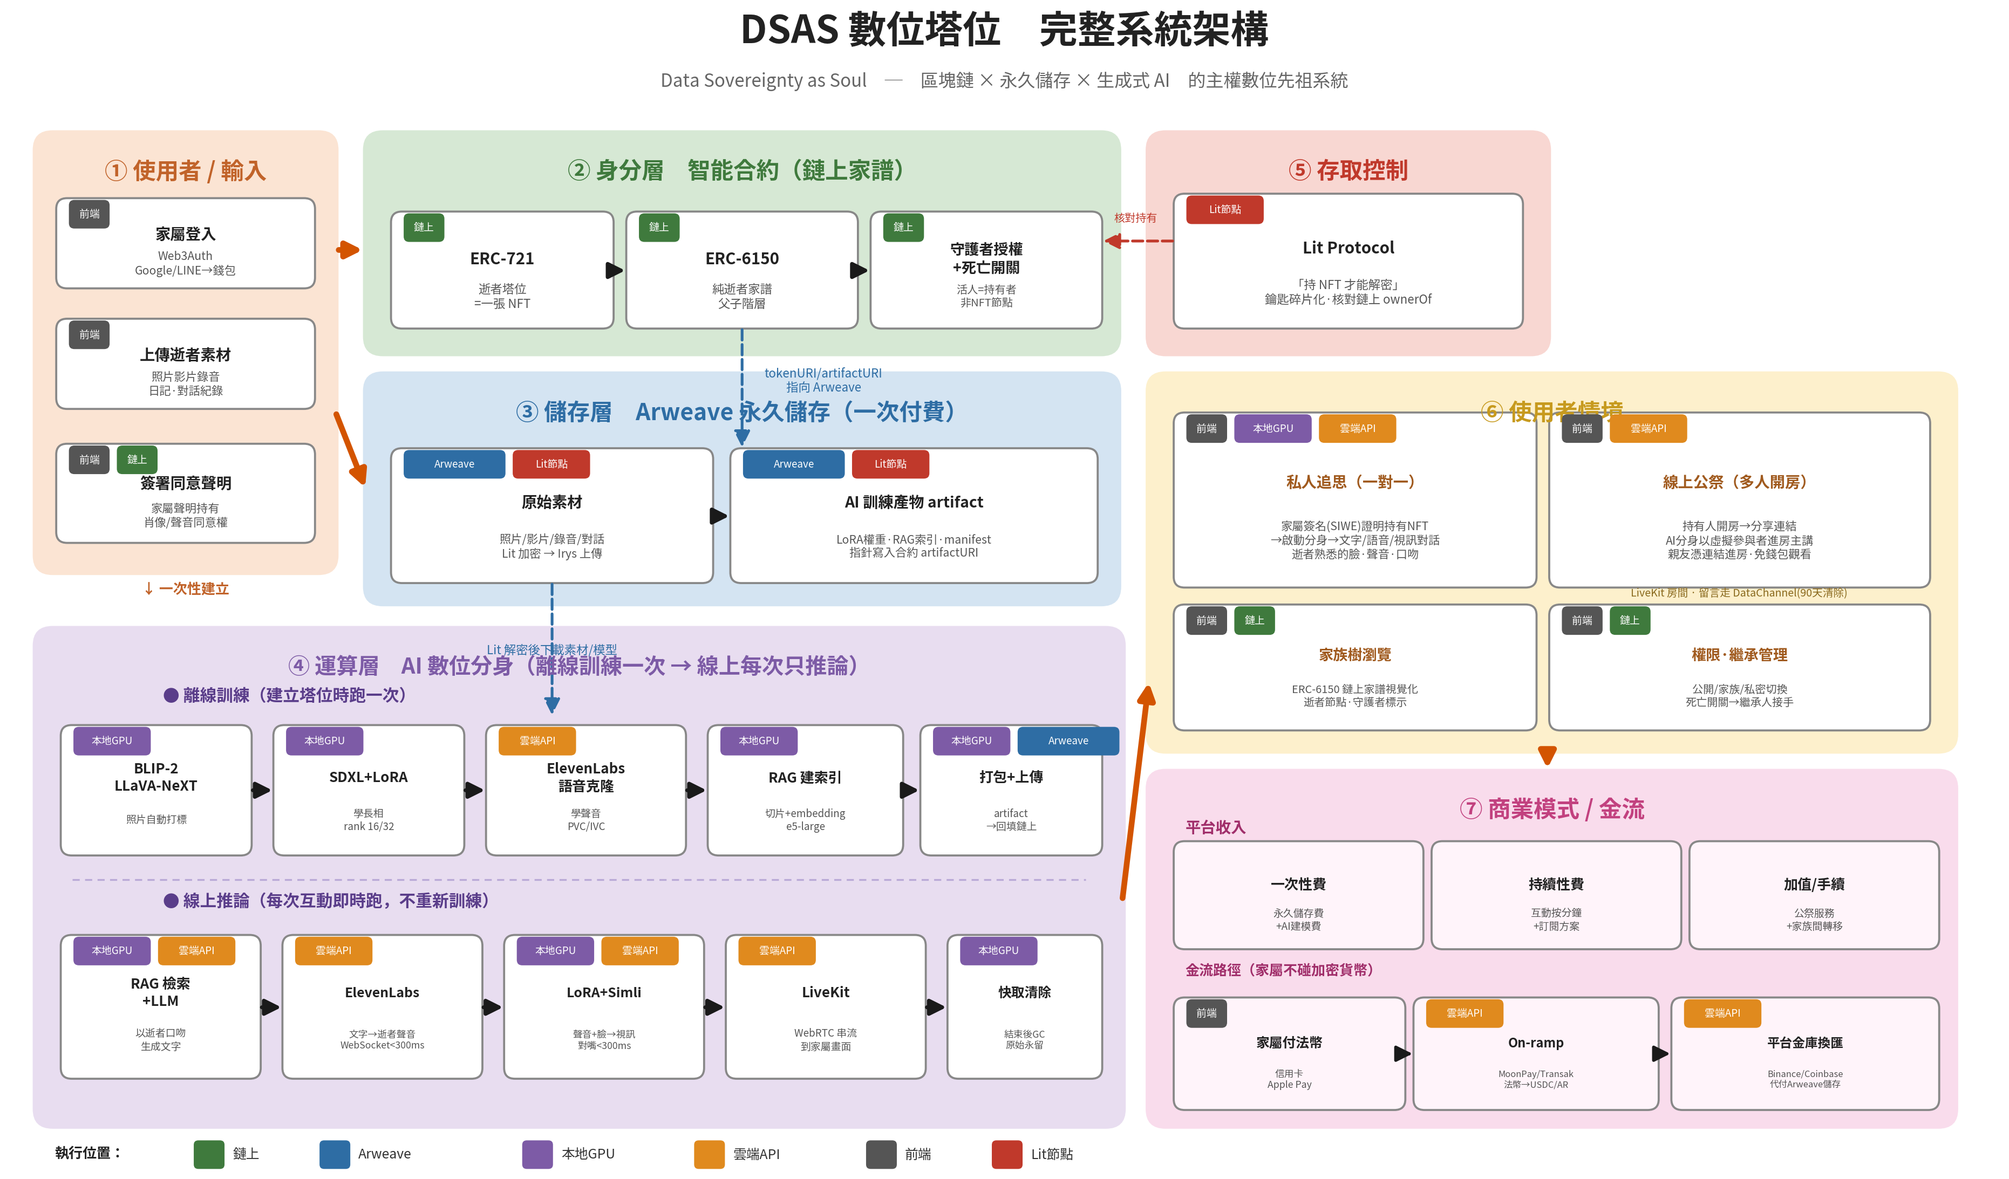

Slide 4
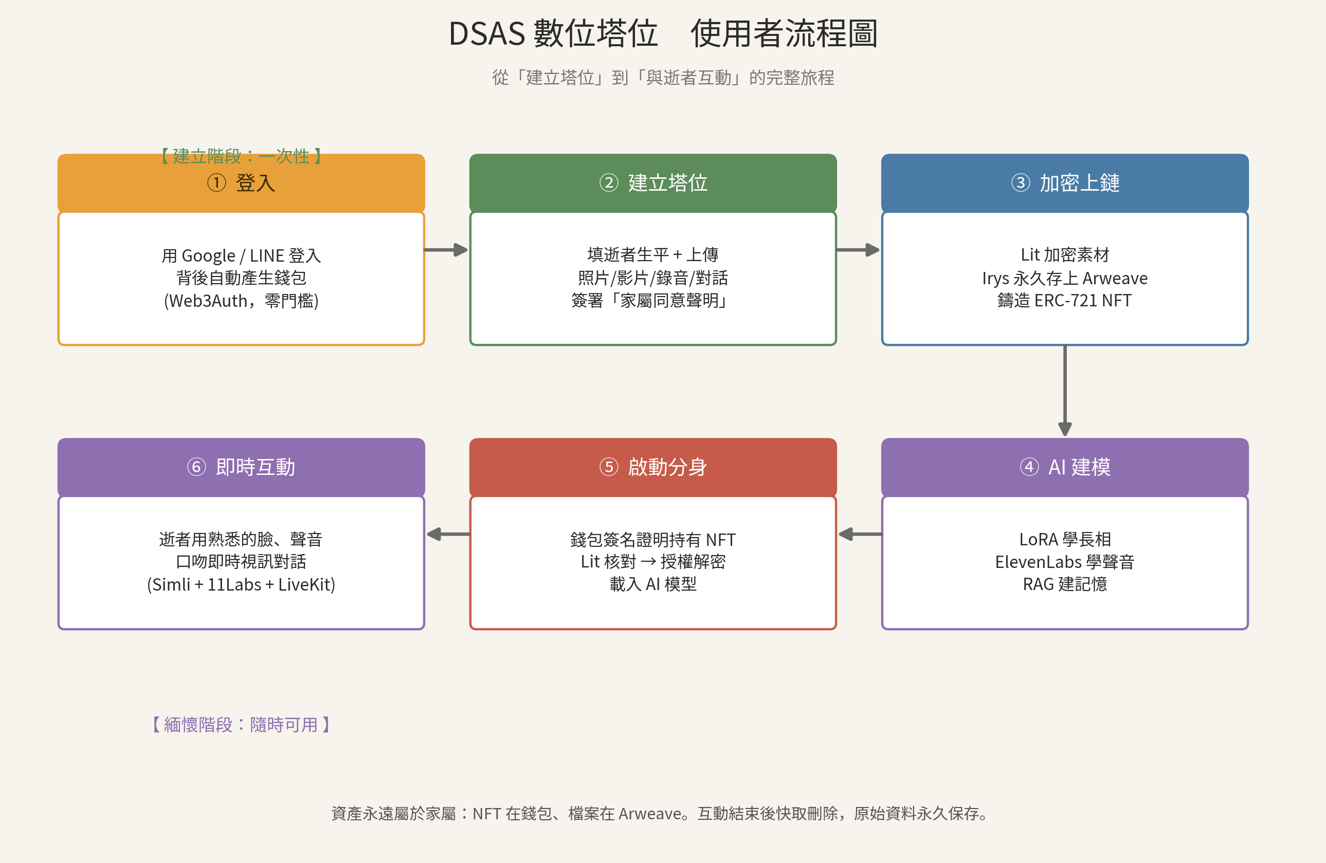

Slide 5
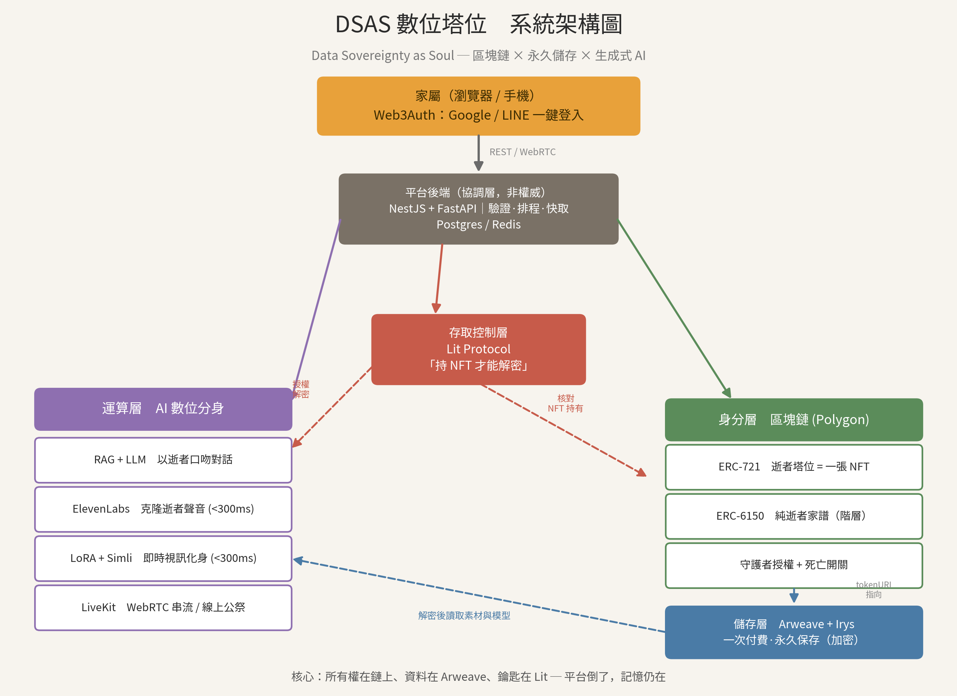

Slide 6
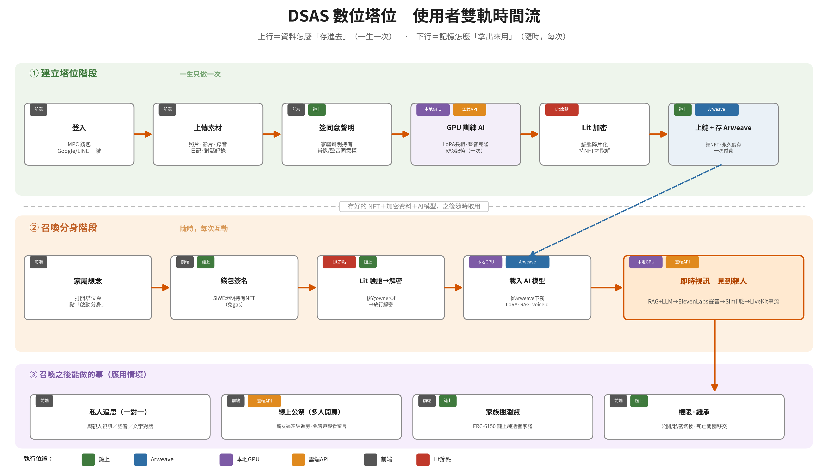

Slide 7
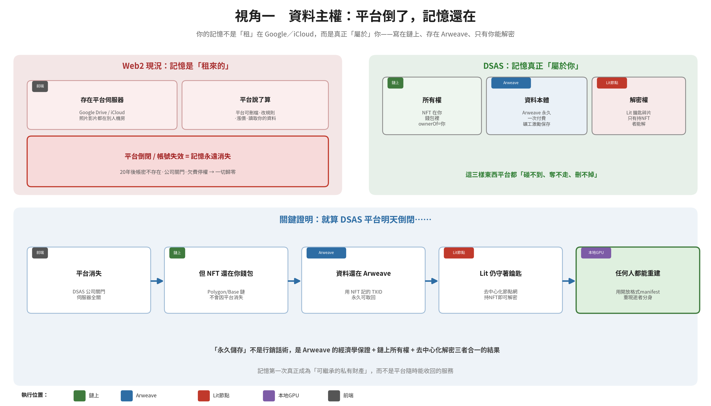

Slide 8
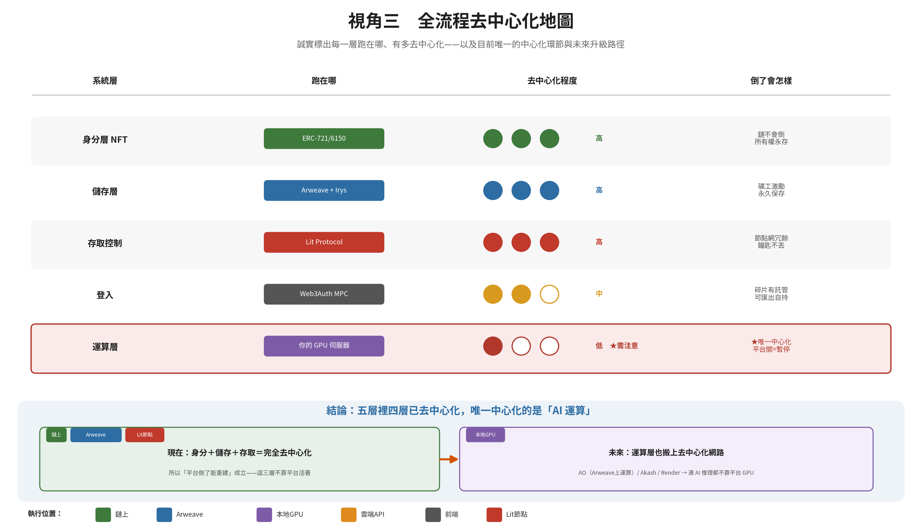

Slide 9
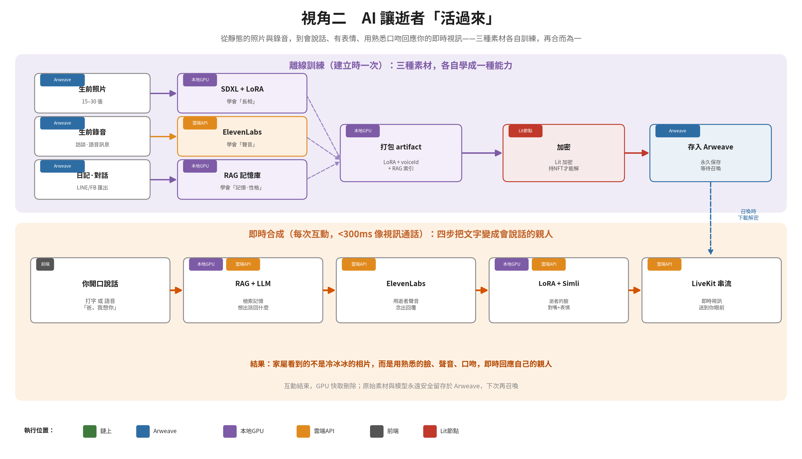

Slide 10



素材

Slide 11
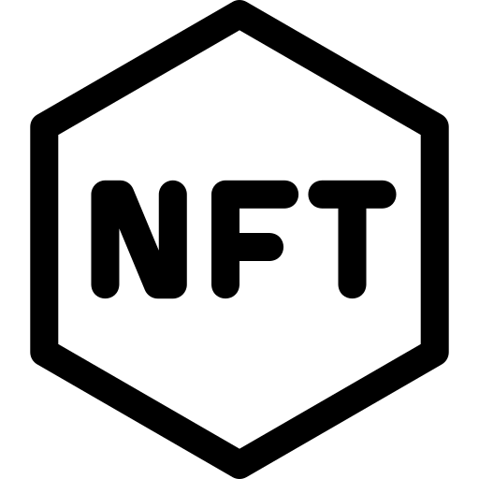






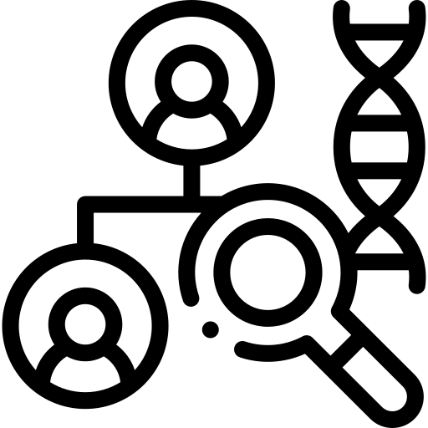



素材

Slide 12


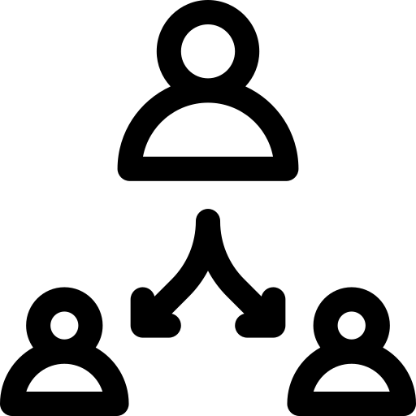


User Input
Each tablet is a unique NFT (ERC-721) with a provable on-chain owner, linked parent-to-child into a family tree (ERC-6150)
EVM Blockchain
ownerOf
parentOf
familyRole
Visibility
Successor
tokenURL
artifactURL
MPC Wallet sign in
Upload Materials
Consent Form Signed
Lit Protocol
ERC-721 and ERC-6150
➥
Decentralized key network — releases decryption keys only if you hold the NFT
metadata
artifact
➦
Name
DOB
DOD
Avatar
Origin
Short Bio
Photos
Videos
Chat History
LoRA
RAG
VoiceId
Services
Arweave + Irys
Lit
Protocol
Permanent decentralized storage: Irys bundles and accelerates
uploads onto Arweave's permaweb, paid once, stored forever
Facetime
Family
Tree
Inference (retrieve from Arweave by TXID)
Online Memorial
Inheritance
Sonnet 4.7
RAG
ElevenLabs
Simli
LiveKit

Slide 13
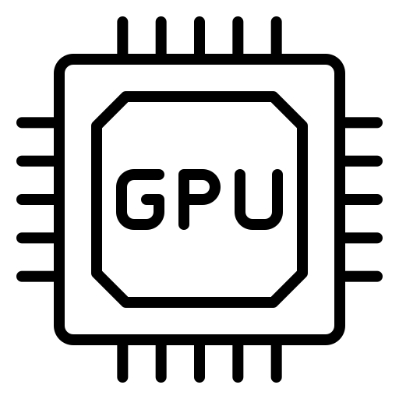




How to Bring Their memory to Life?
Arweave
Local GPU
Irys bundles files into a single transaction and
uploads them onto Arweave’s permaweb, where a one-time fee buys permanent, decentralized storage addressed by a transaction ID (TXID).
Data/Model Artifact Packaging
Local GPU
Chat History
RAG-based Memory Bank
SDXL + LoRA
Local
Training
NFT-Gated Encryption via Lit
Pictures
a lightweight adapter trained on a few dozen photos, teaching an open-source image model to generate the person's face
Arweave
Store in Decentralized Storage
Videos
Elevenlabs - Voice Cloning
& Audio Synthesis
Find Memory
Audio-Visual Reconstruction
Live Streaming
Instant Synthesis
You Speak
Sonnet 4.7
RAG
ElevenLabs
Simli
LiveKit

Slide 14

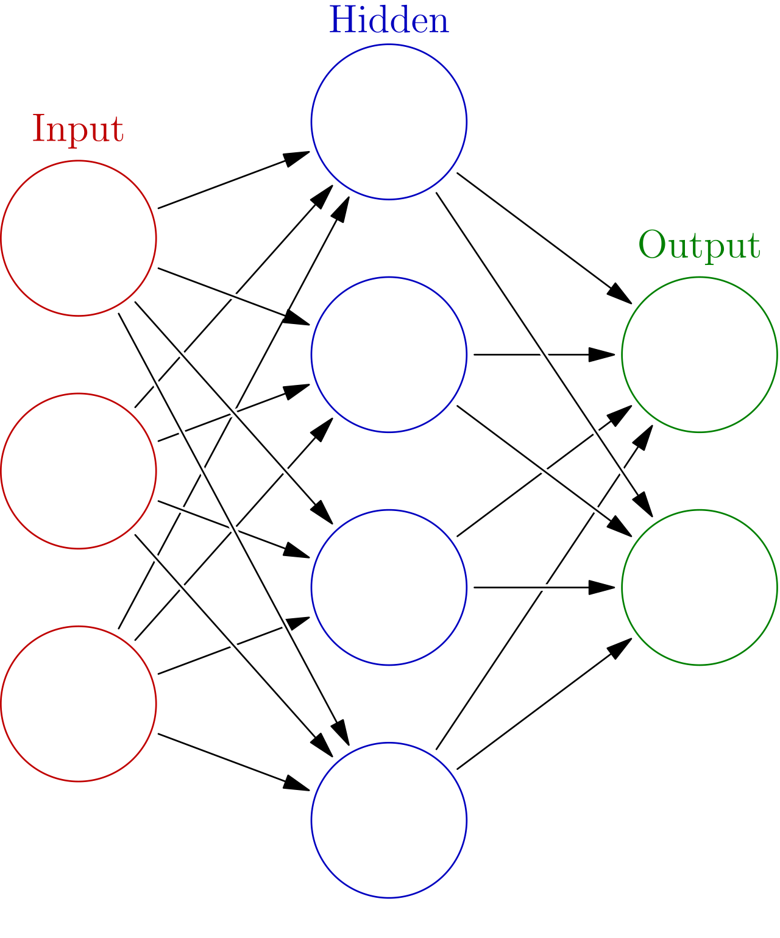




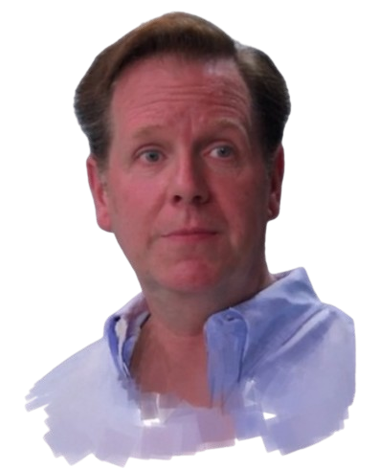

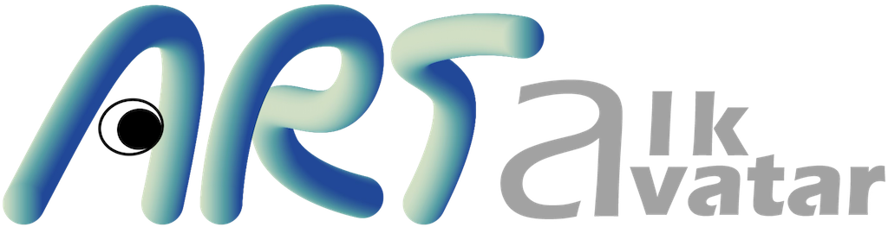

How to Bring Their memory to Life?
Local Rendering
Arweave
Backend RAG
Local GPU
Data/Model Artifact Packaging
Irys bundles files into a single transaction and
uploads them onto Arweave’s permaweb, where a one-time fee buys permanent, decentralized storage addressed by a transaction ID (TXID).
e5 embedding
pgvector
Chat History
3DGS Reconstruction
NFT-Gated Encryption via Lit
single front photo to reconstruct
3DGS talking head
Pictures
Arweave
Voice Clone
Store in Decentralized Storage
Voices
short recording to clone the
person's own voice
Instant Synthesis
Find Memory
Audio Reconstruction
Live Streaming
Top-k
Visual Reconstruction
Speak-To-Text
Aeterlux
embedding
database
chunks
LAM 3DGS
LiveKit
Generate Response
You Speak
OpenAI Whisper
quering
IndexTTS2
avatar
WebGL
Qwen3-14B-AWQ
ARTalk

Slide 15
User Input
Each tablet is a unique NFT (ERC-721) with a provable on-chain owner, linked parent-to-child into a family tree (ERC-6150)
EVM Blockchain
ownerOf
parentOf
familyRole
Visibility
Successor
tokenURL
artifactURL
MPC Wallet sign in
Upload Materials
Consent Form Signed
Lit Protocol
ERC-721 and ERC-6150
➥
Decentralized key network — releases decryption keys only if you hold the NFT
metadata
artifact
➦
Name
DOB
DOD
Avatar
Origin
Short Bio
Photos
Videos
Chat History
LoRA
RAG
VoiceId
Services
Arweave + Irys
Lit
Protocol
Permanent decentralized storage: Irys bundles and accelerates
uploads onto Arweave's permaweb, paid once, stored forever
Facetime
Family
Tree
Inference (retrieve from Arweave by TXID)
Live Streaming
Online Memorial
Inheritance
Qwen3-14B-AWQ
RAG
LAM 3DGS
ARTalk
WebGL
LiveKit

Slide 16
你好

Slide 17
你好

