Slide 1
User Adaptive Intelligent Systems
General Schema of User-adaptive Systems
(Practical Tasks)
Vania Dimitrova School of Computing, University of Leeds

Slide 2
In Topic 1
General schema of a user-adaptive system
This schema will be referred to regularly in this module
Examples of user-adaptive features
Main reading: Jameson, A. (2009). Adaptive interfaces and agents. Human-Computer Interaction: Design Issues, Solutions, and Applications, 105, 105-130 (available on Minerva, this lecture refers to pages 1-15 from the paper)

Slide 3

Which component is the most important and why?
USER MODEL
USER MODEL ACQUISITION
USER MODEL APPLICATION
INFORMATION ABOUT U
ADAPTING TO U
Compare with the answers in the padlet board:
bit.ly/comp3771-topic1
Password: user-adaptive

Slide 4

Practical Tasks
Read pages 1-15 from (Jameson, 2009)
Complete the practical tasks – available from Minerva
Prepare to discuss your solutions at the lectures on 4 October

Slide 5
Example user-adaptive systems (Jameson, 2009)
Supporting system use
Taking over parts of routine tasks
Adapting the interface
Helping with system use
Mediating interaction with the real world
Controlling a dialogue
Supporting information acquisition
Helping users to find information
Recommending products
Tailoring information presentation
Supporting collaboration
Supporting learning

Slide 6
Task 1: Lilsys
Note the main purpose of the system.
Outline the general schema of the system:
What information about the user is collected?
How is this information acquired and sorted?
What is include in the user model?
How is the user model applied?
What adaptive features are offered?
Identify recent scenarios where similar systems can be used.

Slide 7
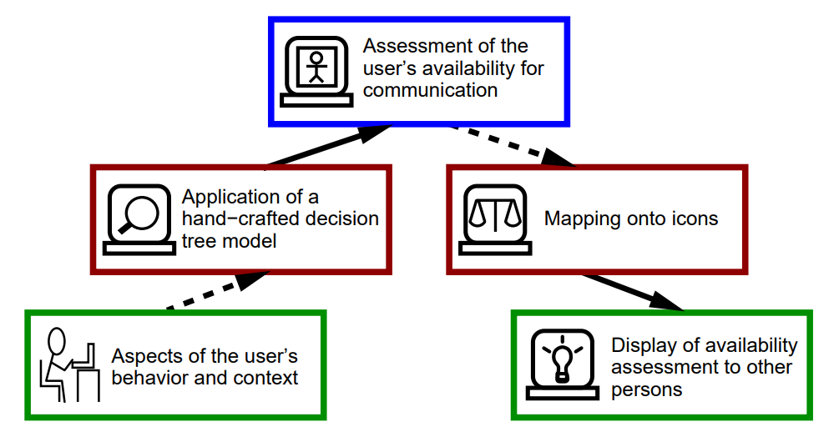
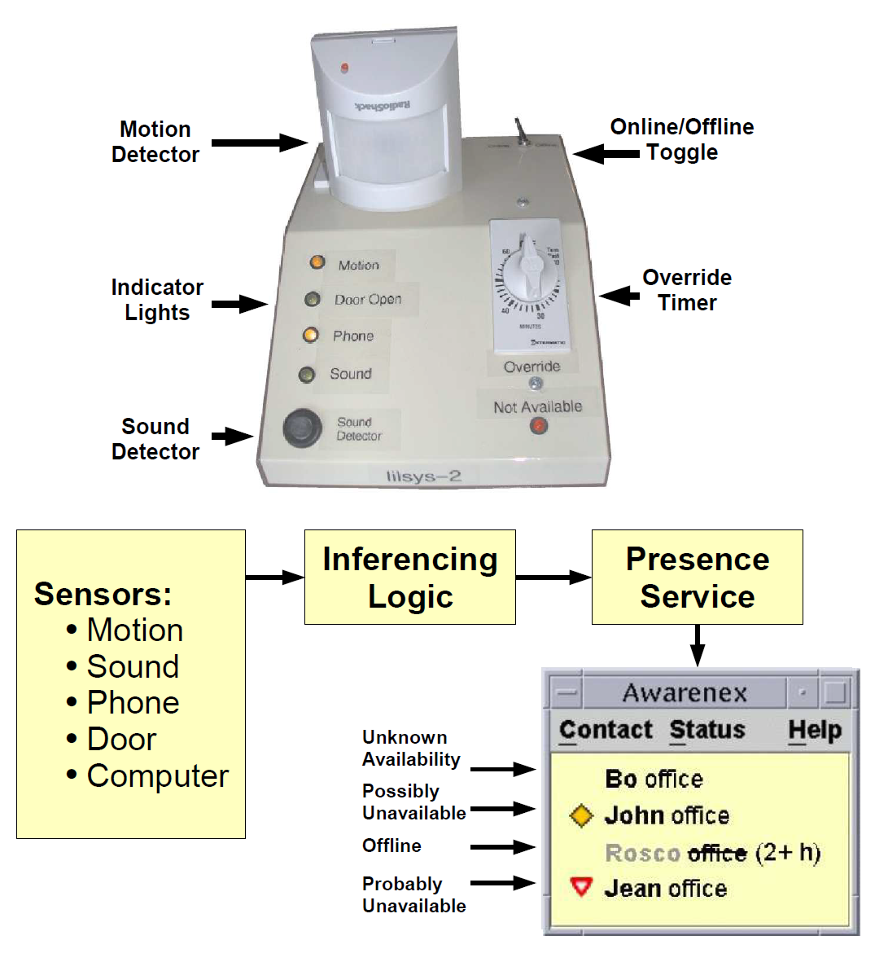
LILSYS’ system

Slide 8
Discussion: Lilsys
What information is collected about the user?
Do you see any concerns with regard to the information collected about the user?
Can you give examples of contemporary systems which are similar to Lilsys?

Slide 9
Discussion: Lilsys
What information is collected about the user?
Physical env. - Sensors movement in the room, door
User act - Keyword/mouse activity/phone
Records – Calendar
Explicit – on/off, inactive
Do you see any concerns with regard to the information collected about the user?
Privacy ethics
Reliability (latency)
Transparency
Can you give examples of contemporary systems which are similar to Lilsys?
Teams (availability)
Emergency cars (smart cars)
Virtual environment (activity)
Smart classroom

Slide 10
Task 2: AgentSalon
Note the main purpose of the system.
Outline the general schema of the system:
What information about the user is collected?
How is this information acquired and sorted?
What is include in the user model?
How is the user model applied?
What adaptive features are offered?
Identify recent scenarios where similar systems can be used.

Slide 11
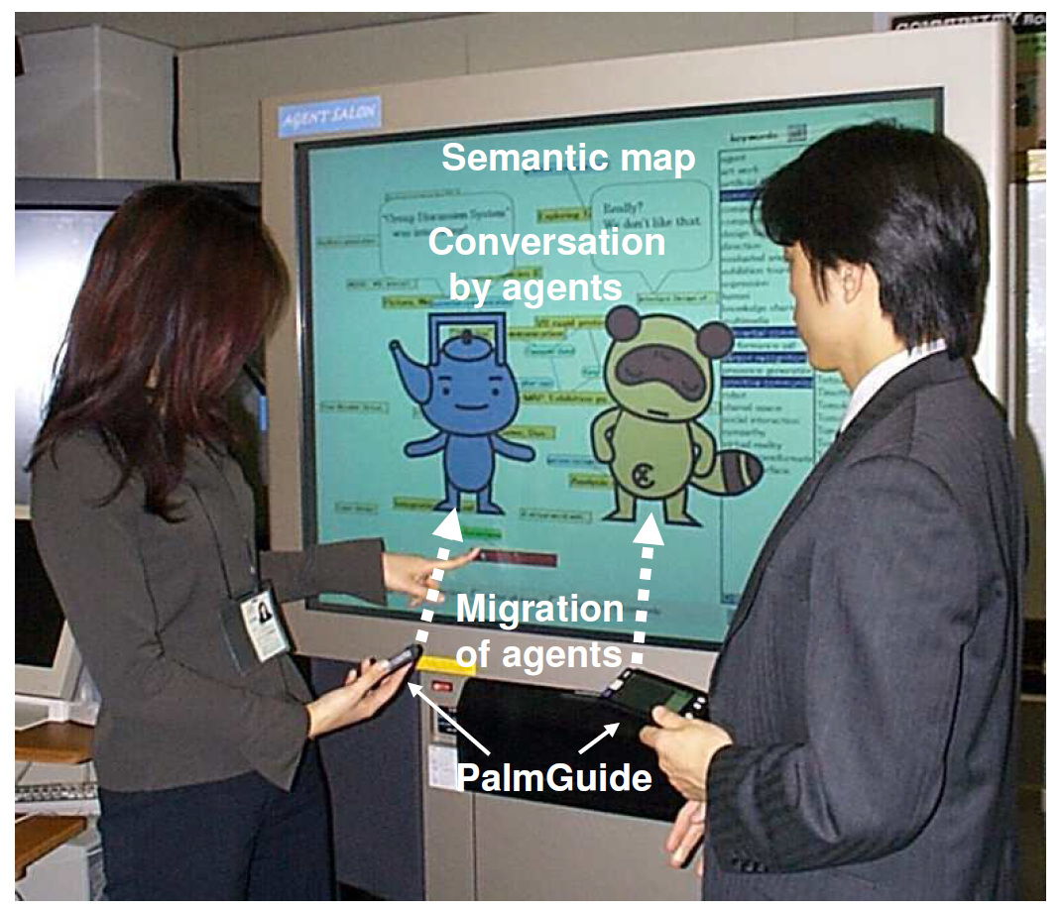
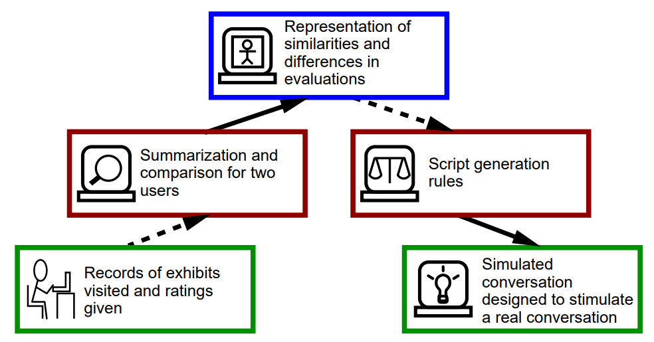
AgentSalon system

Slide 12
Discussion: AgentSalon
What adaptation is offered to the user?
Do you see any concerns with regard to the adaptation?
Can you give examples of contemporary systems which are similar to AgentSalon?

Slide 13
Discussion: AgentSalon
What adaptation is offered to the user?
Who to speak to
What to talk about (common/relevant topic)
Do you see any concerns with regard to the adaptation?
Appropriateness of suggested person
Not natural, could be obtrusive
Reliability of the data about the user/privacy
Topics - reliability
Can you give examples of contemporary systems which are similar to AgentSalon?
Conference navigator (career fairs/fundraisers)
Dating apps
Social media – connections

Slide 14
Task 3: Compare LILSYS and AgentSalon
Identify three similar things about both systems
Identify three things where the systems differ

Slide 15
Similarities
Differences

Slide 16
Similarities
Differences
LILSYS discourages
AGENTSALON encourages
People interaction related
LILSYS needs information about the real world, while AgentSalon uses only information about the user
Both require data processing
Increase efficiency of user tasks
In AgentSalon focus is on adaptation
LILISYS the focus is on user model
Both systems use explicit information from the user
LILSYS adapts others’ behaviour,
while AGENTSALON adapts the user’s behaviour
AGENTSALON requires user input whereas LILSYS is all automatic sensors

Slide 17
Task 4: System Design
The University of Leeds is (hypothetically) considering developing a module recommender to aid students in choosing which modules to study.
You are part of the team responsible for the design of the system. Following the general architecture of user-adaptive systems, draw the architecture of the module recommender.
Briefly outline:
- What user data will be collected and how?
- How will the user model be acquired?
- What will be included in the user model?
- How will the user model be applied to filter news?
- How will the filtered news be provided to the user?

Slide 18
User-adaptive Module Recommender replace the text in the rectangles with your answers
What will be stored in the user model
How will the information about the user be processed to extract the user model?
How will the user model be applied to decide what and how to adapt?
1
What information about the user be collected and how?
How will the interaction be adapted to the user?

Slide 19
Example 2 User-adaptive Module Recommender
3
Profile of the user with the list of their interests
Taxonomy of subject topics
Meta-data about modules
4
5
Process the data, some form of rules, use explicit data too
Matching between the profile and the module meta-data to do positive and negative filtering
2
1
The course, year, modules done so far
Asking the user to indicate their interests
Provide a list with modules that are tailored to the user’s interests?

Slide 20
Summary Topic 1: You should be able to
Understand the general schema of a user-adaptive systems
This schema will be referred to regularly in this module
Apply the schema to practical scenarios
Reason about the importance of each of the components of the schema

