Slide 1
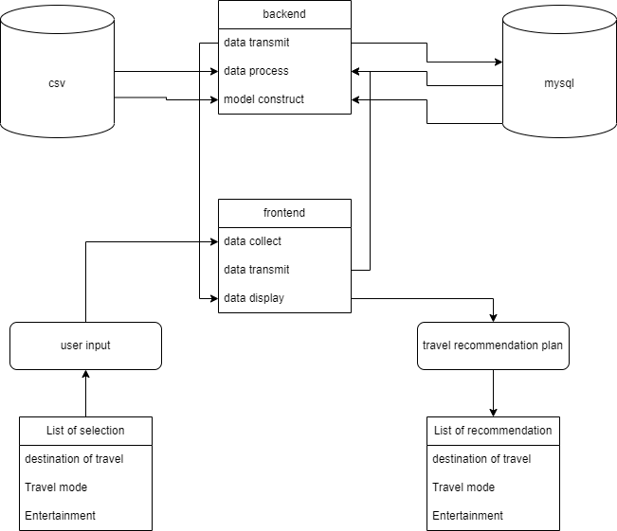
The whole model follow the procedure of this diagram

Slide 2
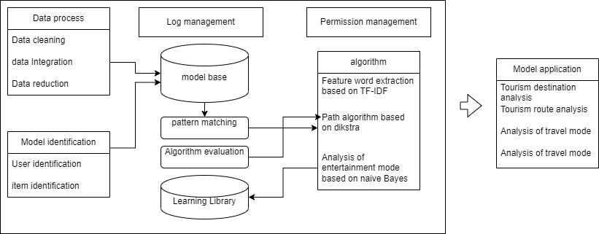
Internal execution process of the system

Slide 3
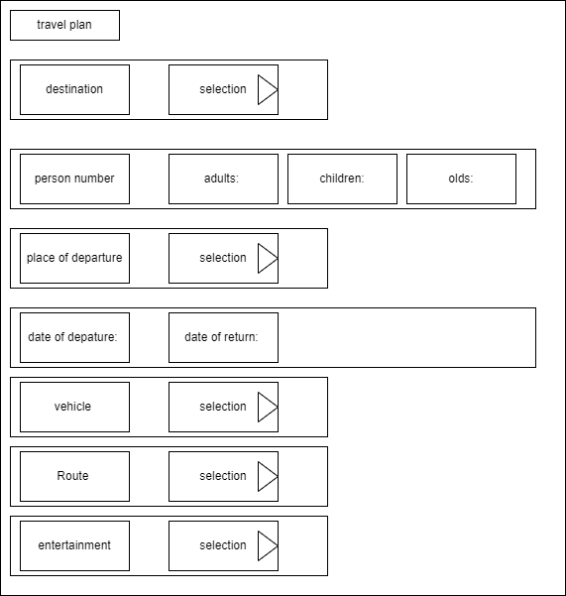
Interface model

Slide 4
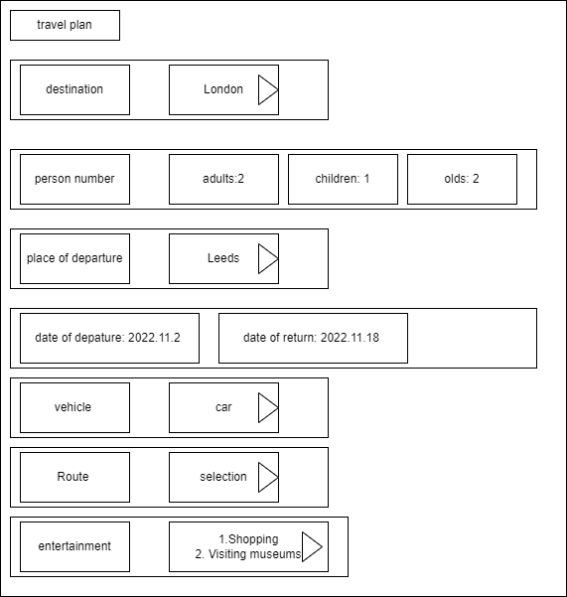
Interface model
For example, after the user fills in

Slide 5
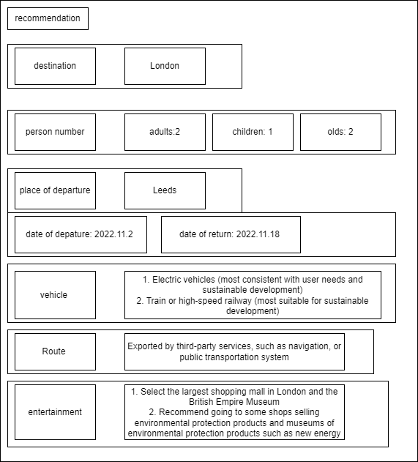
As a result:
recommendation page

Slide 6
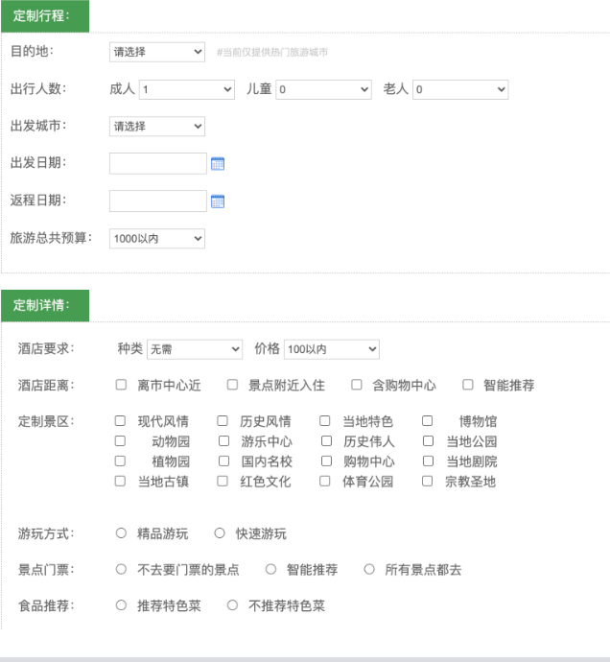
An example of web page:
Because I can't get the map and location information in the UK, I use a third-party service in China.

Slide 7
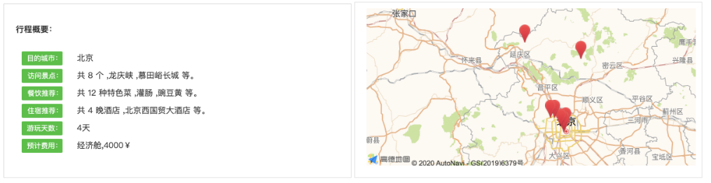
And there is an result

