Slide 1
User Adaptive Intelligent Systems
User Models and Profiles
(Building)
Vania Dimitrova School of Computing, University of Leeds

Slide 2
User models – Three broad questions
What is being modelled?
the nature of information
How this information is represented?
structure
How to construct and maintain these user models?
different user modelling approaches

Slide 3
General Schema of User-Adaptive Systems
USER PROFILE
USER MODEL ACQUISITION
USER MODEL APPLICATION
INFORMATION ABOUT U
ADAPTING TO U

Slide 4
Main Reading
Gauch et al (2007), User Profiles for Personalized Information Access , in Brusilovsky, Kobsa and Nejdl (eds): The Adaptive Web, LNCS 4321 (available on Minerva, this lecture refers to Section 2.2 and Section 2.4)

Slide 5
User Model Building
Step 1: Identify the user
Step 2: Construct the user model

Slide 6
Step 1: User Identification
We need to identify who the user for whom we will build a user model/profile is

Slide 7
Methods for User Identification
Cookies
Easiest and most widely deployed
Accuracy can be poor
Users can opt out
Software agents
Small programs that reside on the user’s computer
Collect information about the user and share with a server via some protocol
More control over the implementation

Slide 8
Methods for User Identification (cont.)
Logins
Users identify themselves upon login
Can access information from different computers
Accuracy pretty good
Session IDs
Store information about the user per visit
Short-term user profile, not suitable for long term
Enhanced proxy servers
User registers their computer with a proxy server
User identification via identification of the computer
Usage of several computers (all should be registered to the proxy server)

Slide 9
Interim Summary
User Information Collection
Explicit: given by the user
Implicit: collected by the system
Step 1: Identify the user
Depends on the data collection
Note the pros and cons of each method
Step 2: Construct the model
Next

Slide 10
Step 2: User Model Construction
Takes the input information about the user
Takes into account the user model representation
Conducts appropriate processing
Extracts the user model
Output: user model

Slide 11

Step 2: User Model Construction
#Clicks
#Seen
Measurements (in the user data)
Metrics (derived by combining the measurements)
User model (derived from the metrics)
Click through rate
#Clicks / #Seen
Engaged / Disengaged

Slide 12
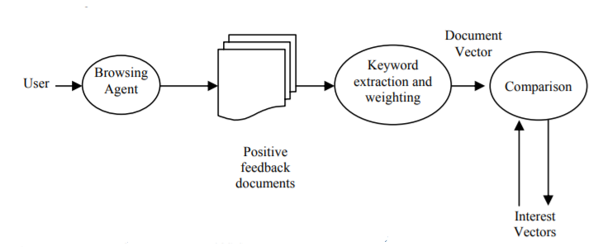
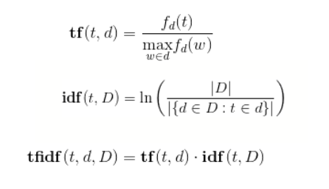
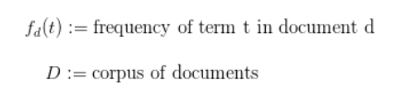
Building Keyword-based User Model
t₁₁,t₂₁,t₃₁,…,t_{n1}
t₁₂,t₂₂,t₃₂,…,t_{n2}
t₁₃,t₂₃,t₃₃,…,t_{n3}
TFIDF

Slide 13
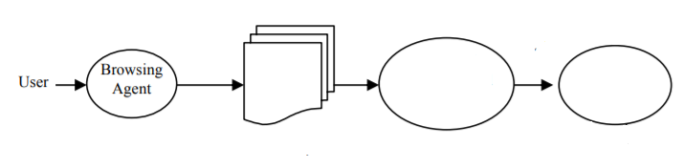
Building Graph-based User Model
Semantic tagging
Graph
overlay
Positive examples
Graph-based profile
Note: this part is different from (Gauch et al 2007).

Slide 14
Building Concept-based User Model (i)
Semantic tagging
Graph
overlay
Concept frequency
Positive examples
Top concepts
Note: this part is different from (Gauch et al 2007).

Slide 15
Building Concept-based User Model (ii)
Topic extraction
Clustering
Positive examples
Top concepts
Note: this part is different from (Gauch et al 2007).

Slide 16
Summary
User Information Collection
Explicit: given by the user
Implicit: collected by the system
Step 1: Identify the user
Depends on the data collection
Note the pros and cons of each method
Step 2: Construct the model
Measurements->Metrics->User Model Value
Keyword-based
Graph-based
Concept-based

