Slide 1
User Adaptive Intelligent Systems
Group recommendations
Vania Dimitrova School of Computing, University of Leeds

Slide 2

Until Now
USER MODEL
USER MODEL ACQUISITION
USER MODEL APPLICATION
INFORMATION ABOUT U
ADAPTING TO U

Slide 3

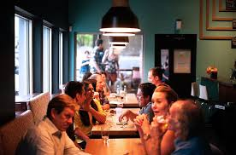


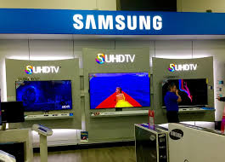

What if the user is a group?
Recommending movie to group
Recommending restaurant to a group
Recommending experience to a group
Recommending house to a group
Recommending TV to a group
Recommending holiday to a group

Slide 4
Main Steps
Obtain individual preferences (user profiles): content-based social (collaborative)
Aggregation strategies: decide what to recommend to the group
Present the recommendations to the group: use appropriate justifications

Slide 5
Example
Which item shall we recommend to the group including User 1, User 2, User 3 and User 4?
How would you select the best item?

Slide 6
Aggregation Strategies: Average
Avg
Averages individual scores

Slide 7
Aggregation Strategies: Multiplicative
Avg
Mult
Multiplies individual scores

Slide 8
Aggregation Strategies: Approval Voting
Avg
Mult
Ap vote
Counts scores above a certain threshold, seen as ‘approval’ value, e.g. consider values ≥7.

Slide 9
Aggregation Strategies: Plurality Voting
Avg
Mult
Ap vote
Pl vote
Chooses the item with highest number of votes.

Slide 10
Aggregation Strategies: Least Misery
Avg
Mult
Ap vote
Pl vote
Least M
Can be combined with others, e.g. average without misery
Considers the minimum of the scores for each item, and choses the item with the maximum value (least misery)

Slide 11
Aggregation Strategies: Most Pleasure
Avg
Mult
Ap vote
Pl vote
Least M
Most P
Considers the maximum of the scores for each item, and choses the item with the maximum value (most pleasure)

Slide 12
Aggregation Strategies: Borda
Borda
Considers item ranking in the individual preferences, then calculates the item ranking for the group

Slide 13
Aggregation Strategies: Copeland Rule
Copeland
Item 2:
Beats: 1, 6, 8
Loses: 3, 4, 5, 7, 9, 10
Counts how often an item beats another item (majority voting) and how many time loses; takes the difference as the value.

Slide 14
Aggregation Strategies: Heuristics
Fairness: take best options for everyone
Authority: take the best option for the most influential user

Slide 15
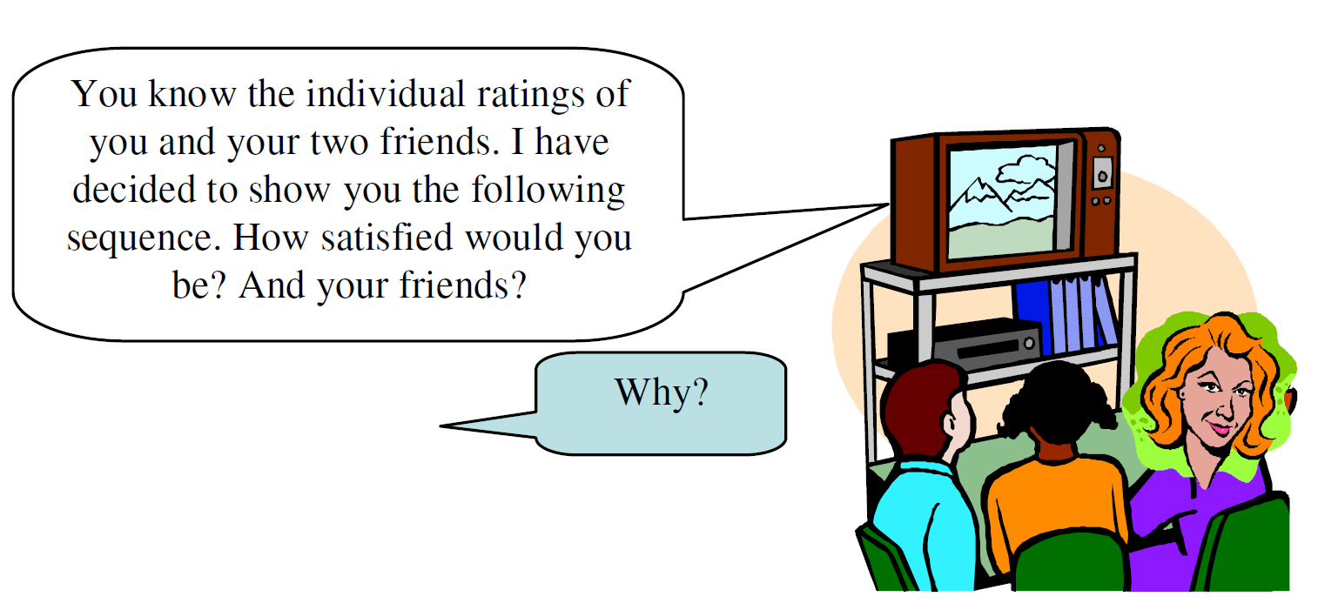
How do we know which is the best option -> Evaluation
Factors that can influence user opinions:
- affective state - relationships with other users

Slide 16
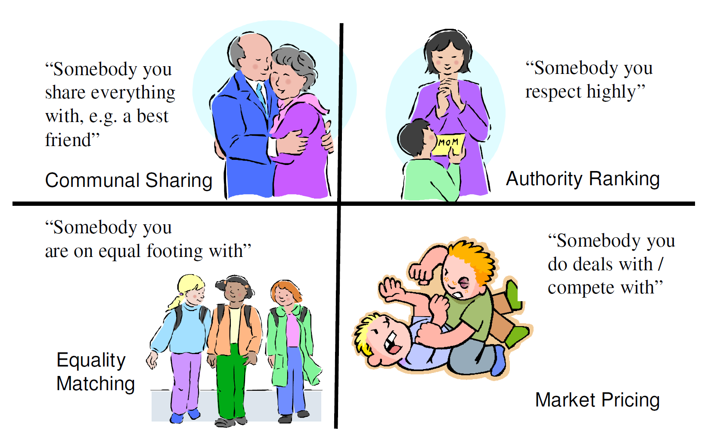
Impact of relationships on accepting group recommendations

Slide 17
Summary
Obtain individual preferences (user profiles): see previous lectures
Aggregation strategies: several possible strategies are possible most systems use some form of hybridisation evaluation is important subjective opinions are influenced by affect and relationships
Present the recommendations to the group: see next lecture – adapting content presentation

Slide 18
Main Reading
Judith Masthoff, Group Recommender Systems: Combining Individual Models. In Recommender Systems Handbook, 2011.
(available on Minerva)

