Slide 1
User Adaptive Intelligent Systems
Recommender Systems:
Hybrid Recommenders (combining recommender algorithms)
Vania Dimitrova School of Computing, University of Leeds

Slide 2
Hybrid Recommenders
Combining recommender algorithms
Building on advantages
Overcoming limitations
User Profile
Content

Slide 3
Reading + Video
Reading: Robin Burke, Hybrid recommender systems:
Survey and Experiments [available in Minerva]
Netflix challenge
https://www.youtube.com/watch?v=ImpV70uLxyw
How did the winning team create their algorithm?

Slide 4
How to combine algorithms?
Assume that we can use more than one recommender algorithm.
Consider a user U an a content item I – each algorithm will produce a recommendation value which indicates whether the item will be recommended to the user
A1 | A2 | A3 | … | An
R1 | R2 | R3 | … | Rn
How to combine A1, A2, A3, …, An to decide what will be the recommendation value of item I for user U?

Slide 5
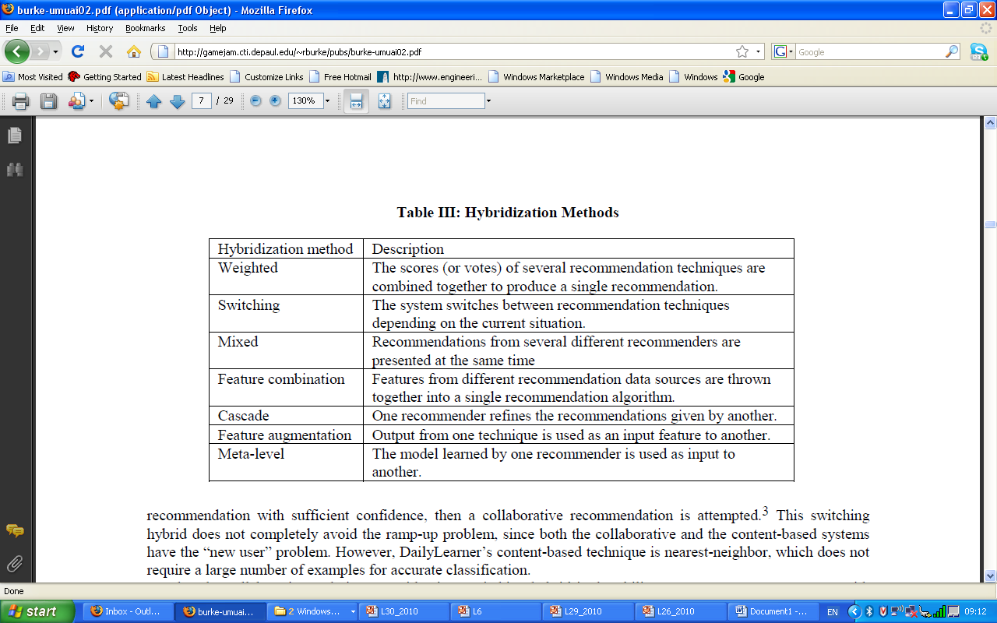
How to combine? Hybridisation Methods

Slide 6
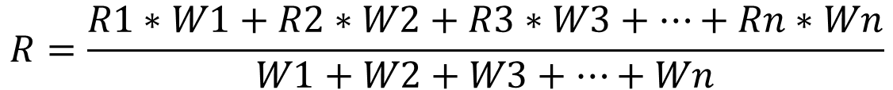
Weighted
Assume that we can use more than one recommender algorithm.
Consider a user U an a content item I – each algorithm will produce a recommendation value which indicates whether the item will be recommended to the user
A1 | A2 | A3 | … | An
R1 | R2 | R3 | … | Rn
W1 | W2 | W3 | … | Wn
$$R=\frac{R1∗W1+R2∗W2+R3∗W3+…+Rn∗Wn}{W1+W2+W3+…+Wn}$$

Slide 7
How to combine? Hybridisation Algorithms

Slide 8
Switching
Assume that we can use more than one recommender algorithm.
Consider a user U an a content item I – each algorithm will produce a recommendation value which indicates whether the item will be recommended to the user
A1 | A2 | A3 | … | An
R1 | R2 | R3 | … | Rn
W1 | W2 | W3 | … | Wn
$$R1 or R2 or R3 or …. Rn$$

Slide 9
How to combine? Hybridisation Algorithms

Slide 10
Mixed
Assume that we can use more than one recommender algorithm.
Consider a user U an a content item I – each algorithm will produce a recommendation value which indicates whether the item will be recommended to the user
A1 | A2 | A3 | … | An
R1 | R2 | R3 | … | Rn
W1 | W2 | W3 | … | Wn
$$For instance, U sees: R1 and R2$$

Slide 11
How to combine? Hybridisation Algorithms

Slide 12
Feature Combination
Assume that we can use more than one recommender algorithm.
Consider a user U an a content item I – each algorithm will produce a recommendation value which indicates whether the item will be recommended to the user
A1 | A2 | A3 | … | An
R1 | R2 | R3 | … | Rn
W1 | W2 | W3 | … | Wn
$$A^{′}that combines features from R1, R2, R3, …Rn$$

Slide 13
How to combine? Hybridisation Algorithms

Slide 14
Cascade
Assume that we can use more than one recommender algorithm.
Consider a user U an a content item I – each algorithm will produce a recommendation value which indicates whether the item will be recommended to the user
A1 | A2 | A3 | … | An
R1 | R2 | R3 | … | Rn
W1 | W2 | W3 | … | Wn
$A1 →R1 R1:A2→R2′ R2′:A3→R3′$

Slide 15
How to combine? Hybridisation Algorithms

Slide 16
Feature Augmentation
Assume that we can use more than one recommender algorithm.
Consider a user U an a content item I – each algorithm will produce a recommendation value which indicates whether the item will be recommended to the user
A1 | A2 | A3 | … | An
R1 | R2 | R3 | … | Rn
W1 | W2 | W3 | … | Wn
$A1 →R1 R1 used to improve A2: A2"→R2′$

Slide 17
How to combine? Hybridisation Algorithms

Slide 18
Meta-Level
Assume that we can use more than one recommender algorithm.
Consider a user U an a content item I – each algorithm will produce a recommendation value which indicates whether the item will be recommended to the user
A1 | A2 | A3 | … | An
R1 | R2 | R3 | … | Rn
W1 | W2 | W3 | … | Wn
$A1 →R1 R1 used to improve A2: A2"→R2′$

Slide 19
Summary: Hybrid Recommenders
Evaluation is crucial – identify pros and cons for each method in a particular situation (application)
Hybridisation methods
– identify an appropriate hybridisation method to maximise the pros and minimise the cons of the combined methods given a particular application
Research trends
– active research field
– research-innovation route quite fast

