Slide 1
User Adaptive Intelligent Systems
Recommender Systems:
Evaluation
Vania Dimitrova School of Computing, University of Leeds

Slide 2
In Previous Lectures
There are many recommendation algorithms
Their performance may differ
Remember the example with collaborative filtering
How do we evaluate recommendation algorithms?
We are here

Slide 3
Algorithm evaluation drives improvement
Watch the video on the history of Amazon recommendation algorithm (https://www.amazon.science/the-history-of-amazons-recommendation-algorithm).
Note what algorithms have been used.
What is the best performing algorithm and why.
Notice how evaluation drove algorithm improvement?

Slide 4
Evaluation Questions
Single algorithm:
Which parameter setting is better?
What are the cases when the algorithm performs best/worst?
Several algorithms:
Which algorithm performs best? How to select/hybridise?
Recommender system:
What are the benefits and drawbacks of recommendations on user experience and business?

Slide 5

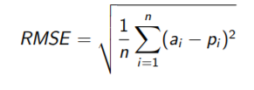
Data-driven Evaluation: Rating Accuracy
MAE (mean absolute error)
Rec Actual
p₁ a₁
p₂ a₂
…
p_{n} a_{n}
RMSE (root mean square error)
Correlation coefficient
Pearson correlation (parametric data)
Spearman or Kendal (non-parametric data)

Slide 6

Calculate MAE and RMSE
MAE
RMSE
1 - definitely not interested
2 - maybe not interested
3 - maybe interested
4 - definitely interested

Slide 7
Compare Recommender Algorithms

Slide 8
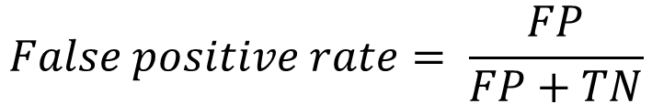
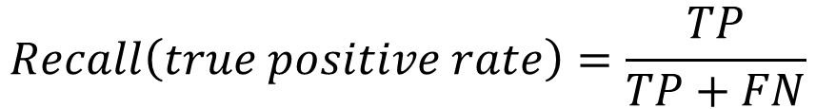
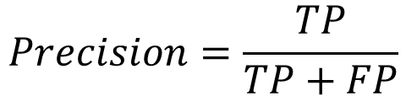
Data-driven Evaluation: Accuracy->Usage Prediction
Confusion Matrix
$$Precision=\frac{TP}{TP+FP}$$
$$Recall\left(true positive rate\right)=\frac{TP}{TP+FN}$$
$$False positive rate= \frac{FP}{FP+TN}$$

Slide 9
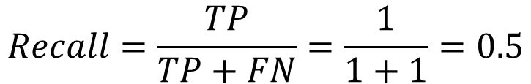
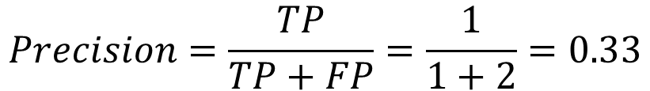
Calculate Precision and Recall
1 - definitely not interested
2 - maybe not interested
3 - maybe interested
4 - definitely interested
1, 2 – No
3, 4 - Yes
$$Precision=\frac{TP}{TP+FP}=\frac{1}{1+2}=0.33$$
$$Recall=\frac{TP}{TP+FN}=\frac{1}{1+1}=0.5$$

Slide 10
Compare Recommender Algorithms

Slide 11
Beyond Accuracy: Coverage
What percentage of items can the recommender form
predictions for?
Consider systems A and B:
A provides better accuracy than B (good!)
but A recommends only subset of ‘easy-to-recommend’ items (not good!)
address the ‘long tail’

Slide 12
Beyond Accuracy: Novelty/Serendipity
It is easy to recommend common items, but what about new ones which the user may like too?
Novelty – not in the prediction (but close to it)
Serendipity (pleasant surprise) – new but relevant
Note that:
Collaborative filtering – novelty and serendipity are embedded in the algorithms (but happen by chance though the social factor ensures relevance)
Content-based and knowledge-based recommenders can provide more sophisticated ways to ensure novelty and serendipity (remember – the graph allows reasoning)

Slide 13
Beyond Accuracy: Diversity
How diverse is the list of items we recommend?
Diversity indices:
Variety (do we have from all content categories)?
Balance (are the items from the categories proportional to the total number of items in the categories)
Disparity (how far are the items, note the relevance with clustering)

Slide 14
Experimental Studies with Users
AB Testing
User allocation - random
System A
System B
User interaction
Performance metrics
Utility metrics
User interaction
Performance metrics
Utility metrics
Compare: mean, median, mode
Statistical significance: parametric (t-test, ANOVA); non-parametric

Slide 15
Summary
Evaluation is crucial
Embed evaluation as part of the development of new features
Consider what performance metrics are important
Consider what state of the algorithm/system you are evaluating
Data-driven assessment
Do you have access to appropriate data
Is there any potential bias or overfitting of the data
Note the similarity with evaluation of machine learning classifiers
Experimental studies with users
A/B testing
Can consider variations (e.g. one system but offers from two different recommender algorithms – check which performs better)

Slide 16
Main Reading
Evaluating recommender systems, Shani and Gunawardana. In Recommender Systems Handbook.
(available on Minerva)

