Slide 1
User Adaptive Intelligent Systems
Recommender Systems:
Introduction
Vania Dimitrova School of Computing, University of Leeds

Slide 2
Schema of User-Adaptive Systems
We now start looking at the
green parts …
USER MODEL
and other input
USER MODEL ACQUISITION
USER MODEL APPLICATION
INFORMATION ABOUT U
ADAPTING TO U

Slide 3
Recommender systems: motivation
The problem:
too much content!
too many choices!

Slide 4
Main Reading
Robin Burke, Hybrid recommender systems: Survey and Experiments
[available in Minerva]

Slide 5
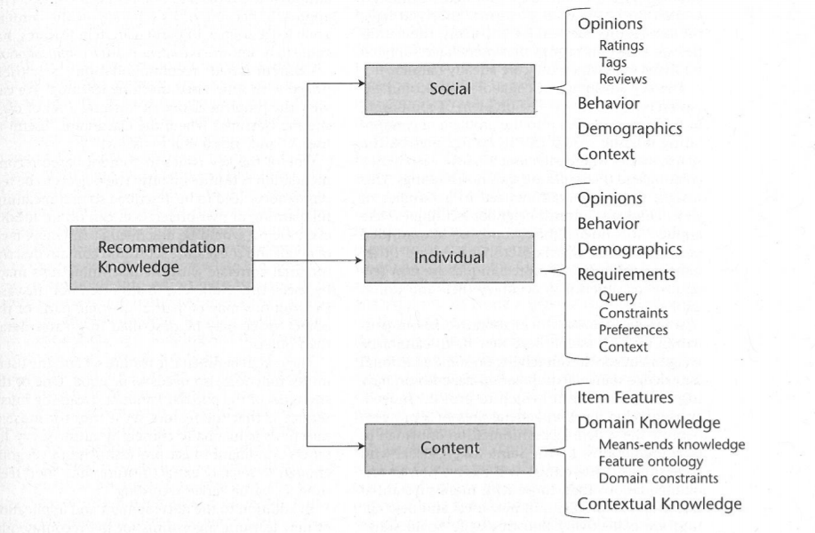
Sources for Recommendations

Slide 6
Recommender Algorithms: Key Features
Background data : the information that the system has before the information processes starts
Input data : the information that the user must communicate to the system in order for the system to generate recommendation
Algorithm : that combines background and input data to arrive at its suggestions
You should be able to describe briefly the background data, the input data, and the algorithm used for the recommender algorithm we cover. The description should be suitable for the specific application context you consider.

Slide 7
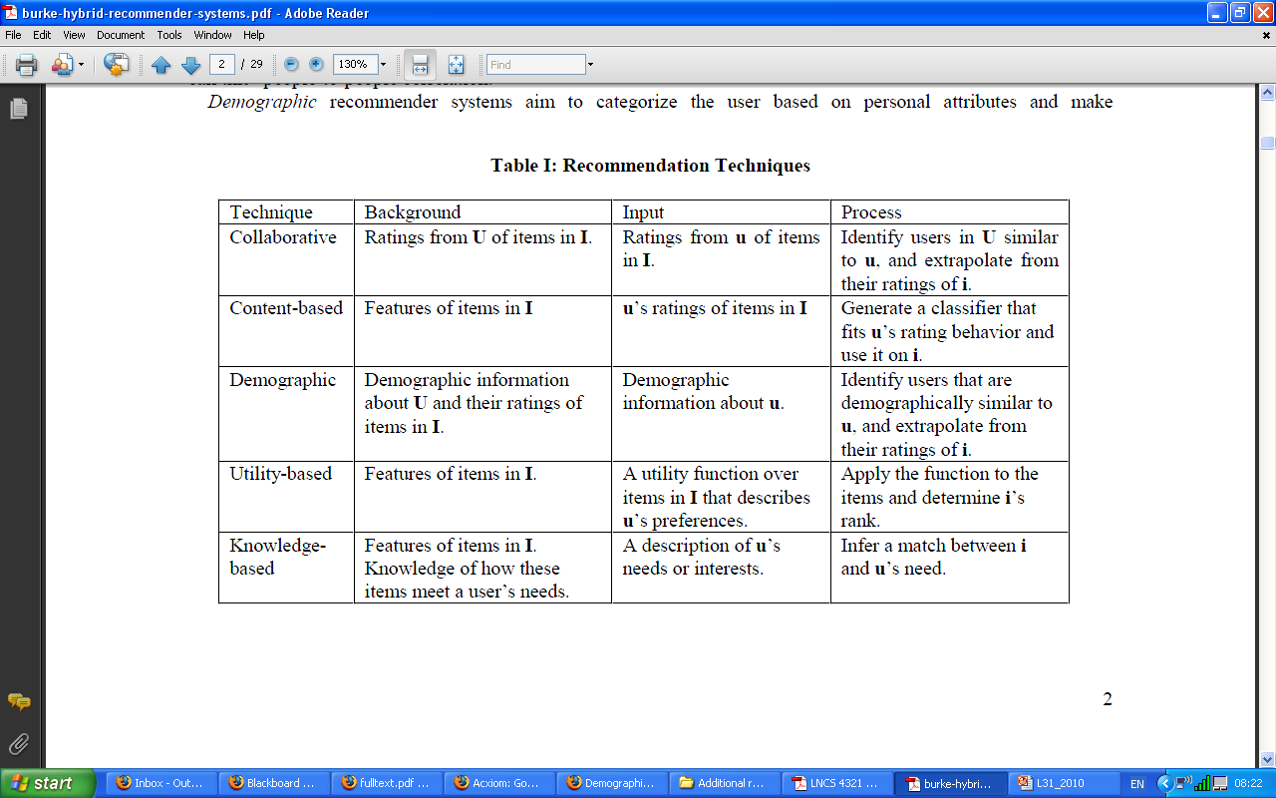
Comparing Recommender Algorithms

Slide 8
Collaborative Recommenders
Other’s ratings
What others like
My ratings
What I like
Give me what people similar to me would like …
“Word of mouth”
“Voting”

Slide 9
Comparing Recommender Algorithms

Slide 10
Content-based Recommenders
Content
Appropriate information about it
User profile
Relevant to the content
User Profile
Content
Give me content that I would like

Slide 11
Comparing Recommender Algorithms

Slide 12
Demographic Recommenders
Other’s ratings
What others like
My ratings
What I like
Demographic Profile
Give me what people demographically similar to me would like …

Slide 13
Comparing Recommender Algorithms

Slide 14
Utility-based Recommenders
Content
Appropriate information about it
User profile
User’s utility
User Profile
Content
Give me content that I would like

Slide 15
Comparing Recommender Algorithms

Slide 16
Knowledge-based Recommenders
Content
Appropriate information about it
User profile
Relevant to the content
+
User Profile
Content
Give me content that I would like
+ show me something new/interesting
+ explain/educate

Slide 17
Comparing Recommender Algorithms

Slide 18
In Topic 4, we will cover the following algorithms
Content-based recommenders
E-mail filters, news recommenders
Knowledge-based recommenders
Buying guides (cars/houses), museum guides
Collaborative or social recommenders
Suggestion lists, “top-n” offers and promotions
Hybrid recommenders
Combination of any of the above

Slide 19
Summary
Key features of recommender algorithms:
Background data
Input data
Algorithm
You should be able to describe briefly the background data, the input data, and the algorithm used for each recommender algorithm we cover, suitable for the specific application context you consider.
Note the link with coursework 1
Reading: Robin Burke, Hybrid recommender systems:
Survey and Experiments [available in Minerva]

