Slide 1
User Adaptive Intelligent Systems
Dynamic Approaches for Adaptive Content Presentation
Vania Dimitrova School of Computing, University of Leeds

Slide 2
Previously: Static approaches
Page-based
Fragment-based
Disadvantages: Static
Content authoring is expensive
Pre-defined content may not cater for all user cases
Need to define conditions when content (pages or fragments) can be used
Even the most flexible approach (altering fragments) suffers from this deficiency as constituents need to be specified

Slide 3
Here: Dynamic approaches Two steps
Dynamic content adaptation:
Automatic selection of content
Automatic structuring of the content
Dynamic content presentation:
Automatic way to define relevance and focus
Automatic media adaptation

Slide 4
Dynamic content adaptation
Content automatically selected from:
Knowledge base, relevance measures (e.g. ILEX, STOP)
Bayesian networks expressing causal probabilistic relationships between variables from the domain (e.g. NAG)
User preferences model, importance measures (e.g. GEA, RIA)
Content automatically structured:
- Task- accomplished planners
- Argumentation models
- Conversation theories

Slide 5
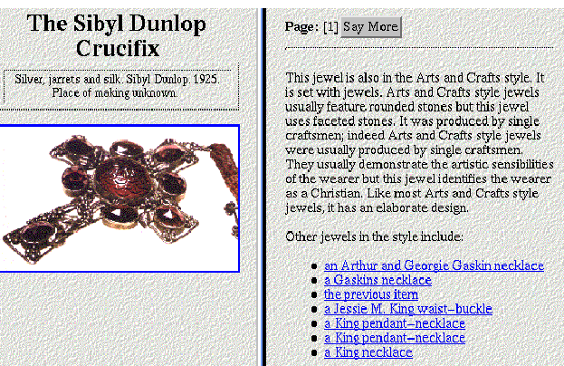
Example: ILEX (natural language text generation)
Domain Model
The Content Potential
Text Structure
Syntactic Structure
Presentational Forms
Representation of Context

Slide 6
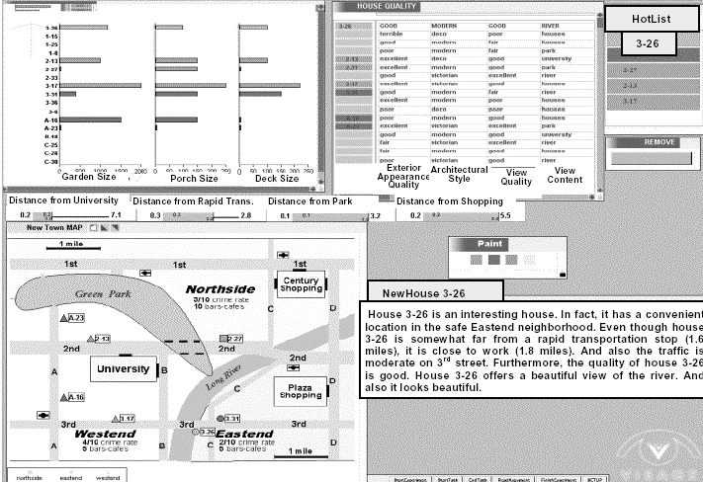
Example: GEA (generator of evaluative arguments)
User preferences in a hierarchical model (e.g. house, location, number of bedrooms)
Argument structure tailored to user preferences (uses measure of relevance)
Level of detail will differ for users or for the same user at different stages

Slide 7
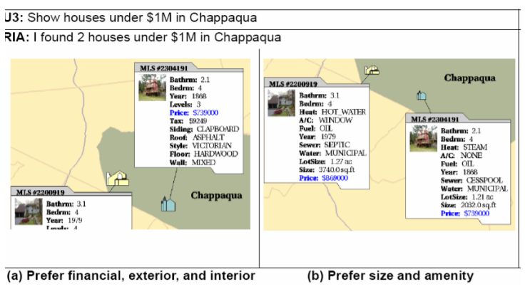
Example: RIA (responsive information architect)
Two different responses to the same query depending on user preferences

Slide 8
Dynamic content presentation
Maintaining focus and context
Focus – emphasise the content that has been found most relevant to the user
Context – allow access to less relevant content to preserve context
Stretch text
Scaling fragments
Dimming fragments
Summary thumbnail

Slide 9
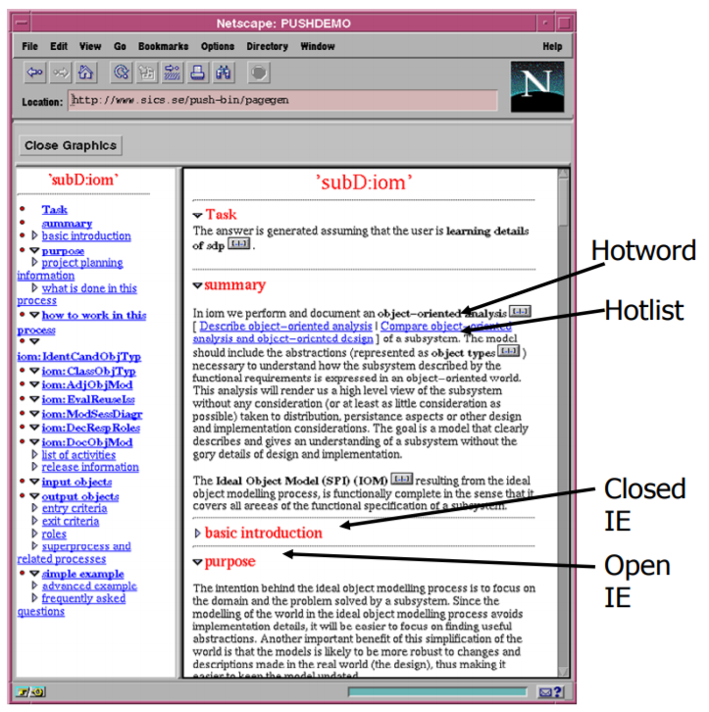
Stretch text adaptation

Slide 10
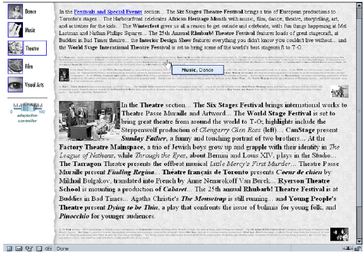
Scaling approach
Follows the
“fish eye”
visualisation
Technique
Adaptation of
an online guide
about cultural
events in Toronto:

Slide 11



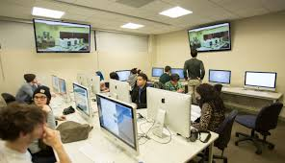

Dynamic content presentation
Media adaptation: factors
User-specific factors
Information-specific features
Media constraints
Contextual information
Limitations of technical resources

Slide 12
Dynamic content presentation
Media adaptation: approaches
Rule-based approaches
Using rules to define how to take into account the media factors in media selection
Optimisation approaches
Given the media factors, find the media combination that produces the most optimal result

Slide 13
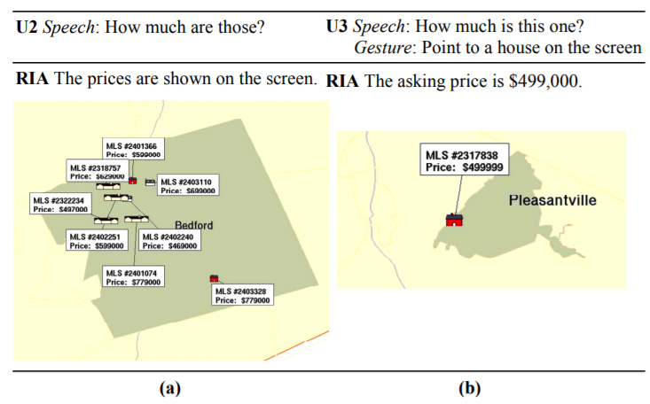
Example: RIA (media adaptation – optimisation)
The optimisation procedure deals with: (1) suitability of the information to the media; (2) increase recallability; (3) maintain presentation consistency

Slide 14
Summary: Adaptive Content Presentation
The main adaptation mechanism of the system
Static:
pre-defined pages
Semi-dynamic:
pre-defined fragments
Dynamic:
automatic content selection and presentation
Link with adaptation mechanisms discussed earlier:
recommendations
filtering
re-ordering

Slide 15
Main Reading
The lecture closely follows the review paper:
Adaptive Content Presentation for the Web, by Andrea Bunt, Giuseppe Carenini, and Cristina Conati (available in Minerva)

