Slide 1
COMP3771 User Adaptive Intelligent Systems
Evaluation of User-adaptive Systems
Vania Dimitrova School of Computing, University of Leeds
Link with the lecture on Evaluation of Recommender Systems

Slide 2
At what stage is the system that you are you evaluating?
System prototype(s) – Formative Evaluation
Does the system work as intended?
Do the components perform adequately?
Which design to chose (from several prototypes)?
Deployable system – Summative Evaluation
What are the benefits of personalisation?
Are there any potential drawbacks?

Slide 3
“Divide to Concur”: Layered Evaluation
3
USER MODEL
2
USER MODEL ACQUISITION
4
USER MODEL APPLICATION
1
INFORMATION ABOUT U
5
ADAPTING TO U
6
Follows the architecture of user-adaptive systems

Slide 4
Layered evaluation
Collection of input data
Interpretation of the collected data
Modelling of the current state of the world
Deciding upon adaptation
Applying adaptation decisions
Evaluating adaptation as a whole

Slide 5

Example: 3Cixty app
See video (link in Minerva)
Smart Personalised City Guide

Slide 6
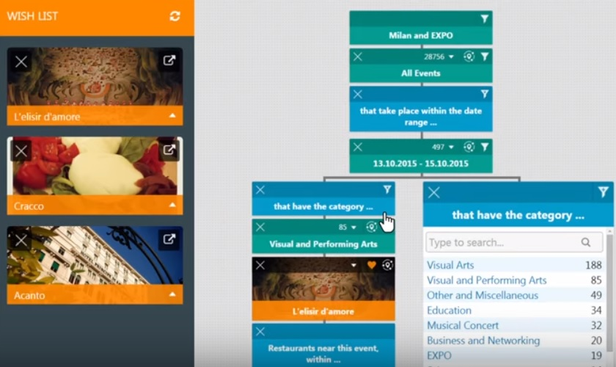
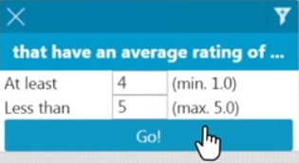
Example: 3Cixty app
See video (link in Minerva)
Collecting information about the user

Slide 7

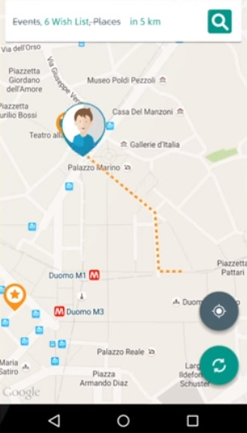
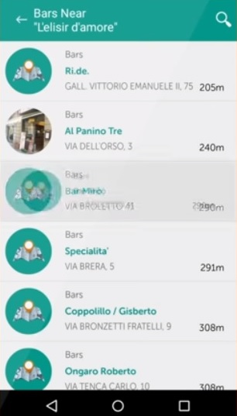
Example: 3Cixty app
See video (link in Minerva)
Recommending places to visit in Milan during a business trip

Slide 8
“Divide to Concur”: Layered Evaluation
3
USER MODEL
2
USER MODEL ACQUISITION
4
USER MODEL APPLICATION
1
INFORMATION ABOUT U
5
ADAPTING TO U
6

Slide 9
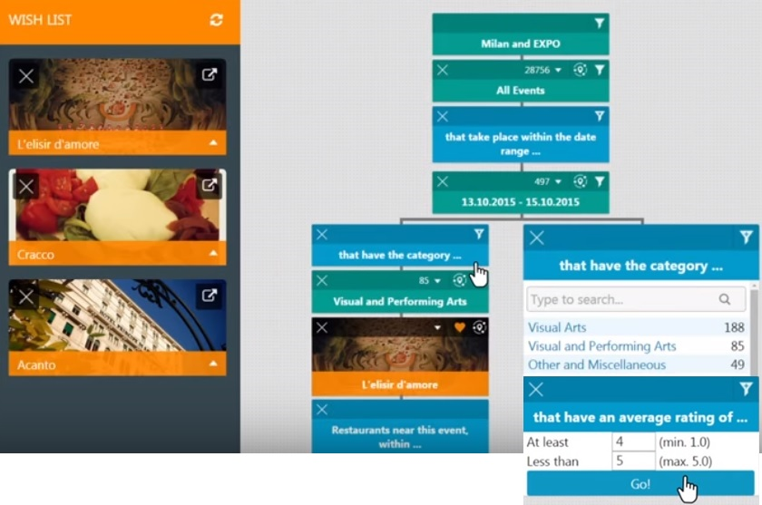
1 - Collection of Input Data
Goal
Check quality of raw input data
Criteria
Accuracy
Latency
Sampling rate
Explicit data collection
Methods
Data mining
Cross validation
User tests
Simulated users

Slide 10
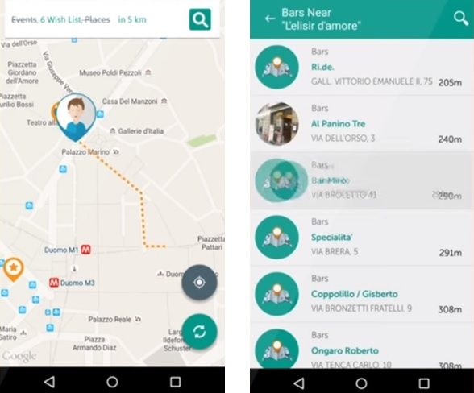
1 - Collection of Input Data
Goal
Check quality of raw input data
Criteria
Accuracy
Latency
Sampling rate
Implicit data collection
Methods
Data mining
Cross validation
User tests
Simulated users

Slide 11
“Divide to Concur”: Layered Evaluation
3
USER MODEL
2
USER MODEL ACQUISITION
4
USER MODEL APPLICATION
1
INFORMATION ABOUT U
5
ADAPTING TO U
6

Slide 12
2- User model acquisition
Goal
Check that input data is interpreted correctly
Criteria
Validity
Predictability
Scrutability
Methods
Data mining
Cross validation
Heuristic evaluation
User tests
Simulated users

Slide 13
“Divide to Concur”: Layered Evaluation
3
USER MODEL
2
USER MODEL ACQUISITION
4
USER MODEL APPLICATION
1
INFORMATION ABOUT U
5
ADAPTING TO U
6

Slide 14
3 - User Model
Goal
Check that the constructed user model represents the user
Primary Criteria
Validity
Predictability
Scrutability
Secondary Criteria
Consciousness
Comprehensiveness
Precision
Sensitivity
Methods
Data mining
Cross validation
Heuristic evaluation
User tests
Simulated users
Focus groups
User as wizard

Slide 15
“Divide to Concur”: Layered Evaluation
3
USER MODEL
2
USER MODEL ACQUISITION
4
USER MODEL APPLICATION
1
INFORMATION ABOUT U
5
ADAPTING TO U
6

Slide 16
4 – User model application (deciding upon adaptation)
Goal
Determine whether the adaptation decisions made are optimal
Criteria
Appropriateness
Acceptance
Predictability
Scruitability
Breadth of experience
Methods
Data mining
Cross validation
Heuristic evaluation/walkthrough
User tests
Simulated users
Focus groups
User as wizard

Slide 17
“Divide to Concur”: Layered Evaluation
3
USER MODEL
2
USER MODEL ACQUISITION
4
USER MODEL APPLICATION
1
INFORMATION ABOUT U
5
ADAPTING TO U
6

Slide 18
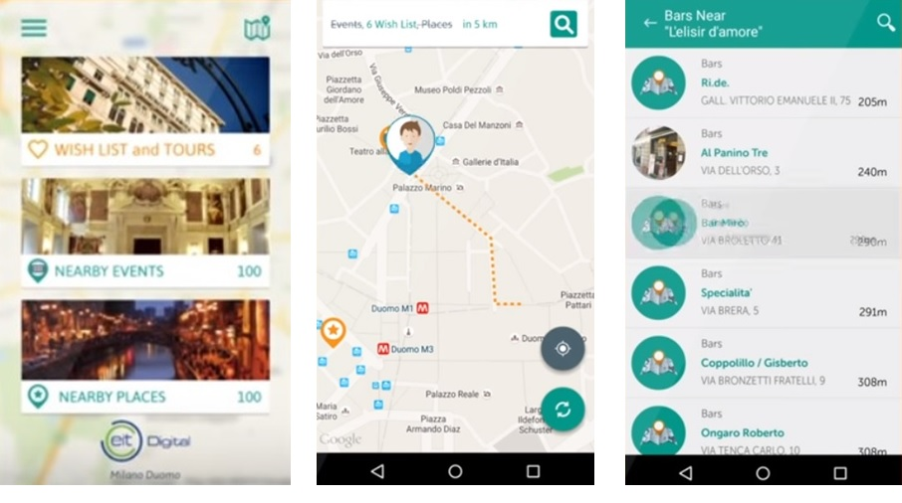
5 - Applying adaptation decisions (User Interface)
Goal
Determine whether the implementation of the adaptation decisions is optimal
Criteria
Usability
Timeliness
Obtrusiveness
Acceptance
Predictibility
Breadth of experience
Methods
Heuristic evaluation
Cognitive walkthrough
Focus groups
User tests
User as wizard

Slide 19
“Divide to Concur”: Layered Evaluation
3
USER MODEL
2
USER MODEL ACQUISITION
4
USER MODEL APPLICATION
1
INFORMATION ABOUT U
5
ADAPTING TO U
6

Slide 20
6 - Evaluating system as a whole
Goal
Evaluate the utility of the system; include both benefits and drawbacks (usability threats)
Typical benefits (utility) of user-adaptive systems:
Efficiency (performing tasks quicker)
Effectiveness (performing tasks better)
User satisfaction (users may be happier with personalised systems)
Trust (users may feel more valued)
Accessibility (all categories of users catered for)
Improved revenue (e.g. in e-commerce)
Customers’ loyalty (e.g. in e-commerce)
Always consider the drawbacks (usability threats)!

Slide 21
Experimental Studies with Users
AB Testing
User allocation - random
System A
System B
User interaction
Performance metrics
Utility metrics
User interaction
Performance metrics
Utility metrics
Compare: mean, median, mode
Statistical significance: parametric (t-test, ANOVA); non-parametric

Slide 22
Main Reading
Layered evaluation of interactive adaptive systems: Framework and formative methods, Paramythis, Weibelzahl, Masthoff 2010 (note that the paper is very detailed, you are not required to get in so much detail for the module, basic understanding of the techniques and an informed choice when they are applicable is what is required in this module; those who are interested to get deep knowledge of evaluation, can enjoy reading the paper in full detail)

