Slide 1
Human emotion recognition
2018/10
Han Shih

Slide 2
Outline
Problem definition
Dataset exploration
Data preprocessing
Model building
Conclusion

Slide 3



Problem definition
Originate from FER2013
Kaggle Facial Expression Recognition Challenge
Simple task
7 predefined classes
Choose one as prediction
CNN only
Notes:
International conference of machine learning
Multi-class classification
Not CNN necessarily, in practice

Slide 4
Problem definition
Expression Recognition
To know how customers respond to ads, products, packaging and store design
Education
Measure real-time learner responses
Adapt and personalize content
Measure effectiveness of lecturer
Notes:
透過表情，可以大略地知道該受測對象的情緒狀態，並可對其做出進一步的回應。
產品包裝、店面布置

Slide 5
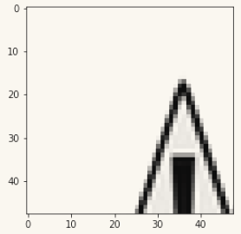
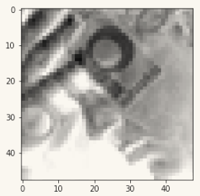
Dataset exploration
Training instances: 22000
Images size: 48*48
Greyscale
Target object cropped
Watermark
Bad data
Notes:
臉部的浮水印、圖片過度曝光/亮度不足導致臉部輪廓不明顯、甚至是缺圖(sample_59)等狀況。 Bad data : less than 3% (Personal estimation Could be ignored

Slide 6
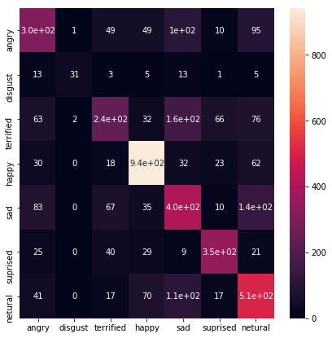
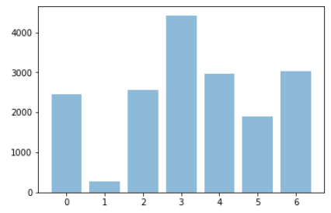
Dataset exploration
Imbalance dataset
The percentage of "disgust" is 1%
Ignore it
Merge into other classes
Train with weight
Over-sampling
Notes:
compared to the effort data cleansing

Slide 7
Data preprocessing
Different sizes
Crop
Scale
Different sources
Whitening
Standardization / re-scaling
Greyscale
Bad data removal
Notes:
練習所用之資料即已做了不少前處理 global average pooling 可以處理不同大小的圖片 whitening 可用於對 overexposed/underexposed 的圖片進行處理

Slide 8
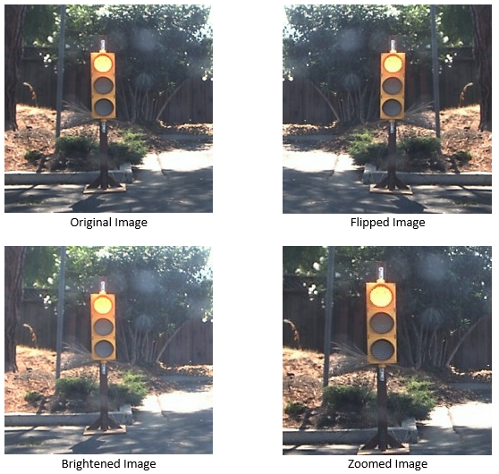
Data preprocessing
Data augmentation
keras.preprocessing.image.ImageDataGenerator
brightness_range
shear_range
zoom_range
rotation_range
horizontal_flip
Notes:
有鑑於 model performance 難以提升，一個簡單的做法就是增加資料量 "more training data" is preferable than "more complex model"

Slide 9
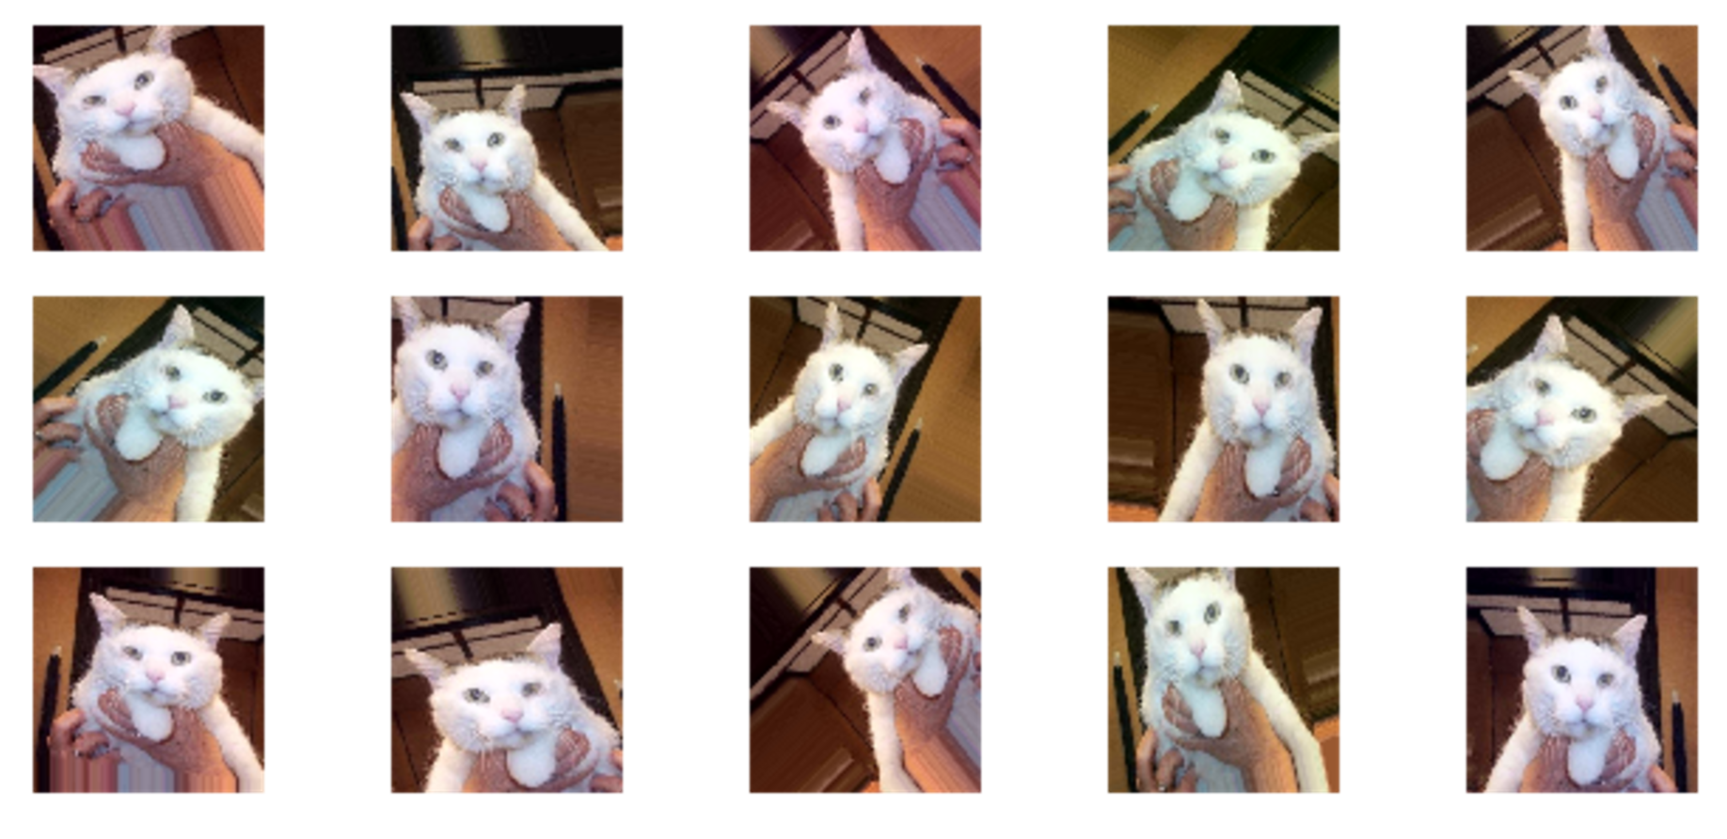
Data preprocessing
Notes:
可能影響 training speed (考量時間&硬體資源)

Slide 10
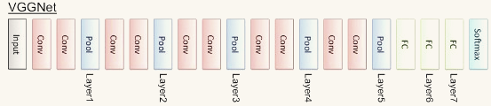
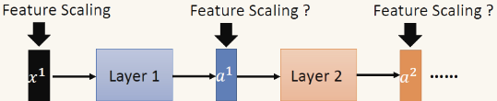
Model building
Using VGG as prototype
Batch normalization
Notes:
Statistics changes during training small learning rate might be helpful -> slower
“internal covariate shift”

Slide 11
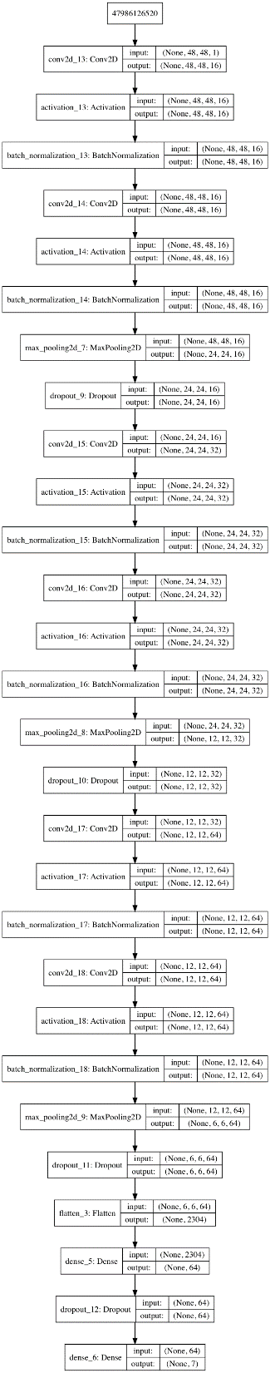
Model building
Using VGG as prototype
Notes:
BN after ACT, DROP after POOL and FC

Slide 12

Model building
Using VGG as prototype
Near 120K instances (through augmentation)
Around 240K parameters
About 300~500 epoch
Weeks of training
OA sucks
Others’ OA
Google cloud platform
Using popular model
keras.applications
Re-scale input
Notes:
#param:#inst ~~ 10:1
實際應用上，直接使用 state of the art 的 model 是建議的選擇 (縮短開發時間 <> 運算成本)

Slide 13

Conclusion
More data augmentation
Width/height/channel shift
Contrast
Noises
Interpolation
Transfer learning
Advanced preprocessing technique
Build multiple models for specific cases
Notes:
1. Constant
may not work for natural images, but can work for images taken in a monochromatic background
2. Edge
extended after the boundary. This method can work for mild translations.
3. Reflect
reflected along the image boundary. useful for continuous or natural backgrounds
4. Symmetric
This method is similar to reflect
5. Wrap
repeated beyond its boundary, not as popularly used as the rest as it does not make sense
*** Not to increase irrelevant data *** 避免添加不合理的資料 EG. 69
人臉擷取、去除非人臉圖片、去除雜訊 …

Slide 14
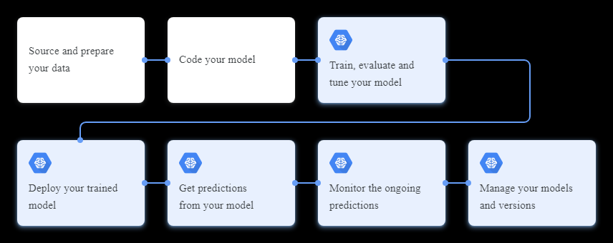
Appendix - Google Cloud ML Engine
Google Cloud Machine Learning Engine
Workflow

Slide 15

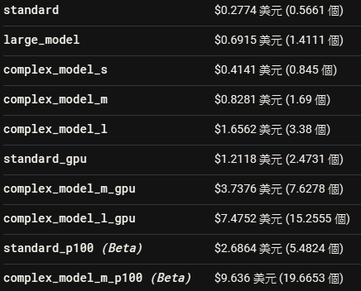
Appendix - Google Cloud ML Engine
Google Cloud Machine Learning Engine
訓練工作為每「訓練單元」 $0.49 美元/小時，訓練單元數量則視機器設定而定。

Slide 16
Appendix - Google Cloud ML Engine
Google Cloud Machine Learning Engine
使用「CUSTOM」配置層級來執行訓練工作。處理叢集選用以下設定：
選用「complex_model_s」當做主要執行個體 5 部「large_model」執行的參數伺服器 8 部「complex_model_s」執行的工作站 作業時間為 2 小時 26 分鐘。計算公式如下：
(($0.41406 + $3.4573 + $3.31248) per hour / 60) * 146 minutes
這項工作的總費用為 $17.48 美元
非運行時段僅收取以下費用
Static IP
Disk usage
Notes:
訓練單元運算力 要和實機裝顯卡比較測試

Slide 17
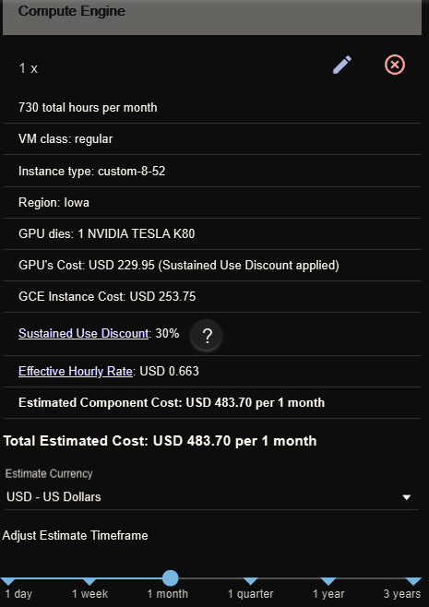
Appendix - Google Cloud Compute Engine
Google Cloud Compute Engine
8 CPU
52G RAM
TESLA K80 *1

Slide 18
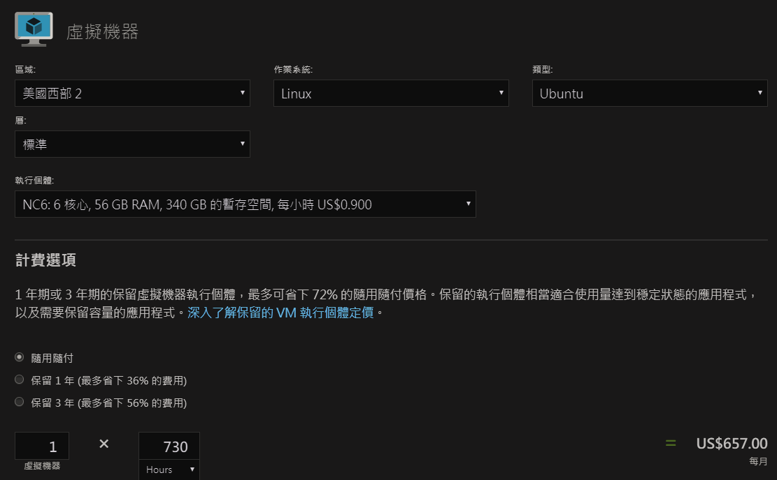
Appendix – Azure VM with GPU
Google Cloud Compute Engine
8 CPU
52G RAM
TESLA K80 *1

Slide 19
Appendix – GPU comparison
123
 | 3D Mark 戰鬥力 | 價格(NTD) | C/P值(越高越好)
GTX TITAN X | 13484 | 36,936 | 36.50%
GTX 1080 Ti | 14092 | 21,853 | 64.48%
GTX 1080 | 12324 | 13,235 | 93.11%
GTX 980 Ti | 11347 | 20,930 | 54.21%
GTX 980 | 9602 | 18,405 | 52.17%
GTX 1070 Ti | 12154 | 12,208 | 99.55%
GTX 1070 | 11206 | 11,531 | 97.18%
GTX 1060 3GB | 8931 | 6,772 | 131.8% (勝)
GTX 1060 6GB | 9009 | 7,668 | 117.4%
GTX 1050 Ti | 5950 | 5,184 | 114.7%
GTX 1050 | 4610 | 3,987 | 115.6%
K80 | ~7000 | 14776~20010/month

Slide 20
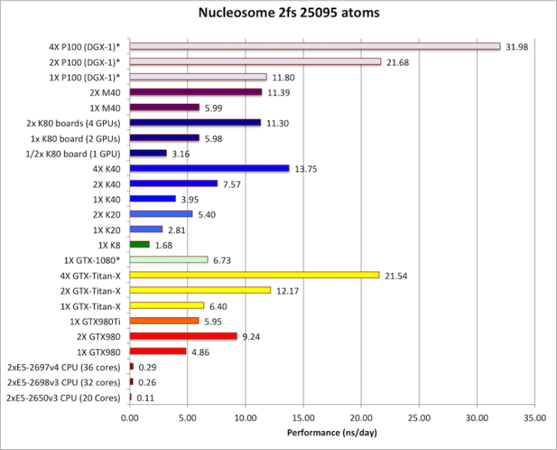
Appendix – Azure VM with GPU
123

Slide 21
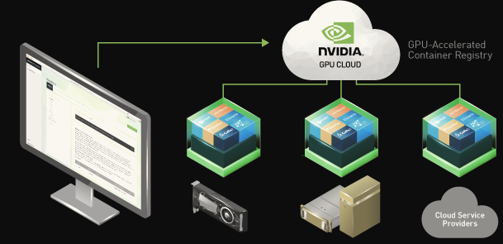
Appendix – NVIDIA Cloud Platform
Optimized deep learning software containers
NVIDIA GPU-accelerated releases of popular frameworks
Support NVIDIA GPUs on Amazon EC2, Google Cloud, Microsoft Azure, and Oracle Cloud

Slide 22
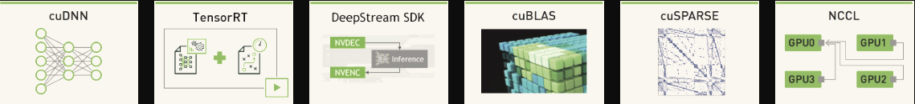
Appendix – NVIDIA Cloud Platform
NVIDIA Deep Learning SDK
cuDNN: building blocks for DNN application
TensorRT: DL inference for runtime
DeepStream SDK: High-level C++ API for transcoding
cuBLAS: basic linear algebra subprogram with GPU
cuSPARSE: linear algebra subroutines for sparse matrices
NCCL: communication routines for multi-GPU training
(DIGITS): train DNNs for image-related tasks
Notes:
Deep Learning Primitives (cuDNN): High-performance building blocks for deep neural network applications including convolutions, activation functions, and tensor transformations
Deep Learning Inference Engine (TensorRT): High-performance deep learning inference runtime for production deployment
Deep Learning for Video Analytics (DeepStream SDK): High-level C++ API and runtime for GPU-accelerated transcoding and deep learning inference
Linear Algebra (cuBLAS): GPU-accelerated BLAS functionality that delivers 6x to 17x faster performance than CPU-only BLAS libraries
Sparse Matrix Operations (cuSPARSE): GPU-accelerated linear algebra subroutines for sparse matrices that deliver up to 8x faster performance than CPU BLAS (MKL), ideal for applications such as natural language processing
Multi-GPU Communication (NCCL): Collective communication routines, such as all-gather, reduce, and broadcast that accelerate multi-GPU deep learning training
Deep Learning GPU Training System (DIGITS): Rapidly train highly accurate deep neural network (DNNs) for image classification, segmentation and object detection tasks

Slide 23
Appendix – Other NVIDIA resources
News and blogs
https://devblogs.nvidia.com/
https://blogs.nvidia.com/
https://news.developer.nvidia.com/
SlideShare
https://www.slideshare.net/NVIDIA/
AI-podcast
https://blogs.nvidia.com/ai-podcast/
YouTube channel
https://www.youtube.com/channel/UC_ErhNjgkPOA9Kuahcj-iTA

