Slide 1
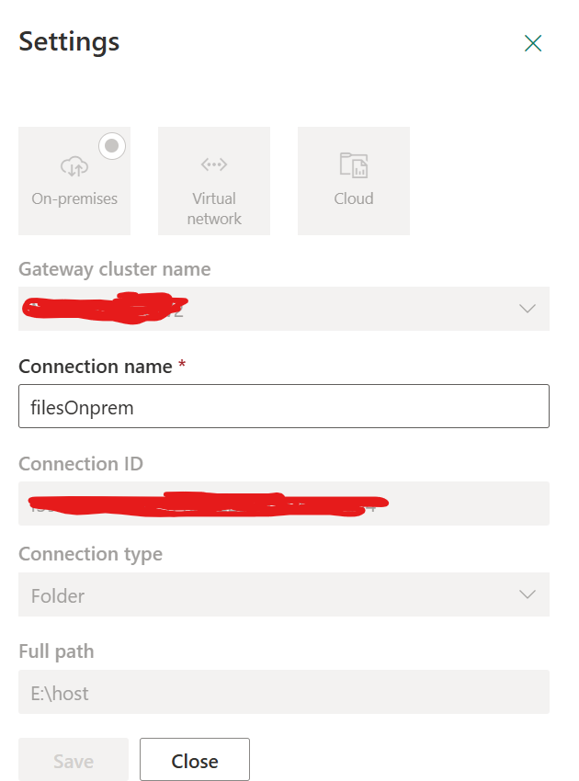
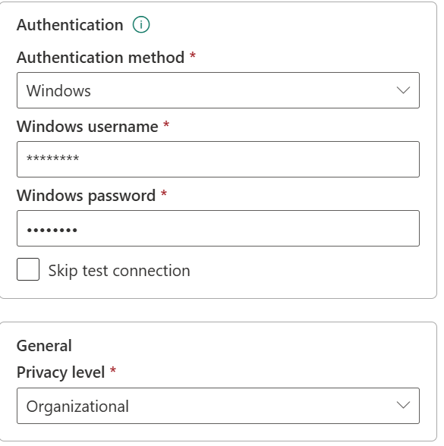
filesOnprem connection to On premise gateway server
. On app.powerbi.com, setup new connection from
Manage Connections and Gateways settings

Slide 2
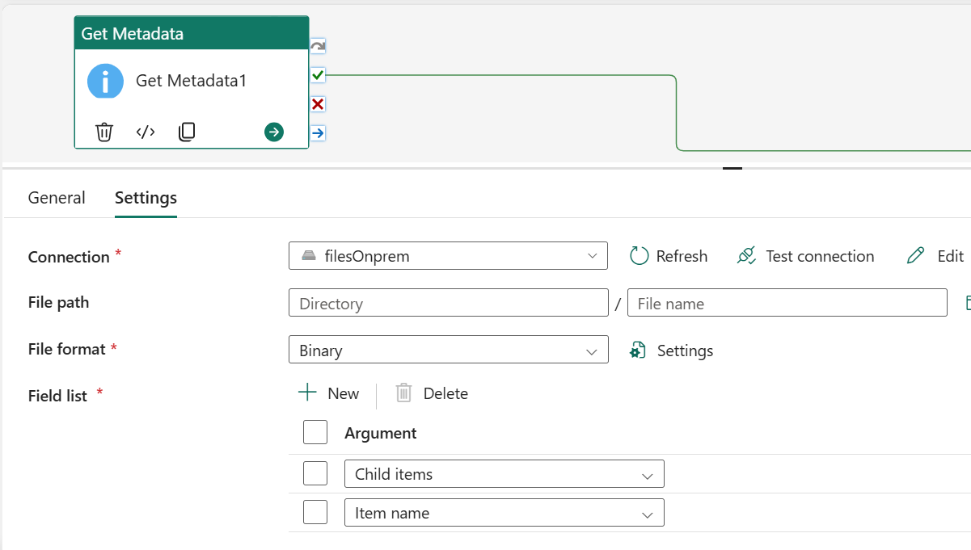
Get Metadata activity
Get list of all file names from source (Onprem)

Slide 3
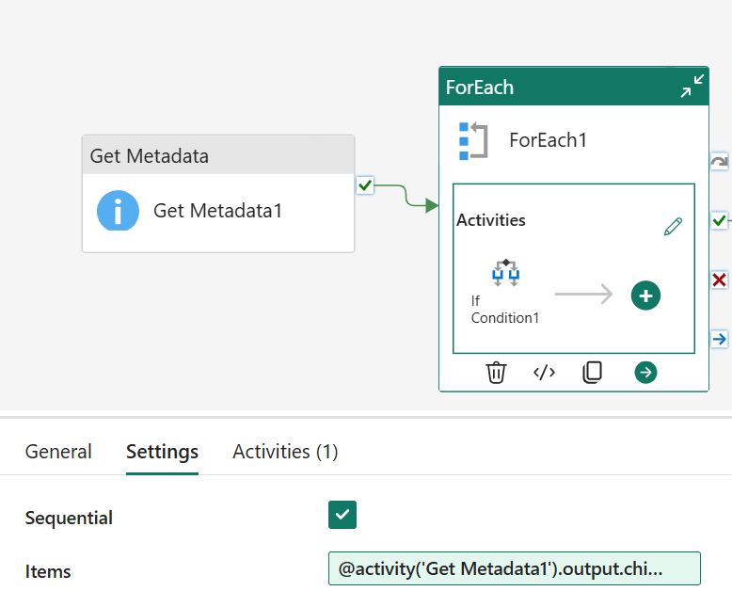
ForEach Settings
The filenames are obtained from Get Metadata to foreach loop
Item : @activity('Get Metadata1').output.childItems

Slide 4
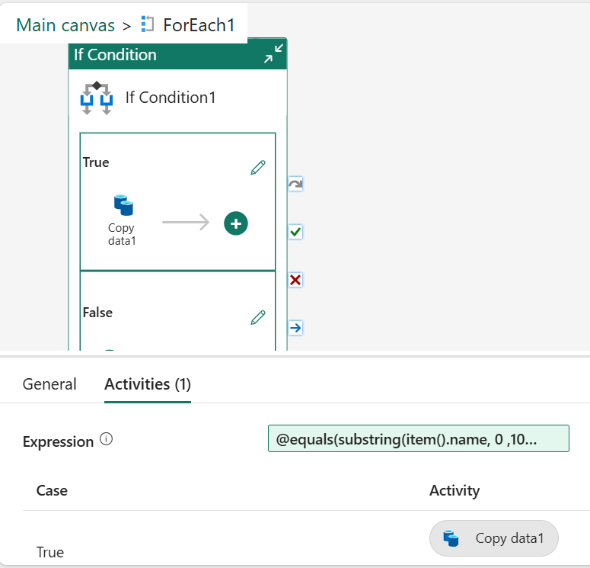
IF Condition
Expression evaluate the date part of the filename and compares with current date if it is equal. True will pass the file name to copy activity to get the file
Expression: @equals(substring(item().name, 0 ,10 ), formatDateTime(utcNow(),'yyyy-MM-dd'))

Slide 5
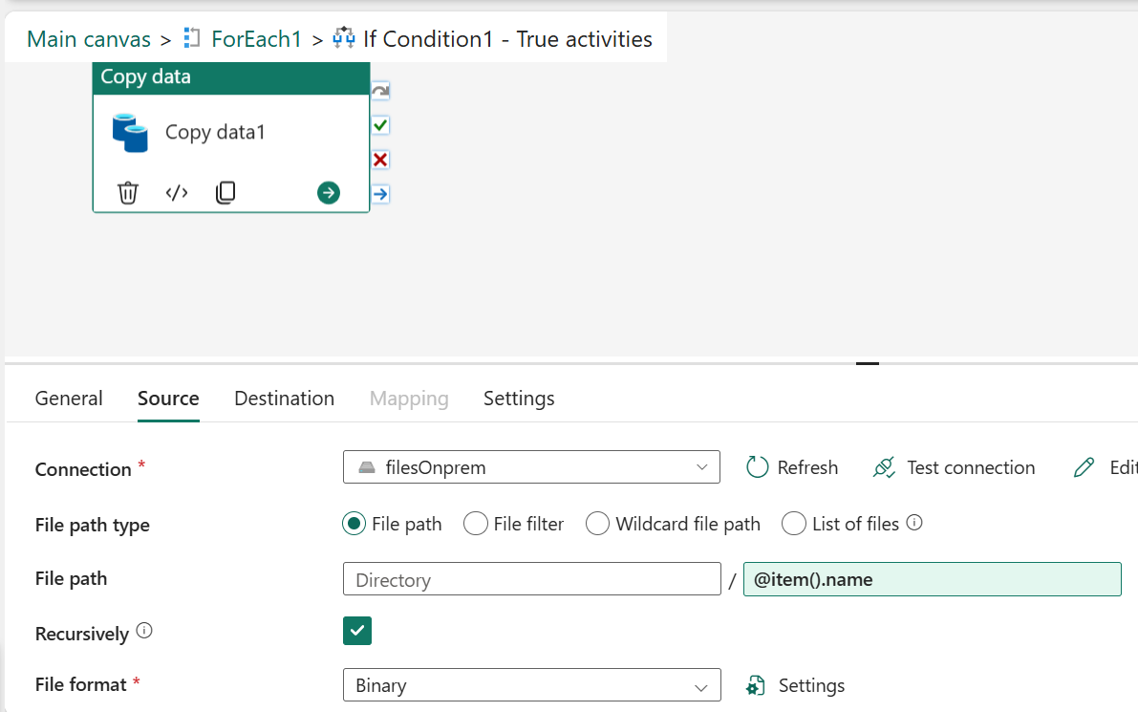
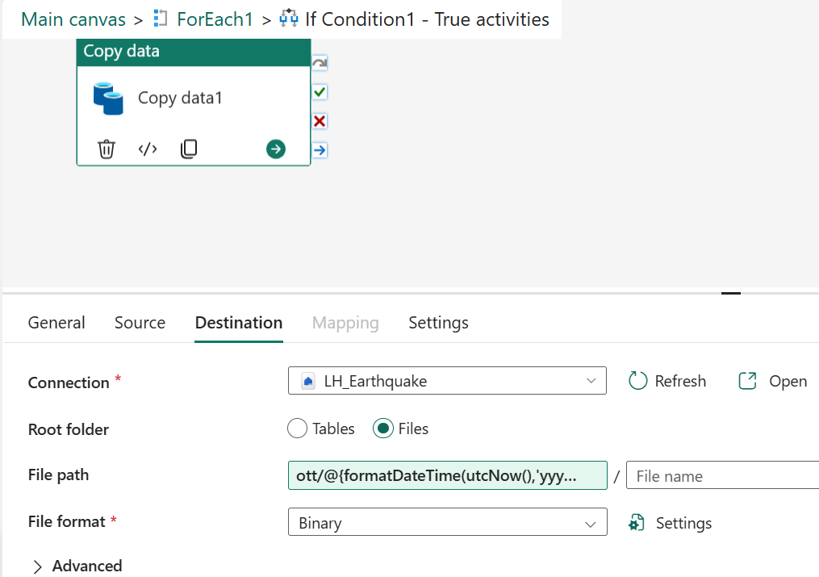
Copy activity within Foreach If condition
File path: ott/@{formatDateTime(utcNow(),'yyyy-MM-dd' )}
Filename: @item().name

Slide 6
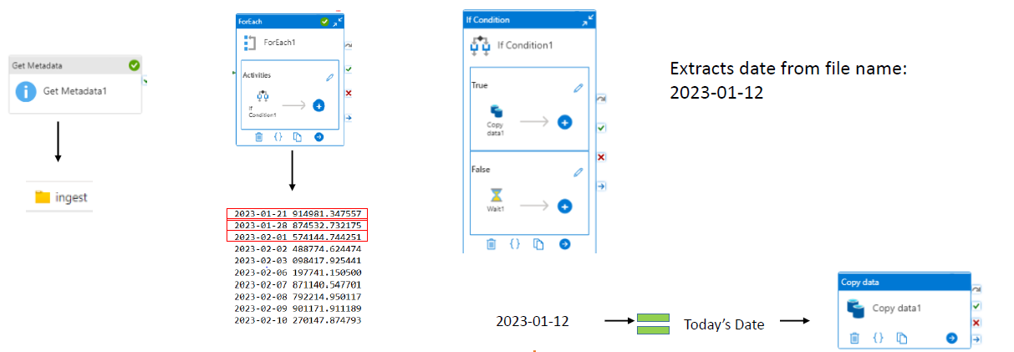
Extracting date from File Name
2025-01-29 120514.csv
0 1 2 3 4 5 6 7 8 9 10
2025-01-29 =Today’s Date

Slide 7
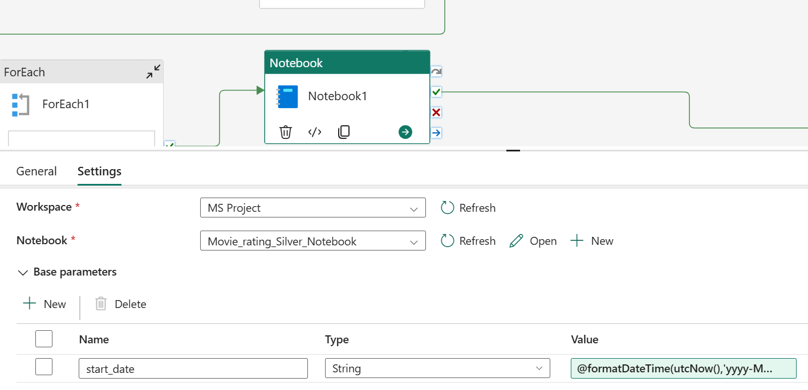
Notebook activity: Transformation
Value: @formatDateTime(utcNow(),'yyyy-MM-dd’)
The value is pass as parameter to the notebook

Slide 8
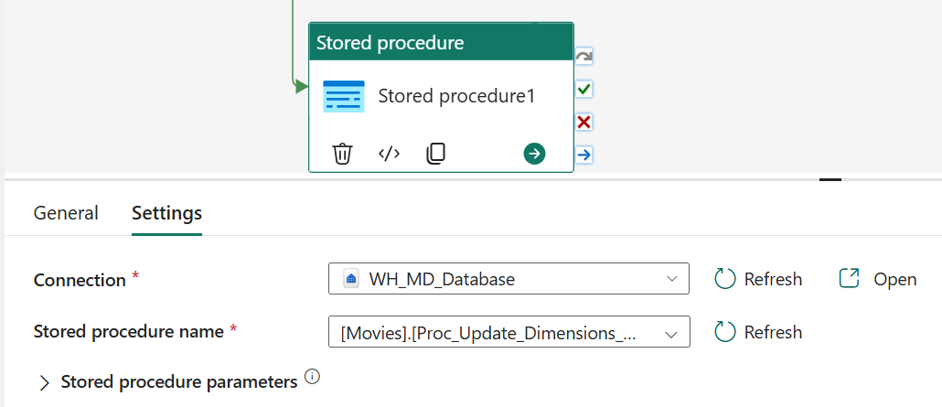
Store procedure activity
WH_MD_Database refers to the connection to the Warehouse

Slide 9
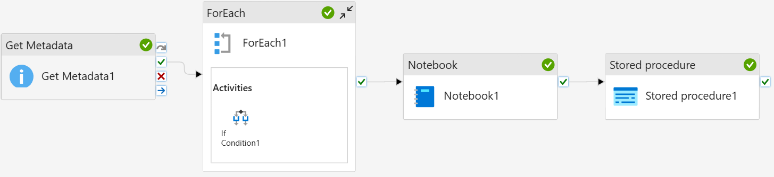

Slide 10
