Slide 1
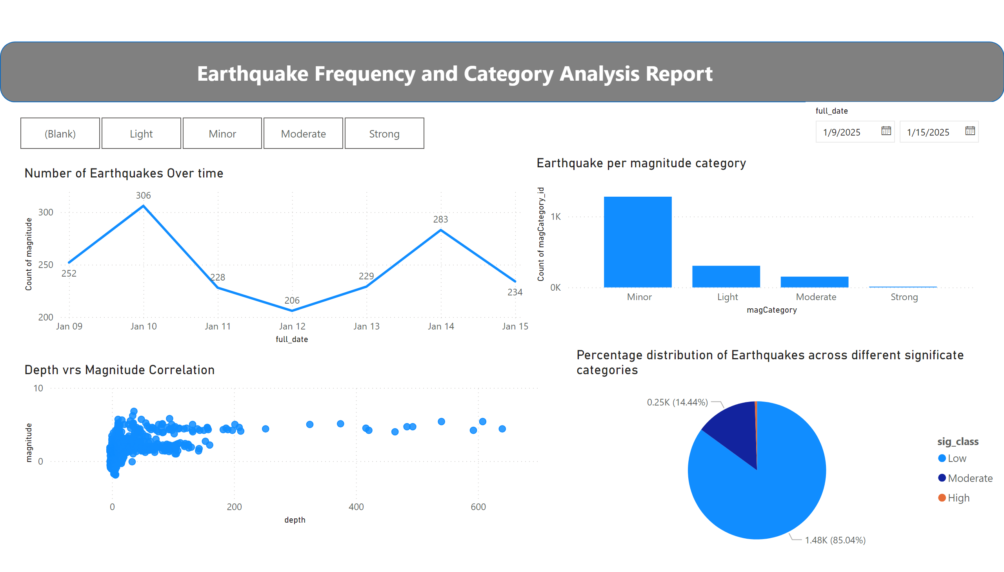
Frequency and Category
Notes:
Number of Earthquakes Over time
No alt text provided
Percentage distribution of Earthquakes across different significate categories
No alt text provided
slicer
No alt text provided
shape
No alt text provided
textbox
No alt text provided
Depth vrs Magnitude Correlation
No alt text provided
Earthquake per magnitude category
No alt text provided
slicer
No alt text provided

Slide 2
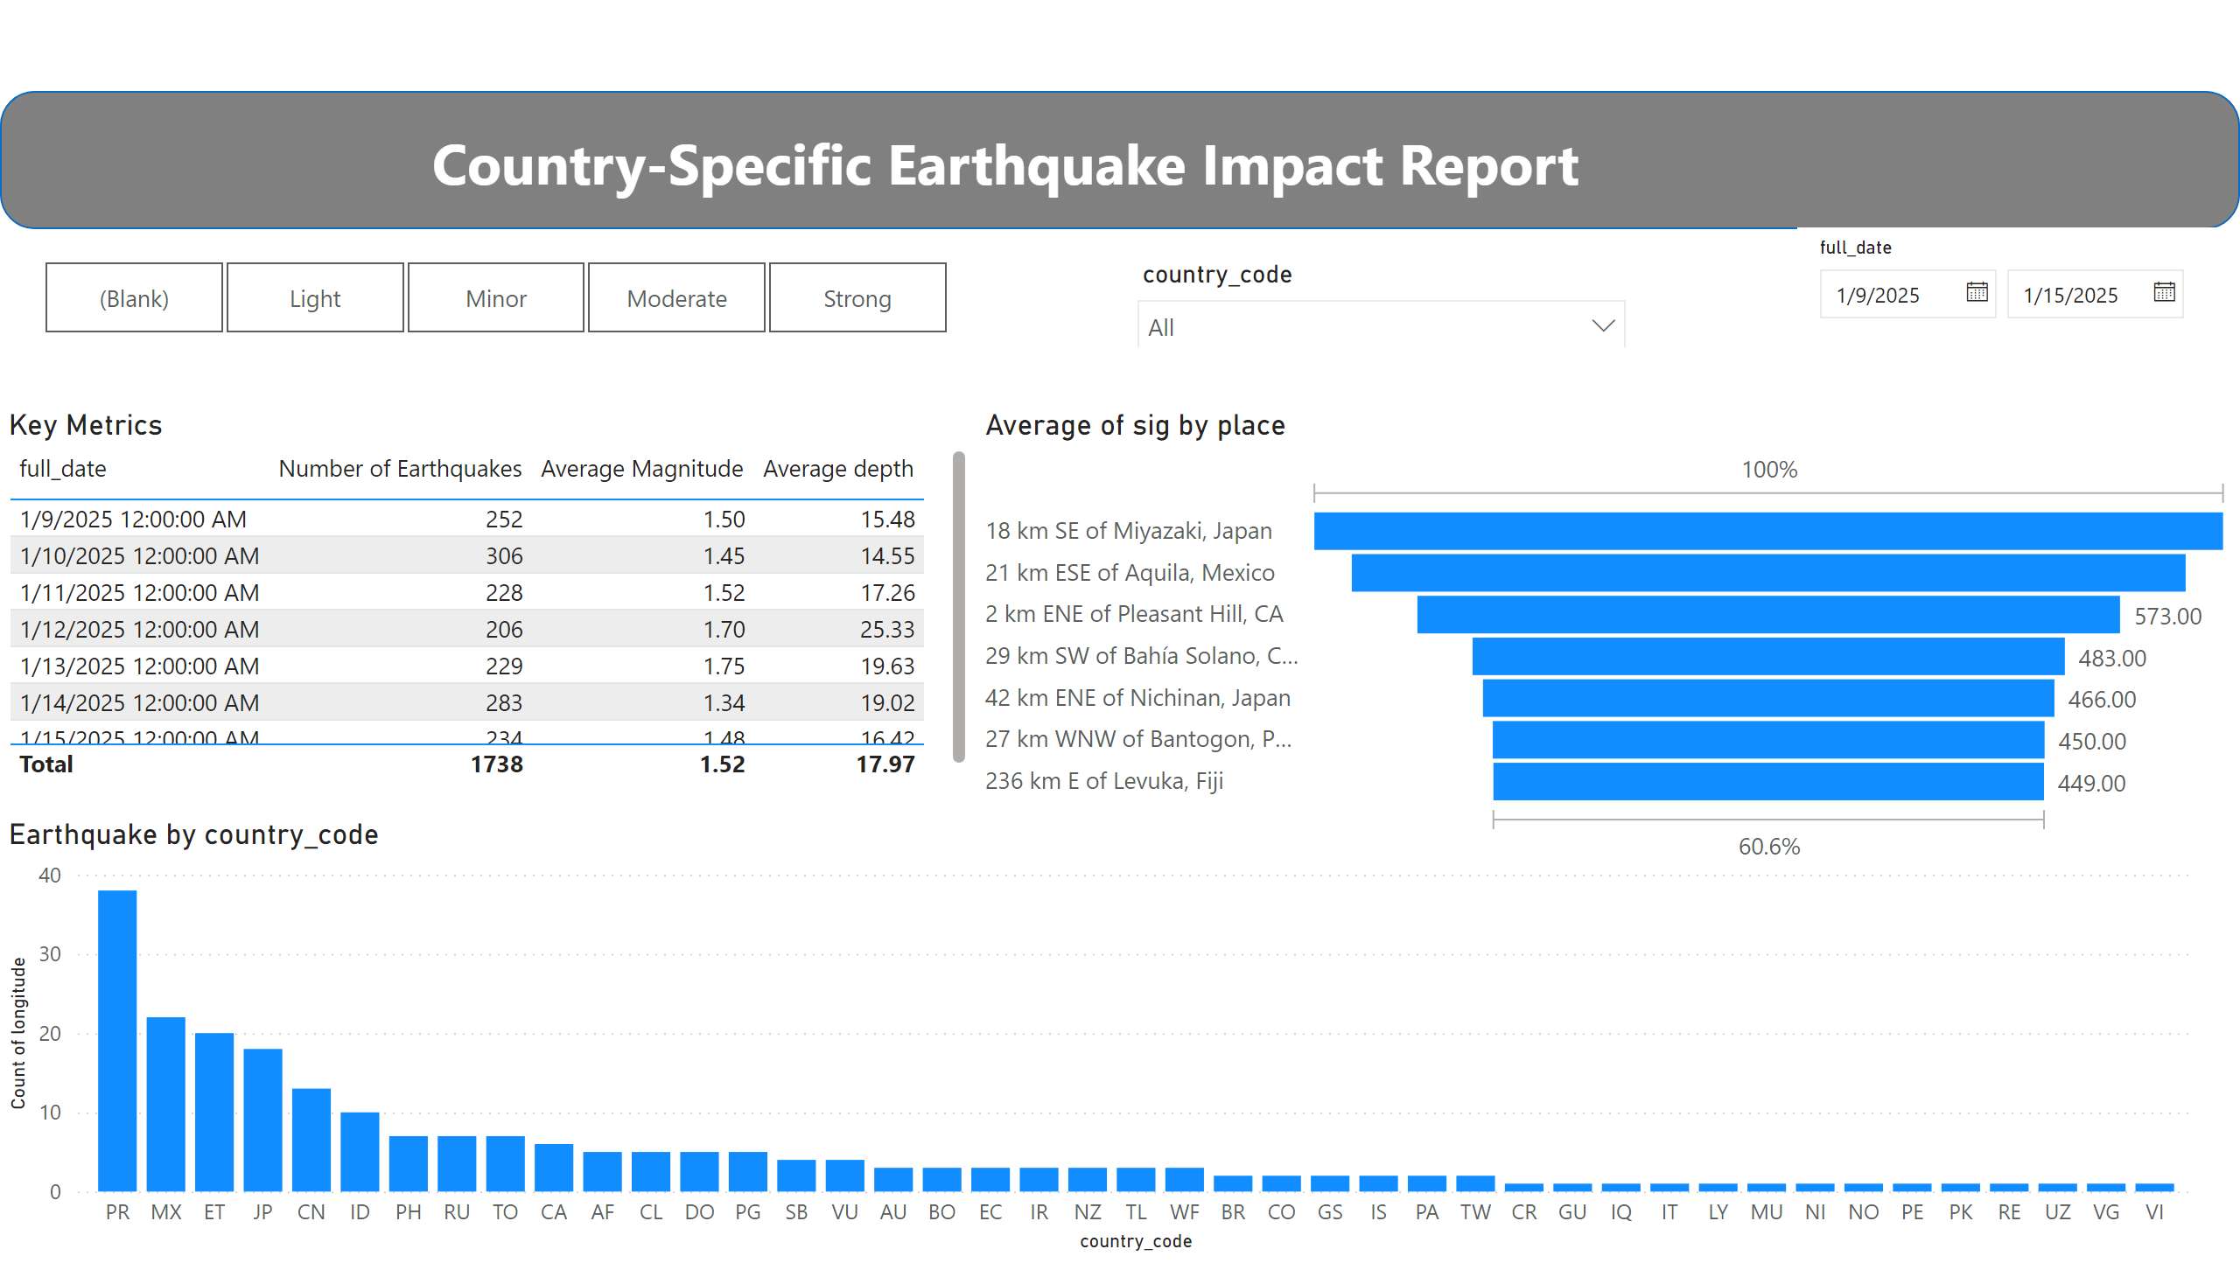
Country Specific
Notes:
shape
No alt text provided
Key Metrics
No alt text provided
Earthquake by country_code
No alt text provided
funnel
No alt text provided
slicer
No alt text provided
slicer
No alt text provided
textbox
No alt text provided
slicer
No alt text provided

Slide 3
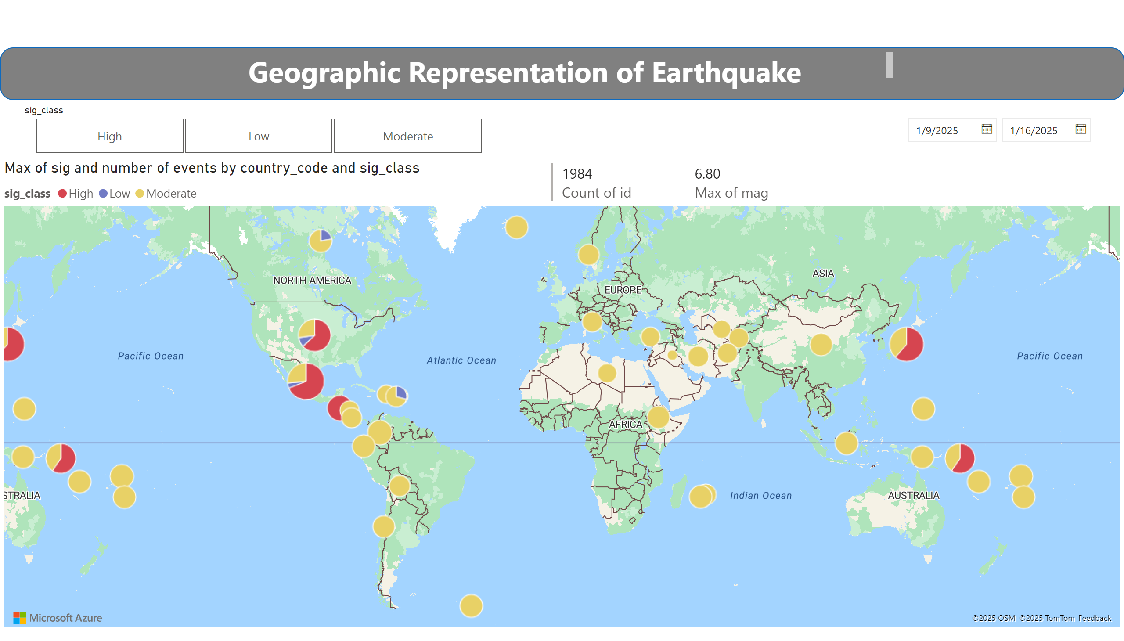
Geographic Representation
Notes:
shape
No alt text provided
textbox
No alt text provided
multiRowCard
No alt text provided
slicer
No alt text provided
slicer
No alt text provided
azureMap
No alt text provided

