Slide 1



Sales_report
View in Power BI
Last data refresh:
2/24/2025 8:21:05 PM UTC
Downloaded at:
3/5/2025 8:39:36 AM UTC

Slide 2
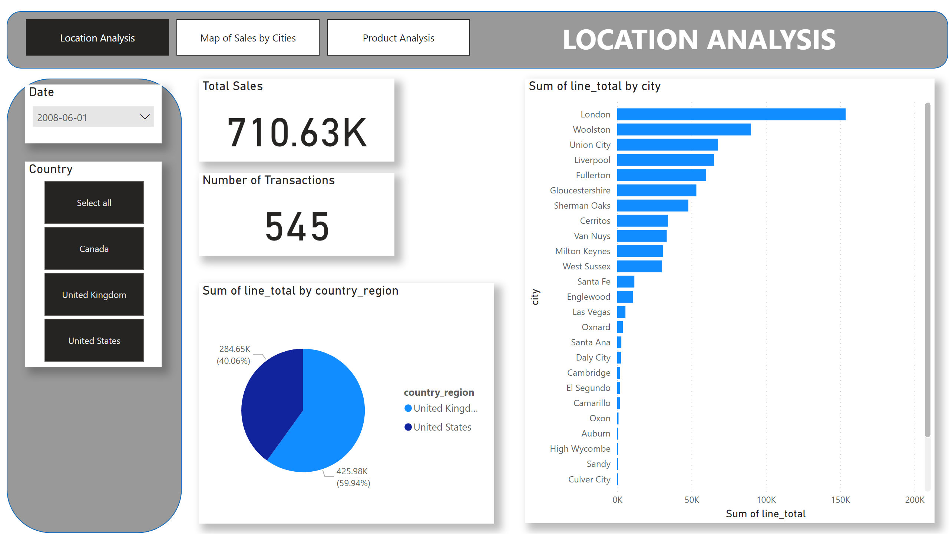
Location Analysis
Notes:
Total Sales
No alt text provided
Country
No alt text provided
Date
No alt text provided
clusteredBarChart
No alt text provided
pieChart
No alt text provided
shape
No alt text provided
textbox
No alt text provided
pageNavigator
No alt text provided
shape
No alt text provided
Number of Transactions
No alt text provided

Slide 3
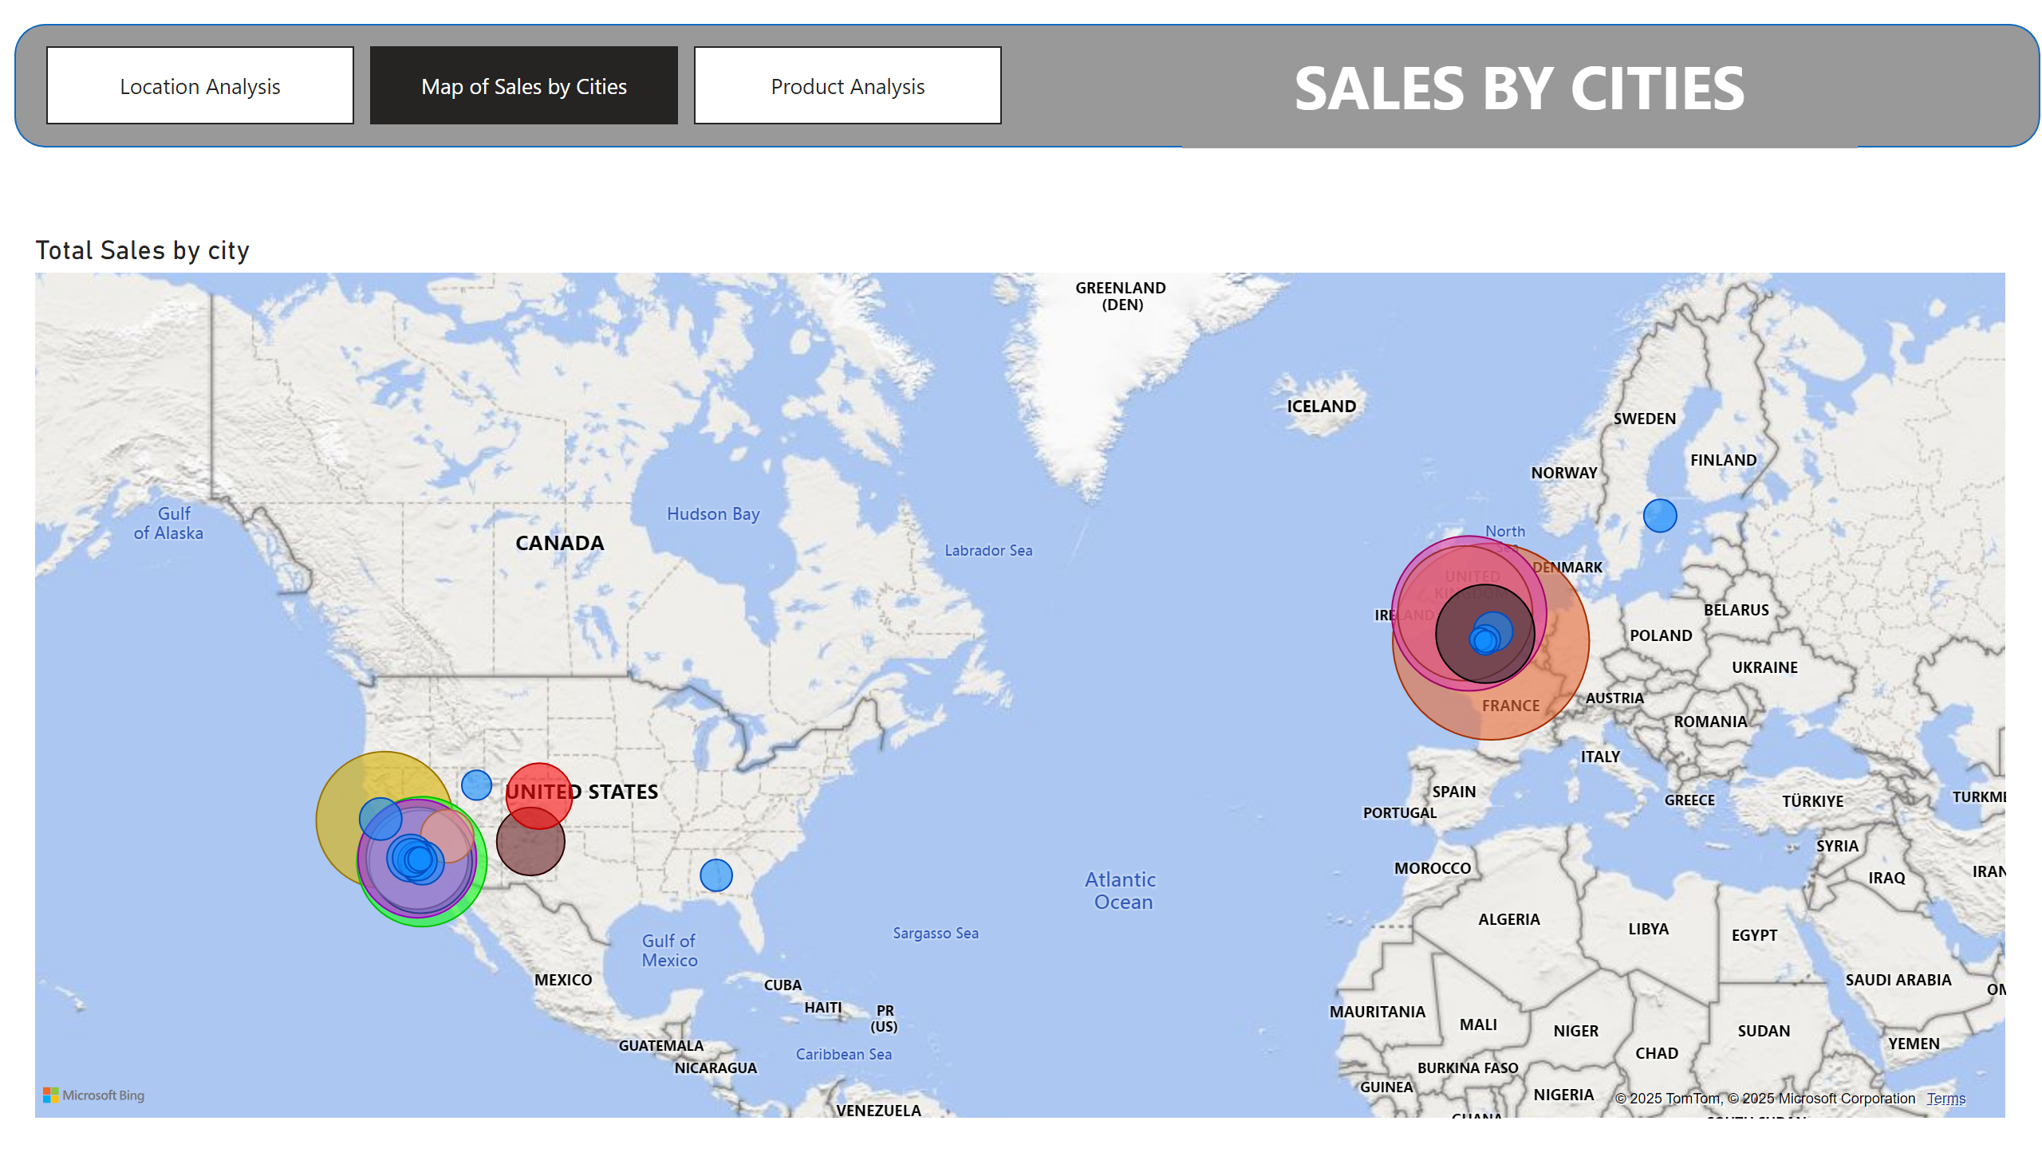
Map of Sales by Cities
Notes:
shape
No alt text provided
textbox
No alt text provided
pageNavigator
No alt text provided
Total Sales by city
No alt text provided

Slide 4
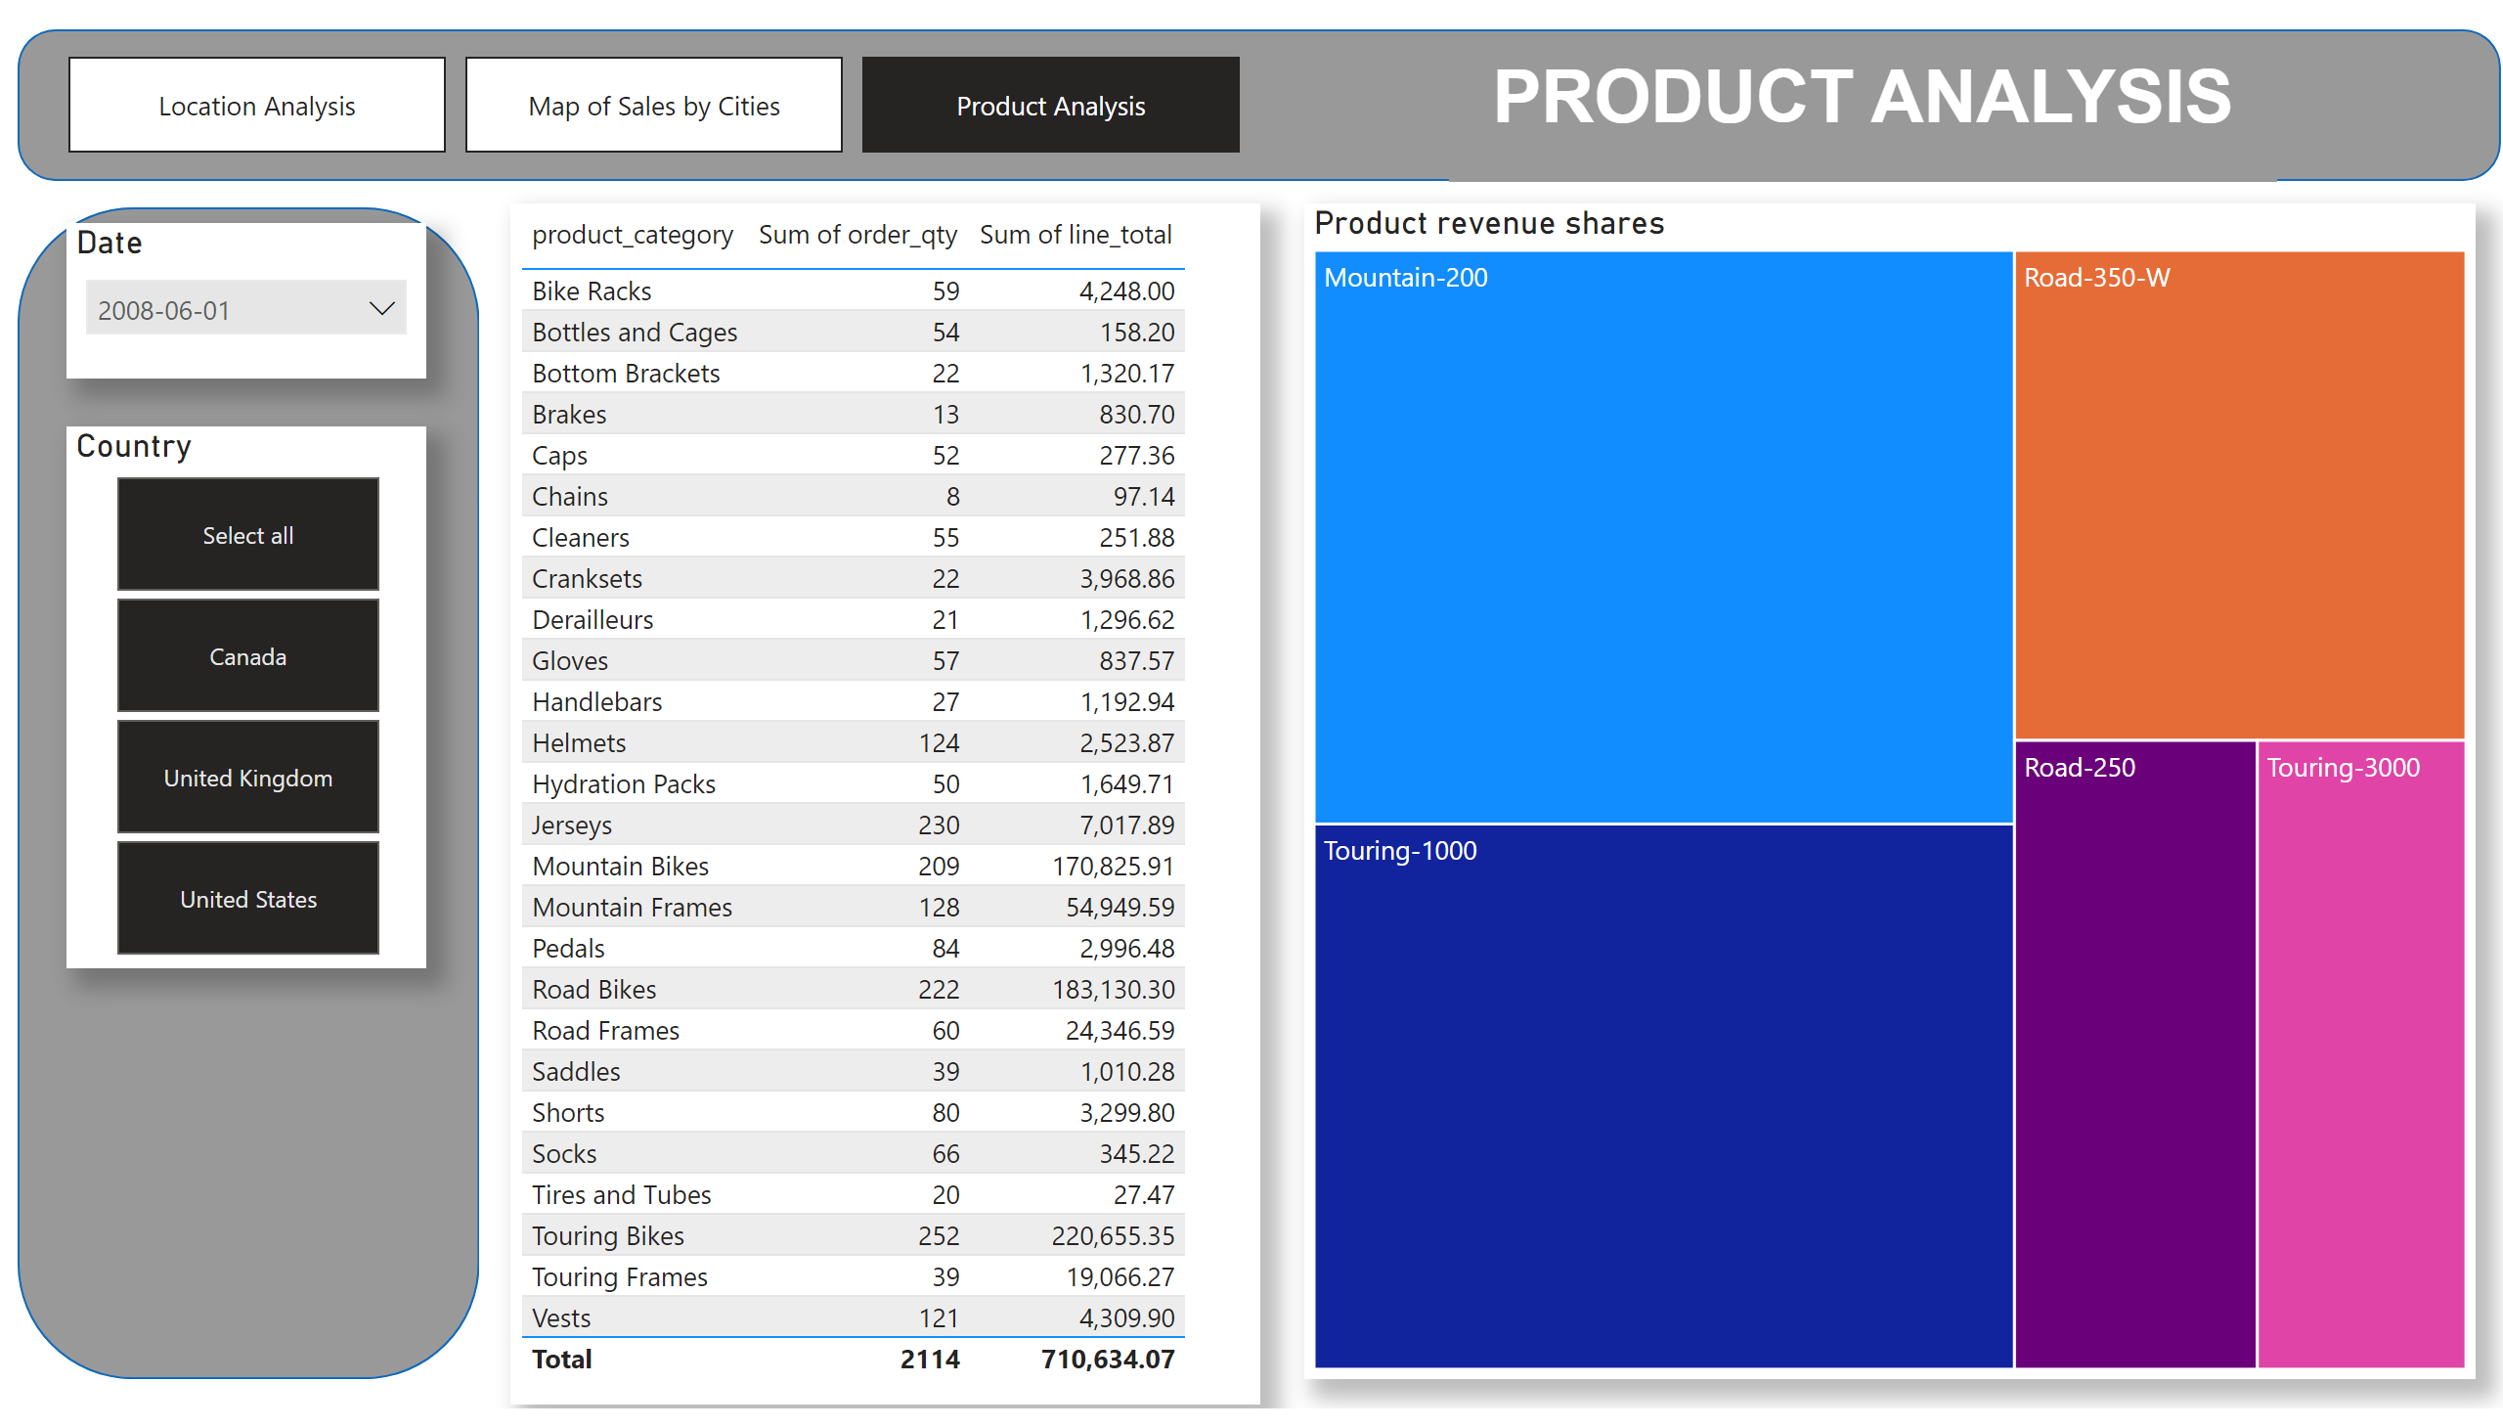
Product Analysis
Notes:
shape
No alt text provided
textbox
No alt text provided
tableEx
No alt text provided
Date
No alt text provided
Country
No alt text provided
shape
No alt text provided
Product revenue shares
No alt text provided
pageNavigator
No alt text provided

