Slide 1
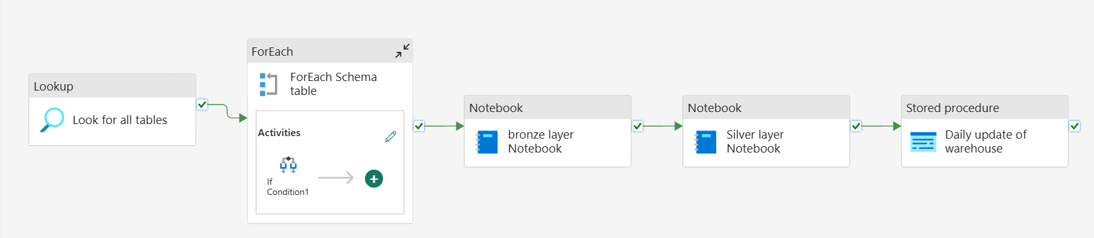

Slide 2
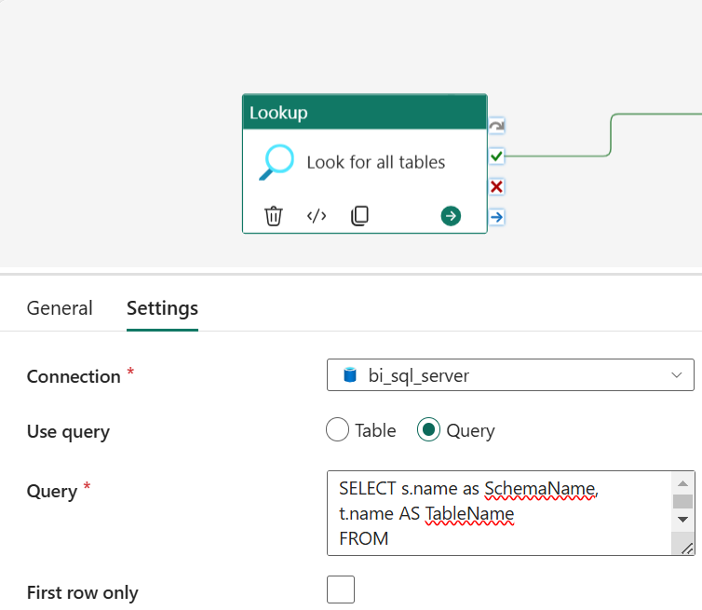
Use Query option
SELECT s.name as SchemaName,
t.name AS TableName
FROM AdventureWorksLT2017.sys.tables t
INNER JOIN AdventureWorksLT2017.sys.schemas s
ON t.schema_id = s.schema_id
where s.name = 'SalesLT'
LOOK UP ACTIVITY CONFIGURATION

Slide 3
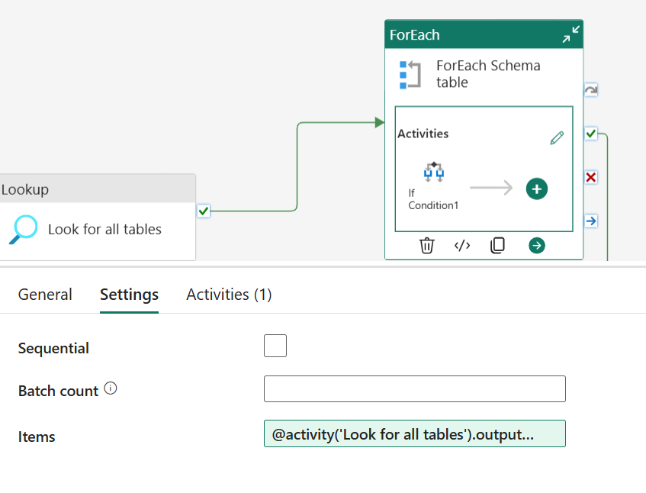
FOREACH CONFIG
Settings: Items—Get the items from the lookup activity and loop through.
@activity('Look for all tables').output.value

Slide 4
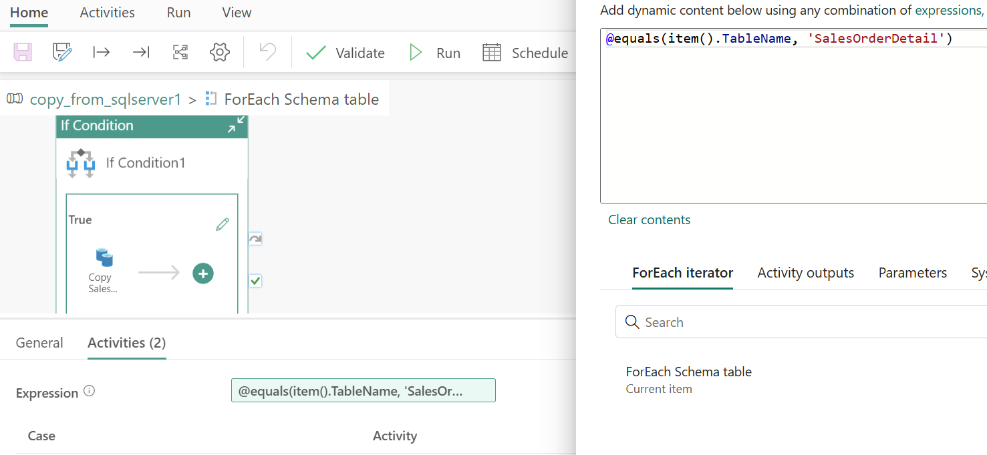
IF CONDITION
@equals(item().TableName, 'SalesOrderDetail')

Slide 5
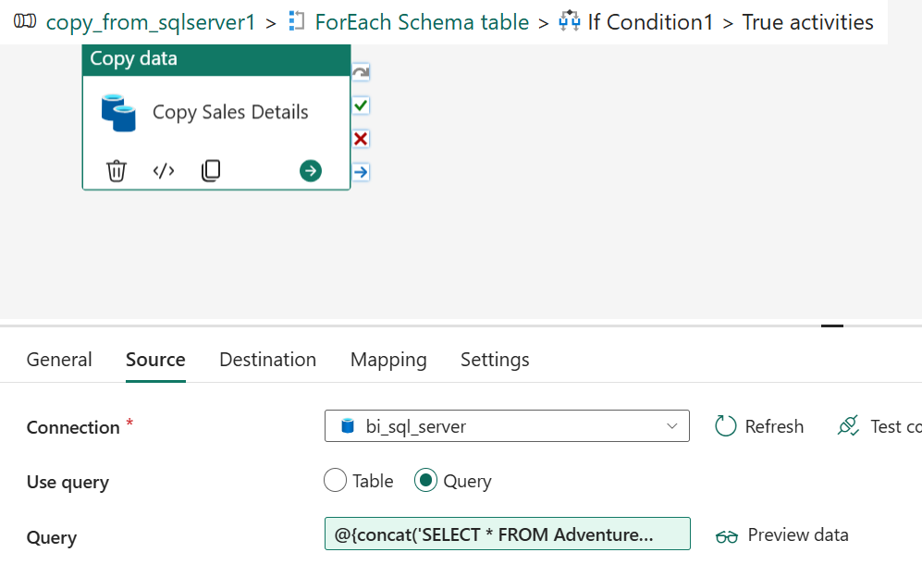
TRUE CONDITION: If table name is SalesOrderDetail the run the query to fetch previous day (D-1) data
COPY ACTIVITY SOURCE
Source: Use query option:
@{concat('SELECT *
FROM AdventureWorksLT2017.[SalesLT].[SalesOrderDetail]
WHERE ModifiedDate >= ''', formatDateTime(adddays(utcNow(),-1),'yyyy-MM-dd'), ''' AND ModifiedDate < ''', formatDateTime(utcNow(),'yyyy-MM-dd'), '''')}

Slide 6
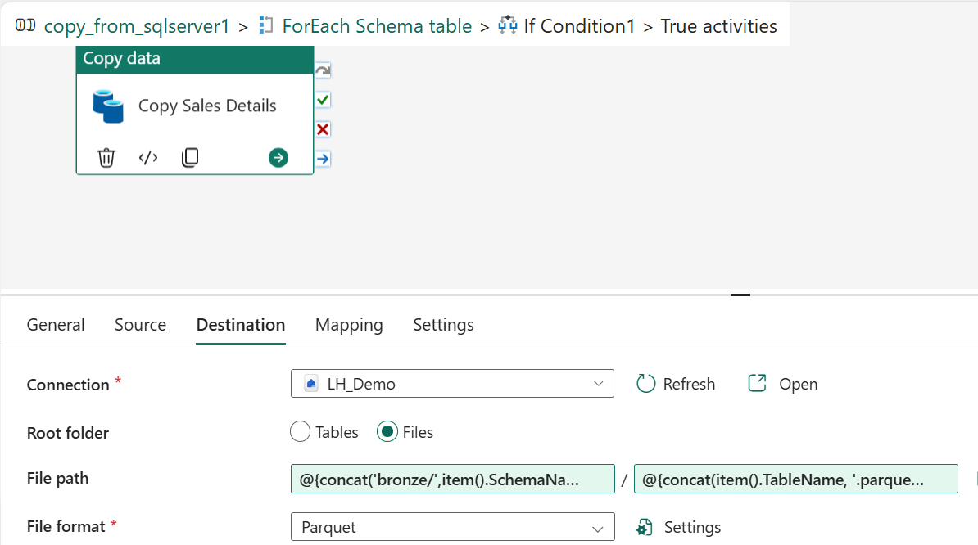
COPY ACTIVITY DESTINATION CONFIG
Root folder is Files
Note: File format is Parquet
File path Directory:
@{concat('bronze/',item().SchemaName, '/', item().TableName)}
File path : File name
@{concat(item().TableName, '.parquet')}

Slide 7
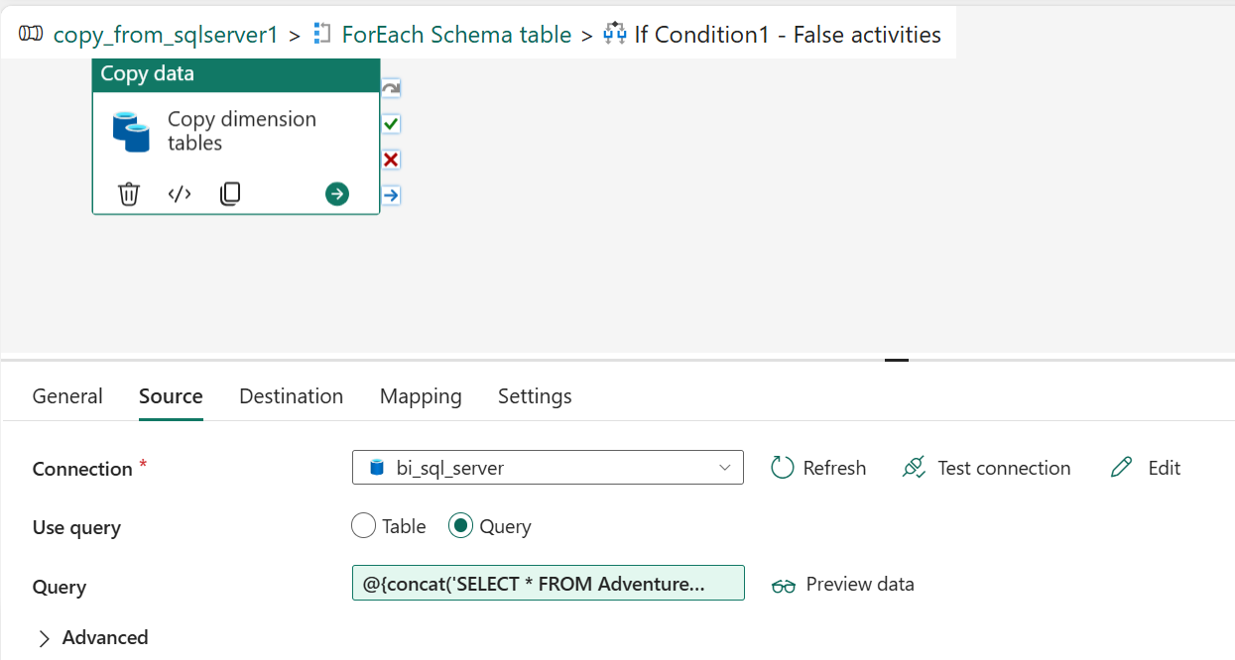
FALSE CONDITION: If table is not SalesOrderDetail the copy activity to fetch the table which is passed as parameter in item().SchemaName, '.', item().TableName)}
COPY ACTIVITY SOURCE
Use query : Query option
@{concat('SELECT * FROM AdventureWorksLT2017.', item().SchemaName, '.', item().TableName)}

Slide 8
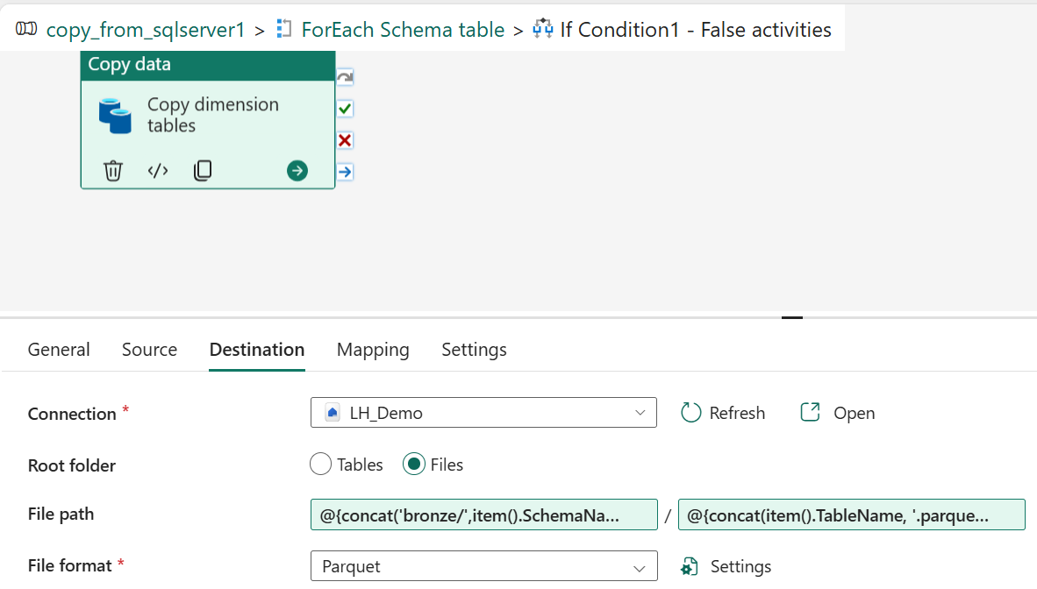
COPY ACTIVITY Destination
Root folder is Files
Note: File format is Parquet
File path: directory
@{concat('bronze/',item().SchemaName, '/', item().TableName)}
File path: filename
@{concat(item().TableName, '.parquet')}

Slide 9
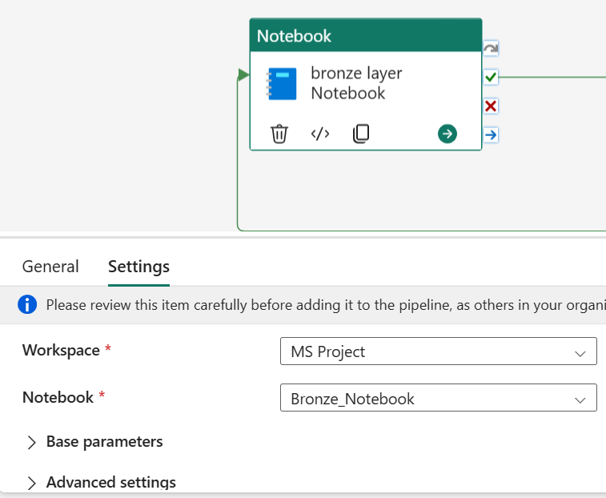

Slide 10
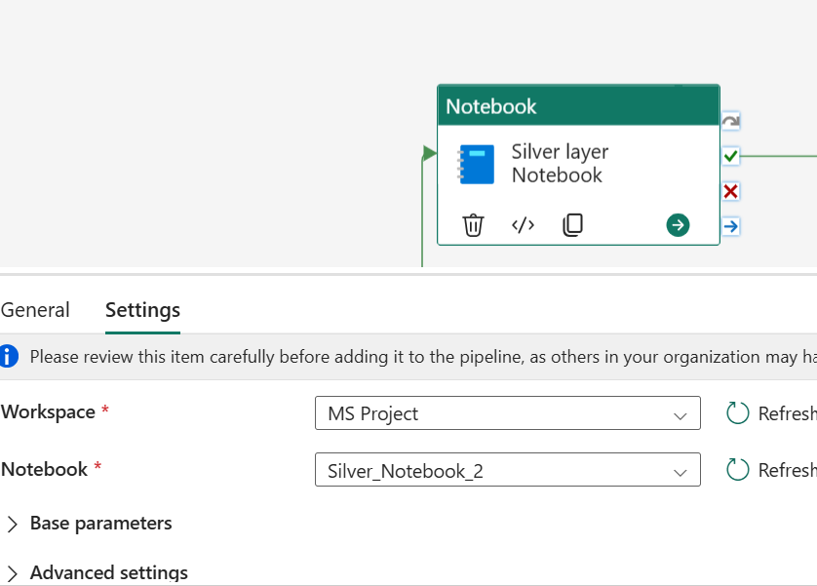

Slide 11
