Slide 1
Road Extraction from Aerial Imagery Using Deep Learning
Frank Chen
Notes:
Hi everyone, I'm Frank Chen. Today I’ll be presenting my project on detecting roads from satellite images using deep learning

Slide 2
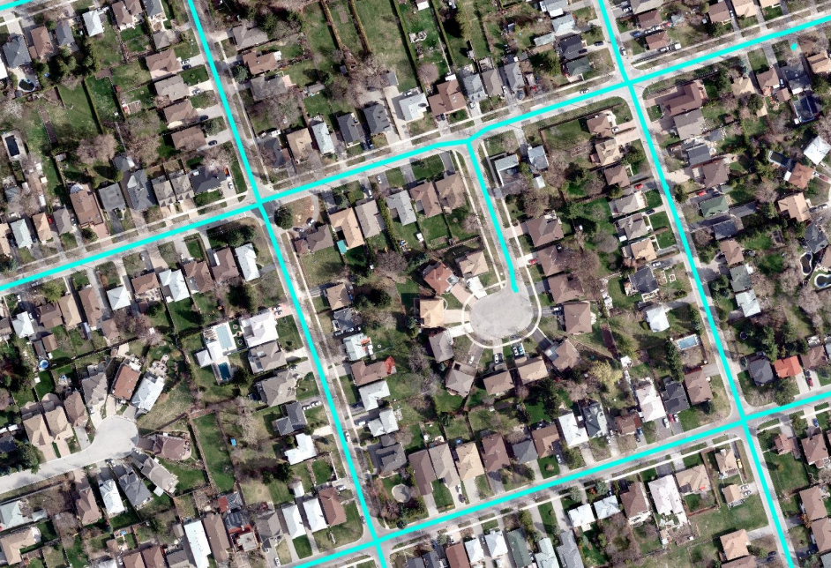
Introduction
Detecting roads from satellite images (DeepGlobe Road Extraction Dataset).
Important for mapping, disaster response, urban planning.
Aim: Build an advanced AI model for automatic road detection.
Source: DeepRoadMapper: Extracting Road Topology from Aerial Images
Notes:
Detecting roads from aerial images is important for things like building maps, helping in disasters, and planning cities. My goal was to build an AI model that can automatically find the roads in these images.

Slide 3
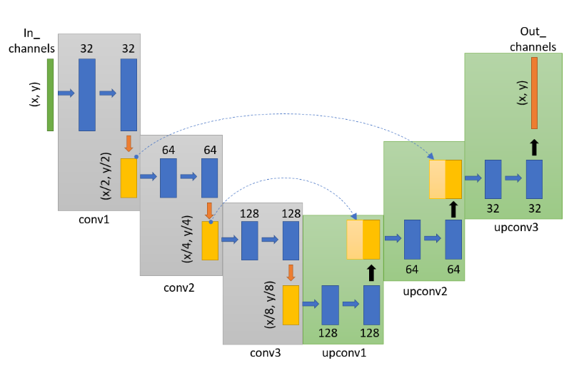
UNet Architecture Overview
UNet is a deep learning model for image segmentation.
Encoder: Downsamples image, extracts features.
Decoder: Upsamples and reconstructs the segmented output.
Skip connections between encoder and decoder.
Very effective for biomedical, geospatial, and satellite segmentation tasks.
Source: Lecture 10
Notes:
I based my work on a model called UNet. Think of UNet like a machine that first shrinks an image to understand the big picture, and then grows it back to full size while filling in the details. It uses shortcut connections to remember important parts during this process. UNet works very well for tasks like medical image segmentation and, in my case, aerial image road detection.

Slide 4
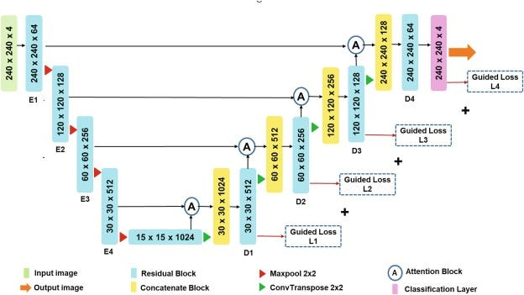
My Advanced UNet
Model from class: Basic UNet (plain convolutional layers).
My model: Introduced Residual Blocks, ASPP, Attention Gates, UpConv.
Goal: Improve feature extraction, focus, and prediction accuracy.
Maji, D., Sigedar, P., & Singh, M. (2022). Attention Res-UNet with Guided Decoder for semantic segmentation of brain tumors. Biomedical Signal Processing and Control, 71, 103077.
Notes:
The basic UNet we learned in class worked well, but I wanted to make it smarter. I made several improvements:
I added Residual Blocks,
Used ASPP to see images at multiple scales,
Introduced Attention Gates to help the model focus better,
And used UpConvolution for better image reconstruction.

Slide 5
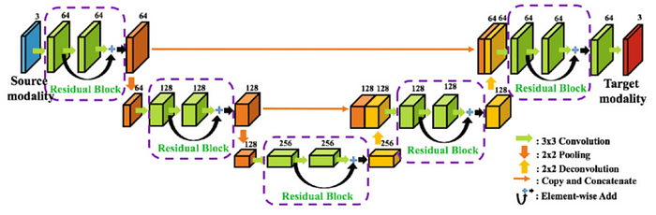
Residual Blocks and ASPP
Residual Block: Allows gradients to flow better; helps build deeper networks.
ASPP: Captures multi-scale information with dilated convolutions.
Xiang, L., Li, Y., Lin, W., Wang, Q., Shen, D. (2018). Unpaired Deep Cross-Modality Synthesis with Fast Training. In: Stoyanov, D., et al. Deep Learning in Medical Image Analysis and Multimodal Learning for Clinical Decision Support. DLMIA ML-CDS 2018 2018.
Notes:
First, Residual Blocks. When neural networks get deep, they can sometimes get confused. Residual Blocks fix this by adding shortcut paths — like quick side roads — so information doesn’t get lost. This helps the model learn faster and better.
Second, ASPP. Roads in images come in different shapes and sizes — small paths, big highways. ASPP helps the model look at the image from different zoom levels at the same time, so it can recognize both tiny and large roads easily

Slide 6
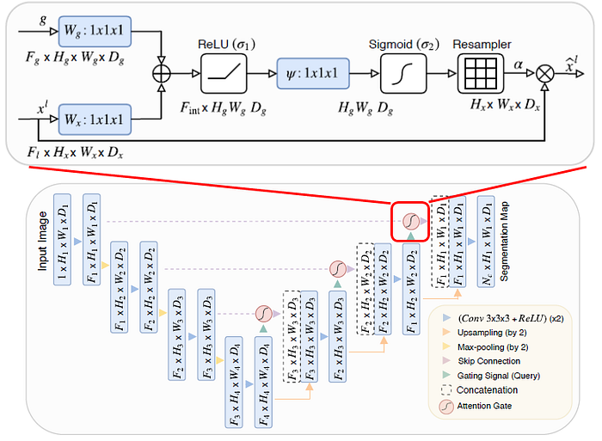
Attention Mechanism and UpConvolution
Attention Gate: Focuses on important areas, suppresses noise.
UpConv: Learnable upsampling for better reconstruction.
Top: Attention Gate (AG), Bottom: Attention U-Net
Notes:
Third, Attention Gates. Imagine if you're trying to find roads but there’s a forest next to them — not everything is important. Attention Gates act like a smart spotlight: they highlight only the useful parts, like the roads, and ignore the noise.
Fourth, UpConvolution. When the model needs to enlarge the image back to its original size, UpConvolution gives it a smarter way to do that. Instead of just stretching the image, it learns how to rebuild fine details properly.

Slide 7
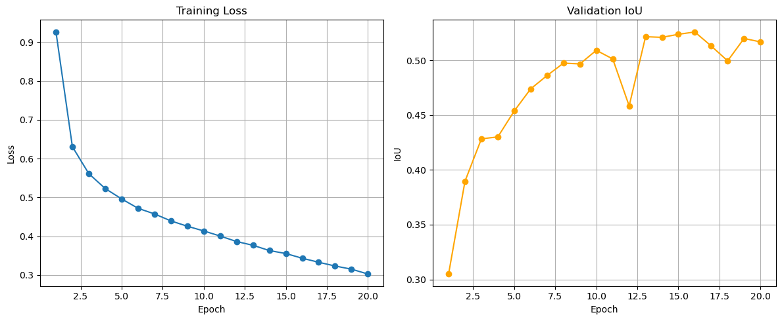
Results: Road Extraction Performance
EPOCHS: 20
Total images: 6226
Train/Test = 70% / 30%
Improved segmentation accuracy over baseline model, IoU = 0.5259; takes about 70 min with an RTX 3070
Cleaner, more continuous road extraction.
Notes:
I trained the model for 20 rounds on over 6,000 images, using a 70-30 train-test split. It reached an IoU score of about 0.53, which measures how well the model matched the true roads. There was a competition on this topic and the winner’s IoU was 0.66 Training took about 70 minutes on an RTX 3070 graphics card.

Slide 8
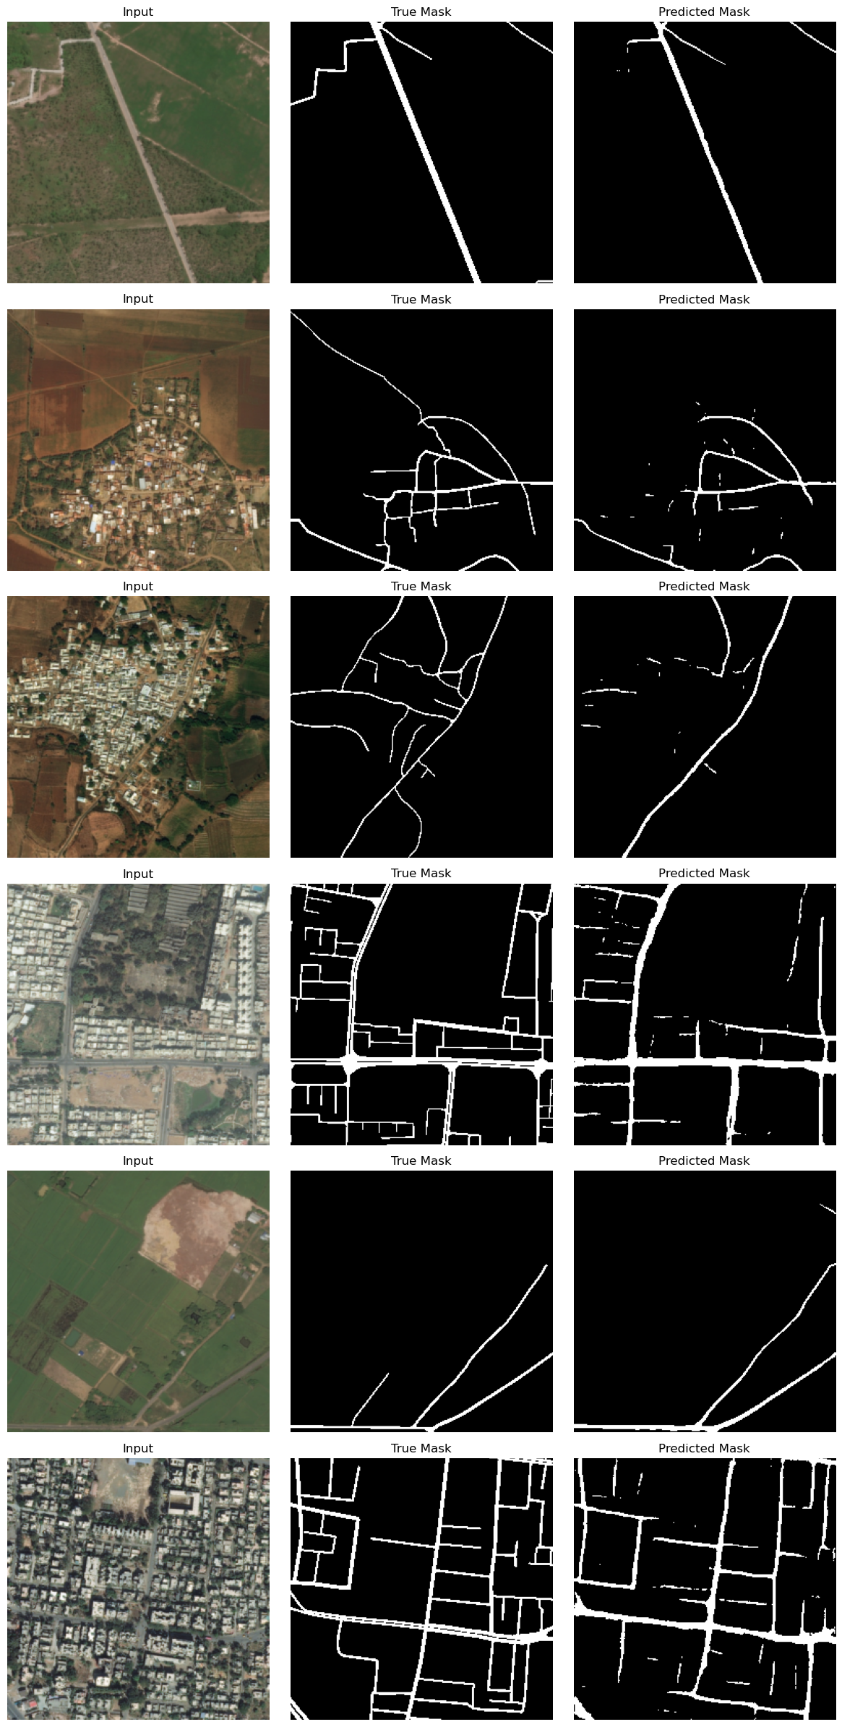
Results: Road Extraction Performance
Notes:
Here, I'm showing the model’s predictions on the test dataset. On the left are the input aerial images, the middle shows the true road masks, and the right shows the masks predicted by my model.
Overall, the model captures the larger road structures very well. However, it still struggles with very thin roads or roads that are partially covered by shadows, trees, or noise. Sometimes, small or broken road sections are missed or disconnected.
This shows that while my improvements made a big difference, there’s still room to make the model even better, especially for detecting fine, detailed road structures.

Slide 9
Thank you!
Notes:
That's all! Thank you. And to be honest I actually not fully understand some concept from this Unet architecture since they are not mentioned in the class, I need to learn as much as possible about it and include them in the final report

