Slide 1
How Does Inconsistent Behavior Affect Your Perceptions on Religious Identity?
Fu Chen
122090020

Slide 2
Religious Identity
What forms religious identity?
  Internal belief (sincere faith)
  External behavior (following rules/practices)
  Moral character (being a good person)
  Self-identification (“they say they are religious”)
Mistakes or misbehaviors?
Question: How Does Inconsistent Behavior Affect Your Perceptions on Religious Identity?

Slide 3
Questionnaire
Four Likert Scale (1-5) Questions:
1. How does Self-identification influence whether you consider someone religious? (agree - view them as they said / disagree – my judgment counts)
2-3. Assume a person firmly believes they are religious and identifies strongly with that religion. However, they intentionally violate a rule of the religion.
  (a) If they provide a personal justification (which you might disagree with);
  (b) If they themselves admit it is wrong but continue to follow other religious practices;
How would you evaluate this person? (agree – yes religious, normal / disagree – fake, despicable)
4. Does inconsistency with religious norms intensify/sharpen your negative evaluation of a person’s misbehavior? (agree – it is even worse / disagree – normally treated)

Slide 4
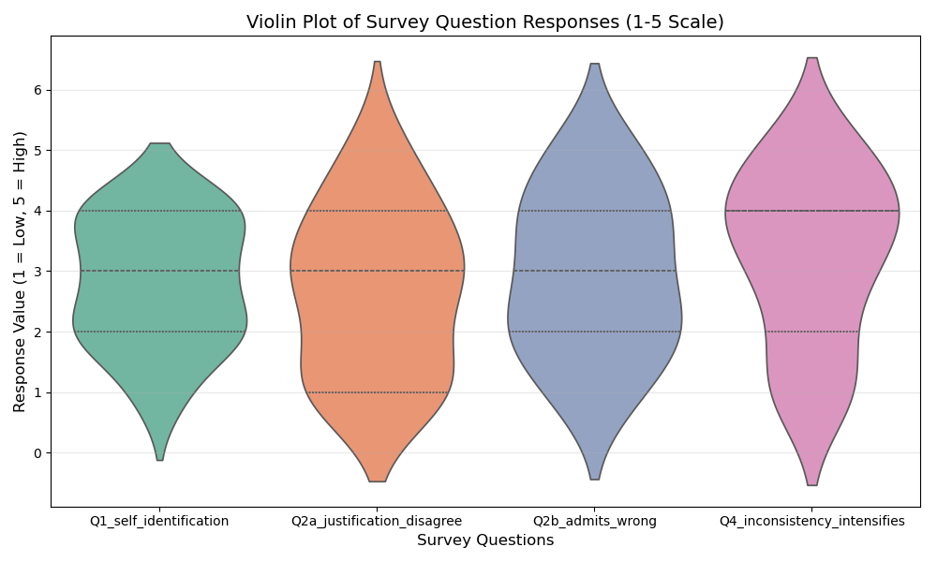
Results
21 responses (from classmates and group chats); Scale: 1-5
Metrics | Question 1 | Question 2 | Question 3 | Question 4
Average | 2.809524 | 2.666667 | 3.095238 | 2.857143
Standard Deviation | 1.030488 | 1.494434 | 1.261141 | 1.352247
Mode | 2 | 3 | 4 | 3

Slide 5
Discussion
Recall Questions 2-3: How would you evaluate this person
  (a) If they provide a personal justification which you disagree with;
  (b) If they themselves admit it is wrong but continue to follow other religious practices;
 | Question 2 | Question 3
Avg | 2.666667 | 3.095238
Mode | 3 | 4
(One-sided p-value <0.05)
Conclusion 1: People significantly think they are different regardless of the same self-identification. (tricky)

Slide 6
Discussion
Recall Questions 1,4:
  1. How does Self-identification influence whether you consider someone religious? (agree - view them as they said / disagree – my judgment counts)
  Does inconsistency with religious norms intensify/sharpen your negative evaluation of a person’s misbehavior? (agree – it is even worse / disagree – normally treated)
 | Question 1 | Question 4
Std | 1.030488 | 1.352247
Corr | -0.45108
(Strong negative correlation)
Conclusion 2: The stronger the agreement on self-identification, the less evaluations are influenced by whether they are religious or not. (make sense)

Slide 7
Conclusion
In conclusion, attitudes toward violating religious norms vary. Some respect self-identification, while others judge based on personal interpretations.
Most people, however, hold implicit biases about religiosity based on behavior and evaluate others differently depending on their own beliefs.
This suggests that religious identity has a strong sociological dimension: regardless of personal belief or mutual respect, implicit biases and differing judgments persist in society.

Slide 8
Acknowledgement
AI Usage:
ChatGPT 5.2 is applied in rephrasing questions in the questionnaire based on my draft.
Codex – Claude 4.6 is applied in code script generation for data collection and analysis.
Claim:
AI tools are NOT used in generating source data or presentation slides of this presentation.

