Slide 1
Applications of machine learning in medical imaging
Presenters:
Chen Fu, Shen Qingning

Slide 2
01
03
Contents
02
04
THE DEFINITION
THE APPROACH
some brief information about medical imaging
some detailed information on AI image processing
THE COMPARISON
THE FUTURE
disadvantages and advantages between manual work and machines
its foreground and room for improvement

Slide 3
INTRODUCTION
The Definition
The images extract information to reflect the underlying pathological and physiological characteristics of both diseased and normal human tissues.

Slide 4
Detailed Cases
In these cases, doctors could judge whether the patient's organs are healthy referring to the outline or brightness of the organ in the image.
application
CT
MRI
rapidly get a physical examination of the patient's multiple organs throughout the body
detect some early lesions in organs more accurately

Slide 5
The Comparison - Efficiency
01
02
There is little difference between humans and machines in the diagnosis of individuals
It is difficult for humans to do it at the same high speed as a machine when facing a large amount of data.

Slide 6
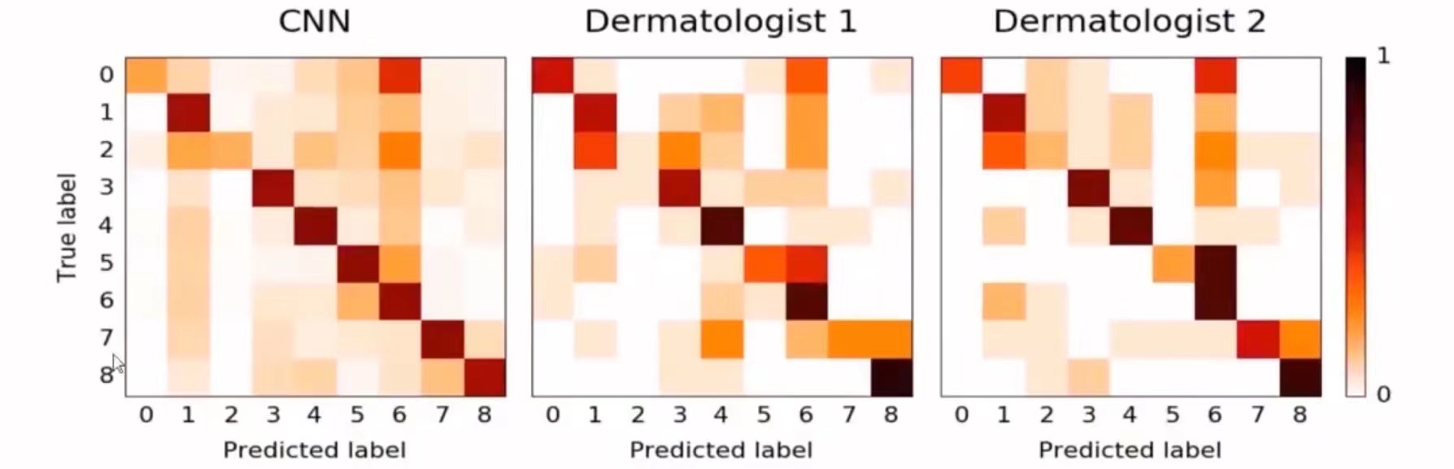
The Comparison - Accuracy
The darker the color on the diagonal indicates higher accuracy.
Machine has more stable accuracy, and can predict benign tumors more accurately. Doctors diagnose malignant tumors more accurately.

Slide 7
The Comparison - Fuctionality
01
02
Machines can examine the image from more perspectives.
It can establish a specific link between the image and the disease.

Slide 8
Approches of Image Processing
collect medical images
mark the raw data
statistical analysis
model building and training
cover mask
ROI segmentation
extract the image feature

Slide 9
Approches of Data Source
laboratory research
hospital publications
health testing instruments
...

Slide 10
Approches of Data Source
more samples ≠ a better result

Slide 11
Approches of Data Processing
DAY 1
DAY 2
DAY 3
DAY 4
DAY 5
Matching
Standard Curves
Feature Classification
1
2
3
4
Signular Value Decomposition
Feature Filtering

Slide 12
Model Preparing
Geometry
volume
surface area
3D diameter
RMS diameter
Image
frequency distribution of grayscales
spatial relationship of grayscales

Slide 13
Programming Tools
Language
Python
Library
Pandas
Scipy
matplot
...

Slide 14
Models
Supervised Learning
Unsupervised Learning
LASSO regression model
Linear regression model
Logistic regression model
...
Classify imformation of patients
Confirmed results in databases
...

Slide 15
Expectation
Functions | Availability
tell the difference between diseased and normal tissues
marks different parts of tissues with different colors
prints out the result and warnings on the computer screen
get accurate information in a short time
improve working efficiency

Slide 16
Currect Application
Diagnose
use MRI and get useful suggestions completely by machine
Visual Aid
tell organs apart and model tissues from various perspectives
Assistant
mark questionable parts on the image for doctors to check

Slide 17
Promising Future
will approximately conform to the clinical scenario gradually
predict multiple diseases for one organ, or confirm one disease with different organs
increase the variety to match the common clinical site
AI in imaging will become a system, which not only is limited to detecting but also has structured reports
AI will enter the medical market soon

Slide 18
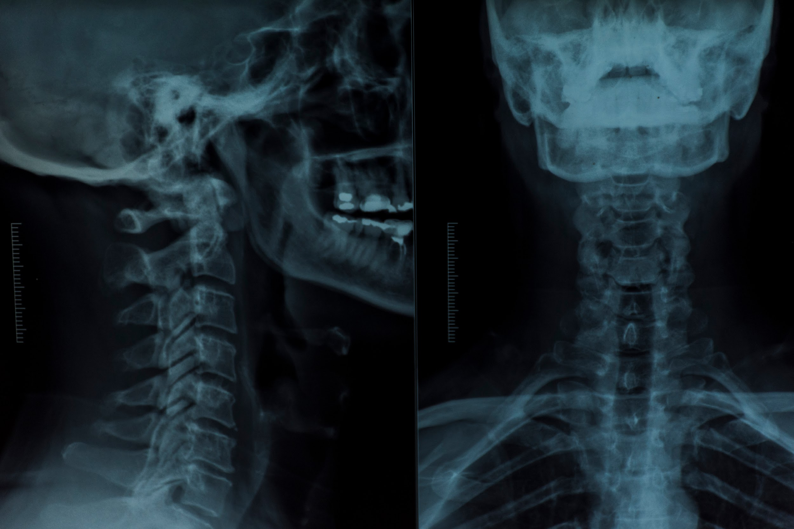
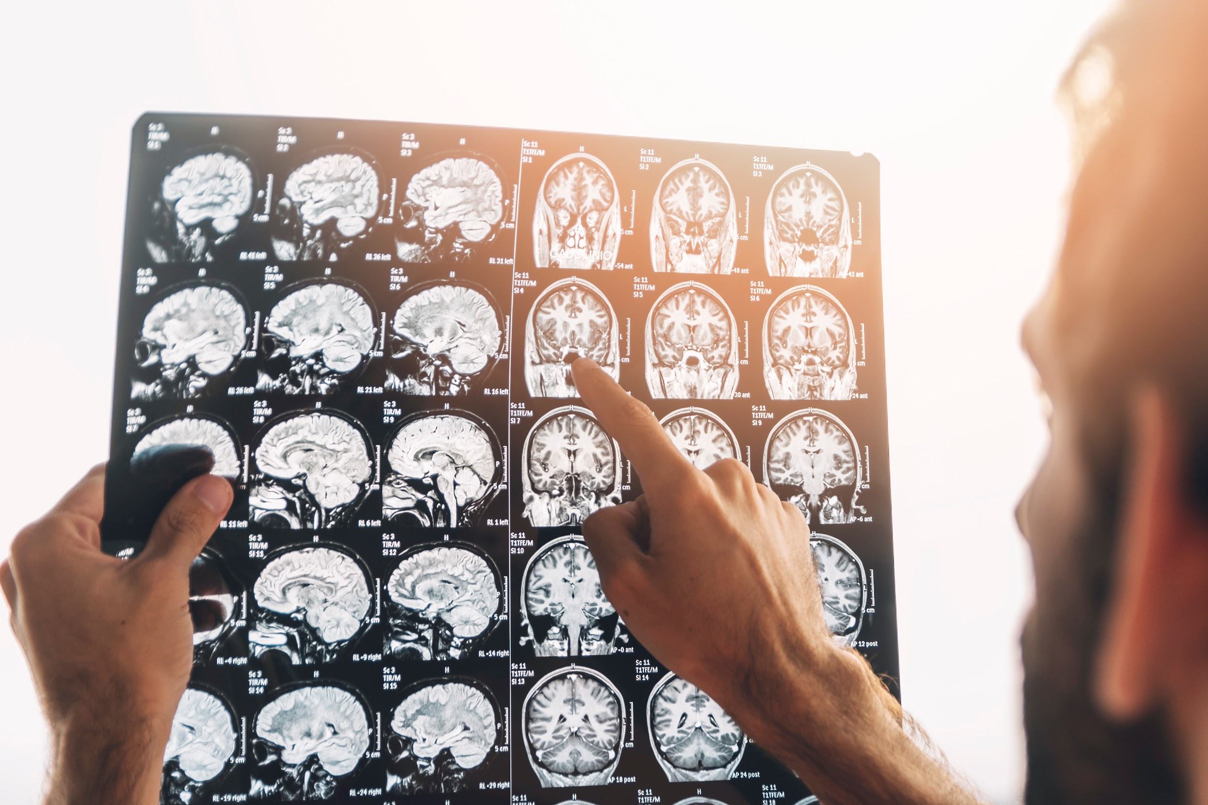
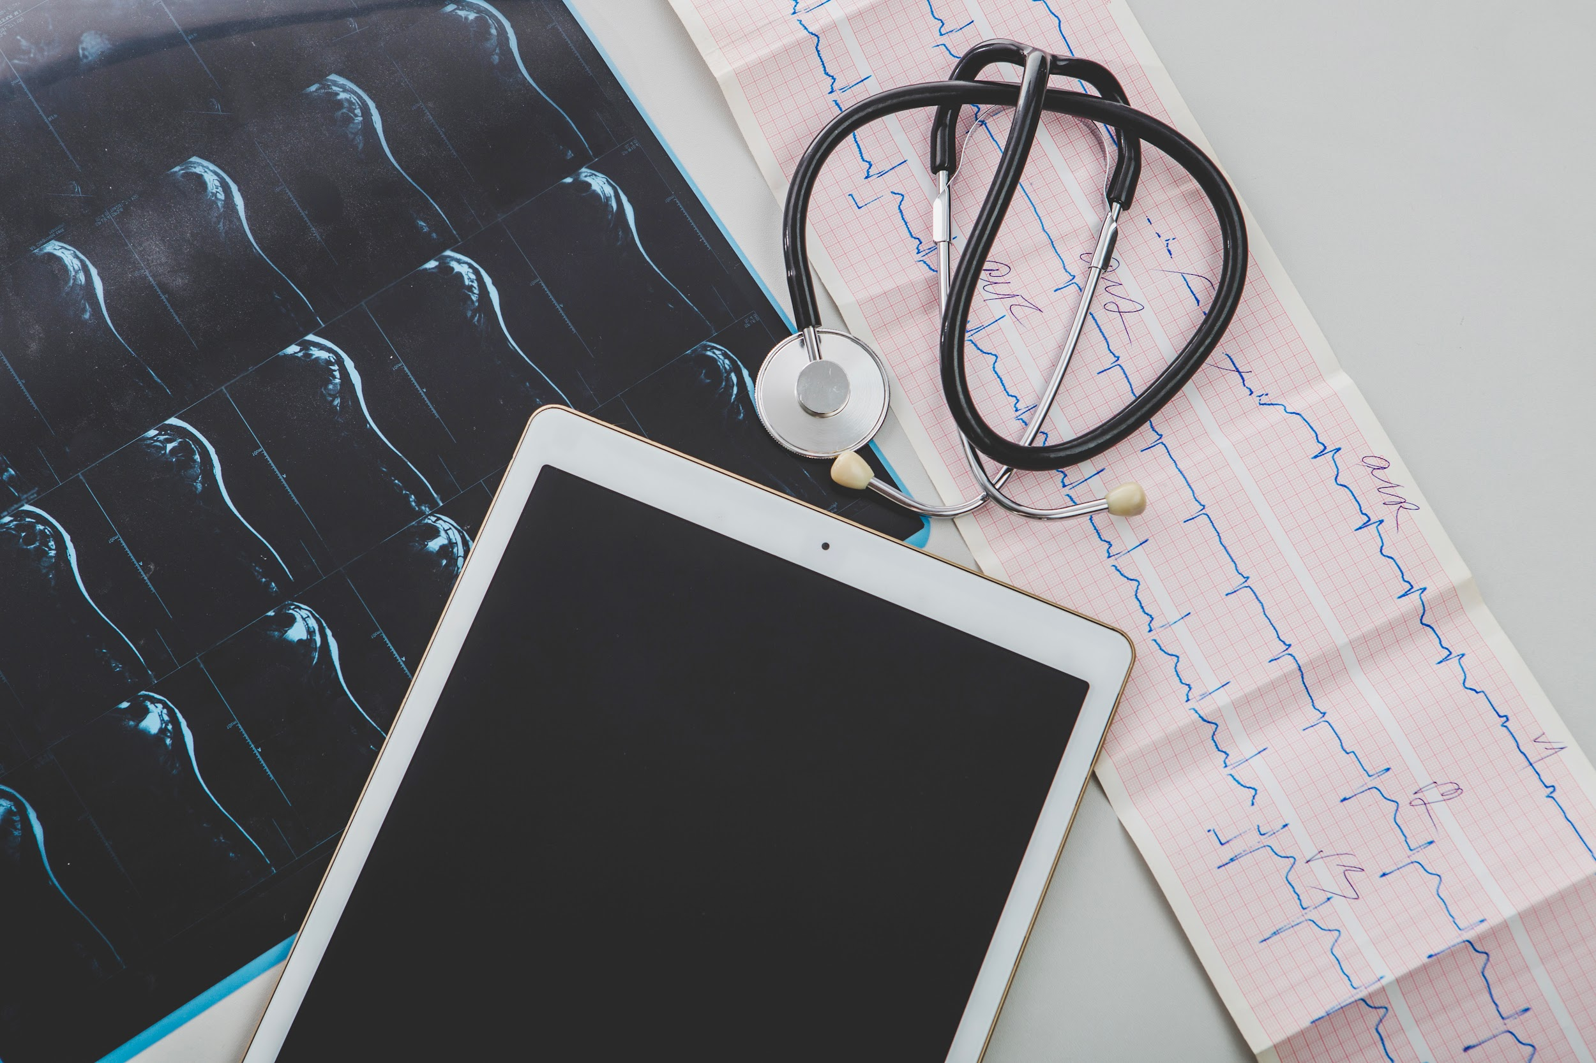
Results
The diversity and importance of
AI applications
in imaging
is necessary and bound to increase

Slide 19
THANKS

