Slide 1
The Impact of
Label Information on
Students’ Food Choices
122090020 Frank

Slide 2
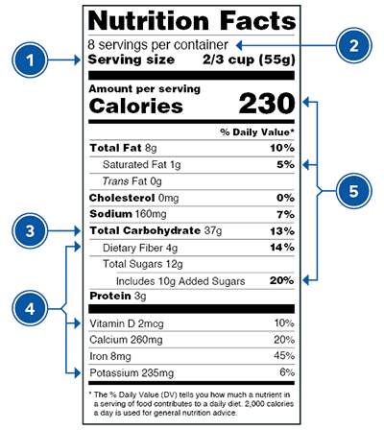
1
Introduction
Food labels
Usage?
inform necessary information
Why do we study them?
promote a better strategy for both purchasing and producing food
(Centers for Disease Control and Prevention, 2022)

Slide 3


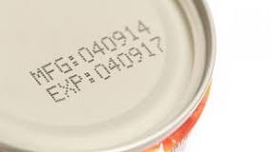
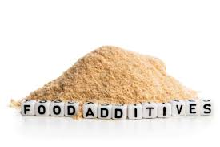
2
Literature Review
“Organic” label matters?
Europe
Yes!
South Africa
No!
(Gracia & De-Magistris, 2016)
(Van Der Merwe et al., 2010)
The shorter, the more effective?
Generally YES! (Roberto & Khandpur, 2014)
Really understand the labels?
Probably NOT! (Wills et al, 2009)

Slide 4
3
Research Gap & Aim
“Organic” label matters...
Understand the labels...
Any other factors...
in China?
among the students?
online shopping?
Study the impact of labels on the food choices
of college students in Chinese mainland.
Research aim:

Slide 5
4
Research Questions
What types of food labels exert greater impacts on the choices of Chinese college student consumers?
What are the potential factors that can influence the impact of food labels on the choices of Chinese college student consumers?

Slide 6
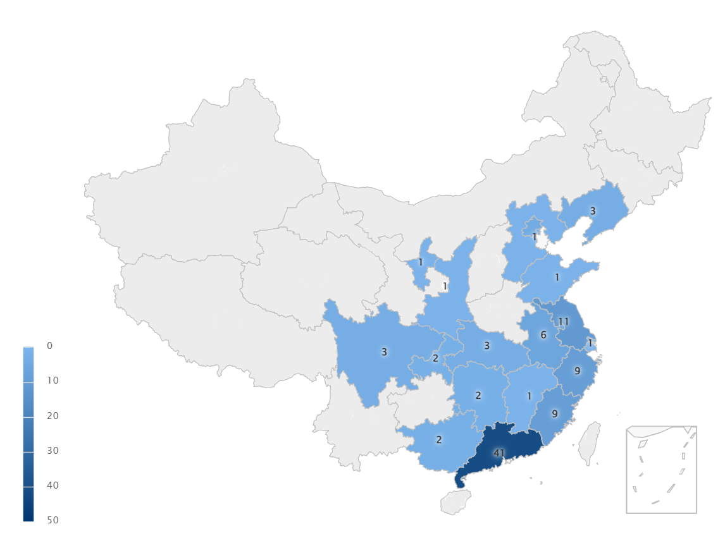
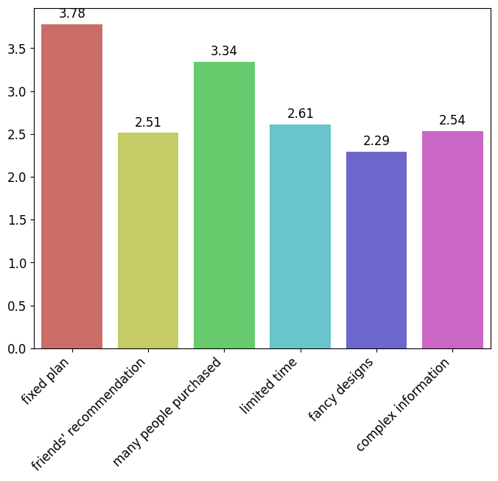
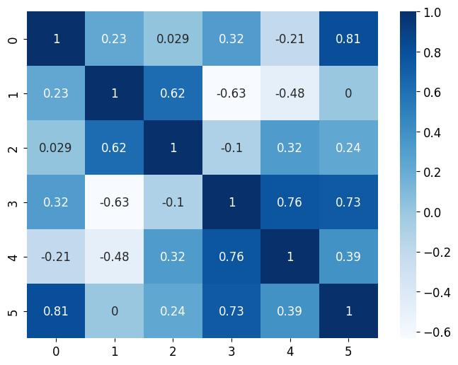
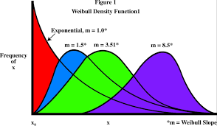
5
Methods
Data collection
Questionnaires (powered by Wenjuanxing)
10 Likert-type scales
4 ranking problems
1 short answer question
Data analysis
Reliability analysis (a=0.83)
Mean analysis
Correlation analysis
101 participants, 18 provinces

Slide 7
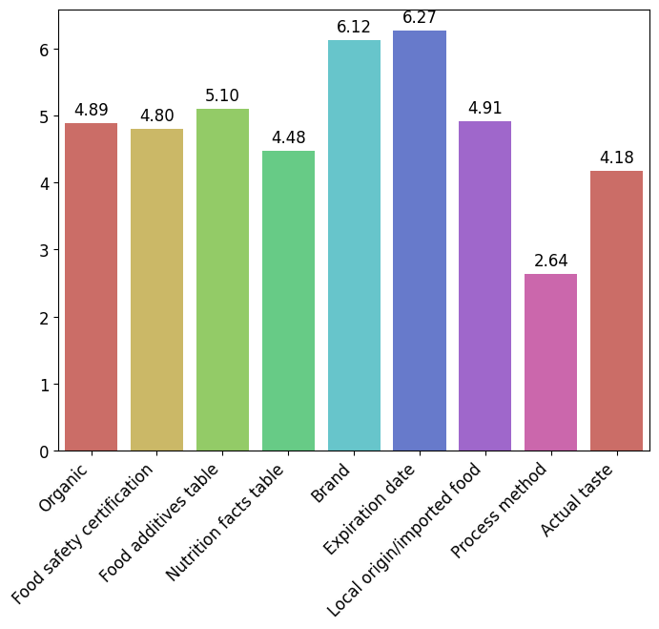
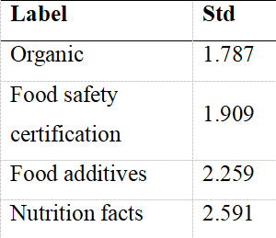

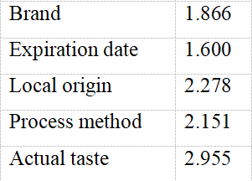
6
Result and Discussion
Actual
Taste
food labels > actual taste
Brand and expiration date are important
(research question 1)
consistent with the findings in Europe (Gracia and De-Magistris, 2016)
Standard deviation is large!

Slide 8
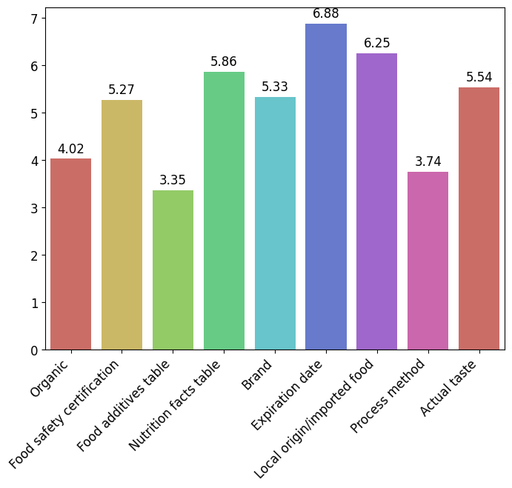
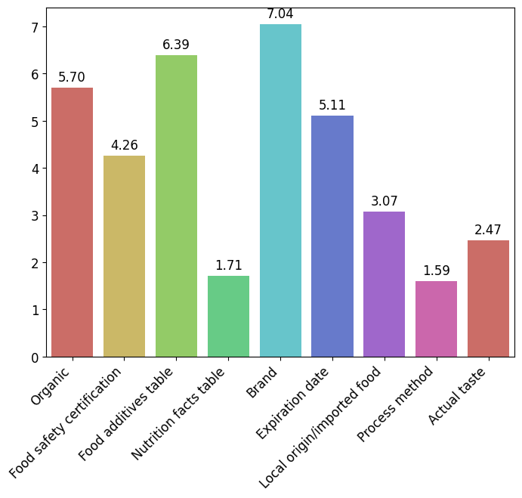
7
Result and Discussion
Purchase method is an important factor!
(research question 2)
Offline
Online
avg-std (offline) | avg-std (online)
1.5 | 1.3
(Brand)
Actual
Taste

Slide 9
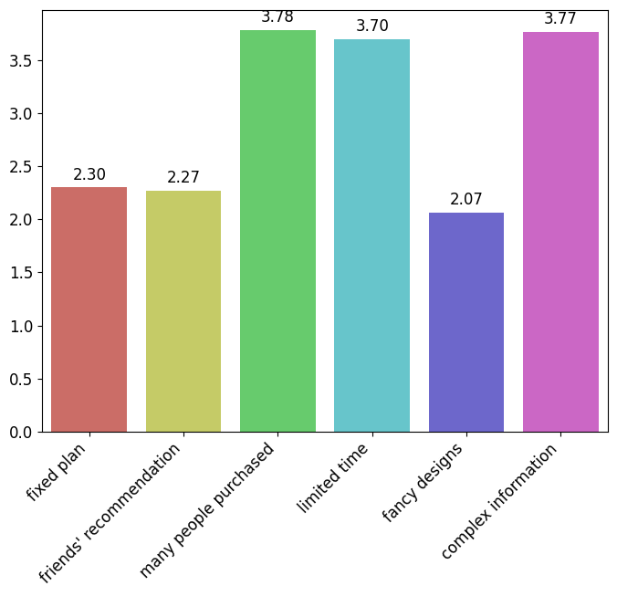
8
Result and discussion
High influential factor and strong correlation:
limited time & complex information (rate>3.7/5.0, correlation>0.73)
In line with Roberto and Khandpur’s result (2014) (research question 2)

Slide 10
9
Conclusion
Aim
the impact of food labels on Chinese college students
Result
Food labels do have significant impact (brand & expiration date)
Purchase method (online / offline) influences the impact of food labels
Complexity of label & limited time also influence the impact
Significance
Verify: consistent with the result in Europe
New factor: purchase method

Slide 11
10
Conclusion
Limitation
participants are mainly in coastal provinces
ignored potential factors (e.g. price)
Suggestion
To consumers: check food labels online
To producers: design concise labels

Slide 12
References
Centers for Disease Control and Prevention. (2022, September 20). Food labels. Centers for Disease Control and Prevention. https://www.cdc.gov/diabetes/managing/eat-well/food-labels.html
Gracia, A., & De-Magistris, T. (2016). Consumer preferences for food labeling: what ranks first?. Food control, 61, 39-46.
Roberto, C. A., & Khandpur, N. (2014). Improving the design of nutrition labels to promote healthier food choices and reasonable portion sizes. International Journal of Obesity, 38(1), S25-S33.
Van Der Merwe, D., Kempen, E. L., Breedt, S., & De Beer, H. (2010). Food choice: student consumers' decision‐making process regarding food products with limited label information. International Journal of Consumer Studies, 34(1), 11-18.
Wills, J. M., Schmidt, D. B., Pillo-Blocka, F., & Cairns, G. (2009). Exploring global consumer attitudes toward nutrition information on food labels. Nutrition reviews, 67(suppl_1), S102-S106.
Thank you!
122090020 Frank

