Slide 1
LuminaSage
A smart desk lamp that protects visual health
Chen Fu / Frank
122090020

Slide 2
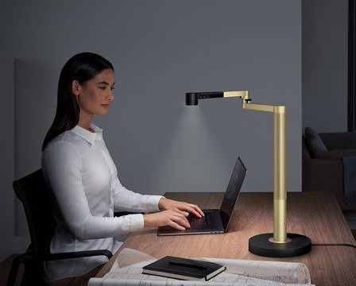
Background
Visual Health
Light Environment
Light / Lamp

Slide 3
Problem
Traditional Desk Lamps?
Personal Feelings
(Scientific?)
Existing Smart Ceiling Lamps?
Generally Preset Parameters
(Individual Characteristics?)

Slide 4
Problem
inaccurate

Slide 5
Solution
inaccurate

Slide 6
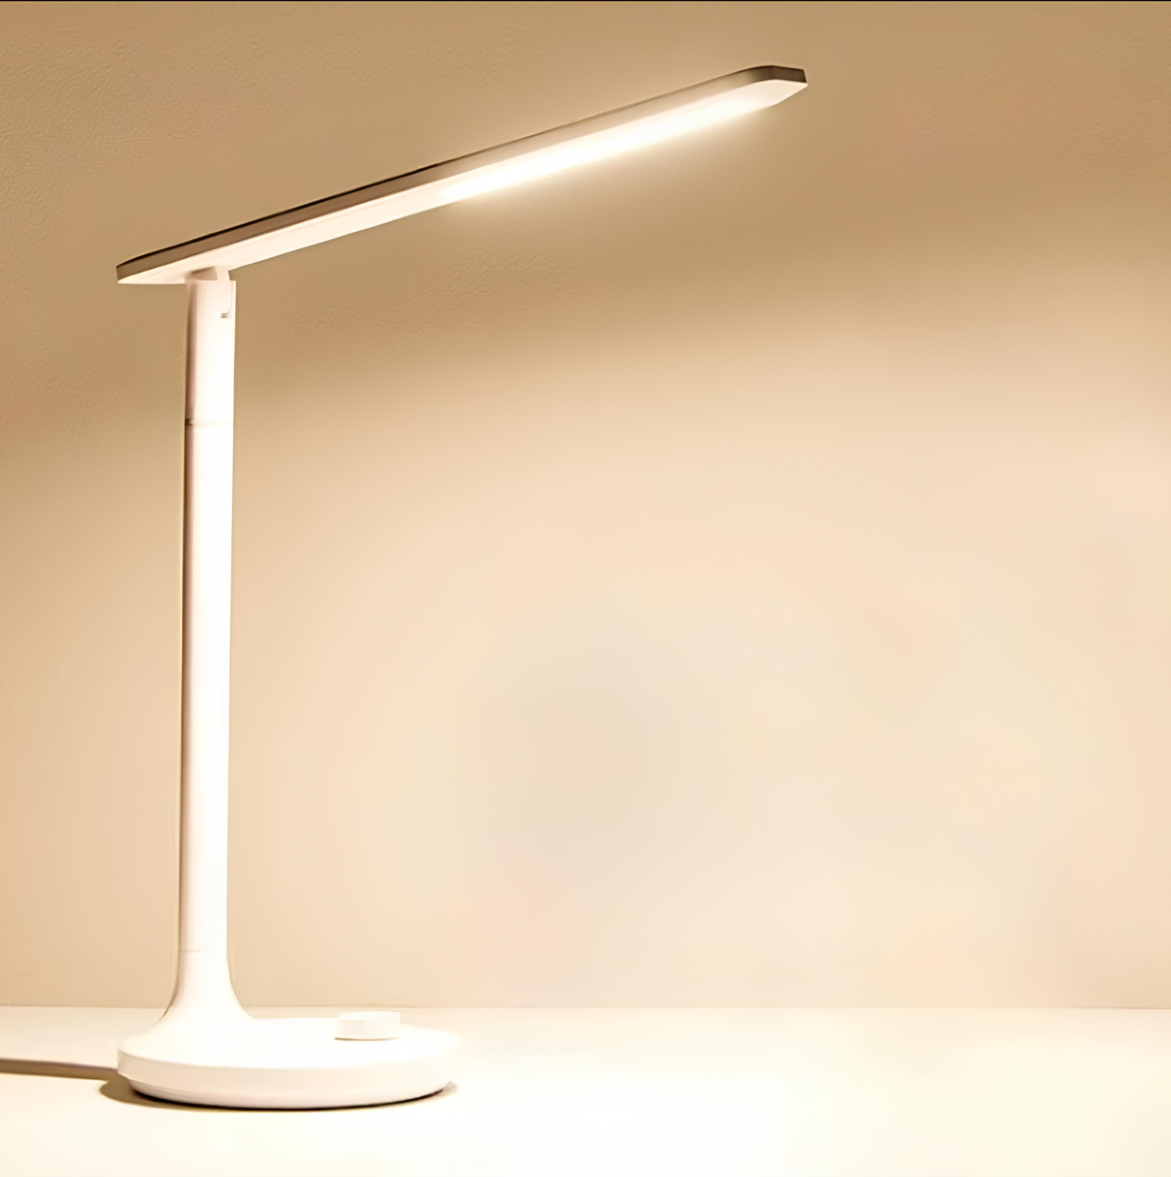
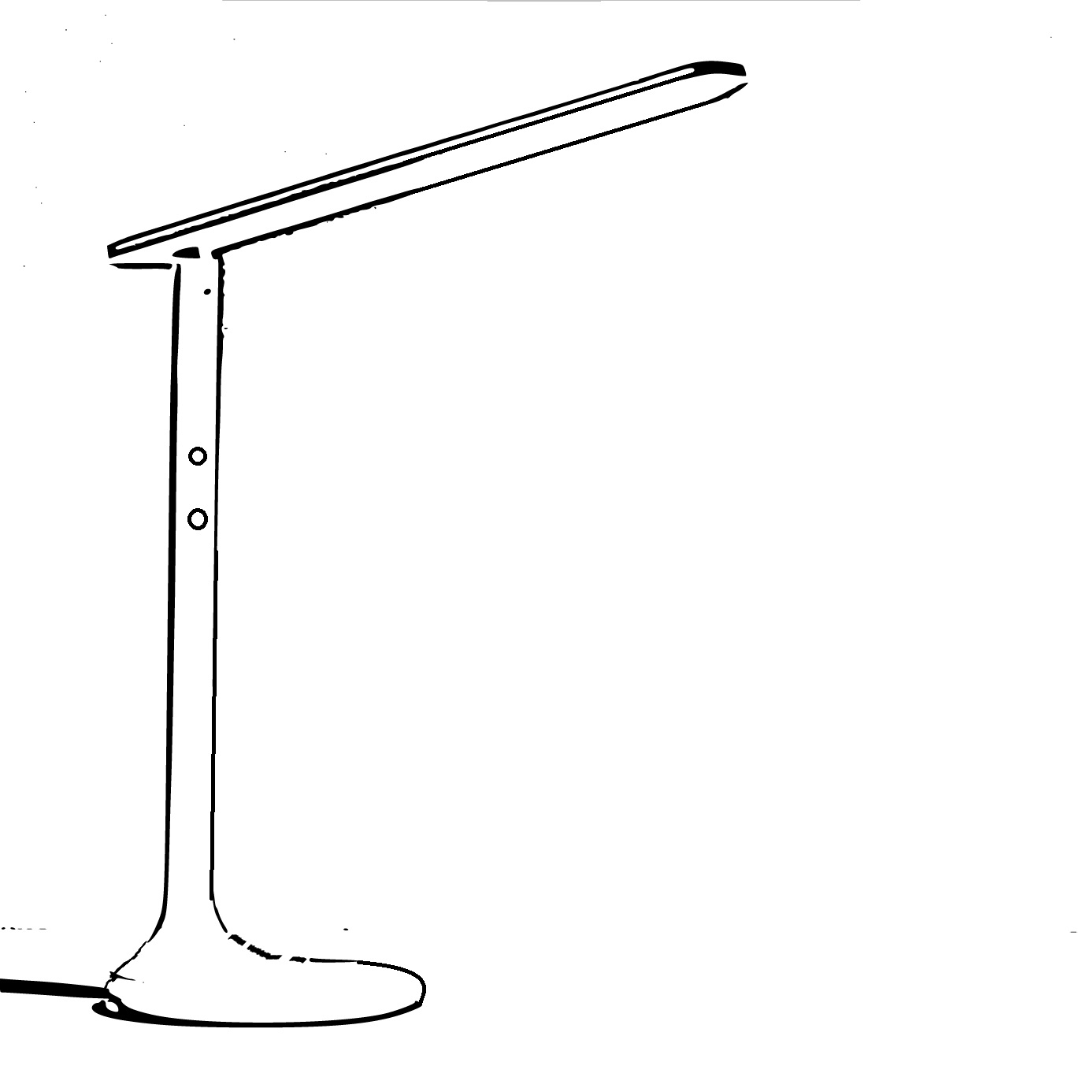
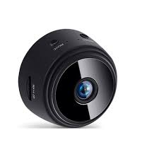
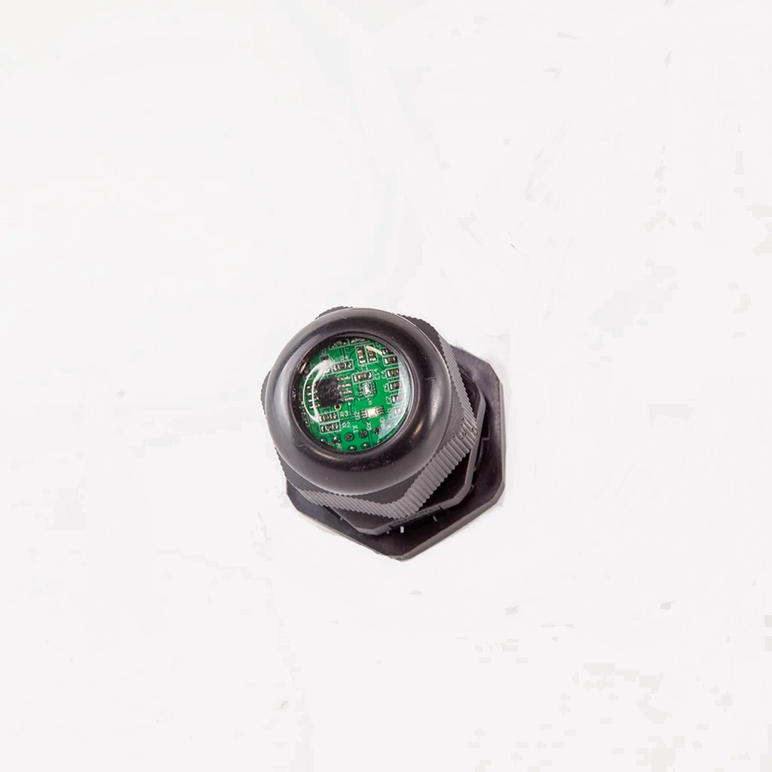
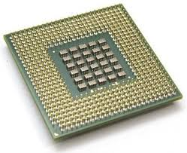
Solution & Implementation
30 cm
camera
36 cm
brightness sensor
AI chip
20 cm

Slide 7
Benefits
Scientific - Personalized
Convenience - Automatic
Private - No internet

Slide 8
Costs
< $20
Overall
≈$50
< $15
(Ignored)
Cheap?
< $20

Slide 9
Conclusion
Adding Camera, Sensor & AI
Automatic & Personalized
Best Light Environment
Better Visual Health

Slide 10
LuminaSage
Thank you!

