Slide 1
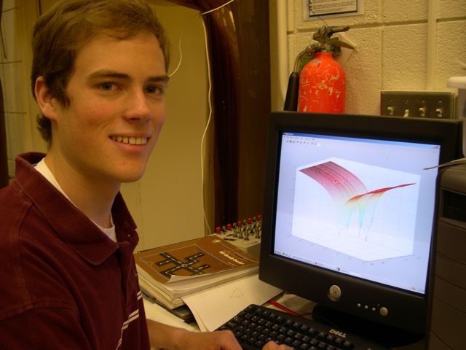
Tips on how to get the most Ph.D. out of your computer
Frank Cleary
December 4th, 2013

Slide 2
Goals
Grad school in pseudo-code:
Ph.D. = False
while not Ph.D. {
run experiments
analyze data
}
Goal today: make the analyze data part faster and better.
Focus on windows users, which very, very few tutorials on this stuff are.

Slide 3
Outline
Version control with git
Data analysis and reporting with the IPython notebook + pandas and matplotlib
A brief mention of R
Task management with asana

Slide 4
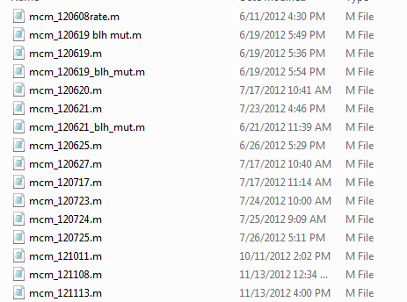
Why use version control?
Perfect reproducibility – Allows you to run the exact same analysis on the exact same data at any point, effortlessly.
Easily try new code without a directory that looks like this:

Slide 5
git
Allows easy, organized accessed to previous file versions.
All the previous versions of files are stored in a “repository”, a hidden .git folder.
You see the files from the state you currently have “checked out.”
For example, to go back to a pervious file version you would checkout that files from that version.

Slide 6
Using git
Download from git-scm.com
Start Git Bash and cd into the directory where your project will live.
Type git init myproject in Git Bash to initialize your project (this creates a new folder)
Make same files
Type git commit –a –m “some useful message” to store this version
Continue storing versions

Slide 7
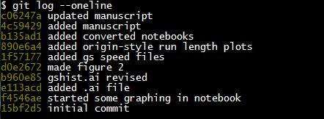
Using git
See your commits type git checkout –oneline
This will give you a hexadecimal number that identifies each commit:
Identifier
Your helpful commit message

Slide 8
Using git
To go back to an older version, checkout the old file with git checkout commitid filename
Example: git checkout e113acd figure1.ai
Identifier
Your helpful commit message

Slide 9
IPython notebook
IPython gives you an improved way of interacting with python
The IPython notebook is an improved way of interacting with IPython.
Can easily explore data and create graphs
Great way to archive/share your analysis
Easiest way to get it: download anaconda: continuum.io/downloads
Also worth checking out pythonxy and the spyder IDE.

Slide 10
Using the IPython notebook
cd into the directory of your choice (preferably one under version control).
Type ipython notebook from the command line
This will launch a browser window with IPython
Demos

Slide 11
Sharing Ipython notebook
Can share the .ipynb file to other ipython users
Can export as html – anyone with a browser can view with this command:
ipython nbconvert mynotebook.ipynb
Can export as .pdf:
ipython nbconvert mynotebook.ipynb --to=latex –-post=pdf
The last two have some additional dependencies you’ll have to install – try them and look at the error messages

Slide 12
Pandas
Pandas is a python library that centers on functions for data analysis.

Slide 13
Making figures
Figures can be made in python (either with pandas function through matplotlib, or with matplotlib directly).
Save as .eps to export to illustrator.
Can also make figures in R, but this takes a bit more effort at the beginning, in my opinion.

Slide 14
Python vs. R
R is a language designed for and by statisticians, so it handles data very well, but the syntax is less intuitive than python’s.
In python, all simple things are simple
Some hard things are simple
In R, some simple things are hard
Lots of hard things are simple
RStudio is a good interface to R

Slide 15
How to learn Python
Codecademy
Python challenge
Rewrite MATLAB code in python

