Slide 1
FDIFF
A tool to find amendments in claims and identify their basis
(F. de Jong, M. Keita, I. Chapple)
Cluster M&M
13.05.2019

Slide 2
Motivation
First examiner has task to check requirements of Art.123(2) and Art. 76(1) during the examination procedure
Chairman also does the same at grant stage
Non compliances regarding Art.123(2) identified by DQA require corrective measures to be taken
Need to improve existing tools

Slide 3

Examples of checking amendments
Current claims vs. original claims
Art. 123(2)
eDrex final vs. original claims
Art. 123(2)
Euro PCT (bis) claims vs. (translated) original PCT claims
Art. 123(2)
Aux request vs. original/main request
Art. 123(2)
Current claims vs. national prio. claims
(PCT vs. FA-dossier)
Divisional vs. Parent claims
Art. 76(1)
Current claims vs. national granted claims
(US-B pub.)
IGRE claims vs. eDrex final

Slide 4
State of the art – Manual check
easy to miss subtle changes
difficult to identify a basis for amendments
difficult if the applicant does not refer to the original set of claims
can I trust the applicant’s tracked changes?
tedious and time-consuming
added subject-matter might go unnoticed

Slide 5
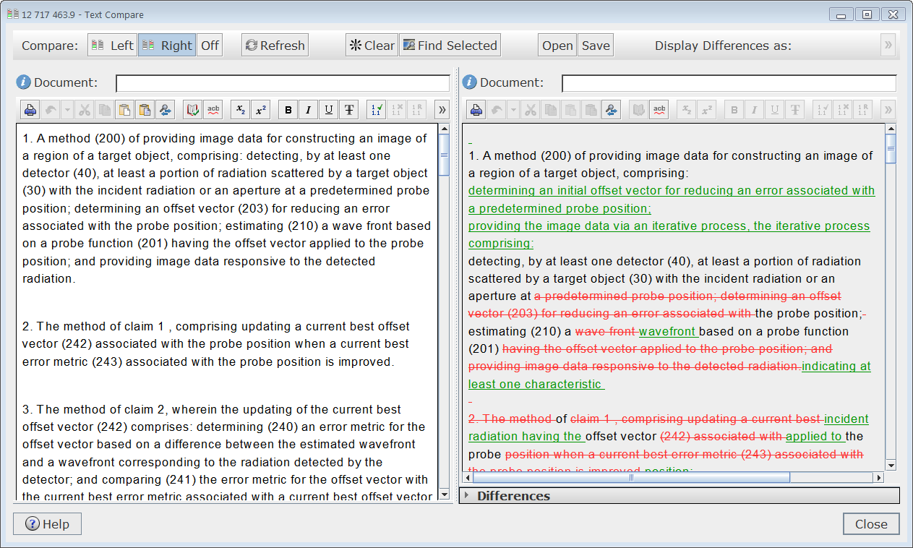
State of the art - Trimaran’s Text Compare
Notes:
side-by-side comparison of arbitrary texts
deleted text is displayed in red and strikethrough, and added text in underlined in green
all amendments appear
But:
only refers to deleted/added parts, i.e. the concept of “moved” text is not present
hard to spot correspondence between texts, e.g. dependent claim being moved
basis for amendments is not given
still tedious and time-consuming

Slide 6
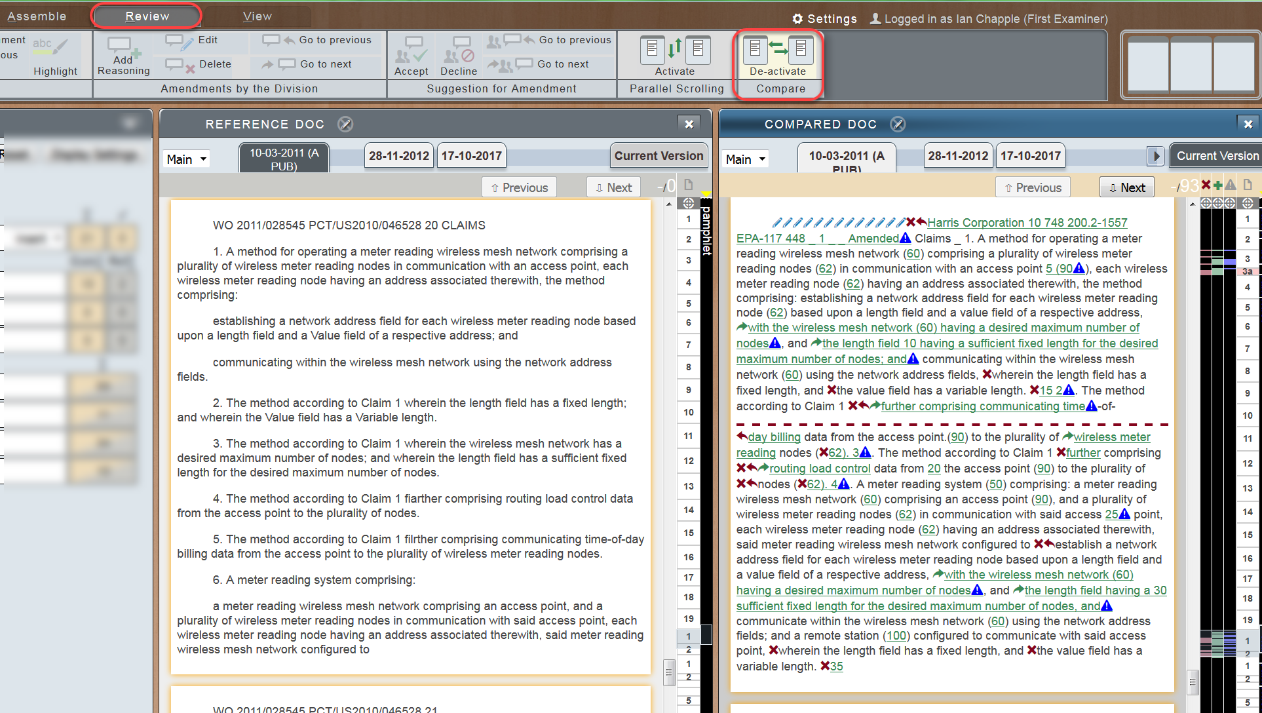
State of the art - eDrex’s Text Compare

Slide 7
State of the art - eDrex’s Text Compare
The eDrex text compare mode is found under the Review tab
It is unfortunately fairly poor:
it is slow in operation, as it has to perform multiple OCR operations in parallel
although it says it is comparing the Current Version, it ignores any amendments made by the First Examiner

Slide 8
State of the art – problem statement
Traditional text comparison tools:
compare entire claim sets, i.e. two blocks of text, which can give a very cluttered result:
moved claims are shown as added and deleted
deleted claims are still shown
do not help in finding a basis for the amendments

Slide 9
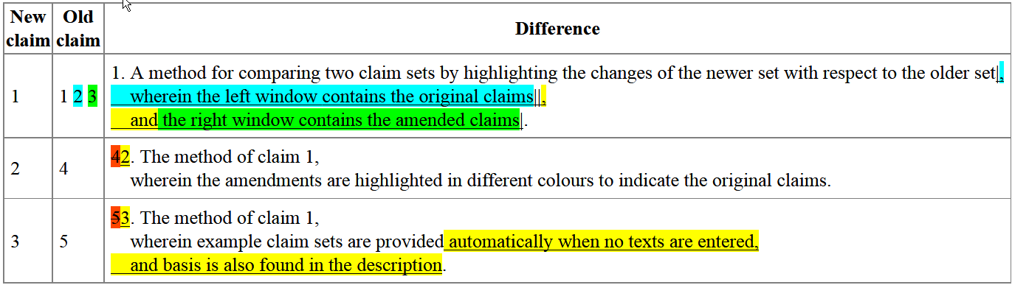
FDIFF – overview
FDIFF aims to:
show only the claims of the latest set,
show, for each claim, on which original claim it was based, and what were the amendments, and
show, for each amendment, where the basis might be

Slide 10
FDIFF – how the algorithm works
Splits the claim sets into individual claims,
Checks each new claim against each old claim, identifying the old claim with the most words in common, i.e. base claim;
New claims
Claim 1. Features A, B, C, F Claim 2. Features D, E
split
Claim 1. Features A, B, C, F
Claim 2. Features D, E
Original claims
New claims
Claim 1. Features A, B, C
Claim 1. Features A, B, C, F
Claim 2. Features D, E
Claim 2. Features D, E
Claim 3. Feature F

Slide 11
FDIFF – how the algorithm works
For added text: iterative comparison against old claims; added text with basis in support claim is highlighted.
Added text with no basis is highlighted in yellow, deleted parts of claims are shown in strikethrough red, and deleted claims are not shown.
Original claims
New claims
Claim 1. Features A, B, C
Claim 1. Features A, B, C, F
Claim 2. Features D, E
Claim 2. Features D, E
Claim 3. Feature F
Notes:
3) iterative comparison against old claims, selecting old claim(s) which have most in common, i.e. support claim(s); added text with basis is highlighted.

Slide 12
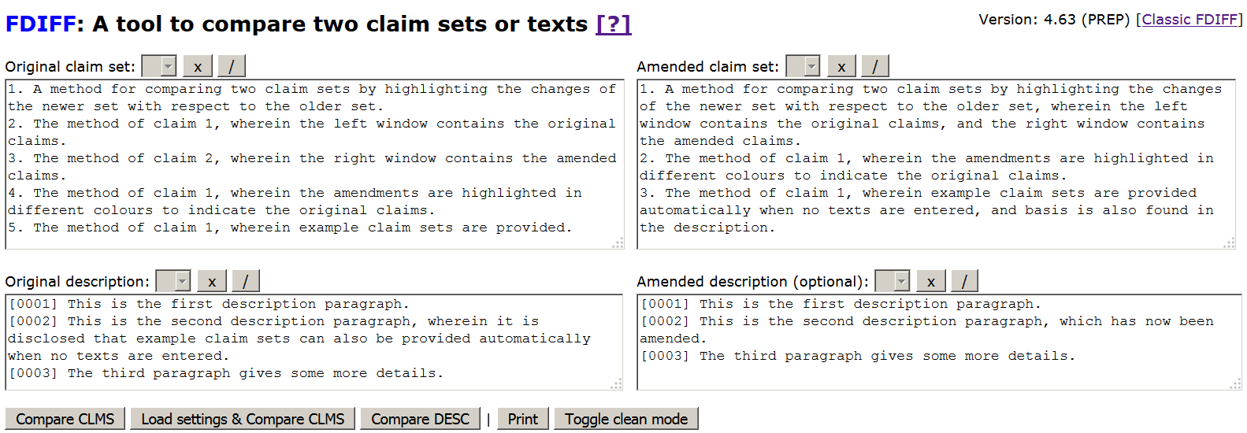
FDIFF - basic input
Notes:
Start of FDIFF demo

Slide 13
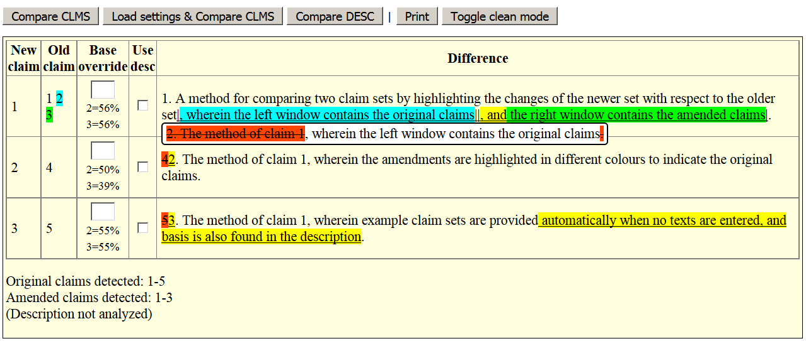
FDIFF – basic output
Compare claims to original claims
Hover over amendments
Notes:
Here the new claim set is compared to the original claim set.
User can override what claims to use for finding basis.
Example: for new claim 2, best match found is old claim 4; old claim 2 has 50% overlap with old claim 4; if >90%, try to define the respective claim as best match using “base override”

Slide 14
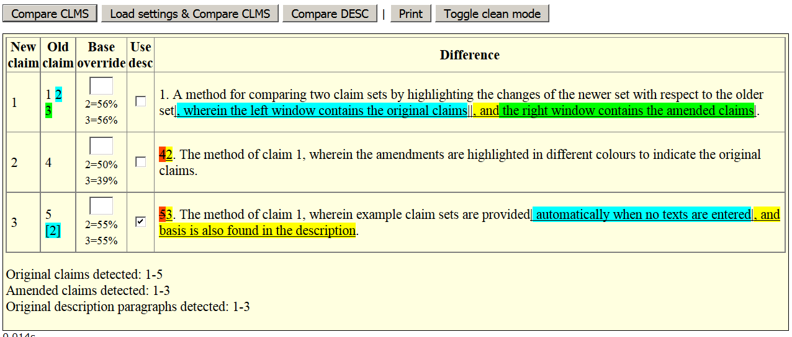
FDIFF – basic output (2)
Compare claims to original claims and description
Notes:
Here new claim 3 is also compared to the original description
Claim 3 is found to be based on original claim 5 + paragraph [2] + some unidentified text (in yellow).

Slide 15
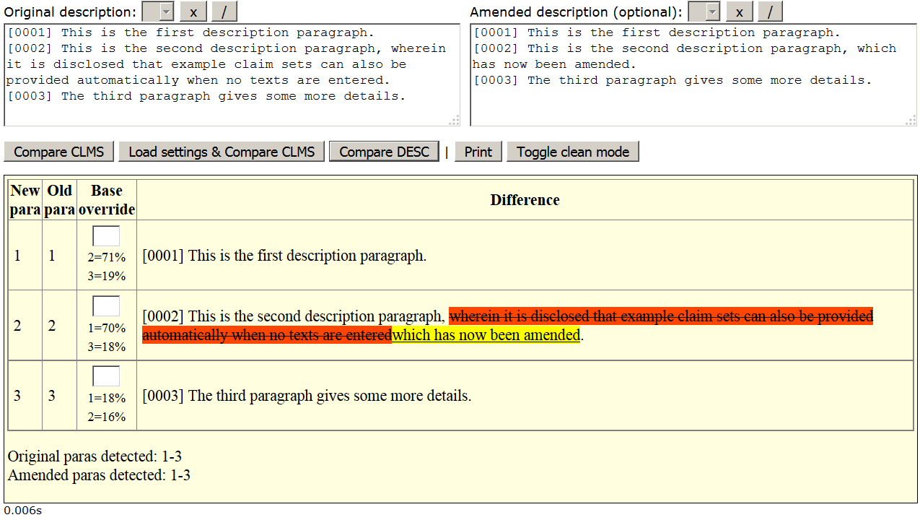
FDIFF – basic output (3)
Compare description to original description

Slide 16
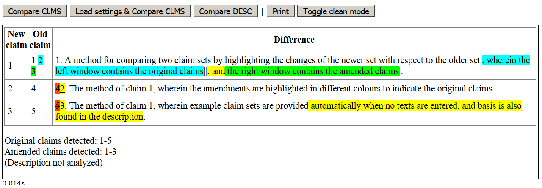
FDIFF – basic output (4)
Clean mode, for copy&paste table into Word
edit title
Mark + copy&paste

Slide 17
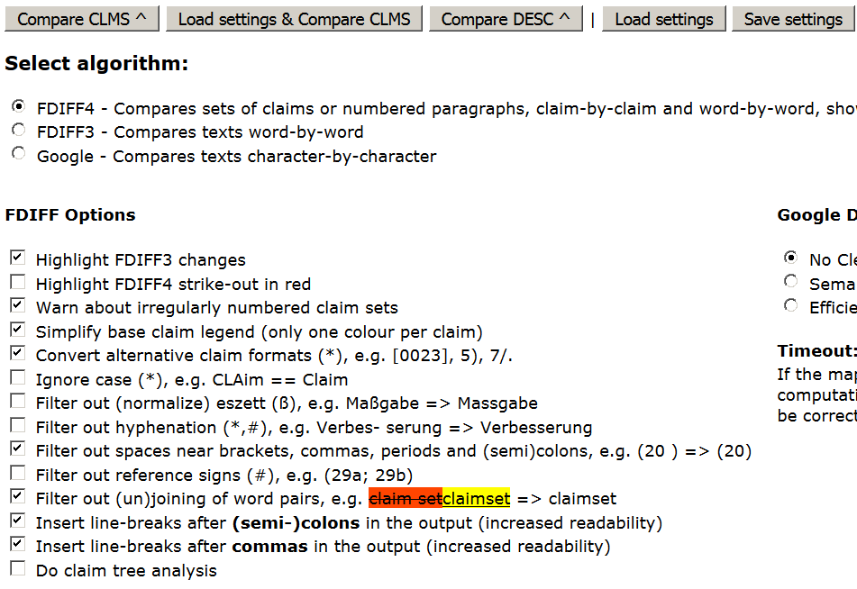
FDIFF – customizing the output
2
1

Slide 18
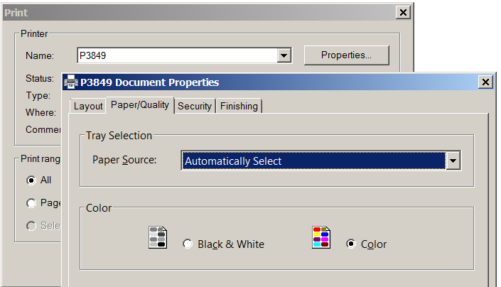
FDIFF – settings for printing with colours
Printer settings

Slide 19
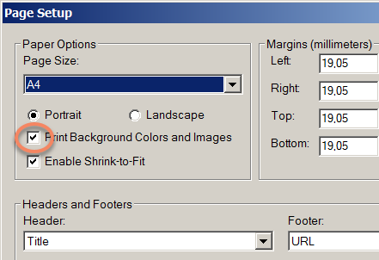
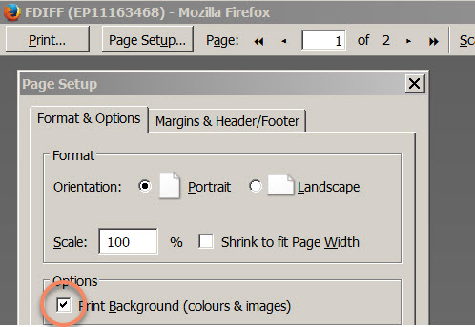
FDIFF – settings for printing with colours
Internet Explorer settings
Firefox settings
Activate colour
Access «Page Setup» via browser menu: File -> Page Setup...
Notes:
End of FDIFF demo

Slide 20
..FDIFF

Slide 21
..FDIFF
Automatically populates the claims and description fields in the FDIFF browser window
Attempts to retrieve as many relevant sets of claims as possible
Enables OCR’ing of the eDrex claims and DI+ submissions

Slide 22
..FDIFF
How to launch:
1) ..fdiff EP17172431
2) ..fdiff (for access to more options via dialog)
3) ..start => select activity «Examination» then action «open FDIFF»
Documentation page: http://q/fdiff

Slide 23

..FDIFF / FDIFF-browser-app
Internal
Browser
Epoque DB
..TRI
..FDIFF
FDIFF
Clms
$$≠$$
Clms
Fulltext Master
OCRit
DI+
eDrex
..FDIFF - storage
Notes:
FDIFF is the browser application work horse doing the comparison
..FDIFF is an EPOQUE preparation that installs/updates the browser application files to the local hard disk,
then downloads the claim texts for a given dossier and starts the FDIFF browser application.
Sources of FDIFF dossier data:
- Epoque DB: same as Viewer content, OCR’ed
- Fulltext DB: same as Trimaran/Ansera Application content, OCR’ed
- DI+: data in pdf format, not OCR’ed
- eDrex: data in pdf format, not OCR’ed

Slide 24
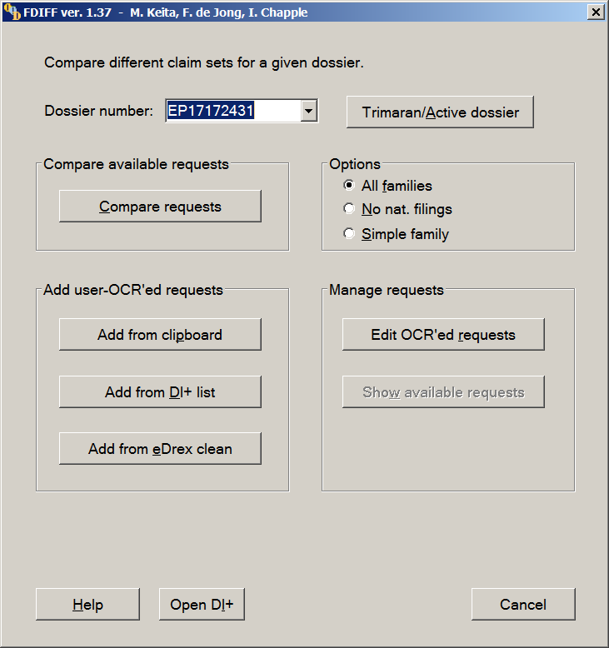
..FDIFF dialog
Launch browser-app with all claim and description sets (incl. manually OCR’ed)
Add requests (claims, desc.) manually:
- using clipboard input
- selecting from DI+ (auto-ocr)
- adding eDrex clean copy (auto-ocr)
Edit / cleanup manually added requests

Slide 25
FDIFF
Several options are available: anti-clutter threshold, ignoring reference signs, hyphenation, output formatting, claim tree analysis...
Standard resilience against OCR errors, e.g. common OCR mistakes fixed
Web-based application but confidentiality is guaranteed (program runs locally)
Resulting windows may be directly printed directly from browser or copy&pasted and edited in Word (and attached to the Votum)

Slide 26
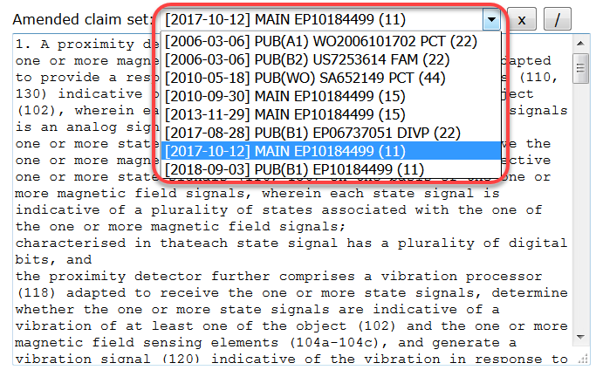
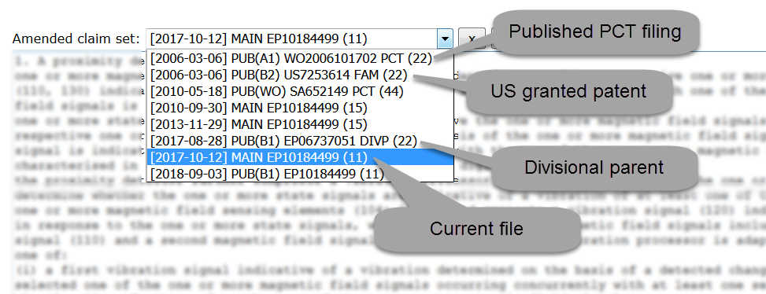
..FDIFF example showing claims of PCT filing, family member grant and divisional parent
Notes:
Start of ..FDIFF demo
EP 10 184 499 is a DIV of EP 06 737 051, which is a regional filing of SA 652 149.

Slide 27
Why are claim sets missing?

Slide 28
The claim set was only recently filed (eg. after a telephone conversation/exchange of emails), and have not yet been OCRed
Due to the terms of the Service Level Agreement with Jouve, who are responsible for OCRing new submissions, it may take up to 10 days for new submissions to be available in the EPO systems in text format
Multiple requests were filed on the same day (eg. a Main request and one or more Auxiliary requests); in such a case, it is possible that only some of the requests may have been OCRed

Slide 29
The file is old, meaning that submitted claim sets were not OCRed for some reason
The file is a Euro PCT file - these are notorious for being badly processed, with certain claim sets being completely excluded from being OCRed
If a claim set of interest is not available in Trimaran or ANSERA, then it has not (yet) been OCRed
- this means that the text version of the claims is not available in FTM, making it impossible for such a set of claims to be retrieved automatically by ..FDIFF

Slide 30
Possible Workarounds
Check whether the missing set is present in Trimaran (copy and add it manually using ..FDIFF (to open the dialog), then Add from Clipboard)
Check whether the missing set is present in Ansera (copy and add it manually using ..FDIFF, then Add from Clipboard)
Lastly, OCR the claims by typing ..FDIFF, then selecting Add from DI+ list to get the text of the missing claim set

Slide 31
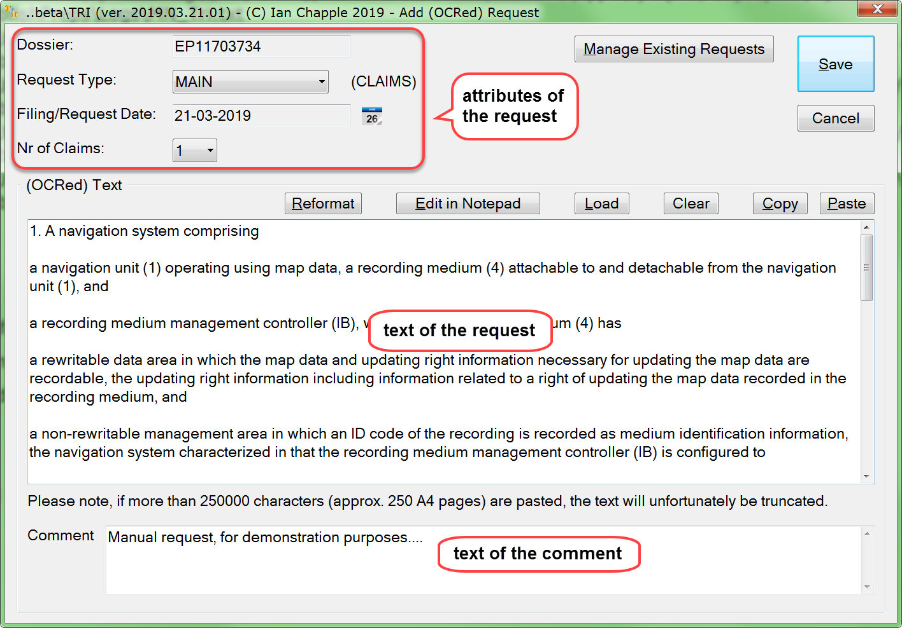
Adding a New Request

Slide 32
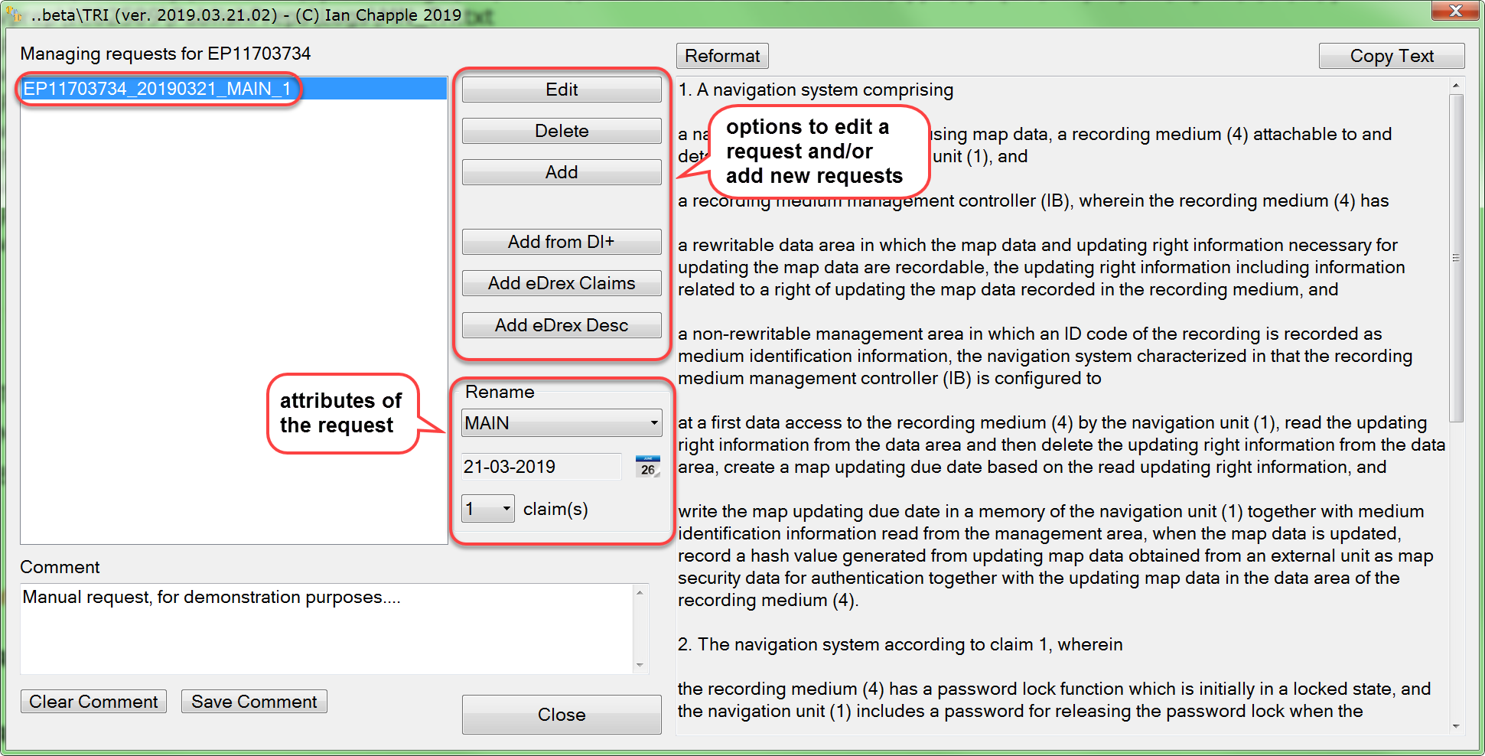
Managing Requests
Notes:
End of ..FDIFF demo

Slide 33
Conclusion
Provides support to the examining division for a tedious task
Makes amendments visible
Displays amendments in a standard way
Tries to find a basis in the original claims
Enables access to claim sets which may not otherwise be available
Responsibility regarding Art.123(2) check stays with examining division

