Slide 1
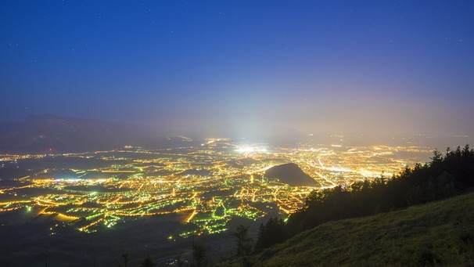







Problem – Why?
Notes:
Problem: Residents, flora, fauna are bothered by traffic noise and street lights during the night

Slide 2
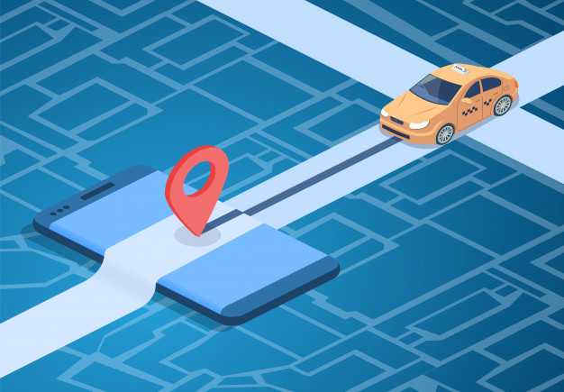

How to...
…LetMeSleep - signs
Measuring noise & light data
Dynamically divert traffic & dim street lights
Streets are opened and lights switched on
Simulation based on actual traffic data
Smart implementation in existing signs
Notes:
Smart implementation in existing signs

Slide 3

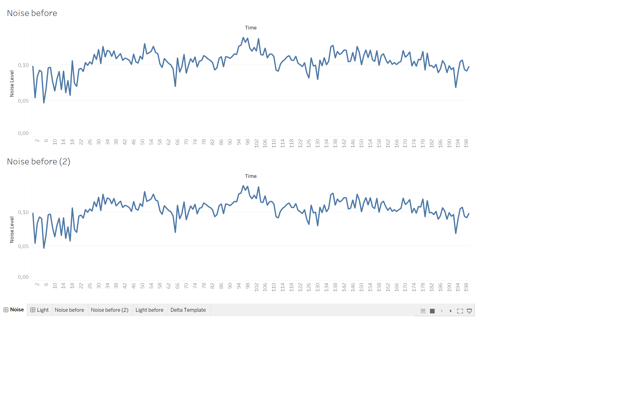
Sustainability
before
after
Longer "silent phases" locally
Avoid noise peaks
Less energy consumption
Less noise / light emission
Notes:
Die kurzen Lärmspitzen werden vom Mittelungspegel kaum erfasst, sind aber äußerst störend.

Slide 4





Outlook
Dynamic signs
Dynamic cars
Dynamic cities
© Sleepy Coders feat. Meike, Miguel, Amir

