Slide 1
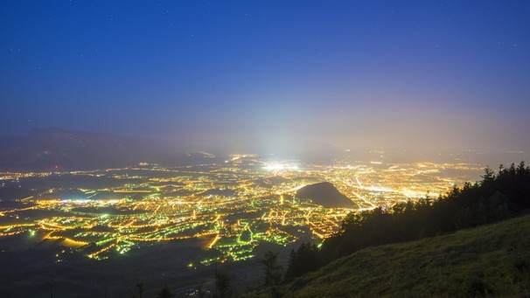







Problem – Why?
Notes:
Problem: Residents, flora, fauna are bothered by traffic noise and street lights during the night

Slide 2

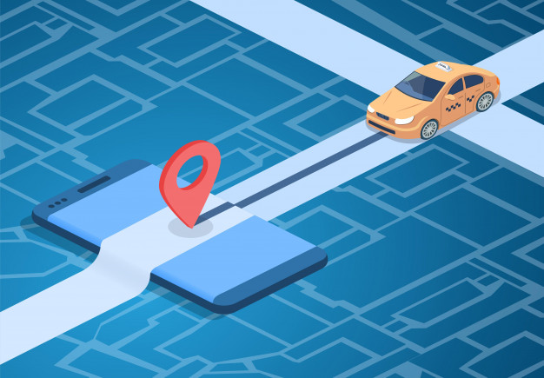
How to...
…intelligent traffic - signs
Measuring noise & light data
Dynamically divert traffic & dim street lights
Smart implementation in existing signs
Notes:
Smart implementation in existing signs

Slide 3
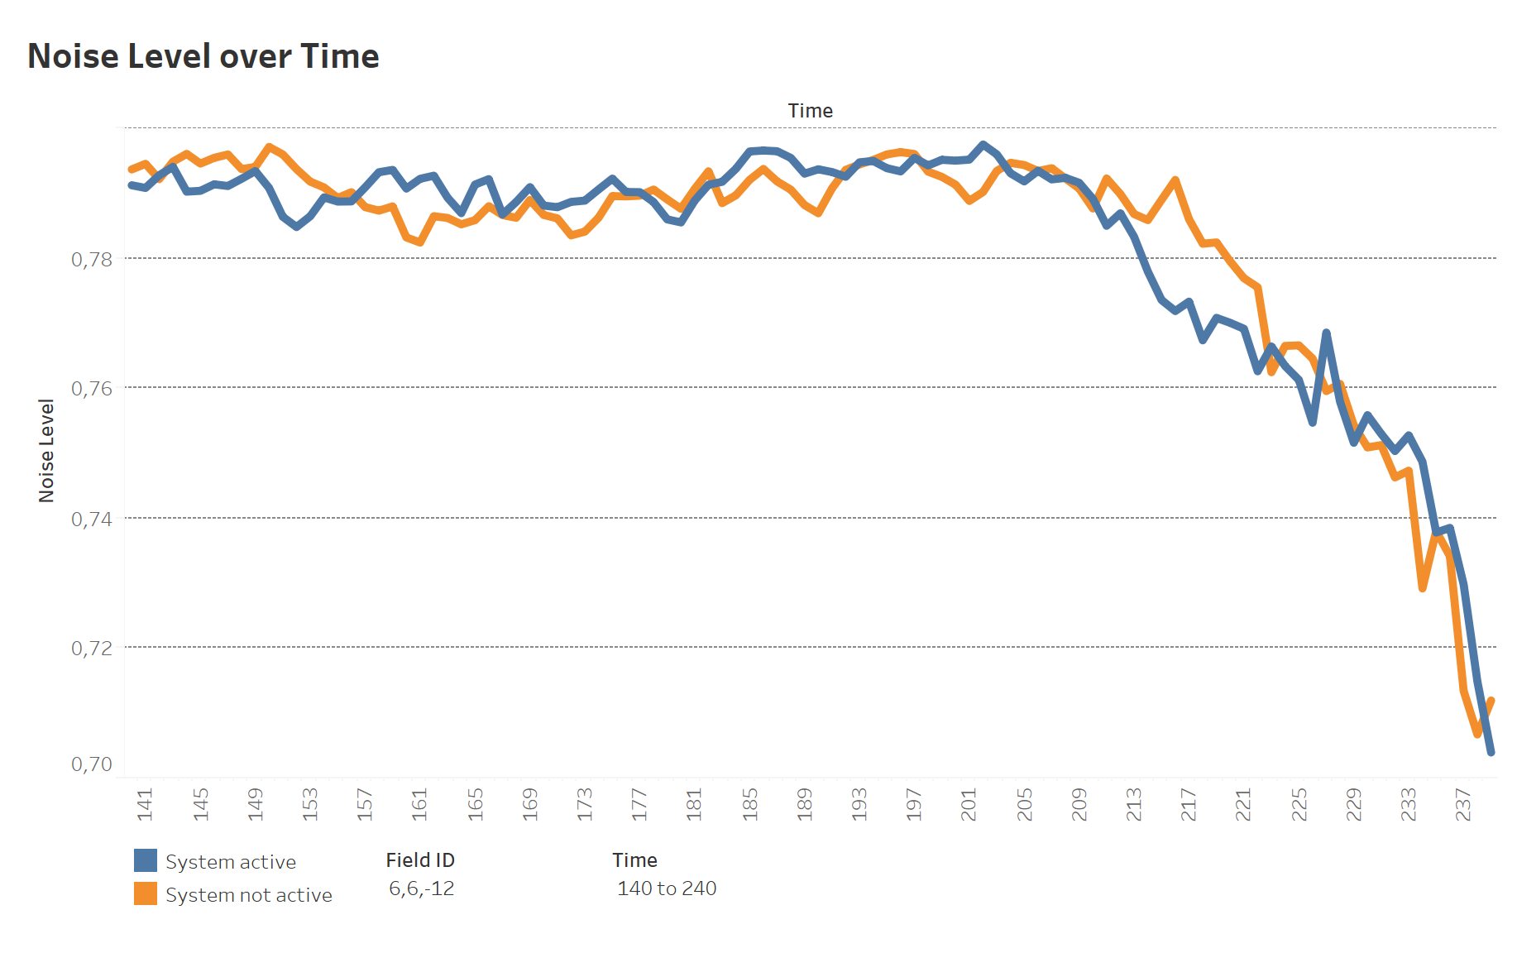
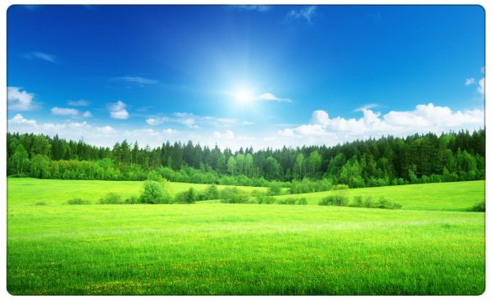
Sustainability
Longer "silent phases" locally
Avoid noise peaks
Less energy consumption
Less noise / light emission
Notes:
Die kurzen Lärmspitzen werden vom Mittelungspegel kaum erfasst, sind aber äußerst störend.

Slide 4
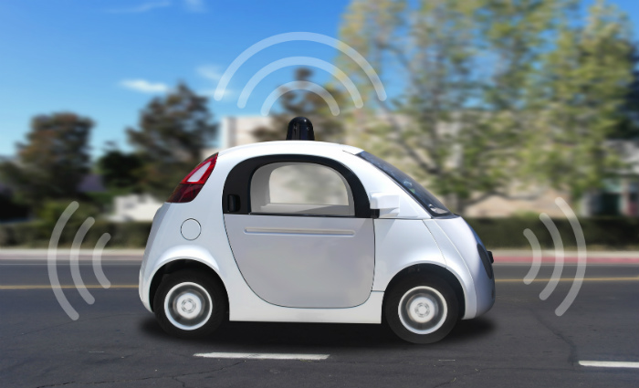


Team Let Me Sleep
was here!
http://82.165.253.18/sleepapi
https://isign.vapor.cloud
https://github.com/frankdressel/code4green

