Slide 1
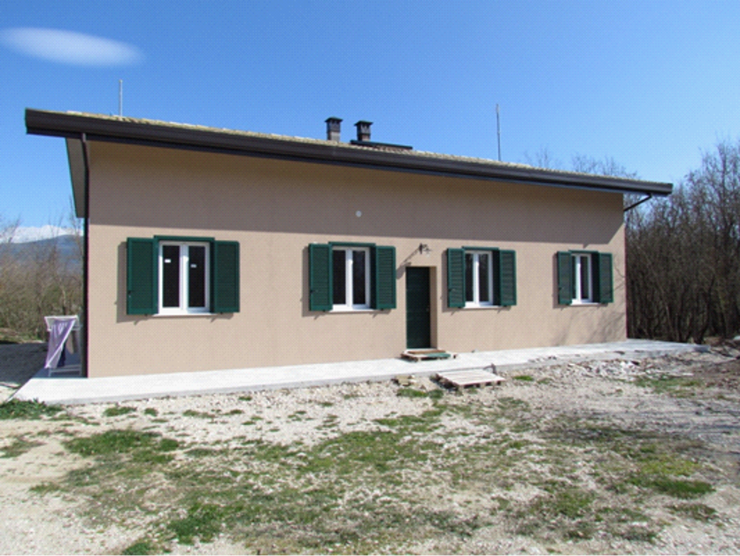
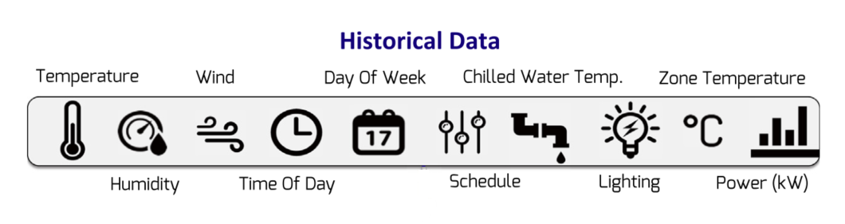

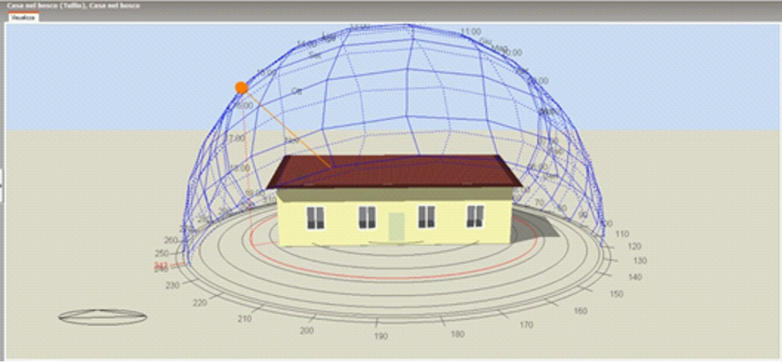













Section 5.1
Section 5.5 – Simulation loop
Section 5.3
Section 5.2
$$T_{k+1|k}^{r,1}$$
Section 2
$$T_{k+1|k}^{r,3}$$
$$E_{DPC}$$
Section 5.4
$$T_{k+1|k}^{r,3}$$
$$E_{bang−bang}$$
$$T_{k+1|k}^{r,4}$$
Bang-bang controller
$$E_{DPC}$$
$$X_{k}^{c}$$
Energy RF model
$$P_{k+j|k}^{}$$
$$E_{bang−bang}$$
DPC
affine model
$$T_{k+j|k}^{1}$$
Section 5.3
$$T_{k+j|k}^{3}$$
$$T_{k+j|k}^{3}$$
$$T_{k+j|k}^{4}$$

Slide 3









