Slide 1
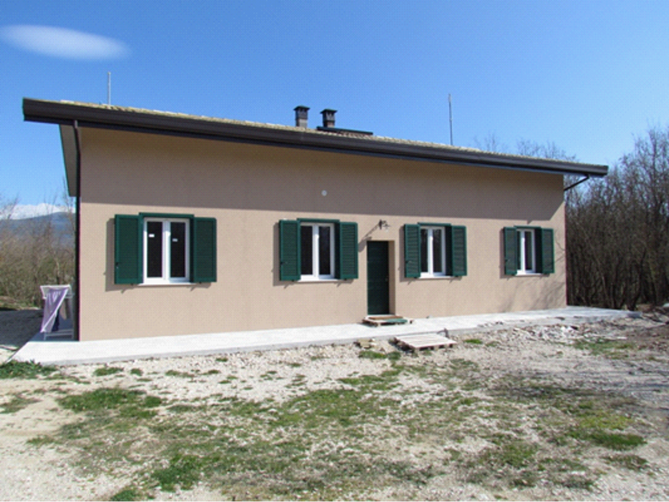



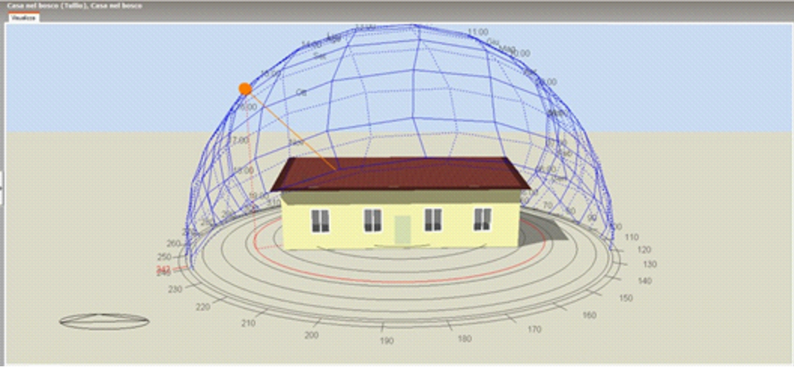


Real data
$$E_{real}$$
$$E_{DPC}$$
optimizer
affine model

