Slide 1

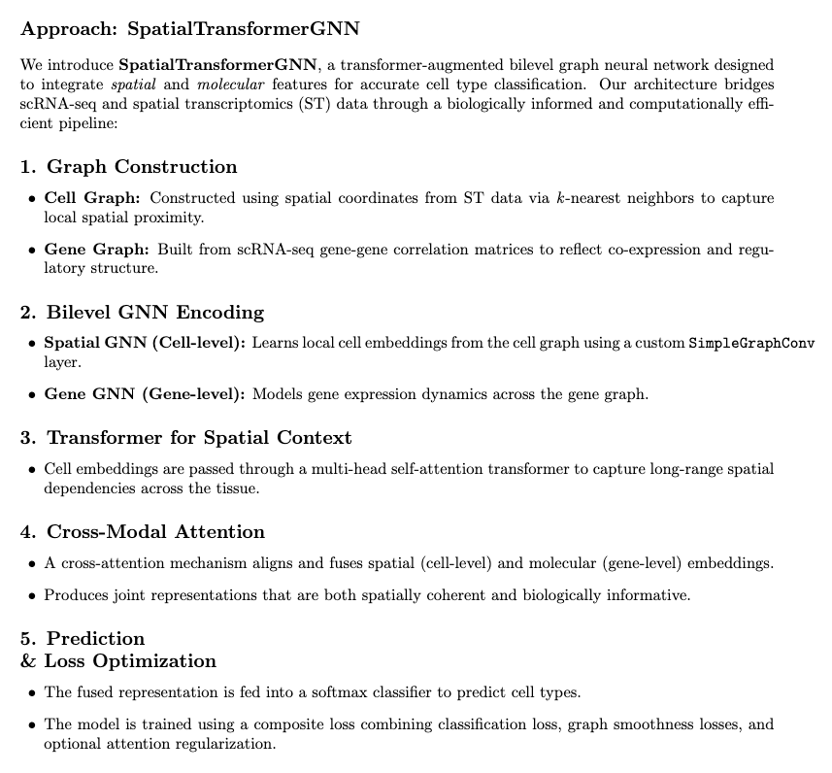
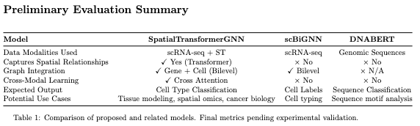
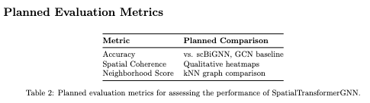
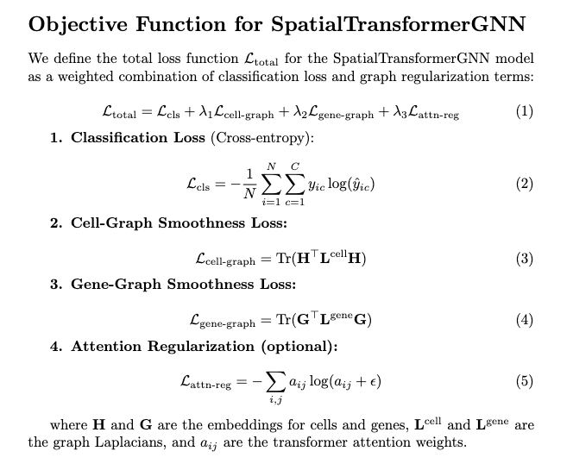
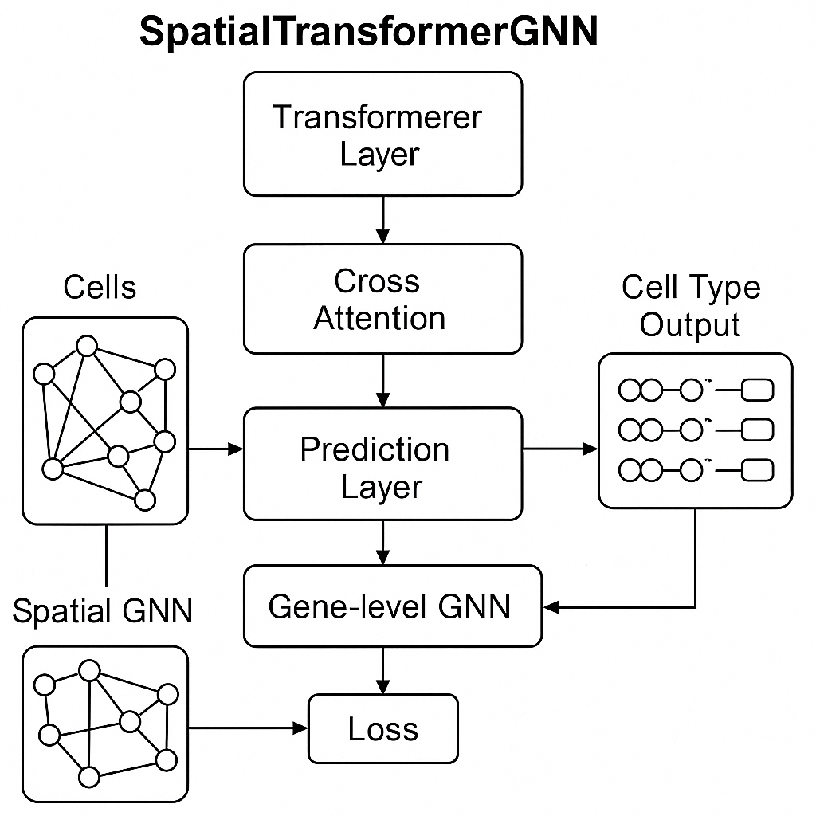
CENTER for COMPUTATIONAL SYSTEMS BIOLOGY @ PVAMU
https://ccsb.pvamu.edu
SpatialTransformerGNN: A Transformer-Augmented Bilevel Graph Neural Network for Spatially Informed Cell Type Classification
FRANKFURT O. OGUNFUNMINIYI
Supervisor: Seungchan Kim, Ph.D.
Center for Computational Systems Biology, Electrical and Computer Engineering Department
Roy G. Perry College of Engineering, Prairie View A&M University
Abstract
Approaches
Results
In my current research, I am developing SpatialTransformerGNN, a bilevel graph neural network that integrates spatial and molecular information to improve cell type classification. This model is motivated by the limitations of current tools like DNABERT, which captures genomic sequence patterns without spatial awareness, and scBiGNN, which models gene-cell relationships but lacks spatial integration. These gaps highlight the need for models that can jointly reason over both transcriptomic data and tissue architecture.
SpatialTransformerGNN is designed to address this by combining graph neural networks with transformer layers in a bilevel architecture. The model captures local dependencies between genes and cells, while a self-attention mechanism learns broader spatial structure. A cross-modal attention module further aligns latent representations from scRNA-seq and spatial transcriptomics (ST), producing joint embeddings that are both biologically meaningful and spatially coherent.
The model is currently being trained and validated on publicly available datasets from the embryonic mouse brain. As part of ongoing work, I aim to evaluate its performance using metrics such as classification accuracy, spatial coherence, and neighborhood preservation. Ultimately, this research aims to contribute a flexible framework that supports deeper insights into tissue organization, cell communication, and spatial regulation, key areas in both fundamental biology and applied fields like cancer research and regenerative medicine.
This research is currently in the model development and experimental validation phase. SpatialTransformerGNN is being trained on matched scRNA-seq and spatial transcriptomics data from the embryonic mouse brain. While results are not finalized, early experiments are focused on evaluating the model’s ability to learn spatially coherent and biologically meaningful embeddings.
Problems
Discussion
Integrating spatial transcriptomics (ST) with single-cell RNA sequencing (scRNA-seq) remains a central challenge in advancing our understanding of tissue architecture and cellular identity. While scRNA-seq offers high-resolution molecular profiles of individual cells, it lacks information about their spatial localization. Conversely, ST provides valuable spatial context but often at the cost of reduced gene coverage and resolution.
Although models such as DNABERT and scBiGNN have achieved meaningful progress in their respective domains, which include modeling sequence features and graph-based cellular relationships. They are not designed to jointly model spatial and transcriptomic data in an interpretable and biologically consistent manner.
This disconnect hinders our ability to explore how cells are organized, how they interact within their microenvironments, and how these patterns evolve during development or disease. To address this, there is a clear need for an integrative framework capable of capturing both fine-grained molecular interactions (e.g., gene-gene and cell-cell) and broader spatial patterns across tissue sections, ultimately enabling more holistic insights into complex biological systems.
Although quantitative results are still being generated, this study proposes a novel and interpretable approach to integrating scRNA-seq and spatial transcriptomics data through a transformer-augmented bilevel graph neural network. The key contribution lies in modeling both local (gene-gene and cell-cell) and global spatial dependencies, which are often overlooked in existing frameworks.
We anticipate that SpatialTransformerGNN will produce spatially coherent embeddings that improve classification performance and neighborhood preservation compared to baseline methods. By aligning molecular and spatial data through cross-modal attention, this model has the potential to reveal new insights into tissue organization, developmental processes, and disease microenvironments.
Acknowledgement
Figure 1: Architecture of SpatialTransformerGNN. The model integrates cell-cell and gene-gene graphs with transformer-based spatial reasoning and cross-modal attention to align scRNA-seq and spatial transcriptomics data.
I would like to sincerely thank my PhD advisor, Dr. Seungchan Kim, at Prairie View A&M University for his guidance, mentorship, and continuous support throughout this research. As part of the Department of Electrical and Computer Engineering and the Center for Computational Systems Biology (CCSB), I have benefited greatly from a collaborative and intellectually stimulating environment. I also gratefully acknowledge the teams behind STOmicsDB and the Mouse Cell Atlas for making their datasets publicly available. Resources like these are essential to advancing research in computational biology and spatial omics.

