Slide 1
SpatialTransformerGNN: A Transformer-Augmented Bilevel Graph Neural Network for Spatially Informed Cell Type Classification
Research Proposal Presentation
Presented by: Olawole Frankfurt Ogunfunminiyi
Date: 2025
Notes:
The title of this presentation, SpatialTransformerGNN: A Transformer-Augmented Bilevel Graph Neural Network for Spatially Informed Cell Type Classification, highlights the focus on integrating transformers and graph neural networks (GNNs) for single-cell analysis. As advances in single-cell RNA sequencing (scRNA-seq) and spatial transcriptomics (ST) have expanded our understanding of cellular heterogeneity, new computational methods are needed to analyze spatial relationships efficiently. This research introduces a hybrid model that leverages both graph-based learning and transformer attention mechanisms to enhance cell-type classification.
Single-cell analysis has traditionally faced challenges in integrating transcriptomic and spatial information. Existing methods either lack spatial resolution or fail to model long-range dependencies effectively. GNNs are powerful for capturing local relationships but are limited in their ability to handle broader spatial interactions. On the other hand, transformers excel at modeling global dependencies but are underutilized in spatially aware single-cell studies. This research seeks to bridge these limitations by combining the strengths of both architectures.
This presentation will outline the motivation, problem statement, research objectives, methodology, and expected contributions of SpatialTransformerGNN. Additionally, we will discuss the anticipated challenges and the potential impact of this work on computational bioinformatics, precision medicine, and disease modeling. Through this work, we aim to develop a model that effectively integrates single-cell RNA sequencing (scRNA-seq) and spatial transcriptomics (ST) data to improve cell-type classification accuracy and spatial interpretability.

Slide 2
Introduction & Motivation
Single-cell RNA sequencing (scRNA-seq) provides high-resolution transcriptomics but lacks spatial context.
Spatial transcriptomics (ST) preserves spatial organization but has lower gene coverage.
Integrating these modalities is essential for understanding cellular function.
Graph Neural Networks (GNNs) model cell-cell interactions but lack spatial awareness.
Transformers capture long-range dependencies but are underutilized in spatial single-cell analysis.
This research proposes a hybrid approach: SpatialTransformerGNN.
Notes:
Single-cell RNA sequencing (scRNA-seq) has revolutionized transcriptomics by providing high-resolution gene expression profiles at the cellular level. However, it does not preserve spatial context, which is crucial for understanding tissue organization and cellular interactions. Conversely, spatial transcriptomics (ST) retains spatial organization but often has lower gene coverage, making it challenging to derive comprehensive biological insights. Integrating these modalities is crucial for gaining a deeper understanding of cellular function in the context of their spatial environments.
To address these limitations, graph neural networks (GNNs) have been widely used to model cell-cell interactions. While GNNs capture local relationships efficiently, they struggle to represent global dependencies across spatial regions. On the other hand, transformers, which have been successful in fields like natural language processing (NLP) and computer vision, are highly effective at modeling long-range dependencies. However, their application in spatial single-cell analysis remains largely unexplored.
This research proposes SpatialTransformerGNN, a hybrid model that combines graph-based learning and transformer attention mechanisms. By integrating GNNs with transformers, we aim to enhance spatial representation learning, leading to better cell-type classification and biological interpretability. This approach will allow us to leverage the strengths of both architectures to improve the understanding of cellular heterogeneity and spatial relationships.

Slide 3
Problem Statement
Existing models struggle to integrate both transcriptomic and spatial information.
GNNs are effective for local neighborhood modeling but fail to capture global spatial patterns.
Transformer-based models can capture long-range dependencies but are not widely applied to spatially informed single-cell analysis.
How can we develop a model that integrates both GNNs and Transformers for improved cell-type classification?
Notes:
Current computational methods for analyzing single-cell data struggle to jointly model transcriptomic and spatial information. While graph neural networks (GNNs) effectively capture local neighborhood structures, they fail to incorporate global spatial dependencies. This limitation makes it difficult to accurately classify cell types and understand cellular interactions within a spatially structured tissue environment.
Similarly, transformer-based models, which have shown remarkable success in NLP and vision tasks, have not been widely adopted for spatially aware single-cell analysis. While transformers can capture long-range dependencies, they often require large amounts of training data and are computationally expensive when applied to large spatial datasets. Existing single-cell analysis frameworks either lack spatial context or fail to integrate different data modalities effectively.
This research aims to develop a model that integrates both GNNs and Transformers to improve cell-type classification while maintaining spatial awareness. The key challenge is to design a framework that can efficiently combine gene-gene interactions, cell-cell relationships, and cross-modal fusion mechanisms while maintaining computational feasibility. Addressing these challenges will provide a novel computational approach for analyzing single-cell spatial data.

Slide 4
Research Objectives
Develop a bilevel graph framework modeling gene-gene and cell-cell interactions.
Enhance spatial representation learning through transformer-based attention mechanisms.
Implement a cross-modal fusion mechanism aligning scRNA-seq and ST embeddings.
Benchmark against existing models using public datasets.
Evaluate classification performance using standard metrics.
Notes:
The primary goal of this research is to develop a bilevel graph framework that models gene-gene and cell-cell interactions while incorporating transformer-based spatial representation learning. This will enhance the ability to classify cell types while preserving both local and global spatial dependencies within tissues.
To achieve this, we will implement a cross-modal fusion mechanism that aligns single-cell RNA sequencing (scRNA-seq) and spatial transcriptomics (ST) embeddings. By aligning these modalities effectively, we aim to reduce data sparsity and improve classification performance. This will allow for more biologically interpretable results in single-cell analysis.
We will benchmark our model against existing state-of-the-art methods using publicly available datasets. Evaluation will be conducted using standard classification metrics such as accuracy, F1-score, and spatial coherence. Through these objectives, we aim to demonstrate that SpatialTransformerGNN improves upon existing methods by integrating GNN-based local learning and transformer-based global attention mechanisms.

Slide 5
Related Work
scBiGNN (2023): Bilevel GNN for cell-type classification but lacks spatial context.
SpaGCN (2021): Uses GCNs for spatial transcriptomics but cannot model long-range dependencies.
STAGATE (2022): Self-supervised learning on ST data but does not integrate scRNA-seq.
Transformer-based models have been successful in genomics but not applied for spatially informed analysis.
Notes:
Several existing models have attempted to integrate spatial information in single-cell analysis, but they each have limitations. scBiGNN (2023) is a bilevel GNN-based model for cell-type classification, but it lacks spatial awareness, limiting its ability to model complex tissue structures. Similarly, SpaGCN (2021) utilizes graph convolutional networks (GCNs) to model spatial transcriptomics, but it cannot capture long-range dependencies effectively.
STAGATE (2022) is a self-supervised learning approach designed for spatial transcriptomics, but it does not integrate scRNA-seq data, which reduces its ability to model transcriptional heterogeneity. While transformer-based models have been successfully applied in genomics, their application in spatial single-cell analysis remains underexplored.
This research aims to address these gaps by combining GNNs and transformers into a single, hybrid framework. By incorporating cross-modal learning, we will improve spatially aware cell-type classification, making SpatialTransformerGNN a unique and novel contribution to the field.

Slide 6
Methodology Overview
Data Preprocessing: scRNA-seq and ST data integration.
Graph Construction: Gene-gene and cell-cell graphs.
Transformer-Augmented Learning: Local (GNN) and global (Transformer) features.
Model Training & Evaluation: Benchmarking with real datasets.
Notes:
The proposed SpatialTransformerGNN framework consists of four major components: data preprocessing, graph construction, transformer-augmented learning, and model evaluation. The data preprocessing stage will integrate scRNA-seq and spatial transcriptomics (ST) data, ensuring alignment and reducing sparsity in gene expression profiles.
The graph construction module will generate two distinct graphs: a gene-gene interaction graph and a cell-cell spatial graph. These graphs will be combined into a hybrid structure, enabling the model to learn both local and global representations. This approach ensures that each cell's features are informed by both molecular interactions and spatial positioning.
In the transformer-augmented learning stage, we will combine GNNs for local feature extraction and transformers for capturing long-range dependencies. The model will be trained and evaluated on real-world datasets using established classification benchmarks. The effectiveness of the model will be measured using accuracy, F1-score, and spatial coherence metrics.
Accuracy
What it measures: The percentage of correct predictions made by the model out of all predictions.
In cell-type classification context:
If the model predicts 100 cells, and 90 are correctly classified, accuracy = 90%.
Formula: Accuracy=(True Positives+True Negatives)Total PredictionsAccuracy = \frac{(True\ Positives + True\ Negatives)}{Total\ Predictions}Accuracy=Total Predictions(True Positives+True Negatives)​
Limitations:
If your data is imbalanced (e.g., 90% of cells are one type), accuracy might be misleading.
F1-Score
What it measures: The balance between precision (how many predicted cells of a certain type were actually that type) and recall (how many of that type the model found out of all existing ones).
Formula: F1=2×Precision×RecallPrecision+RecallF1 = 2 \times \frac{Precision \times Recall}{Precision + Recall}F1=2×Precision+RecallPrecision×Recall​
Why it’s useful:
It’s more informative than accuracy when dealing with imbalanced classes or when both false positives and false negatives matter.
Spatial Coherence
What it measures: Whether cells of the same predicted type are spatially clustered together in tissue, rather than randomly scattered.
In other words:
It checks if the model’s classification makes biological sense in the tissue layout.
For example, certain cell types are naturally grouped — the metric penalizes predictions that place those cells far apart.
How it's computed (conceptual):
Compare the spatial positions of cells predicted as the same type — if they’re close together, score is high; if scattered, score is low.
Why it matters:
High accuracy with poor spatial coherence suggests the model ignores spatial relationships — not good for biological interpretability.

Slide 7
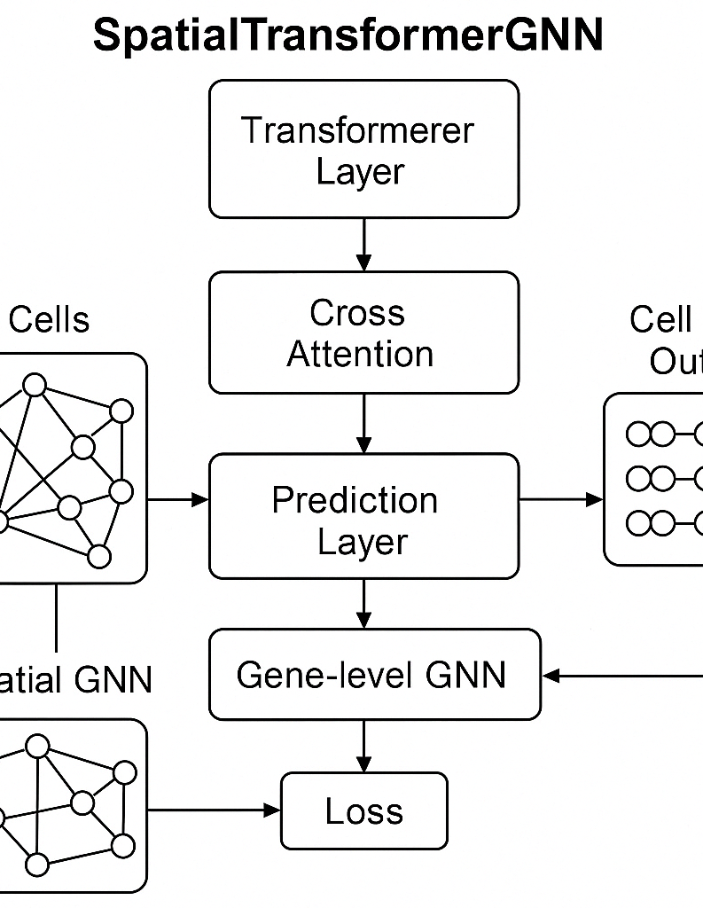
Graph Construction
Gene-Gene Interaction Graph: Derived from expression correlation networks.
Cell-Cell Spatial Graph: Based on spatial proximity in transcriptomics spots.
Hybrid Graph Model: Combines both structures for richer feature learning.

Slide 8
Transformer-Augmented Learning
Local Feature Learning: GNNs for fine-grained relationships.
Global Feature Learning: Transformers capture long-range dependencies.
Cross-Modal Attention: Aligns scRNA-seq and ST embeddings.

Slide 9
Model Training & Evaluation
Proposed Datasets:
StomicsDB - https://db.cngb.org/stomics/
CROST - https://crost.org/
Human Cell Atlas - https://www.humancellatlas.org/
Metrics: Accuracy, F1-score, spatial coherence.
Validation: Performance comparisons against existing models.

Slide 10
Expected Challenges & Solutions
High computational cost → Use cloud GPUs and model pruning.
Alignment issues → Implement cross-modal contrastive learning.
Data sparsity → Apply graph-based imputation techniques.

Slide 11
Project Timeline
Week 1: Literature Review, Dataset Selection
Week 2: Data Preprocessing
Week 3: Graph Construction
Week 4: Transformer-Based Learning Module
Week 5: Baseline Model Training
Week 6: Model Optimization & Fine-Tuning
Week 7: Validation & Report Writing
Week 8: Final Report Submission & Presentation

Slide 12
Expected Contributions
Introduce a hybrid transformer-GNN model for spatially aware cell-type classification.
Improve accuracy by integrating scRNA-seq and ST data.
Enhance biological interpretability of single-cell spatial analysis.

Slide 13
Applications & Impact
Computational bioinformatics
Precision medicine
Spatially resolved single-cell analysis
Drug discovery and disease modeling

Slide 14
Conclusion
This research proposes SpatialTransformerGNN, a hybrid model integrating GNNs and Transformers.
The model aims to enhance spatially aware cell-type classification.
Contributions to computational bioinformatics and precision medicine.
Future work: Extend the approach to multi-omics data integration.

Slide 15
References
Chen et al. (2022). STAGATE: Self-supervised learning for spatial transcriptomics.
Hu et al. (2021). SpaGCN: Integrating gene expression with spatial information.
Ji et al. (2021). DNABERT: Pre-trained transformers for DNA sequence classification.
Zhou et al. (2023). scBiGNN: Bilevel Graph Representation Learning for Cell Type Classification.

