Slide 1

Software Security Analysis
Partha Das Chowdhury

Slide 2
So far
Software supply chain attacks
Log4j
Abstract syntax tree
Building parsers
Software side channels
Spectre
Meltdown
Constructing test cases for a secure pipeline
Code coverage
Mutation tests
Working with gdb, stack and assembly
Spatial memory safety
Reverse Engineering
Malware Analysis
Strings
Yara
Controlled execution using gdb
Static and dynamic analysis in Windows environment
Code

Slide 3
“Laws of the land”
Waking up exercise: There is a code legacy-debt.py
Can you do a security debt audit.
The focus is not just on what is bad, but what will incur GDPR fine in millions.
Can you see someone else’s SSN without knowing their id?
Code

Slide 4
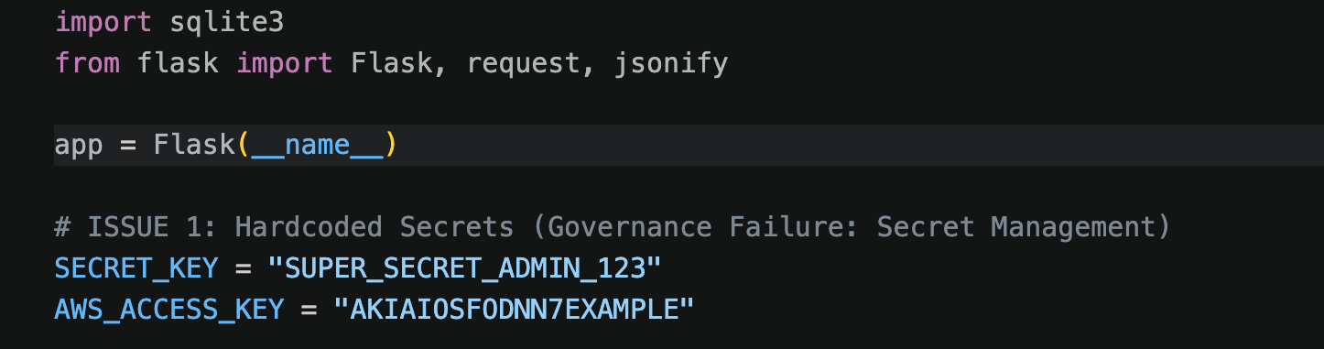
30 minutes for this task
Code

Slide 5
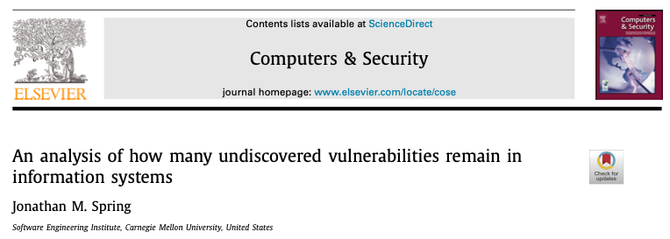
We refer to this paper in the context of Godel’s theorem while covering Computers and Intelligence.
https://www.sciencedirect.com/science/article/pii/S0167404823001013

Slide 6
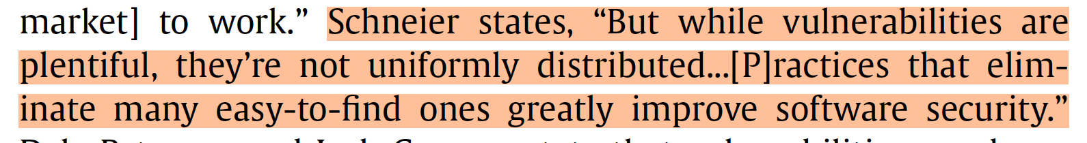
The state of play with software systems.
This is from Bruce Schneier.
We will come back to this shortly.

Slide 7
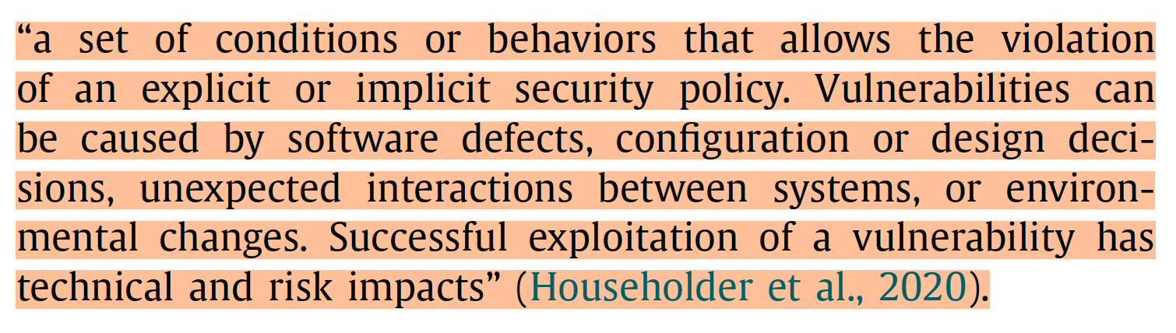
What is a vulnerability?

Slide 8
Security policy
Security policies are not fixed.
They depend on context and change with time and space.
They should change. (We have shown this in the context of E2EE messaging applications.)
The point is not to blame the system designer, but the threat landscape is ever evolving (next slide).

Slide 9
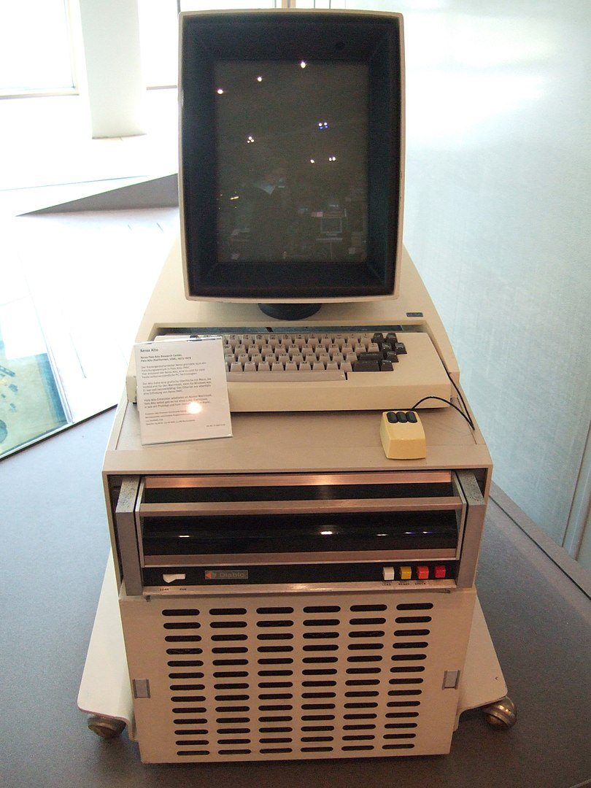
1970s – Needham Schroeder’ s Authentication mechanism on Alto at Xerox PARC

Slide 10
Things we proved safe…
Mihir Bellare & Phil Rogaway proved OAEP as secure.
Victor Shroup found a gap in the proof and that it worked ‘by accident’ only for RSA
Larry Paulson proved SSL\TLS to be secure in 1999.
We have seen ciphersuite downgrade attacks, timing attacks & Bleichenbacker attack.
IBM 4758 was evaluated to FIPS-140 level 4 and was thought to be ‘unhackable’
Mike Bond and Jolyon Clulow came up with attacks.
This is an interesting example where the hardware was secure, but the software was not. ( This was known to IBM).
Mihir Bellare et. al. proved SSH’s use of symmetric crypto was secure.
Martin Albrecht, Kenny Paterson and Gaven Watson found holes in the use. (The length field was not in the model.)

Slide 11
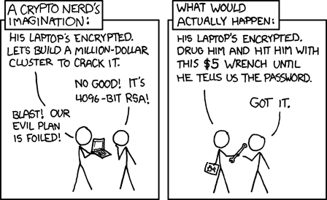

Slide 12

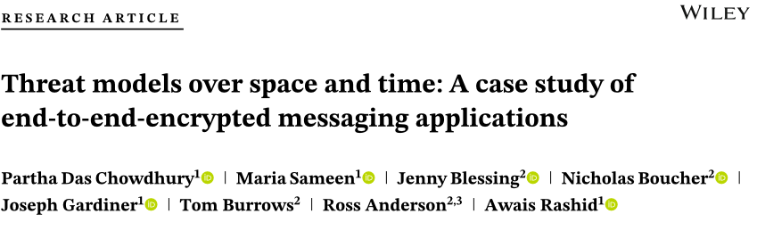






Threats are not static
https://onlinelibrary.wiley.com/doi/epdf/10.1002/spe.3341

Slide 13
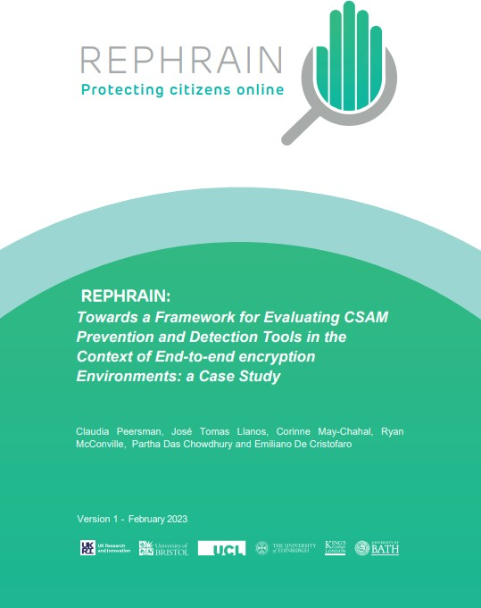
Scoping to often to protect human rights.

Slide 14
Scoping to often to protect human rights.
Threats due to expanded memory scanning
Where are they placed?
Users are not responsible for detecting and recovering from threats.
Threats due to embedding tools within other applications
Security & privacy permissions dependent on the goals and incentives of the embedding application
Mandated backdoor can lead to interesting policy externalities

Slide 15
Scoping to often to protect human rights.
Safe Defaults
Users do not have fixed behavior
How do applications adapt when the system context and user behavior change?
Limits of authentication
Debates in Xerox parc
Hiding behind double ratcheting.

Slide 16
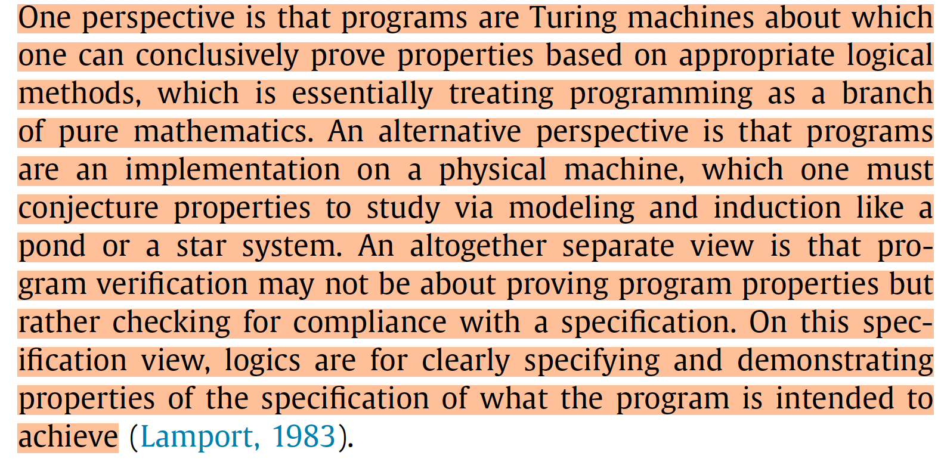
What is a program verification?

Slide 17
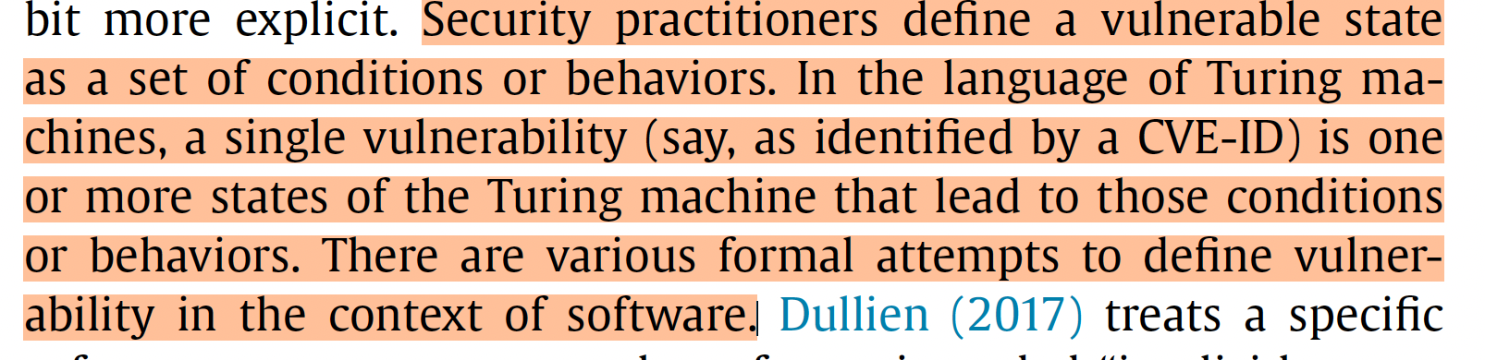
What is a vulnerability?
Let us remember a Turing machine from the other lessons.
This is essentially formulating a CVE as a state.

Slide 18
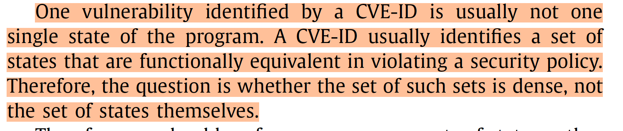
What is a vulnerability?

Slide 19
What is a state?
The value of variables.
The instruction being executed.
The contents of the memory.
(Any program will have many many states.)

Slide 20
A CVE is a culmination of many such states.
For example, Log4Shell (CVE-2021-44228) has many underlying behaviors and different states. It is not one snapshot.
The vulnerability of a JNDI lookup to a malicious server can be triggered by various different states.
They can be different inputs, different execution paths, protocols (LDAP, RMI, etc) so on and so forth.
While each of them will trigger the vulnerability, but the CVE is a collection of these individual states. (I personally like this formalism and would urge all of you to reflect on this.)

Slide 21
A CVE is a culmination of many such states.
While each of them will trigger the vulnerability, but the CVE is a collection of these individual states. (I personally like this formalism and would urge all of you to reflect on this.)
The fact that all these states trigger the vulnerability, that makes them functionally equivalent.
This means we know some states but at the same time we do not know many such states. For example, CVE-2021-44228, CVE-2021-45046, both captured various different functionally equivalent states for Log4shell.

Slide 22
How many vulnerabilities are there in a computer program?
This touches on theoretical computer science and security operations.
Mathematical models need to capture real systems.
Animating systems is not enough.
The animated abstraction needs to be significantly more cumbersome than the implementation.
The above means we can interrogate systems in diverse contexts and challenge the assumptions they make.

Slide 23
Virtually Perfect Security
The fallacy of perfect security.
Security is not some sort of a metaphysical property.
We do not need to answer the question “ a system is secure or not” in absolute.
Context & Abstractions are important.
Many attacks on TLS are due to usage.
Security is relative to a particular abstraction.
Quest for perfect abstraction has often led to think ‘normal’ behavior as threats.

Slide 24
Can we proactively prove a state as vulnerable?
This will mean predicting if a number is a Turing machine.
The first proposition involves solving the Halting problem. We also discuss Godel’s theorems in a related context. (I always felt that it would have been better for me to have read Turing’s 1950 paper before the 1936 paper.)
Program verification works in specific contexts and there will always be more vulnerabilities, than we can find.

Slide 25
Vulnerability recording and naming.
Common Weakness Enumeration: This is like a listing of all bugs (diseases), and weaknesses.
Cross site scripting or memory corruption etc.
Common Vulnerabilities and Exposures: Specific instances of vulnerabilities in a particular product or version.
CVE-Year-ID Number -> CVE-2021-44228 is Log4shell

Slide 26
Vulnerability recording and naming.
Say one of us finds a bug.
This is assigned a unique ID (CVE).
The vulnerability is scored (CVSS).
This is finally published in the NVD database. (National Vulnerability database).
Companies check their systems against this database, patch their systems.
Developers use CWE lists to learn what mistakes to avoid.
Analysts track which CVEs are being actively exploited in the wild.

Slide 27
CWE and CVE.
CWE is the conceptual error while CVE is the instantiated vulnerability.
For example, Log4shell pertains to the CWE 502 & others.
This goes back to our earlier formulation of CVE as a collection of functionally equivalent states.
In-Class Group Exercise: Can you find the most prevalent CVEs from Github SA and classify them according to CWEs?
I will divide the groups, and each group will look at a different languages/eco-system.
If you focus on top 25 CVEs based on criticality that should be fine for now. Then group them into CWEs.
Each group will discuss and then we will compare across the languages/ecosystems.
Do you have CVEs without a CWE? Do you have CVEs connected to multiple CWE?

Slide 28

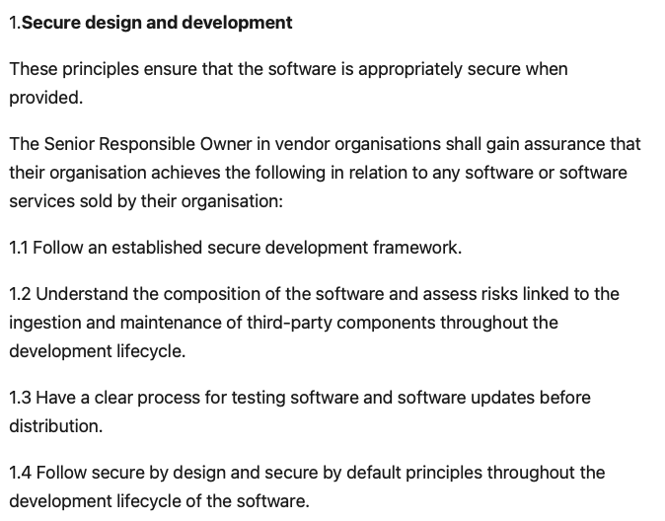
Code

Slide 29
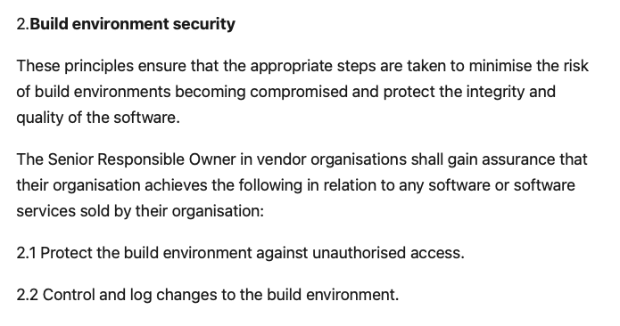
Code

Slide 30
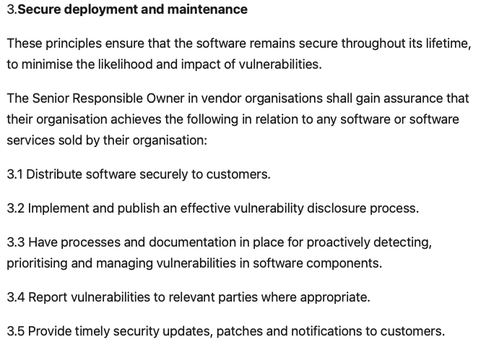
Code

Slide 31
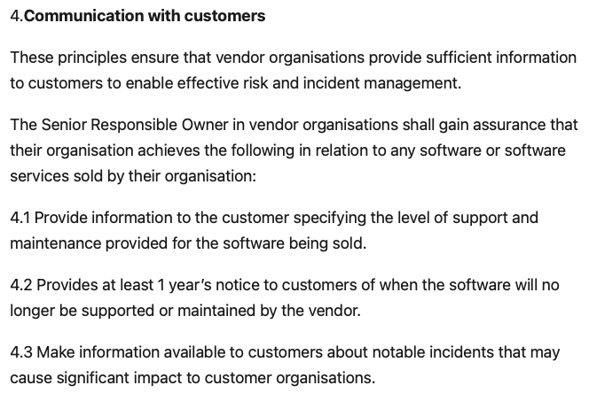
Code

Slide 32
“Laws of the land”
Waking up exercise: There is a code legacy-debt.py
Can you do a security debt audit.
The focus is not just on what is bad, but what will incur GDPR fine in millions.
Can you see someone else’s SSN without knowing their id?
How these security debts link to the software security code of practice? Discuss in group?
Code

Slide 33

This is in your folders
Code

Slide 34
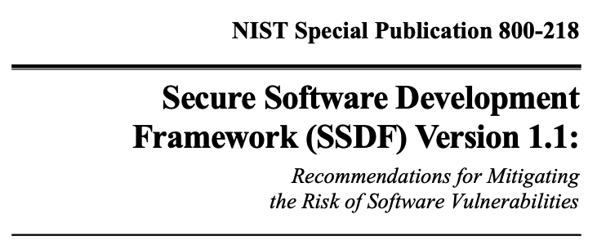
Code

Slide 35
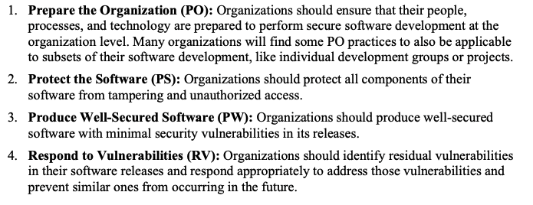

Slide 36
Analysts are the guardians of the Pipeline

Slide 37
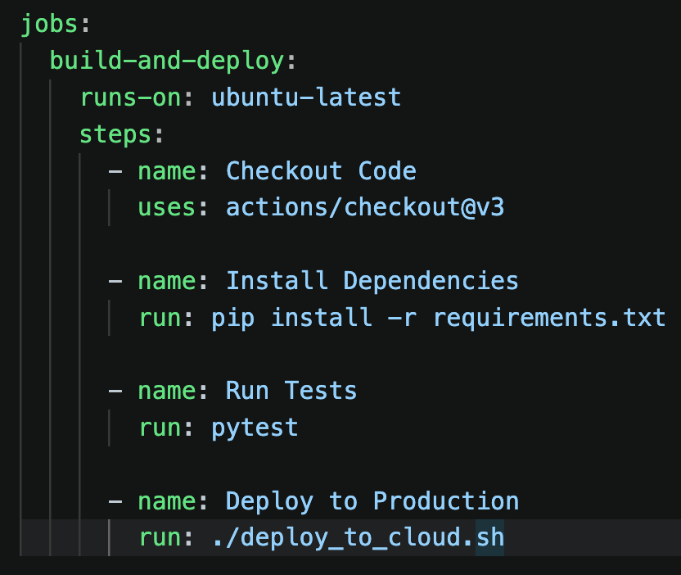
Analysts are the guardians of the Pipeline
This is a happy path.
We will add governance gatekeeping here.

Slide 38
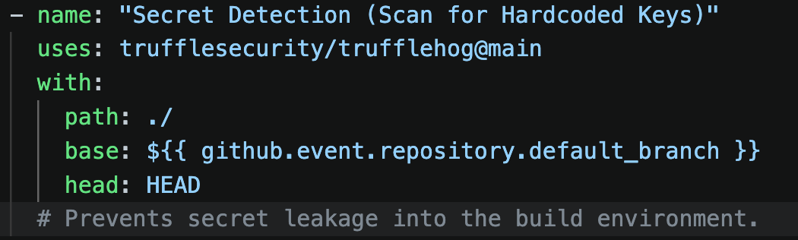
Analysts are the guardians of the Pipeline
Let us link this back to our security debts exercise

Slide 39
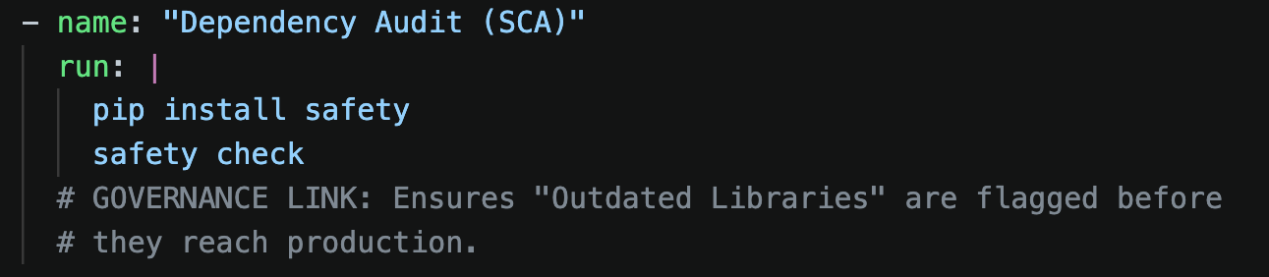
Analysts are the guardians of the Pipeline
This is to protect software from vulnerable dependencies.

Slide 40
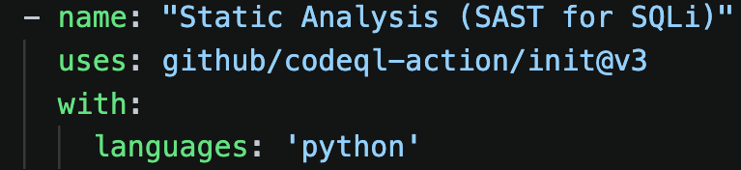
Analysts are the guardians of the Pipeline
Produce well secured software.

Slide 41
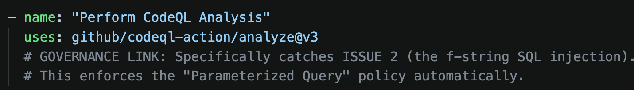
Analysts are the guardians of the Pipeline
Produce well secured software.

Slide 42
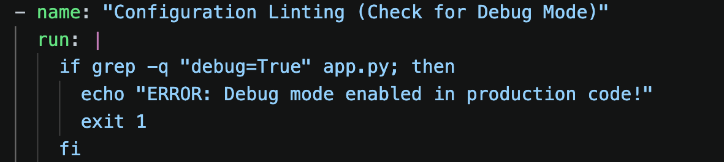
Analysts are the guardians of the Pipeline
Produce well secured software.

Slide 43
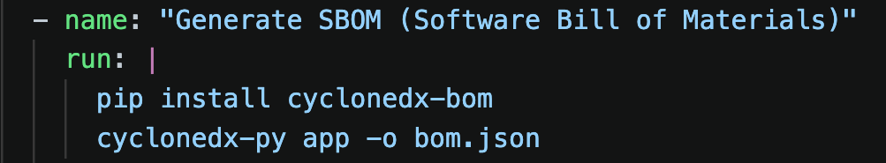
Analysts are the guardians of the Pipeline
Respond to vulnerabilities.

Slide 44
Let us build an automated pipeline
Create or sign in to your git hub account.
Type git config --global user.name “your username”
Type git config --global user.email” your email”
Create a new repository on Github and make it public and do not add a ReadMe.

Slide 45
Analysts are the guardians of the Pipeline
There is a file auth-service.py.
We will write test cases for the service auth-autest.py.
We will write a YAML file to act as an engine auth-pipe.yaml.
Organise your files as
Project Directory ->.github/workflows/<yaml>
-> auth-service.py
->.gitignore
->requirements.txt
->/tests/auth-autest.py

Slide 46
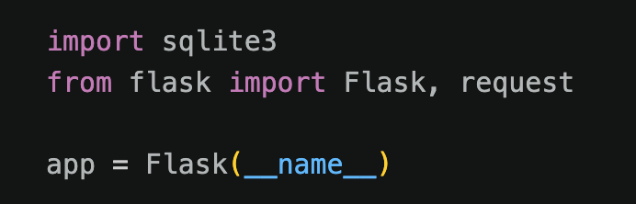
Analysts are the guardians of the Pipeline
Imports the micro framework Flash to handle web requests
SQLite to store credentials
For an analyst these are red flags

Slide 47
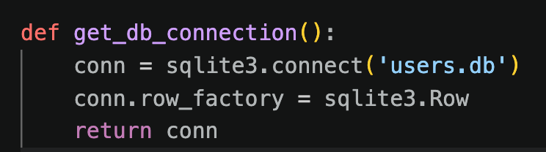
Analysts are the guardians of the Pipeline
Open connection to a local file.
The second line treats data as dictionaries, we do not need to remember index values.
For an analyst local files are not good news in many contexts.

Slide 48
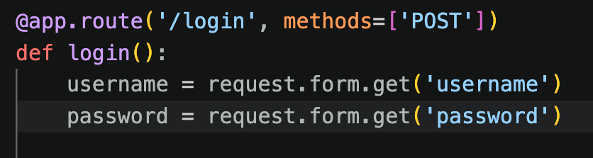
Analysts are the guardians of the Pipeline
Defines an end point login that only accepts post request.
For an analyst the omission of any validation is a red flag.

Slide 49
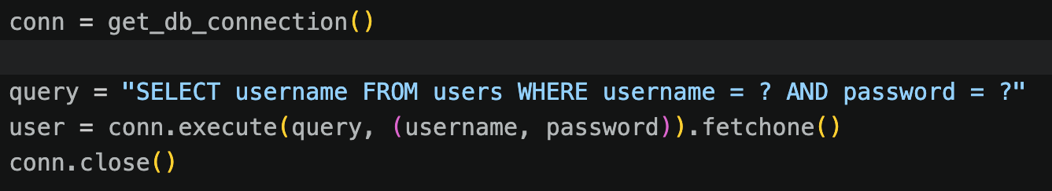
Analysts are the guardians of the Pipeline
Here there are parameterized queries (?). Everything in the container ? is treated as data and not command.

Slide 50
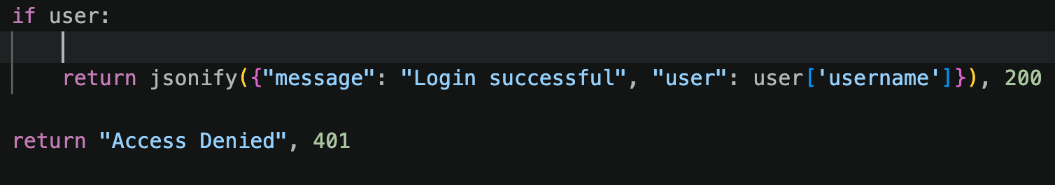
Analysts are the guardians of the Pipeline
jsonify() converts the python dictionary into json string. This helps the Github robot to check responses against unwanted leakage.

Slide 51
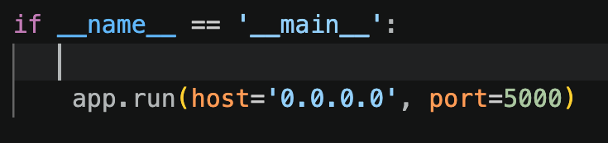
Analysts are the guardians of the Pipeline
This will keep the port open in a cloud environment.

Slide 52
Analysts are the guardians of the Pipeline
There is a file auth-service.py.
We will write test cases for the service auth-autest.py.
We will write a YAML file to act as an engine auth-pipe.yaml.

Slide 53
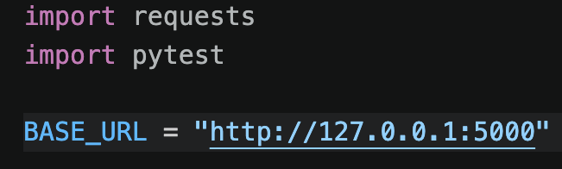
Analysts are the guardians of the Pipeline
Environment set up.
Requests is the library to send GET, POST. These are the hands of the analyst.
Pytest is the brain of the analyst.
The base_url should be a clean temporary VM.

Slide 54
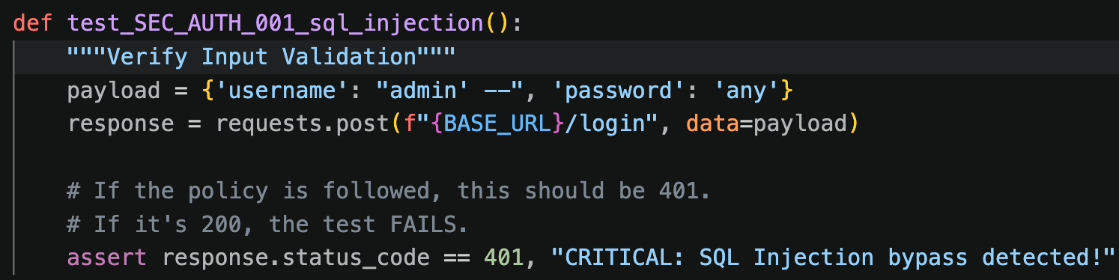
Analysts are the guardians of the Pipeline
Attack payload admin’ --.
If there is a success, then it’s a problem. The pipeline stops.

Slide 55
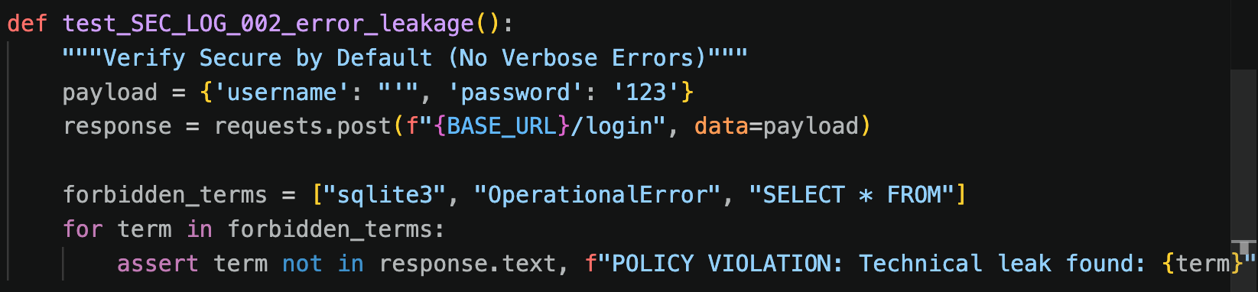
Analysts are the guardians of the Pipeline
This is to test if the program leaks a block list of technical terms.
Check the ”`” here.

Slide 56
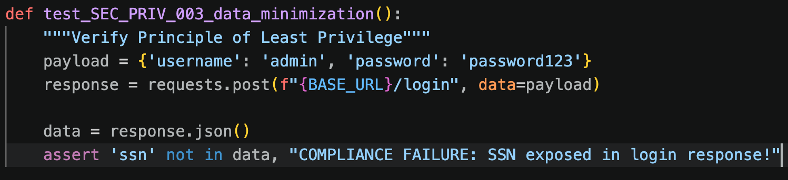
Analysts are the guardians of the Pipeline
This does a legitimate log in to detect if any PII is leaked.

Slide 57
Analysts are the guardians of the Pipeline
There is a file auth-service.py.
We will write test cases for the service authautest.py.
We will write a YAML file to act as an engine auth-pipe.yaml.

Slide 58
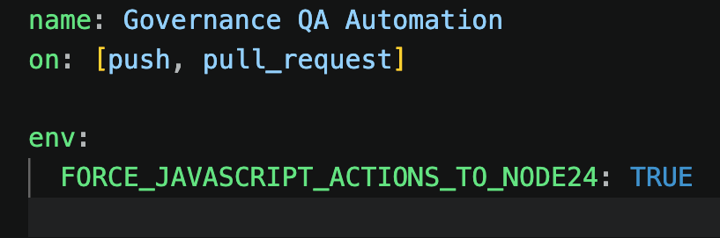
Analysts are the guardians of the Pipeline
push: when developers save code.
pull_request: When someone tries to merge their code.
This means continuous monitoring.
I got a lot of deprecation warnings earlier, this fixed that.
This is to use the latest Node.js engine

Slide 59
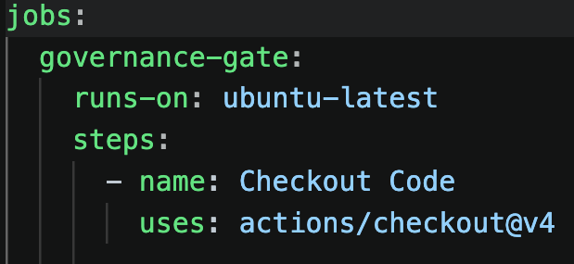
Analysts are the guardians of the Pipeline
What to do -> jobs
Where -> the environment.
Clone the code.

Slide 60
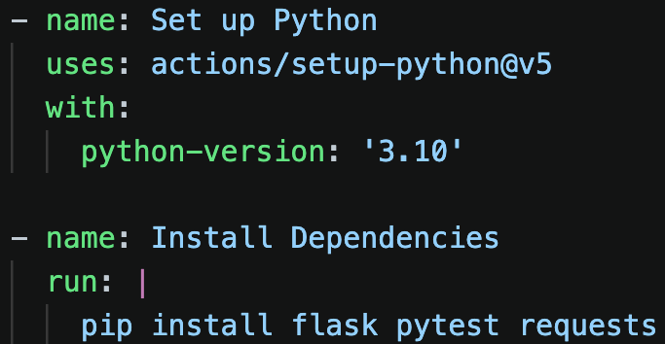
Analysts are the guardians of the Pipeline
Installs specific version of Python
Installs dependencies.
flask to run the app
pytest to run the tests
requests to simulate the attacker

Slide 61
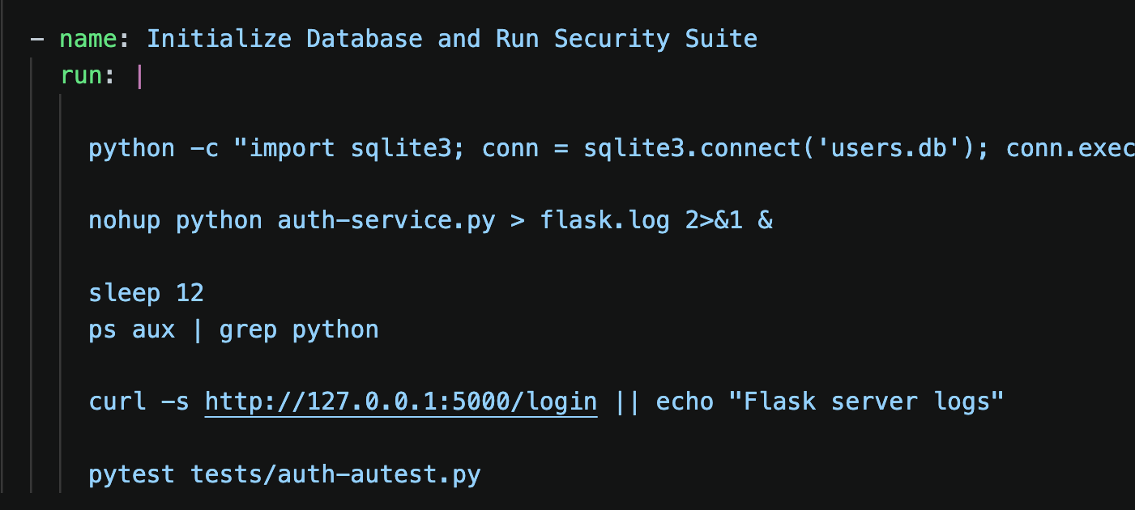
Analysts are the guardians of the Pipeline
Auditor
Simulation to create a users.db and puts some data inside.
nohup tells Linux not to hang up when it moves to the next line.
The flask.log 2>&1 places all log messages into a debug file.
& is critical, this makes Flask app run in the background.
I put the ps as I was not successful many times and the curl is also for the same purpose.
This gives the web serve 5 seconds to wake up and start listening.

Slide 62
Let us build the automated pipeline
Go to your project directory as cd <project directory>
Type git init –b main
Type git add . (grabs everything)
Type git commit –m “message”
Type git remote add origin <your repository url> (You will find this under the code <> button in your repository and will end with .git)
Type git push origin main (If you need authentication get tokens or we will help)
Go to the actions tab on your repository and see the red/green button.

Slide 63
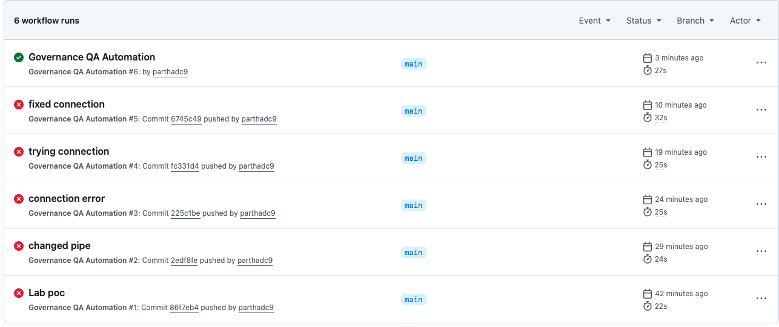
Analysts are the guardians of the Pipeline
This is my successful automated pipeline.
A lot of fixes before this worked.

Slide 64
Analysts are the guardians of the Pipeline
What you just did is
Automated security testing
Environment integrity
Vulnerability remediation

Slide 65
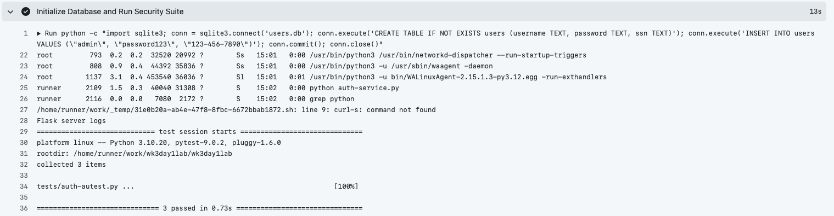
Analysts are the guardians of the Pipeline
This created users.db and placed a dummy ‘admin’ user with a fake ssn. Now there is data to audit during tests.

Slide 66
Analysts are the guardians of the Pipeline
Line 22-26 says that Flask app started successfully in the background and is listening.

Slide 67
Analysts are the guardians of the Pipeline
Typo in my curl command but I did not realize it and tried a fix with a || so the script worked.

Slide 68
Analysts are the guardians of the Pipeline
Pytest took over and ran the three functions we wrote. The code is secure against SQL injection, does not leak database details and no PII were leaked.
Beware of a false sense of security

Slide 69
Analysts are the guardians of the Pipeline
There is a file auth-service-new.py
Can you test that with the same auditor and YAML. You need to make one change. Be careful, don’t break your build pipeline.
Would encourage you all to try but ask if not sure.
Show us the results.

Slide 70
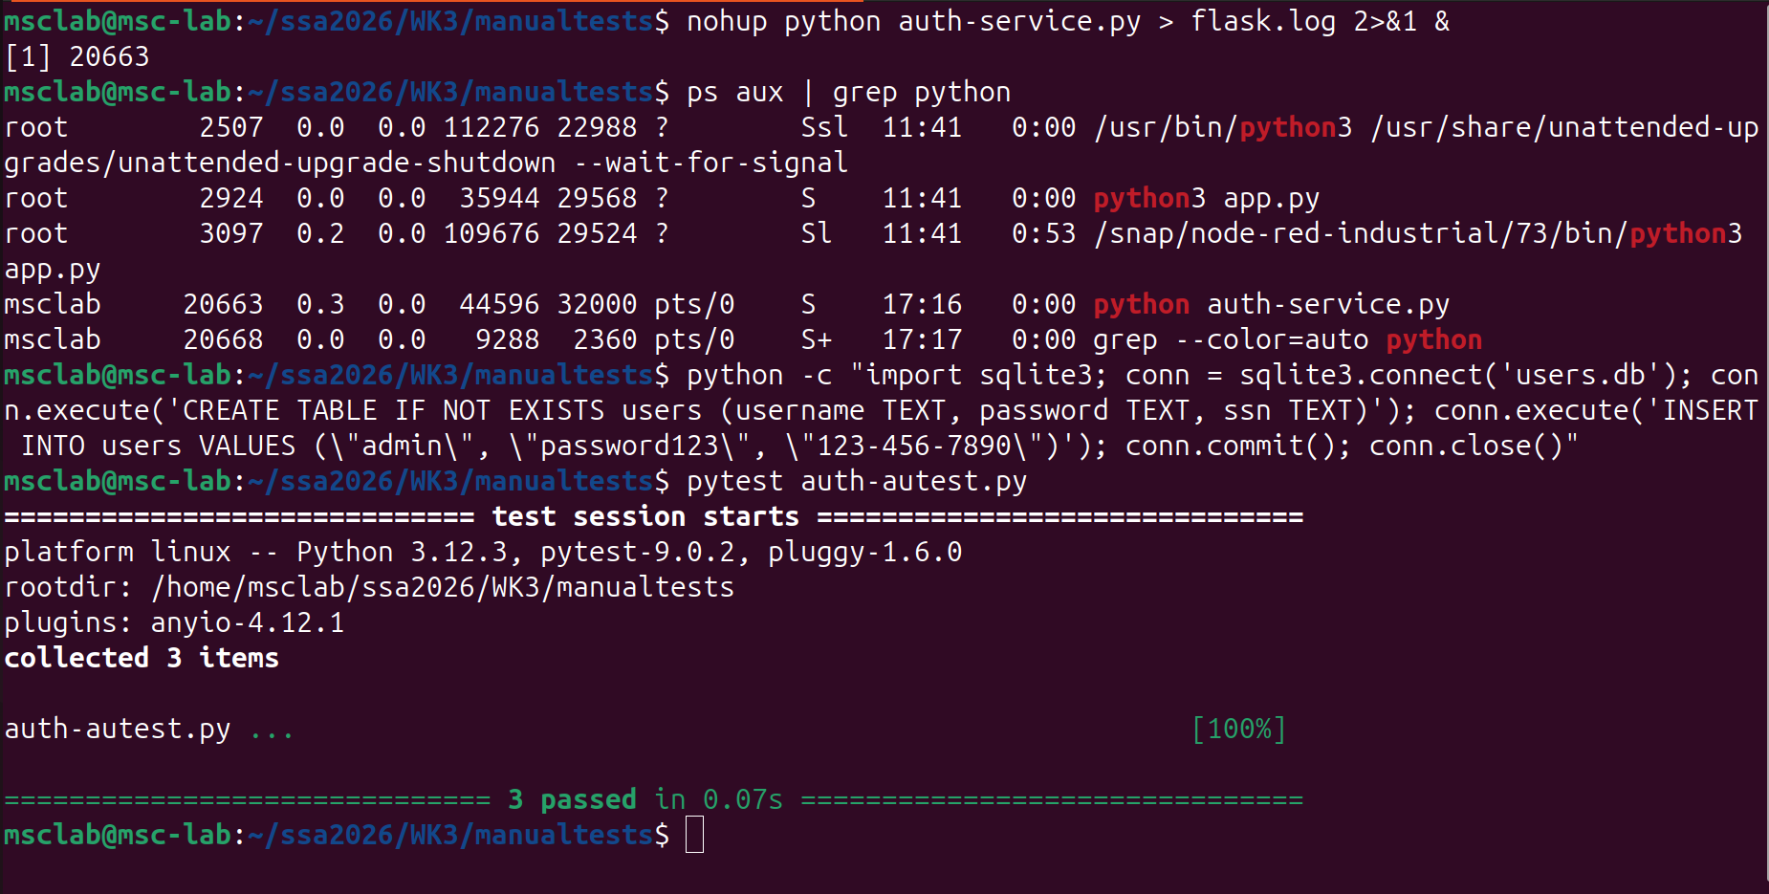
Analysts are the guardians of the Pipeline (Manual tests)

Slide 71
Lab Exercise to be done in groups
Each group has
Developers.
Security auditor (those would modify the test script.)
The DevOps engineer who would manage the YAML and Github action logs.
Warm up
Let developers push a faulty code (modify the service).
As a group watch the Actions tab.
Take and show a screenshot from the output to identify the hole.

Slide 72
Lab Exercise to be done in groups
Second exercise
Security auditor (those would modify the test script.) to add a 4th test case.
The server must never return a 500 Internal Server Error even if the input is invalid. It should always return 400 or 401.
Human factors
How could a developer bypass the Github actions gate?
Is it better to see a red on Github or to find the bug in an app live?
Finally add a security.md file in your repository. Explain why you did so and what are the benefits of doing so.

