Slide 1
Potential MISMATCH of Supply and Demand
Transformation
Value Adding
Using Resources
Transformation
Value Adding
Using Resources
Input
Outputs
Input
Outputs

Slide 2



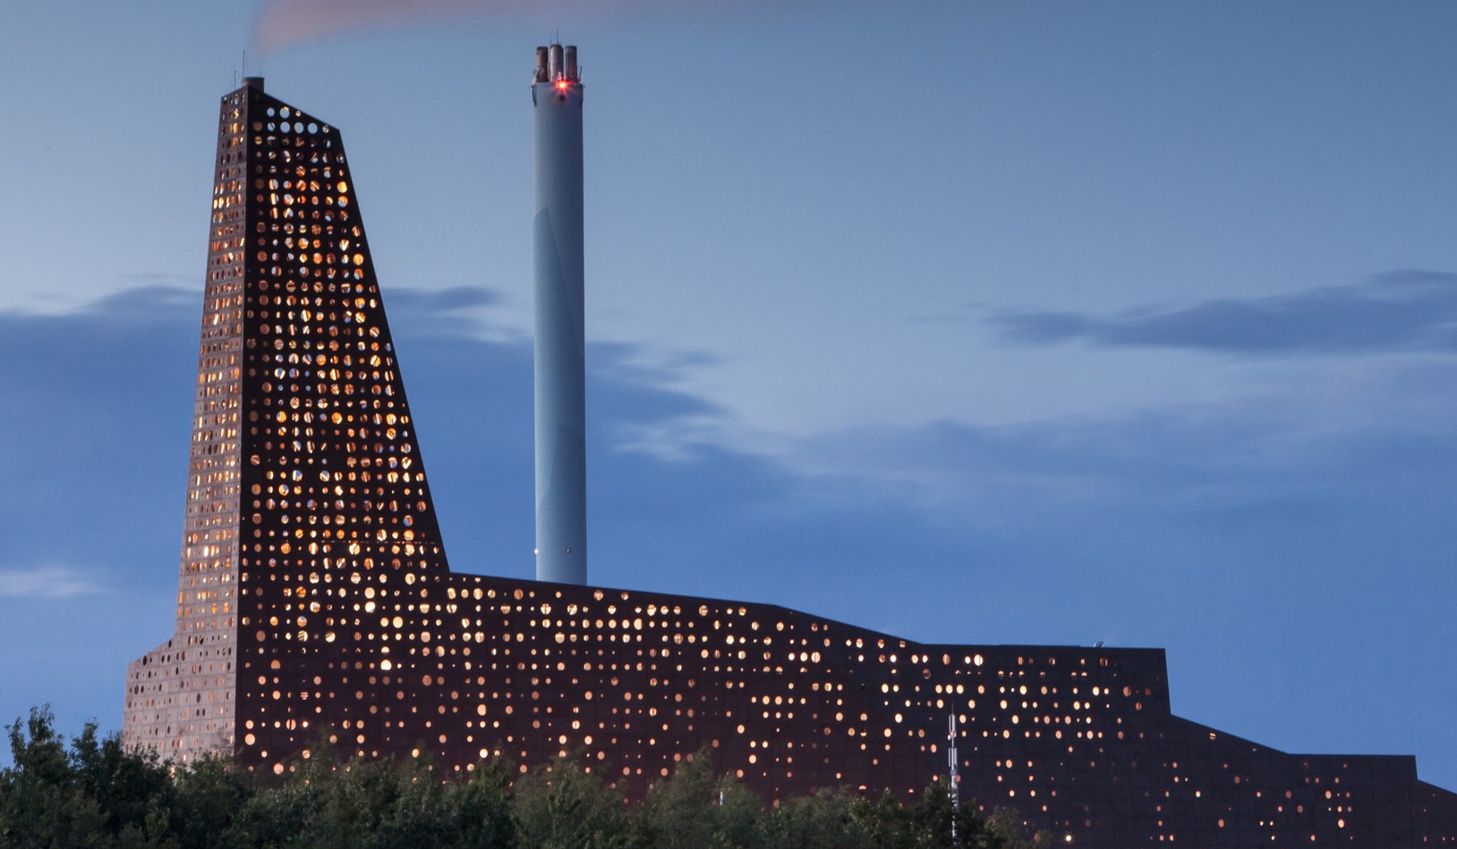
H&M accused for burning unsold clothes in 2017

Slide 4
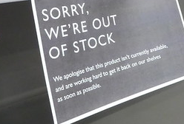
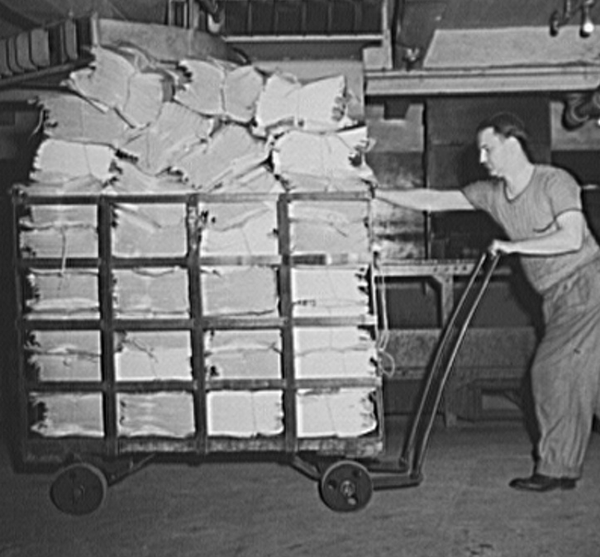

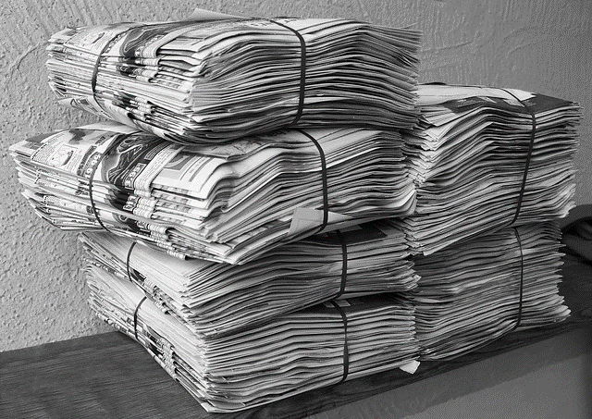
More demand than newspapers Newsvendor misses potential profit (cost of underage)
Morning Newsvendor gets newspapers from wholesaler How many?
Throughout the day Selling newspapers
Less demand than newspapers Leftover discarded at scrap value (cost of overage)
Images: picryl.com, pixabay.com, flickr.com

