Slide 1


Automatically Verifying and Reproducing Event-Based Races in Android Apps
Yongjian Hu Iulian Neamtiu Arash Alavi

Slide 2






Rise of Event-Driven Systems
Mobile apps
Web apps
Event-based races are prevalent and may cause harmful result: crash, incorrect results, etc.
Notes:
Event-driven systems have been existing for a while, and nowadays they are more and more popular. These systems include billions of mobile platforms running Android, iOS, and windows, and we also have many web applications like google docs and Microsoft office writing in the new HTML5 standard, which incorporate a event-driven model. In the era of big data, we also have many data centers running asynchronous tasks every second.
But there’s a lack of tools for debugging the unique class of concurrency errors that manifest in these systems.
// spend more time

Slide 3
Outline
Motivation of Event-Based Race
Most prevalent concurrency errors in Android [Maya et al., PLDI’14, etc.]
Prior Work of Event-Based Race Detectors
Imprecise: mostly false positives & benign races
Not able to reproduce the race
Our Approach: ERVA
Replay based approach to verify race
Event flipping to alternate schedule
Filter benign races by state comparison
Experiment Result
3% true positive harmful races in out work

Slide 4

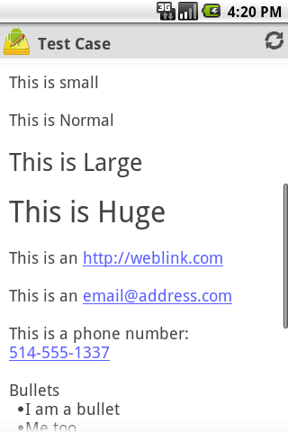
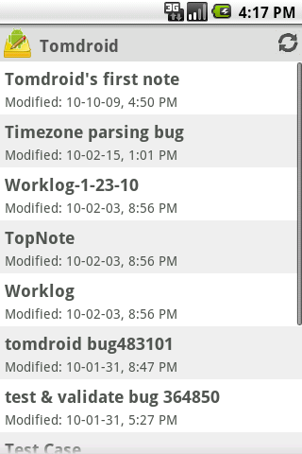


Example of Event-Based Race
Syncing…
Done!
Back

Slide 5
Example of Event-Based Race
Syncing…
Crash!
Back

Slide 6
State-of-art Race Detectors for Event Driven Systems
Web Applications
WebRacer, PLDI’12
EventRacer for JavaScript, OOPSLA’13
Mobile Applications(Android)
DroidRacer, PLDI’14
CAFA, PLDI’14
EventRacer for Android, OOPSLA’15
Instrumented Framework
App Execution
Happens Before Graph Building
Race Detection
Report Filtering and Generation

Slide 7
Limitation of State-of-art Race Detector
False positives
DroidRacer: FP rate is 63%
CAFA: FP rate is 21.7%, benign rate 27.8%
EventRacer reduces FP by race coverage, but still have FPs in our experiment
Cannot distinguish between harmful &benign races
Manual efforts to check the race report
Cannot reproducing races
Notes:
We use EventRacer in our experiment because it is end-to-end system with affordable overhead and better race filtering techniques.

Slide 8
False Positive Type 1: Imprecise Android Model
EventRacer reports a harmful race in AnyMemo’s RecentListFragment
onCreateView() {
mHandler = new Handler();
mAdapter = new ArrayAdapter();
}
Looper Thread
Thread
onCreateView
onResume() {
Thread thrd = new Thread() {
public void run() {
// query database operation
mHandler.post(new Runnable() {
public void run() {
mAdapter.clear();
for (RecentItem ri : database)
mAdapter.insert(ri);
}
});
}
}
thrd.start();
}
onResume
Runnable

Slide 9
False Positive Type 2: Implicit Happens-Before Relation
One race reported in CoolReader app’s CoolReaderActivity
[CoolReaderActivity.java]
onStart() {
waitForCRDService(new Runnable() {
public void run() {
Service.getHistory().loadFromDB(…);
……
new CRRootView(…);
}
});
}
Delayed post time = 0
Looper Thread
post(Runnable r)
Atomicity
onStart
post(Runnable r)
Delayed post time = 0
onRecentBookListLoaded
[History.java]
onRecentBookListLoaded(List list) {
mBooks = list;
}
getOrLoadRecentBooks
[History.java]
getOrLoadRecentBooks(…) {
if (mBooks != null && mBooks.size() > 0)
// update mBooks.
}

Slide 10
Benign Race Type 1: Ad-hoc Synchronization
One race reported in Volley HTTP library
public class ImageLoader {
private Handler mHandler = new Handler();
private Runnable mRunnable;
private void batchResponse(…) {
if (mRunnable == null) {
mRunnable = new Runnable() {
public void run() {
// deliver batched request
mRunnable = null;
}
}
mHandler.post(mRunnable);
}
}
}
Looper Thread
batchResponse
Benign race: read/write access protected by the control flow
Runnable.run()
batchResponse

Slide 11
Benign Race Type 2: No External Visible State Difference
One race reported in AnyMemo app’s QACardActivity
startLoading() {
for (Loader loader : mLoaders) {
loaderManager.initLoader(loader);
nRunningLoader++;
}
}
Thread-1
Thread-2
checkAllLoaderCompleted() {
nRunningLoader--;
if (nRunningLoader <= 0) {
onAllLoaderComplete();
}
}
onLoadFinished
checkAllLoaderCompleted() {
nRunningLoader--;
if (nRunningLoader <= 0) {
onAllLoaderComplete();
}
}
Benign race: no state difference
onLoadFinished

Slide 12
Our Approach ERVA: Event-race Reproducer and Verifier for Android
Race detection phase
Race verification phase
Race Report
False positive
Benign
race
Harmful
race
Input log
App state comparison
Instrumented platform (emulator)
Input replay
Event flipping
Event Racer
Input capture
Event capture
EDG
Replay platform (emulator or phone)
single execution
multiple executions
App

Slide 13
ERVA Details
Input Capture and Replay
Input, sensors, IPC, threading events are captured by VALERA(OOPSLA’15)
Event Dependency Graph(EDG)
Causal relationship between events (strong HB relations)
Event Flipping
Leverage VALERA’s deterministic schedule replay
User defined order of event execution which is allowed by EDG
State Recording and Comparison
Externally visible state(EVS)
EVS = All GUI states(layout & contents) + shared preference data
EVS is extensible to dump customized state
Race Verification

Slide 14
Race Verification: FP Race Type 1
onCreateView() {
mHandler = new Handler();
mAdapter = new ArrayAdapter();
}
Looper Thread
Thread
onCreateView
onResume() {
Thread thrd = new Thread() {
public void run() {
// query database operation
mHandler.post(new Runnable() {
public void run() {
mAdapter.clear();
for (RecentItem ri : database)
mAdapter.insert(ri);
}
});
}
}
thrd.start();
}
Dead lock!!!
onResume
Runnable

Slide 15
Race Verification: FP Type 2
Analyze the trace
[CoolReaderActivity.java]
onStart() {
waitForCRDService(new Runnable() {
public void run() {
Service.getHistory().loadFromDB(…);
……
new CRRootView(…);
}
});
}
Looper Thread
post1(Runnable r1, delay1=0)
onStart
post2(Runnable r2, delay2=0)
onRecentBookListLoaded
[History.java]
onRecentBookListLoaded(List list) {
mBooks = list;
}
getOrLoadRecentBooks
[History.java]
getOrLoadRecentBooks(…) {
if (mBooks != null && mBooks.size() > 0)
// update mBooks.
}
post1 < post2
&& delay1 == delay2

Slide 16
Race Verification: Benign Type 1
One race reported in Volley HTTP library
public class ImageLoader {
private Handler mHandler = new Handler();
private Runnable mRunnable;
private void batchResponse(…) {
if (mRunnable == null) {
mRunnable = new Runnable() {
public void run() {
// deliver batched request
mRunnable = null;
}
}
mHandler.post(mRunnable);
}
}
}
Looper Thread
batchResponse
Runnable.run()
Flippable
batchResponse
Different branch condition executed in flipped schedule
Racy read write disappear in new schedule

Slide 17
Race Verification: Benign Type 2
One race reported in AnyMemo app’s QACardActivity
startLoading() {
for (Loader loader : mLoaders) {
loaderManager.initLoader(loader);
nRunningLoader++;
}
}
Thread-1
Thread-2
checkAllLoaderCompleted() {
nRunningLoader--;
if (nRunningLoader <= 0) {
onAllLoaderComplete();
}
}
onLoadFinished
Flippable
checkAllLoaderCompleted() {
nRunningLoader--;
if (nRunningLoader <= 0) {
onAllLoaderComplete();
}
}
Benign race: no state difference
onLoadFinished
External visible state dumping and comparison

Slide 18
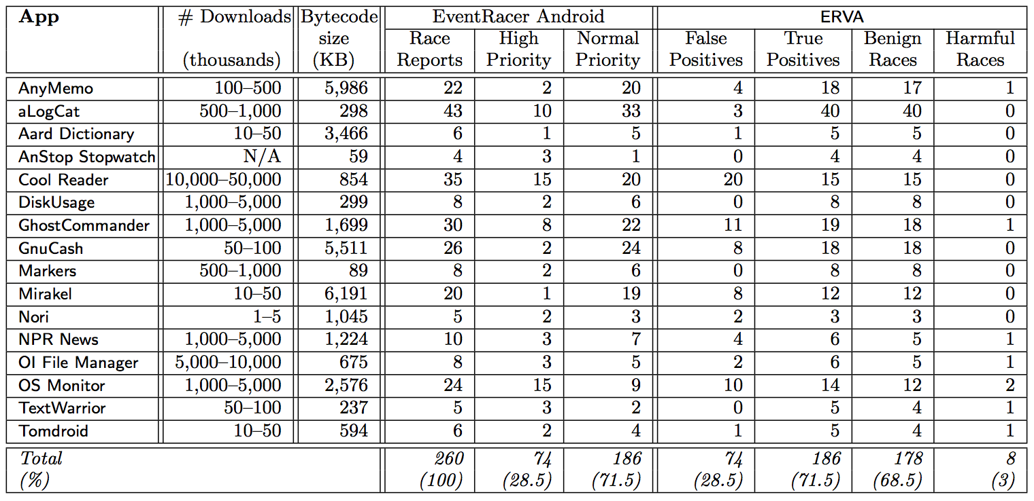
Experimental Result
High priority: races in app code
Normal priority: races in framework but invoked from app

Slide 19
Related Work
Race Detection
Multi-threaded races
Various works: static, dynamic or hybrid approaches
Event-based races
Web apps: WebRacer, EventRacer
Mobile apps: DroidRacer, CAFA, EventRacer Android
Race Classification
Multi-threaded races
Instruction-level replay, Narayanasamy et al., PLDI’07
Symbolic execution, Kasikci et al., ASPLOS’12

Slide 20
Related Work
Model checking for event driven systems
Systematically explore all schedules for find concurrency errors
R4: OOPSLA’16, for web applications
Dynamic partial order reduction + bounded conflict reversal
AsyncDroid: CAV’15, for Android applications
Delay-bounded prioritized systematic exploration
Model checking may have scalability problems
Huge number of events, exponential schedules
EVRA can help model checkers
Use EDG to filter unreachable schedules
Use EVS to verify harmful and benign races

Slide 21
Conclusions
Event-based races
Most prevalent concurrency errors
Prior works on event-based race detectors
Imprecise, mostly false positives & benign races
Not able to reproduce races
Our approach: ERVA
Replay based approach to verify race
Event flipping to alternate schedule
Filter benign races by state comparison
Experiment result
3% true positive harmful races

Slide 22
Thanks!

Slide 23
Android Event Handling
Thread
Handler
UI Thread
Message Queue
Thread
Looper
msg
evt
msg
Handler
Hardware Events

Slide 24
Deterministic Event Schedule: Recording
UI Thread
Message Queue
Event Log
Looper
A
B
C
D
1
2
3
4

Slide 25
Deterministic Event Schedule: Replaying
Reconciling different event orders between record and replay
Controller =
4
3
1
2
UI Thread
Message Queue
Event Log
Looper
B
D
C
A
A
B
C
D
1
2
3
4
Pending Queue

