Slide 1


Improving the Android Development Lifecycle with the VALERA Record-and-replay Approach
Yongjian Hu Tanzirul Azim Iulian Neamtiu
Notes:
Software Analysis for Android: Infrastructure for Security, Verification, and Reliability
Users are increasingly relying on smartphones, hence concerns such as mobile app security, privacy, and correctness have become increasingly pressing. Software analysis has been successful in tackling many such concerns, albeit on other platforms, such as desktop and server. To fill this gap, my group has been developing infrastructural tools that permit a wide range of software analyses for the Android smartphone platform. Developing these tools has required surmounting many challenges unique to the smartphone platform: dealing with input non-determinism in sensor-oriented apps, non-standard control flow, low-overhead yet high-fidelity record-and-replay. Our tools can analyze substantial, widely-popular apps running directly on smartphones, and do not require access to the app's source code. I will begin by presenting three such tools we have developed for dynamic analysis, automatic exploration, and custom static analysis. Next, I will present two main applications of our infrastructure. First, Android security: finding deceitful practices in free apps, and Moving Target Defense for thwarting attacks. Second, Android verification and reliability techniques (automated test case generation, finding data loss bugs, failure detection and recovery) that have helped us find, reproduce, and recover from bugs in popular apps.

Slide 2


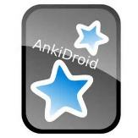

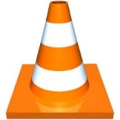


Characterizing mobile bugs
Mobile bugs study
38 Android, 16 iOS apps
Popular, large user base, long evolution history
Bugs reports (fixed and closed): 18,579 Android; 2,967 iOS
Findings
Mobile bugs fixed faster than desktop bugs (26 days vs 99 days)
Mobile bugs have higher severity that desktop bugs
Bug causes
Android | iOS
Concurrency: 66% | Crash: 52%
Crash: 23% | App. logic: 32%
Security: 5% | Build:12%
How to reproduce these?
"A Cross-platform Analysis of Bugs and Bug-fixing in Open Source Projects: Desktop vs. Android vs. iOS” B. Zhou, I. Neamtiu, R. Gupta; in EASE 2015

Slide 3
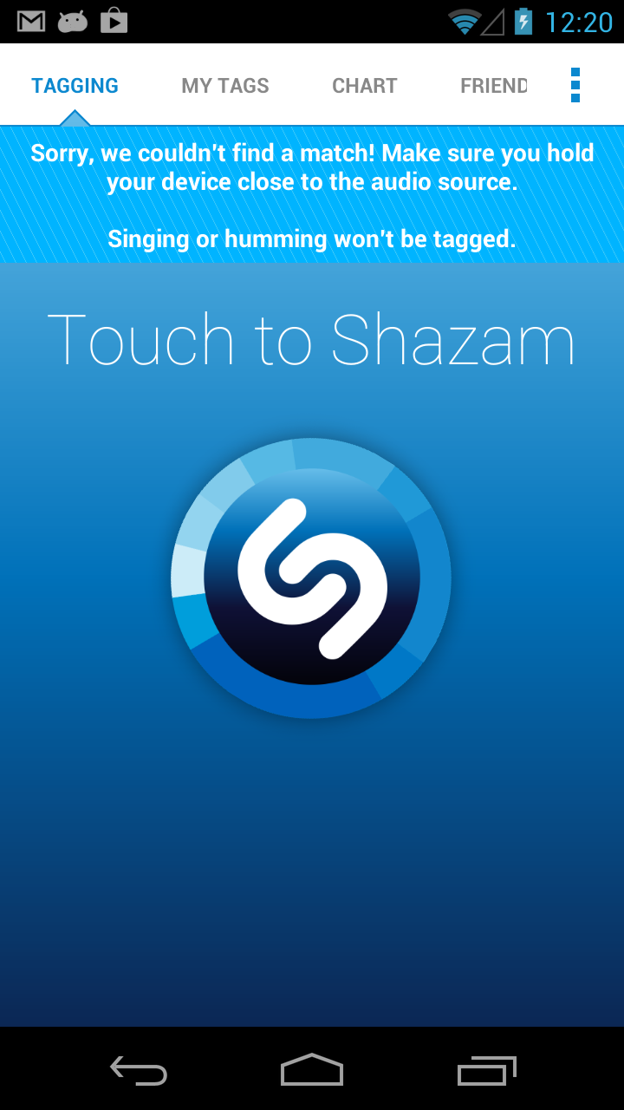
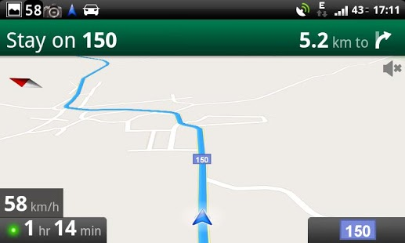
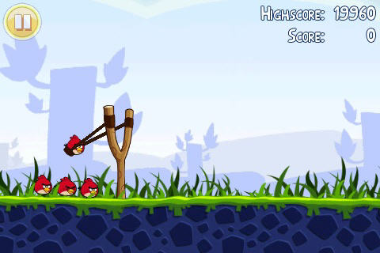

Goal: replay Android executions
Challenges
complex sensor input
no source code
run on real phones
high-throughput concurrent
events
Where is replay useful?
Debugging
Profiling
[Regression] Testing
Repeatability

Slide 4
VALERA (Versatile yet Lightweight Record-and-replay for Android)
VALERA binary rewriting
App
Instrumented App
VALERA runtime
GPS
Mic.
Camera
Intents
Event schedule
Network
Android Framework
modified
ScheduleReplayer
Touchscreen
Accelerometer
…
Dalvik VM
Linux kernel
"Versatile yet Lightweight Record-and-replay for Android"
Y. Hu, T. Azim, I. Neamtiu; in OOPSLA 2015
Notes:
“Second try”: VALERA

Slide 5










VALERA results
50 popular apps, high-bandwidth streams
Record and replay 70-second executions
App | Streams or Events Replayed | Overhead (%) | Log rate (KB/sec)
Amazon | Camera (frame buffer), Network, Touchscreen | 2.3 | 473
Barcode Scanner | Camera (frame buffer), Network, Touchscreen | 3.0 | 2,034
TripAdvisor | GPS, Network, Touchscreen | 3.1 | 19
Yelp | GPS, Network, Touchscreen | 1.1 | 12
Shazam | Microphone, Network, Touchscreen | 1.2 | 66
All 50 |  | 1.1 | 208
"Versatile yet Lightweight Record-and-replay for Android"
Y. Hu, T. Azim, I. Neamtiu; in OOPSLA 2015
Notes:
Successful replay: screen looks the same as during record Limitations: network non-determinism, dynamic layout
Adobe Reader
Amazon Mobile
Angry Birds Rio
Angry Birds Seasons
Angry Birds Space
Background HD Wallpapers
Baseball Superstars 2012
BBC News
Bible
BMX Boy
Boxing game
Brightest Flashlight
Bubble Shoot
Color Note
Craigslist Mobile
Crime City
Daily Horoscope
Dance Legend
Death Rally Free
Dictionary
Drag Racing
Drag Racing- Bike Racing
Draw Something
Easy Battery Saver
eBay
Espn Score Center
Evernote
Facebook
Feed Your Dino Free
Fruit Ninja
Gas Buddy
Google Earth
Google Play Books
Google Play Movies
Google Plus
Google Search
Google Translate
Groupon
HeartRadio
How to Read Thoughts
iFunny
IMDB
Instagram
Jewels Star
Kindle
Maps
Movies by Flixster
MP3 Ringtone Maker
Myxer
NBA Gametime
One Touch Drawing
Pandora
Picsart
Pool Master Pro
PulseNews
Recipe Search
Running Fred
Shoot Bubble Deluxe
Sincerely Ink Cards
Sky Map
Slacker Radio
Slot City Machines
Solitaire
Stick Man BMX Stunts Bike
Talking Tom 2
TED
Temple Run
Tetris
Textgram
TouchNote PostCards
Tunewiki
Twitter
Unblock me Free
Unicorn Dash
Uno Free
Visual Anatomy
Weather Bug
Weather Channel
Where's my water
Word Search
Words with Friends
Yellow Pages
Yelp
Youtube
Zedge
Zinio
Sygic: GPS Nav&Maps
TripAdvisor
Waze Social GPS
Flixster
Scout GPS Nav.
Route 66 Maps
GPSNavig.&Maps
NavFreeUSA
Barcode Scanner
Google Goggles
Pudding Camera
QR Droid
CamScanner
CamCard Free
RedLaser Barcode
Walmart
Shazam
SoundCloud
musiXmatch
Best Voice Changer
Smart Voice Recorder
PCM Recorder
RoboVox Lite
Voice Search Lnch.
----- Meeting Notes (11/28/12 11:27) -----
say will discuss why we couldnt replay the 14

Slide 6
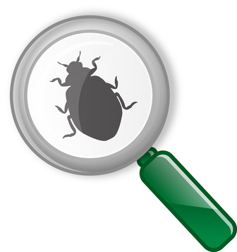
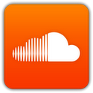



Reproducing bugs: Replay a trace that leads to a bug in an app
Couple replay with debugger to examine crash state
Experiment: Gathered bugs containing "steps to reproduce" from bug repositories
Bug category | App
File format | Ankidroid 0.7b3 APV PDF viewer 0.2.7 Quickoffice 4.1.80 Soundcloud 1.2.2
Invalid input | K-9 Mail 4.0.0.3
Stress | NPR News 2.1b
Scripts/plugins | Firefox 14.0
App logic | Home Switcher 1.6 Facebook 1.7.1
Notes:
----- Meeting Notes (11/28/12 11:27) -----
bug reposities have steps to reproduce
and version number of buggy app
add npr in list
DONT NEED TRACE
what experient was
how was scientific

Slide 7
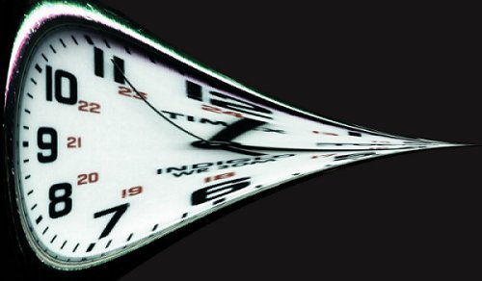
Time warping: alter execution time without changing app behavior
Fast forwarding: reduce time delays between input events and gestures during data entry (e.g., virtual and physical keyboard) or idle time (e.g., user reading the screen)
App | Original (seconds) | Fast-forwarded (seconds) | Reduction (%)
Facebook 1.9 | 250 | 163 | 35
Gas Buddy | 263 | 85 | 68
Amazon Mobile | 299 | 109 | 63
Dictionary.com | 238 | 144 | 39
Pandora | 314 | 24 | 92
Notes:
----- Meeting Notes (11/28/12 11:27) -----
bug reposities have steps to reproduce
and version number of buggy app
add npr in list
DONT NEED TRACE
what experient was
how was scientific

Slide 8
Semantic sensor data alteration: distort sensor readings by a factor q (where 0 ≤ q ≤ 1) in a semantically meaningful way
GPS location: map shift, unknown location, change speed
Camera: blur, darken, lighten, rotate
Microphone: add noise, change sample rate
Sensor alteration | App | Outcome
GPS location | Yelp GPS Navigation&Maps Route 66 Maps Navfree USA | Crash
Camera | CamCard HD Free Barcode Scanner | Error
Microphone | Shazam | Error
Notes:
----- Meeting Notes (11/28/12 11:27) -----
bug reposities have steps to reproduce
and version number of buggy app
add npr in list
DONT NEED TRACE
what experient was
how was scientific

Slide 9
Event flipping: found, verified, reproduced 8 races in real-world apps
App | Harmful Races
AnyMemo | 1
GhostCommander | 1
NPR News | 1
OI File Manager | 1
OS Monitor | 2
TextWarrior | 1
Tomdroid | 1

Slide 10
Conclusions
Mobile bugs, bug-fixing processes differ from desktop bugs/processes
How to find, reproduce fix them?
Record-and-replay
Challenging on Android
Applications
Debugging, reproducing bugs
Finding new bugs
Profiling

