Slide 1
Static Detection of Event-based Races in Android App
Yongjian Hu
Univ. of California, Riverside
Iulian Neamtiu
NJIT

Slide 2





Motivation
Rise of Event-Driven Systems
Concurrency is a Serious Issue
66% of high-severity Android bugs are due to concurrency [Zhou et al., EASE’15]
84% of Android race bugs are event-driven races [Bielik et al., OOPSLA’15; Hsial et al. PLDI’14; Maiya et al., PLDI’14]
Mobile apps
Web apps
Data centers

Slide 3
Concurrency Error Example
class MainActivity {
DataBase mDB;
BroadcastReceiver recv = new BroadcastReceiver() {
void onReceive(Context ctx, Intent i) {
Bundle b = i.getExtras();
mDB.update(b);
}
}
void onCreate(...) {
mDB = new DataBase();
registerReceiver(recv, ...);
}
void onStart() {
mDB.open();
}
void onStop() {
mDB.close();
}
void onDestroy() {
unregisterReceiver(recv);
mDB = null;
}}
Main Thread
Broadcast Receiver
onCreate()
register
onStart()
update
onReceive()
not ordered
onStop()
unregister
onDestroy()
update() before close() OK
Notes:
Inter-component race

Slide 4
Concurrency Error Example
class MainActivity {
DataBase mDB;
BroadcastReceiver recv = new BroadcastReceiver() {
void onReceive(Context ctx, Intent i) {
Bundle b = i.getExtras();
mDB.update(b);
}
}
void onCreate(...) {
mDB = new DataBase();
registerReceiver(recv, ...);
}
void onStart() {
mDB.open();
}
void onStop() {
mDB.close();
}
void onDestroy() {
unregisterReceiver(recv);
mDB = null;
}}
Main Thread
Broadcast Receiver
onCreate()
register
onStart()
onStop()
update
not ordered
onReceive()
unregister
onDestroy()
update() after close() Exception!
Notes:
Inter-component race

Slide 5
State-of-the-art in (Android) Race Detection
Prior Android race detectors: all are dynamic
DroidRacer [Maiya et al., PLDI’14]; CAFA [Hsiao et al., PLDI’14]; EventRacer [Bielik et al., OOPSLA’15]
Limitations
Coverage issues → False negatives; “no run - no see”
False positives (imprecise Android modeling)
Static race detection is hard [Hong and Kim, STVR’15]
Only 7 out of 43 detectors are static
“the accuracy of [static] models is often low because of the imprecision inherent to static analysis methods”
Notes:
Android modeling issues
Control flow analysis + constraints

Slide 6
Our Approach
SIERRA: the first static, sound event-driven race detector for Android apps
Highly effective
Finds 29 true races per app vs. 4 (best dynamic detector)
Efficient
Analyzes an app in 31 minutes on average

Slide 7
SIERRA: StatIc Event-based Race detectoR for Android
Building HB Graph
Race Refinement
Race Reporting
Hybrid Context
Selector
Race <rw₁,rw₁’>
Race Prioritization
App
PA Refiner
Static HB Graph
Race <rw₂,rw₂’>
. . .
Call Graph Builder
Pointer Analysis
Analysis booster
Race Reports
WALA
Path/Context Sensitivity Refutation
THRESHER

Slide 8
Event Race Definition
Action = context-sensitive event handling
Novel abstraction, reifies
Callbacks (lifecycle, GUI callbacks, etc.)
Thread, AsyncTask, Executor
Handler’s SendMessage and PostRunnable
Happens-before (HB): A1 ≺ A2
A1 is completed before A2
Event race = “racy” pair of memory accesses
Access same location: α(x) = α(y)
At least one access is write: α(x):Write ꓦ α(y):Write
Access from two actions: θ(x) = A1 ꓥ θ(y) = A2 ꓥ A1 ≠ A2
No HB between two actions: A1 ⊀ A2 ꓥ A2 ⊀ A1
Notes:
Actions A1 & A2 execute on the same Looper thread

Slide 9
“Boosting” Static Analysis with Fixpoint-based Callgraph Construction
Manifest.xml lists all the activities
For each activity:
Find lifecycle callbacks, e.g., onCreate, onStart
Find XML registered callbacks, e.g., onClick
Find system callbacks, e.g., onLowMemory
Build call graph for found actions
Find and add to work list registered UI callbacks, e.g., onItemClick, onLongPress
Added to work list if new actions found
Go back to step 4. Iterate until fixpoint
onCreate
onItemClick
thread
onStart
onLongPress
Runnable1
……
onResume
onClick
AsyncTask
Runnable2
……
onCreate
OptionsMenu
onPost
Execution
onLow
Memory
msg1.
handleMessage

Slide 10
Action Sensitivity: When Context Sensitivity is Insufficient
Hybrid context sensitivity [Kastrinis et al., PLDI’13]
K object sensitivity for dispatch invocations
K call-site sensitivity for static invocations
a
K=2
Base64.encodeBytes(byte[] source)
Base64.encodeBytes(byte[] source, int offset, int length, int options)
Base64.encodeBytesToBytes(byte[] source, int offset, int length, int options) {
……
os = new OutputStream(…);
os.write(…);
}
Points-to(<[c2::c3], os>) =
{<[c2::c3], new OutputStream>}
Event1:
WRITE: <[c2::c3], os>
READ: <[c2::c3], os>
c1:
c2:
c3:
Action1
c1’:
Base64.encodeBytes(byte[] source)
c2:
Base64.encodeBytes(byte[] source, int offset, int length, int options)
c3:
Base64.encodeBytesToBytes(byte[] source, int offset, int length, int options) {
……
os = new OutputStream(…);
os.write(…);
}
Points-to(<[c2::c3], os>) =
{<[c2::c3], new OutputStream>}
Event2:
WRITE: <[c2::c3], os>
READ: <[c2::c3], os>
Action2
Conflated → Imprecise → False positive

Slide 11
Action Sensitivity: When Context Sensitivity is Insufficient
Hybrid context sensitivity [Kastrinis et al., PLDI’13]
K object sensitivity for dispatch invocations
K call-site sensitivity for static invocations
We add Action sensitivity
Base64.encodeBytes(byte[] source)
Base64.encodeBytes(byte[] source, int offset, int length, int options)
Base64.encodeBytesToBytes(byte[] source, int offset, int length, int options) {
……
os = new OutputStream(…);
os.write(…);
}
Points-to (<[c2::c3@a1], os>) =
{<[c2::c3@a1], new OutputStream>}
Event1:
WRITE: <[c2::c3@a1], os>
READ: <[c2::c3@a1], os>
c1:
c2:
c3:
Action1
No race
c1’:
Base64.encodeBytes(byte[] source)
c2:
Base64.encodeBytes(byte[] source, int offset, int length, int options)
c3:
Base64.encodeBytesToBytes(byte[] source, int offset, int length, int options) {
……
os = new OutputStream(…);
os.write(…);
}
Points-to(<[c2::c3@a2], os>) =
{<[c2::c3@a2], new OutputStream>}
Event2:
WRITE: <[c2::c3@a2], os>
READ: <[c2::c3@a2], os>
Action2

Slide 12
Happens-before Rules
onResume()
Action invocation rule (sender ≺ receiver)
Component lifecycle rule
GUI layout/object order
Intra-procedural domination
Intra-action, inter-procedural domination
Inter-action transitivity
Transitivity
onResume ≺ onClick2
onResume ≺ onClick1
*
onClick2()
onClick2 ≺ onClick3
onClick1()
onClick3()
onPause()
Method M
e₁
Δ_{e1}
<_{dom}
A₁
e₂
Δ_{e2}
A₁≺A₂
A₂

Slide 13
Symbolic Execution-based Refutation
So far, the analysis is…
Context sensitive
Field sensitive
Path insensitive
…and discovers 22% of all possible actions orders
Which is not bad!
Next, we use symbolic execution-based refutation to further order accesses
Bonus: on-demand path sensitivity!

Slide 14
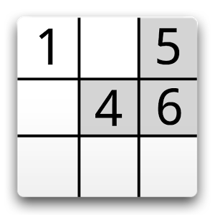
Example
OpenSudoku app
Path
Constraints
Timer.Runnable runner = {
void run() {//action A
if (mIsRunning) {
mAccumTime=... // 𝜶_{A}
if (*) {
...
postDelayed(runner,...);
}
else
mIsRunning=false; }
}}
Backward symbolic execution
Method entry
if (mIsRunning)
mIsRunning = false
mAccumTime = …
if (*)
Post
Delayed
mIsRunning = false
mIsRunning = false
void stop(){// action B
if (mIsRunning) {
mIsRunning = false;
mAccumTime=... // 𝜶_{B}
}
}
Method exit
mIsRunning = true
if (mIsRunning)
true
mIsRunning = false
mAccumTime = …
Can 𝜶_{A} occur before 𝜶_{B}?
Yes!

Slide 15
Example
Path
Constraints
void stop(){// action B
if (mIsRunning) {
mIsRunning = false;
mAccumTime=... // 𝜶_{B}
}
}
Method entry
Backward symbolic execution
mIsRunning = false
if (mIsRunning)
true
mIsRunning = false
mAccumTime = …
mIsRunning = false
Timer.Runnable runner = {
void run() {//action A
if (mIsRunning) {
mAccumTime=... // 𝜶_{A}
if (*) {
...
postDelayed(runner,...);
}
else
mIsRunning=false; }
}}
Method exit
mIsRunning = true
if (mIsRunning)
mAccumTime = …
Race Refuted!
Can 𝜶_{B} occur before 𝜶_{A}?
No!

Slide 16





Evaluation
Effectiveness: races found
App | Installs (millions) | Actions | HB edges | Racy pairs | After action sensitivity | After refu- tation | True races | False posi-tives | Event Racer
Barcode Scanner | > 100 | 136 | 2,756 (30%) | 64 | 24 | 15 | 11 | 4 | 7
VLC | > 100 | 151 | 2,349 (20%) | 202 | 78 | 35 | 32 | 3 | 0
FB Reader | > 10 | 259 | 4,710 (14%) | 836 | 285 | 106 | 93 | 13 | 5
K-9 | > 5 | 312 | 5,725 (12%) | 1,347 | 370 | 89 | 72 | 17 | 1
NPR | > 1 | 490 | 10,673 (9%) | 607 | 132 | 21 | 21 | 0 | 3
Across 20 apps |  | 160 | 2,755 (22%) | 431 | 80 | 33 | 29 | 4 | 4
≫
Efficiency (median time, in seconds)
Best prior work (dynamic)
Basic static analysis (CG,PA) | HB construction | Symbolic Execution | Total
1,310 | 29 | 560 | 1,899
Dataset: 194 open-source apps; 20 analyzed manually
Limitation: bound #paths to 5,000 while still sound (report race, might be false positives)
Notes:
Median bytecode size: 1.1MB

Slide 17
Conclusions
Event-based races: most prevalent concurrency errors in Android
Prior approaches: all dynamic
Low coverage, false negatives, false positives
Our approach
First fully static event-based race detector
Novel action sensitive context abstraction
Static happens-before relation
Static backward symbolic execution to refute false races
Highly effective; efficient

Slide 18
Backup

Slide 19
Race Prioritization
Priority
High priority
Races in app code
Normal priority
Races in framework but invoked from app code
Low priority
Purely framework race
Report race if
Witness feasible paths from alternative schedules
Cannot refute (to preserve soundness)
E.g., Out Of Memory, max paths limit, max time limit (1,500 sec.)
Potential false positive
Notes:
needs manual inspection

Slide 20
Context Sensitivity(cont’d)
Object insensitive = imprecision
void onTouchEvent(MotionEvent e1, MotionEvent e2) { …… if (e1.getX() – e2.getX() > 120.0f …) { Message msg = new Message(); msg.what = FLING; …… this.handler.sendMessage(msg); } else { Message msg = new Message(); msg.what = LONG_PRESS; …… this.handler.sendMessage(msg); } }
O1:
Handler handler = new Handler() { public void handleMessage(Message msg) { …… switch (msg.what) { case FLING: …… case LONG_PRESS: …… } } }
MERGED

Slide 21
Context Sensitivity(cont’d)
Object sensitivity in SIERRA = precision
O_{h}:
Handler handler = new Handler() { public void handleMessage(Message msg) { …… switch (msg.what) { case FLING: …… case LONG_PRESS: …… } } }
void onTouchEvent(MotionEvent e1, MotionEvent e2) { …… if (e1.getX() – e2.getX() > 120.0f …) { Message msg = new Message(); msg.what = FLING; …… this.handler.sendMessage(msg); } else { Message msg = new Message(); msg.what = LONG_PRESS; …… this.handler.sendMessage(msg); } }
ctx:<o_{h},c1>
C1:
C2:
ctx:<o_{h},c2>
Handler handler = new Handler() { public void handleMessage(Message msg) { …… switch (msg.what) { case FLING: …… case LONG_PRESS: …… } } }
K-obj + 1-call-site for event posting and message passing

Slide 22
Happens-before Rules
Rule 1: Action invocation rule
The sender action happens-before the recipient
Rule 2: Component lifecycle rule
Activity.onCreate < Activity.onStart
Activity.onStart < Activity.onStop
……
Rule 3: GUI layout/object order
Activity.onResume < View.onClick < Activity.onPause

Slide 23
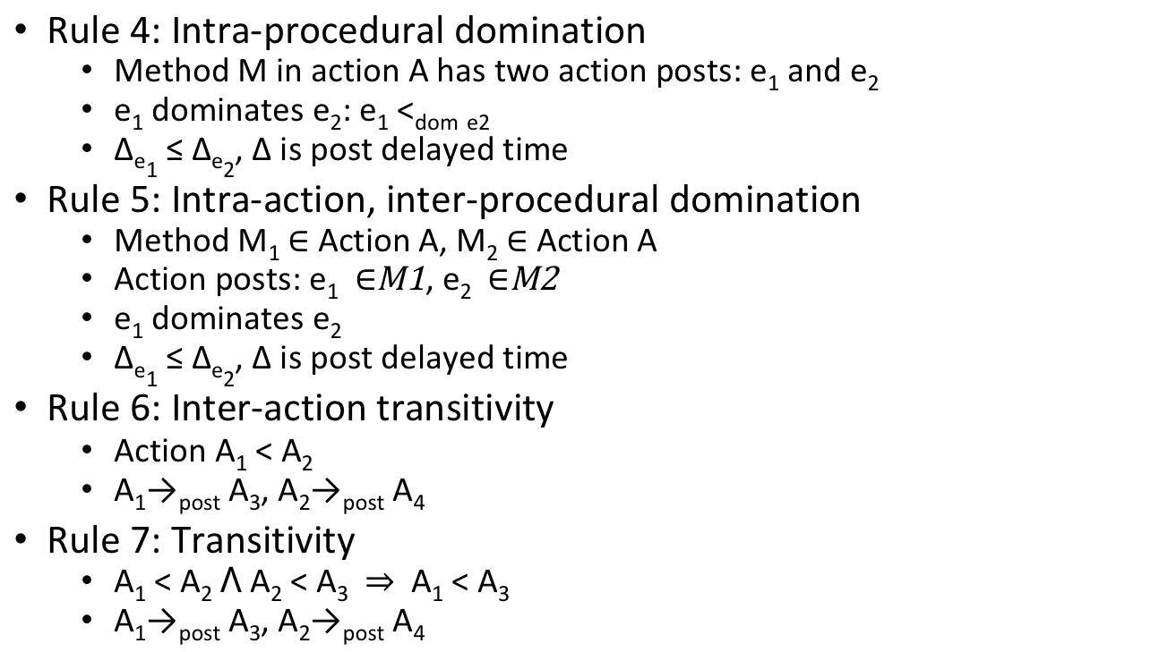
Happens-before Rules (cont’d)
Rule 4: Intra-procedural domination
Method M in action A has two action posts: e₁ and e₂
e₁ dominates e₂: e₁ <_{dom} _{e2}
Δ_{e1} ≤ Δ_{e2}, Δ is post delayed time
Rule 5: Intra-action, inter-procedural domination
Method M₁ Action A, M₂ Action A
Action posts: e₁ , e₂
e₁ dominates e₂
Δ_{e1} ≤ Δ_{e2}, Δ is post delayed time
Rule 6: Inter-action transitivity
Action A₁ < A₂
A₁→_{post} A₃, A₂→_{post} A₄
Rule 7: Transitivity
A₁ < A₂ ꓥ A₂ < A₃ A₁ < A₃
A₁→_{post} A₃, A₂→_{post} A₄
Method M
e₁
Δ_{e1}
<_{dom}
A₁
e₂
Δ_{e2}
<_{HB}
A₂

Slide 24
Context Sensitivity(cont’d)
Object insensitive = imprecision
void onTouchEvent(MotionEvent e1, MotionEvent e2) { …… if (e1.getX() – e2.getX() > 120.0f …) { Message msg = new Message(); msg.what = FLING; …… this.handler.sendMessage(msg); } else { Message msg = new Message(); msg.what = LONG_PRESS; …… this.handler.sendMessage(msg); } }
O1:
Handler handler = new Handler() { public void handleMessage(Message msg) { …… switch (msg.what) { case FLING: …… case LONG_PRESS: …… } } }
MERGED

Slide 25
Context Sensitivity(cont’d)
Object sensitivity in SIERRA = precision
O_{h}:
Handler handler = new Handler() { public void handleMessage(Message msg) { …… switch (msg.what) { case FLING: …… case LONG_PRESS: …… } } }
void onTouchEvent(MotionEvent e1, MotionEvent e2) { …… if (e1.getX() – e2.getX() > 120.0f …) { Message msg = new Message(); msg.what = FLING; …… this.handler.sendMessage(msg); } else { Message msg = new Message(); msg.what = LONG_PRESS; …… this.handler.sendMessage(msg); } }
ctx:<o_{h},c1>
C1:
C2:
ctx:<o_{h},c2>
Handler handler = new Handler() { public void handleMessage(Message msg) { …… switch (msg.what) { case FLING: …… case LONG_PRESS: …… } } }
K-obj + 1-call-site for event posting and message passing

Slide 26
Context Sensitivity (cont’d)
SIERRA’s hybrid context sensitivity
<k-obj + action> for normal dispatch methods
<k-cfa + action> for static methods
<k-obj + 1-call-site + action> for event posting and message passing
SingletonContext
For singleton design pattern
Use global context instead of adding action sensitivity
InflatedViewContext
Invoked via View.findViewById(int viewId)
Use viewId as context item

Slide 27
Happens-before Rules
Rule 1: Action invocation rule
The sender action happens-before the recipient
Rule 2: Component lifecycle rule
Activity.onCreate < Activity.onStart
Activity.onStart < Activity.onStop
……
Rule 3: GUI layout/object order
Activity.onResume < View.onClick < Activity.onPause

Slide 28
Happens-before Rules (cont’d)
Rule 4: Intra-procedural domination
Method M in action A has two action posts: e₁ and e₂
e₁ dominates e₂: e₁ <_{dom} _{e2}
Δ_{e1} ≤ Δ_{e2}, Δ is post delayed time
Rule 5: Intra-action, inter-procedural domination
Method M₁ Action A, M₂ Action A
Action posts: e₁ , e₂
e₁ dominates e₂
Δ_{e1} ≤ Δ_{e2}, Δ is post delayed time
Rule 6: Inter-action transitivity
Action A₁ < A₂
A₁→_{post} A₃, A₂→_{post} A₄
Rule 7: Transitivity
A₁ < A₂ ꓥ A₂ < A₃ A₁ < A₃
A₁→_{post} A₃, A₂→_{post} A₄
Method M
e₁
Δ_{e1}
<_{dom}
A₁
e₂
Δ_{e2}
<_{HB}
A₂

Slide 29
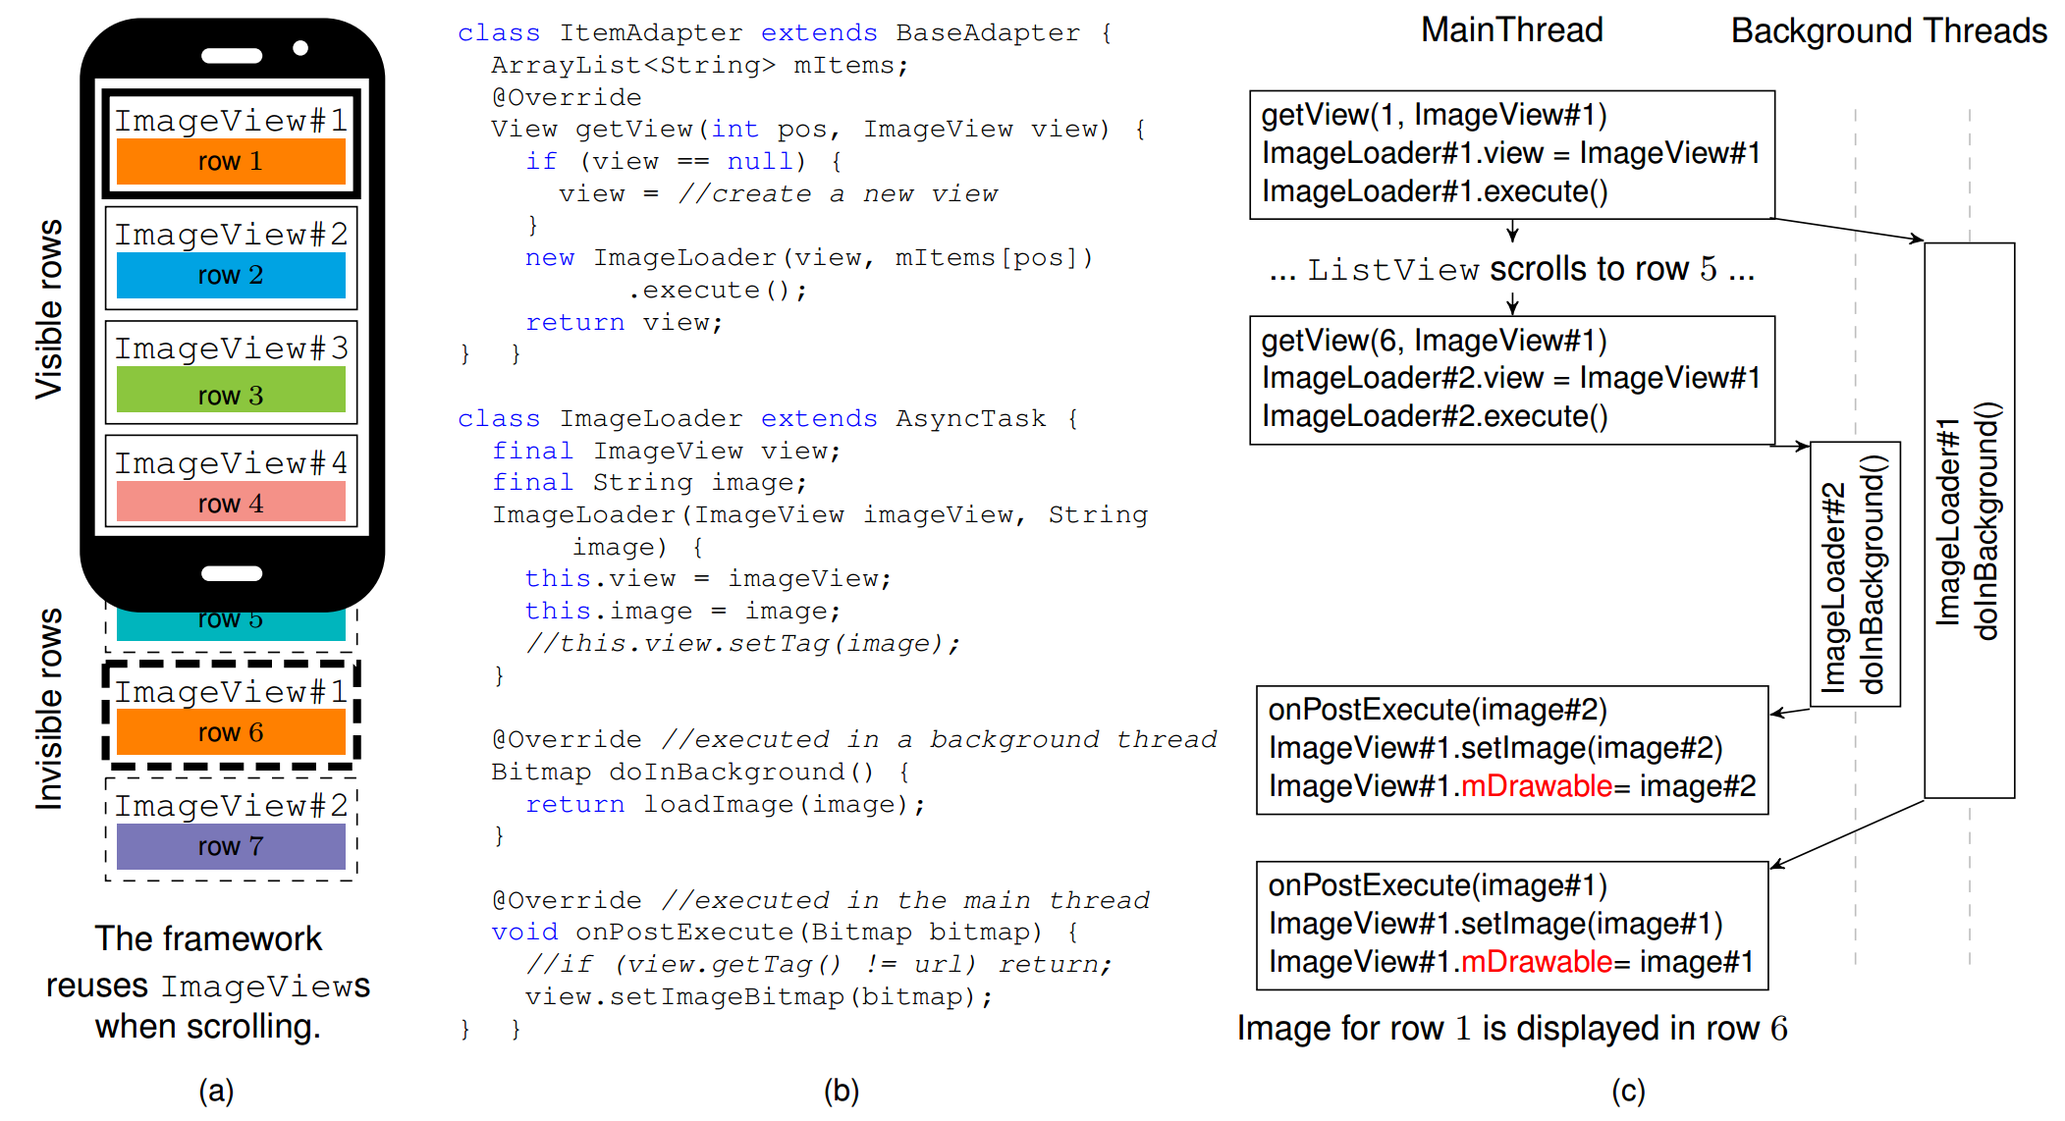
Concurrency Error, Example 1
Intra-component Race
Image overridden!

Slide 30
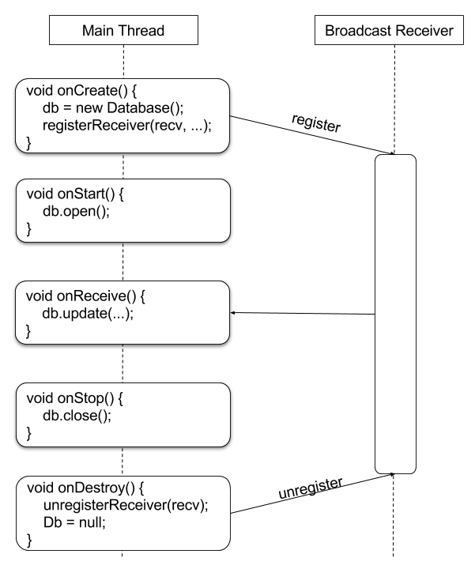
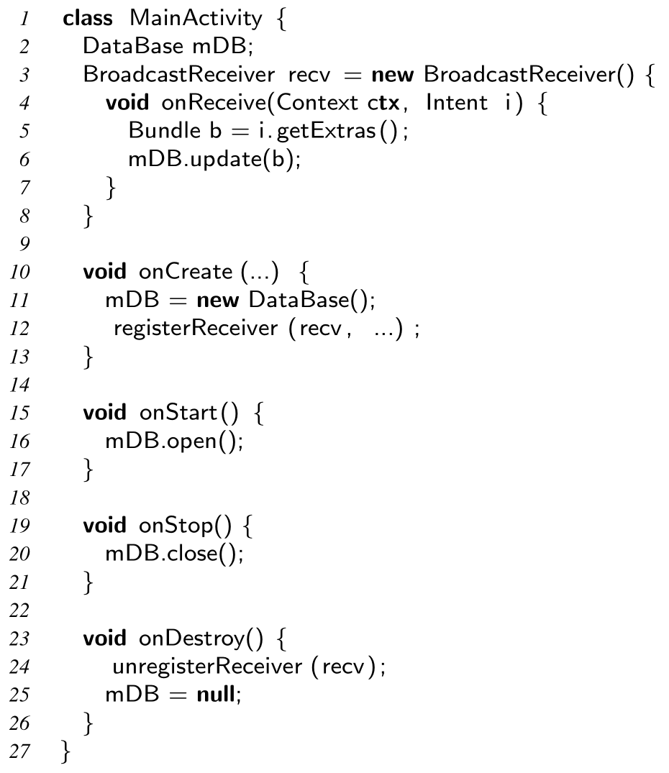
Concurrency Error, Example 2
Inter-component Race
update() before close(): OK

Slide 31
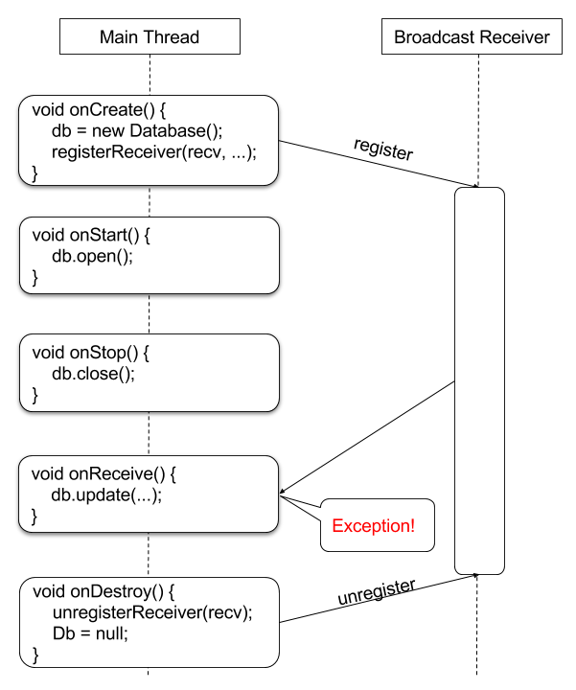
Concurrency Error, Example 2
Inter-component Race
update() after close(): Exception!

Slide 32
“Boosting” Static Analysis with Fixpoint-based Callgraph Construction
Manifest.xml lists all the activities
For each activity:
Find lifecycle callbacks, e.g., onCreate, onStart
Find XML registered callbacks, e.g., onClick
Find system callbacks, e.g., onLowMemory
Build call graph for found actions
Find and add to work list registered UI callbacks, e.g., onItemClick, onLongPress
Added to work list if new actions found
Go back to step 4. Iterate until fixpoint
onCreate
onItemClick
thread
onStart
onLongPress
Runnable1
……
onResume
onClick
AsyncTask
Runnable2
……
onCreate
OptionsMenu
onPost
Execution
onLow
Memory
msg1.
handleMessage
onCreate
Prior Android static analyses: imprecise
onStart
onResume
*
AsyncTask
onItemClick
onLow
Memory
onCreate
OptionsMenu
msg1.
handleMessage
onPost
Execution
onClick
thread
onLongPress
Runnable2
Runnable1
*

