Slide 1
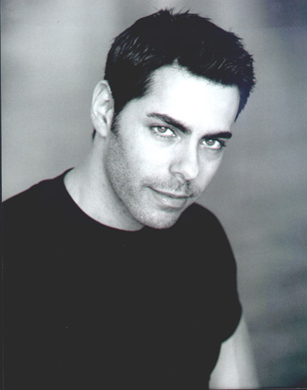
Ben
Regular gym attendee
PROFILE
Ben is a 25 year old male who has been attending gym for 5 years now. He attends gym 4 times a week. He has been injured 3 times through his 5 years at the gym but only once has it been serious. He was personally trained in his first year but now does it on his own. He finds that he has too much to think about whilst exercising, too many body parts to try to keep aligned to the technique.
GOALS
Stay fit
Attend gym
Stay away from injuries
NEEDS
A way to keep track of his technique
To know what he is doing wrong
To know how to improve it

